Slide 1
NEED FINDING PRESENTATION
Jesus Bermudo
Daniel Eler

Slide 2
Student with no personal computer
Problem
Students doesn’t have their own personal computer to work with their assignments and projects.
They always do their work in other computers.
Go to a computer shop to rent a computer.
Expensive computer rent.

Slide 3
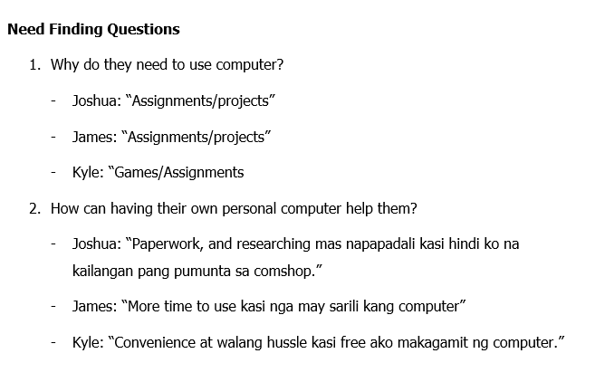

Slide 4
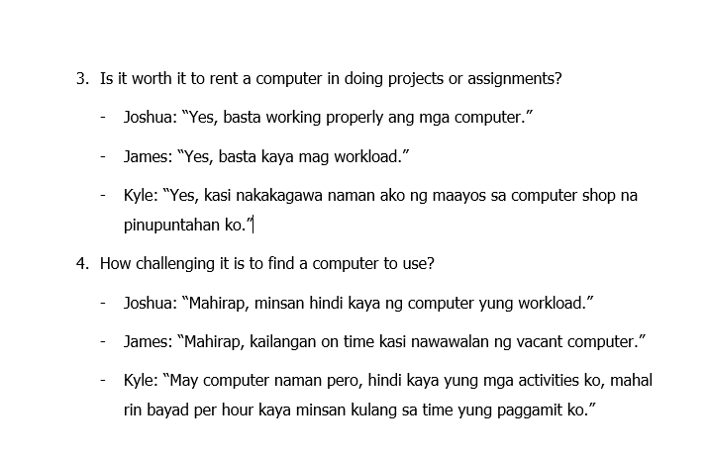

Slide 5
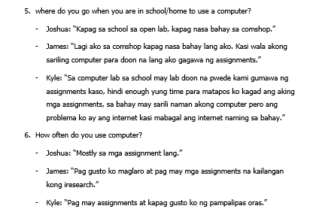

Slide 6
USER NEEDS
Cheaper rent
Capable computers
Availability of computers
Opening hours

Slide 7
Point of View
Users prefer cheaper rent prizes than expensive ones especially when there is no need for longer use of computers
Users want to use capable computers to accommodate their works or activities properly
Users do not want to waste time and want to have easy access to available computers
Users want to know the opening hours of different Internet Cafes due to their different time schedules

Slide 8
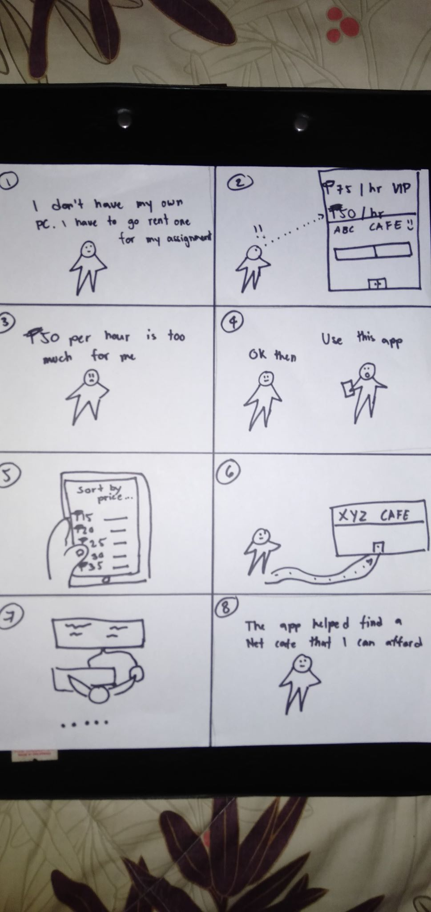
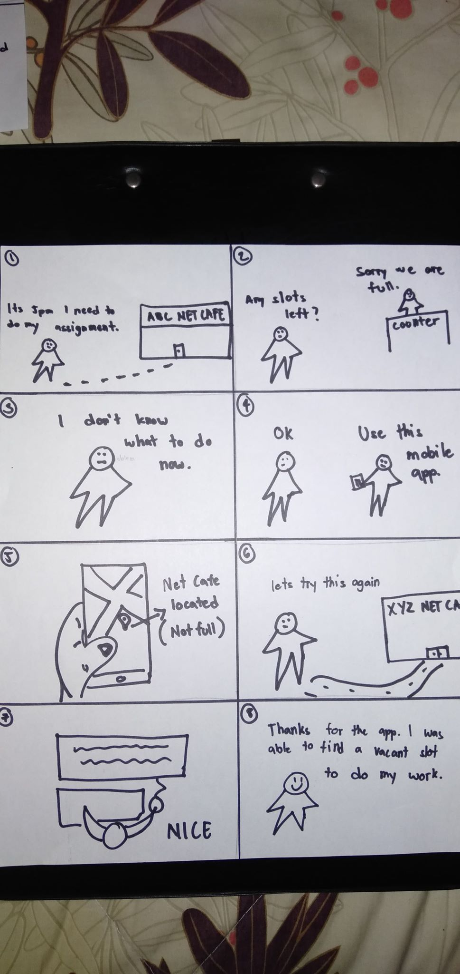
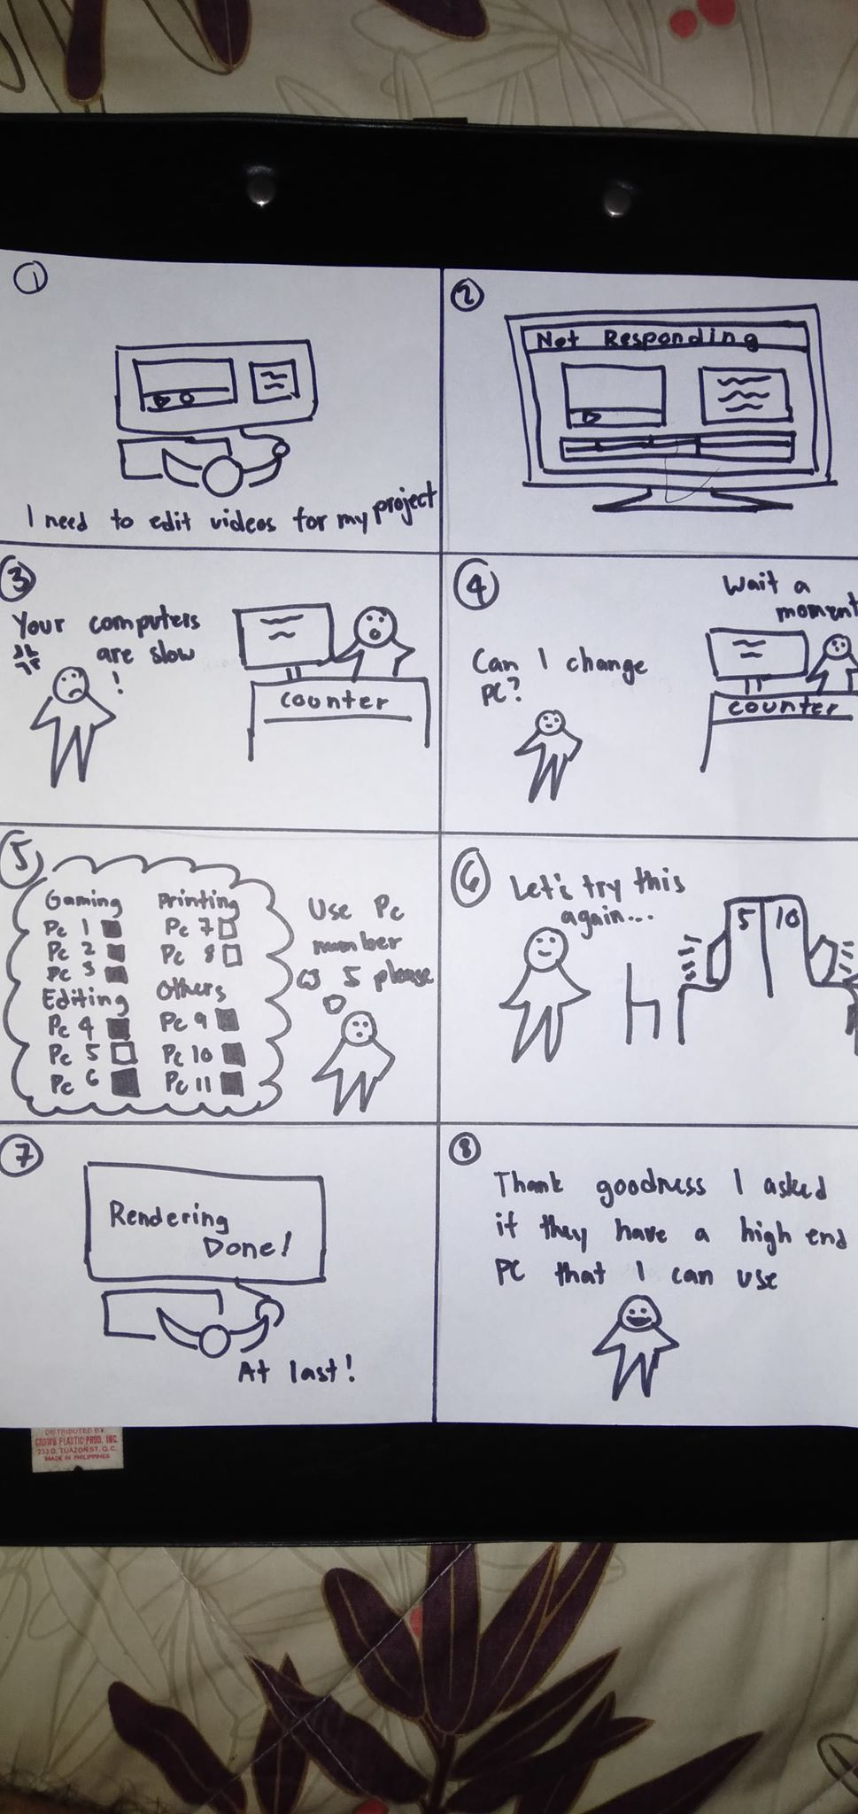
STORYBOARD

Slide 9
PROTOTYPE

Slide 10
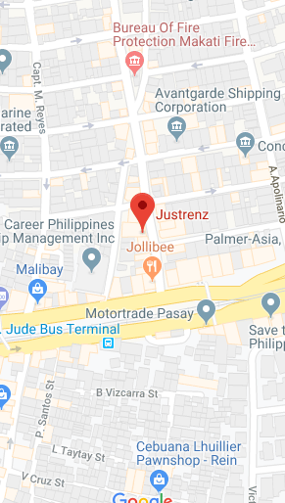
Nearest
ROG
HANAP
PC
JUSTRENZ 200 Meters
SHOW IN MAP
“Find cheapest pc rental near you.”
ROG 500 Meters
SHOW IN MAP
Nearest
TNC 600 Meters
Cheapest
SHOW IN MAP
PC QUALITY
LOW PC – 13PHP HR
MID PC- 25 PHP HR
HIGH PC – 30PHP HR

Slide 11
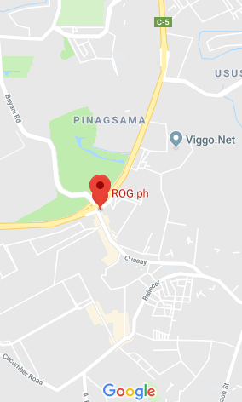
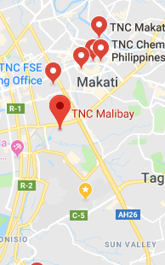
JUSTRENZ
TNC
Cheapest
ROG 500 13PHP 1HR
SHOW IN MAP
JUSTRENZ 15PHP 1HR
SHOW IN MAP
TNC 25PHP 1HR
SHOW IN MAP
LOW PC – 15PHP HR
MID PC- 25 PHP HR
HIGH PC – 35PHP HR
LOW PC – 20PHP HR
MID PC- 30 PHP HR
HIGH PC – 40PHP HR

Slide 12
PC QUALITY
ROG
LOW PC – 13PHP HR
MID PC- 25 PHP HR
HIGH PC – 30PHP HR
JUSTRENZ
LOW PC – 15PHP HR
MID PC- 25 PHP HR
HIGH PC – 35PHP HR
TNC
LOW PC – 20PHP HR
MID PC- 30 PHP HR
HIGH PC – 40PHP HR

Slide 13

PC MANAGER
Gaming
Printing
Editing
Surfing
PC1
PC2
PC3
PC4
PC1
PC2
PC3
PC4
PC1
PC2
PC3
PC4
PC1
PC2
PC3
PC4
PC5
PC6
PC7
PC8
PC5
PC6
PC7
PC8
PC5
PC6
PC7
PC8
PC5
PC6
PC7
PC8
PC9
PC10
PC11
PC12
PC9
PC10
PC11
PC12
PC9
PC10
PC11
PC12
PC9
PC10
PC11
PC12
PC13
PC14
PC15
PC16
PC13
PC14
PC15
PC16
PC13
PC14
PC15
PC16
PC13
PC14
PC15
PC16
PC17
PC18
PC19
PC20
PC17
PC18
PC19
PC20
PC17
PC18
PC19
PC20
PC17
PC18
PC19
PC20

Slide 14
1 HOUR
REMAINING TIME:
1 HOUR
2 HOURS
TIME SPENT:
2 HOURS
3 HOURS
3 HOURS
OPEN TIME
4 HOURS
PAUSE
ADD TIME
LOGOUT

Slide 15
User Feedback (First Prototype)
Prototype has no pictures
Unresponsive Map
Provide current reviews of the Internet Cafes, also let the users comment, or do a review about the place.
Create an advanced booking system

Slide 16
User Feedback (Second Prototype)
Provide the total price
Create hints or clues for the users to have an idea how the interface works

Slide 17
THANK YOU

