Slide 1
Quadplane eVTOL Trajectory Tracker
Mason Peterson

Slide 2
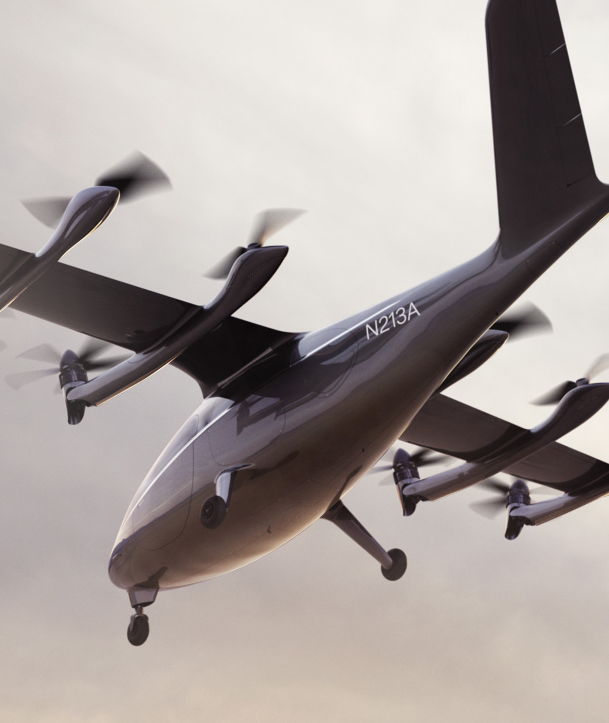
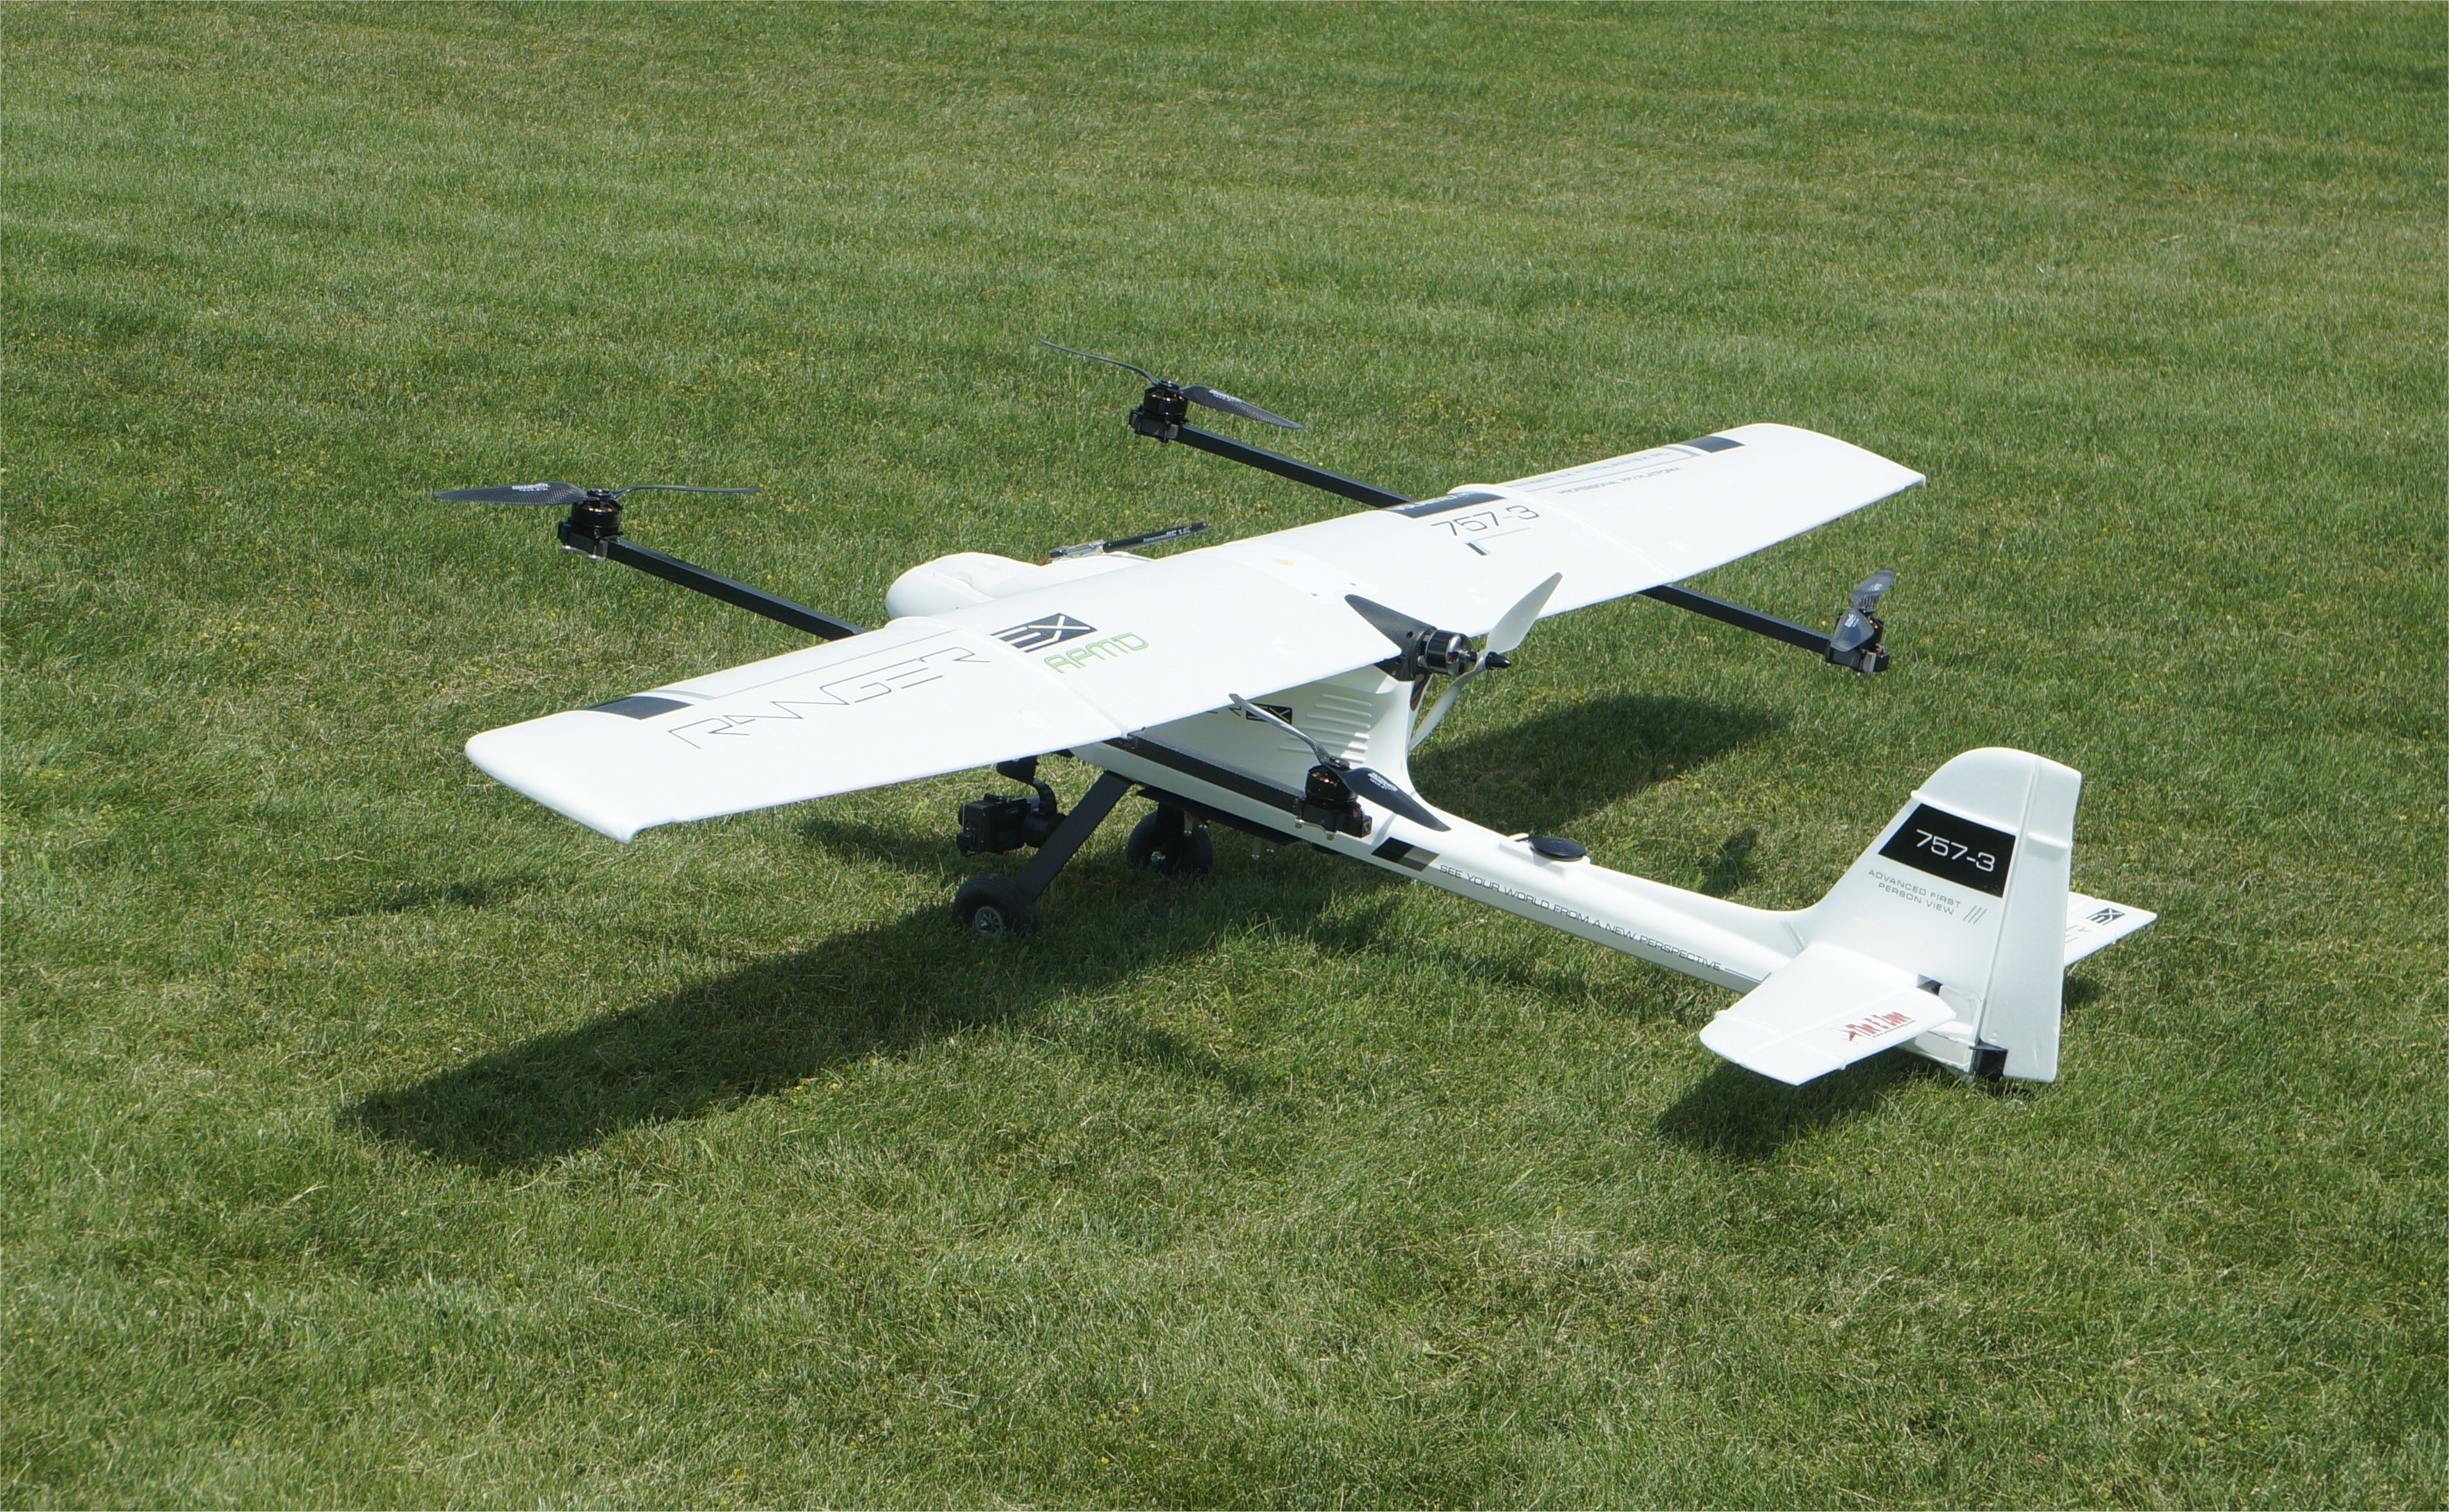
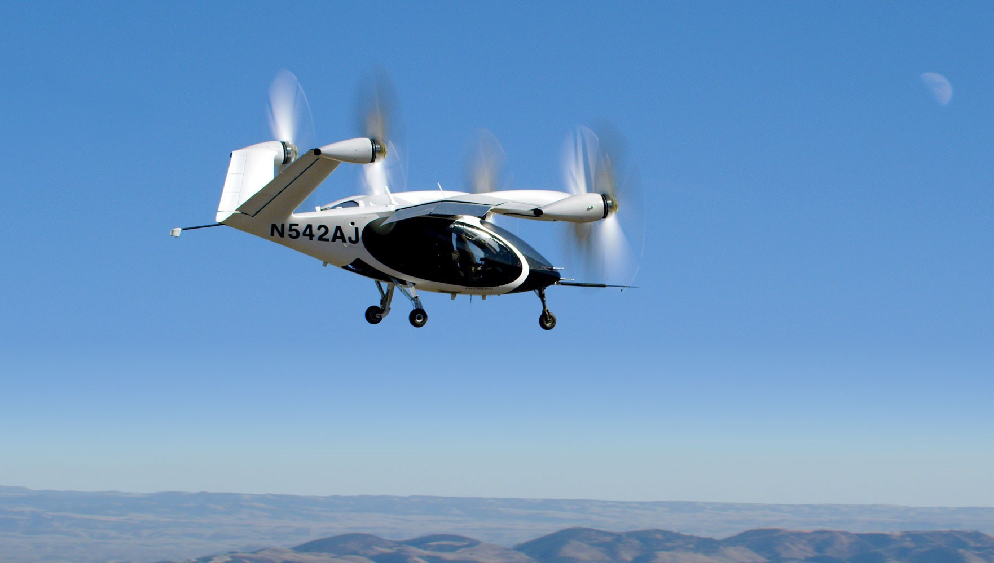
Electric Vertical Take-Off and Landing (eVTOL) Aircraft
Vertical take-off and landing
Fixed-wing cruise
Both versatile and efficient

Slide 3
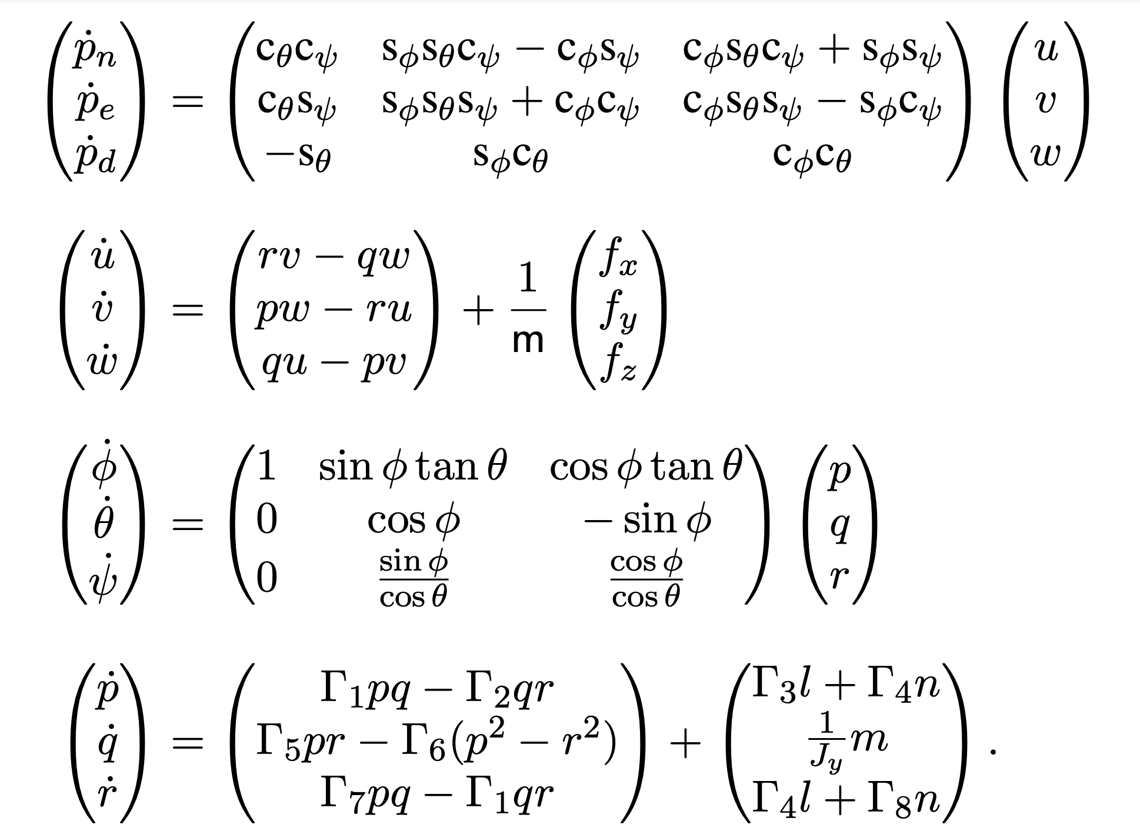
MAV Dynamics Model

Slide 4
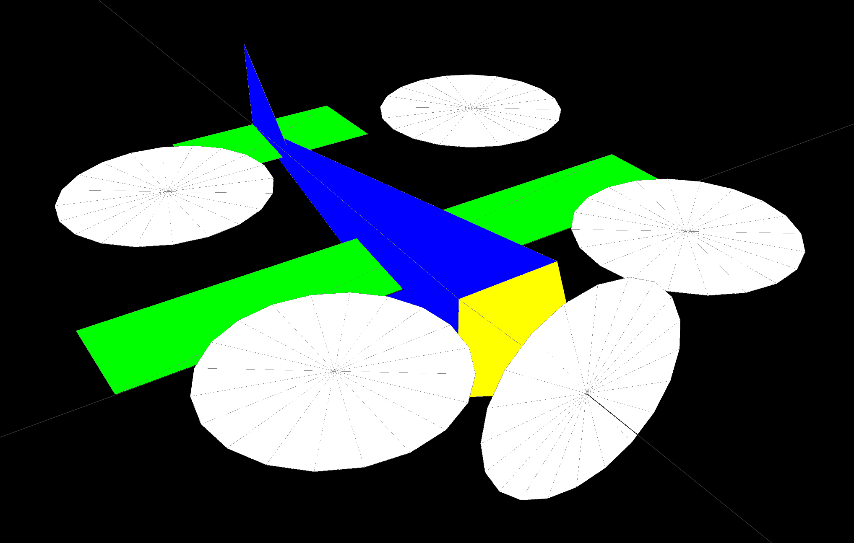
MAV Dynamics Model
New rotors produce force in the –z direction and cause new torque terms

Slide 5

eVTOL Dynamics Model: Thrust
Force in the $−z$ direction
$F_{z}=T_{p}(δ_{throttle}, w_{r})$

Slide 6
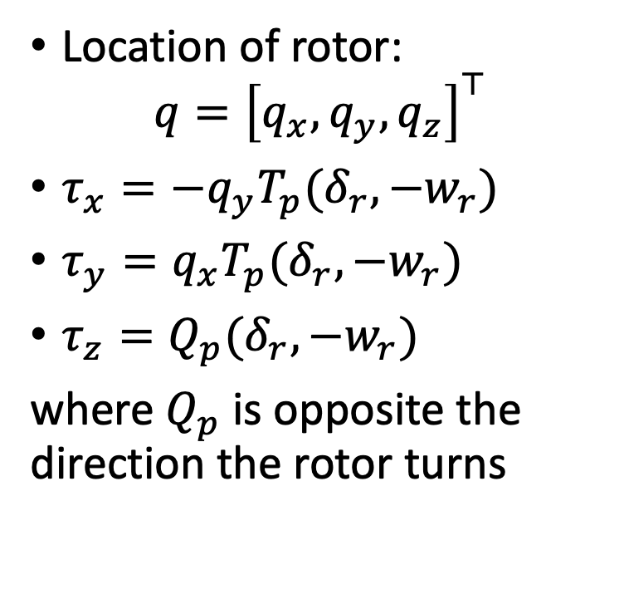
eVTOL Dynamics Model: Torque
Location of rotor:
$$q={\left[q_{x}, q_{y}, q_{z}\right]}^{⊤}$$
$τ_{x}=−q_{y}T_{p}(δ_{r}, −w_{r})$
$τ_{y}=q_{x}T_{p}(δ_{r}, −w_{r})$
$τ_{z}=Q_{p}(δ_{r}, −w_{r})$
where $Q_{p}$ is opposite the direction the rotor turns

Slide 7
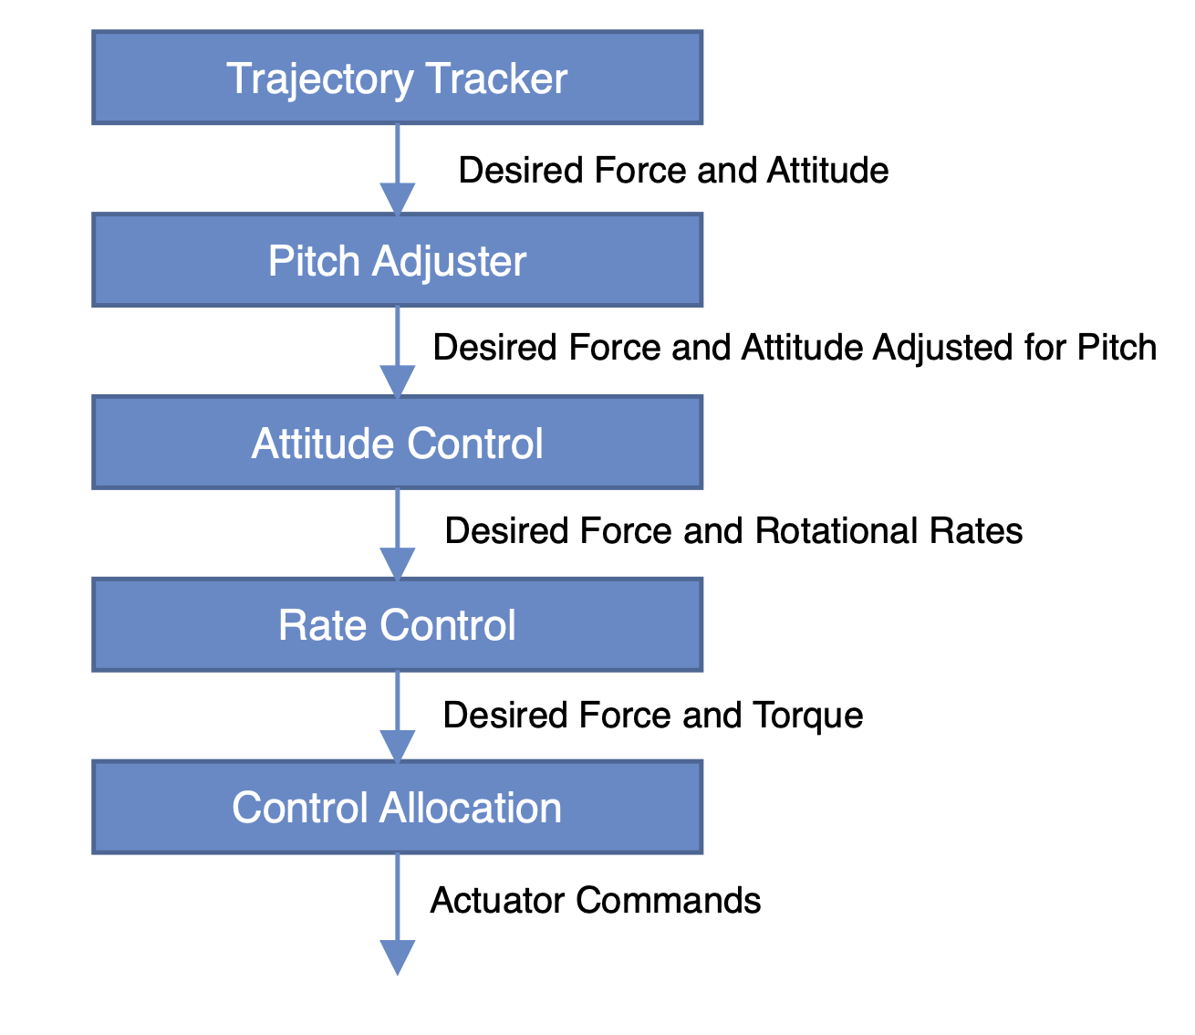
eVTOL Controller

Slide 8
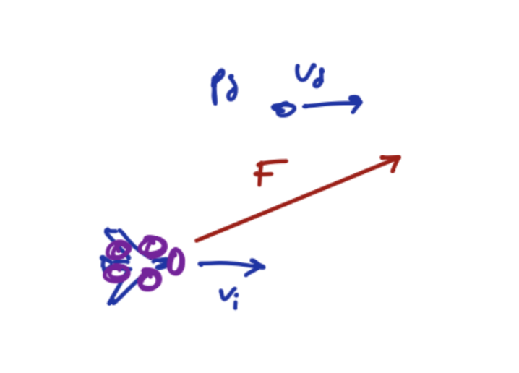
Trajectory Tracker
PD Control based off desired position, velocity, and acceleration

Slide 9
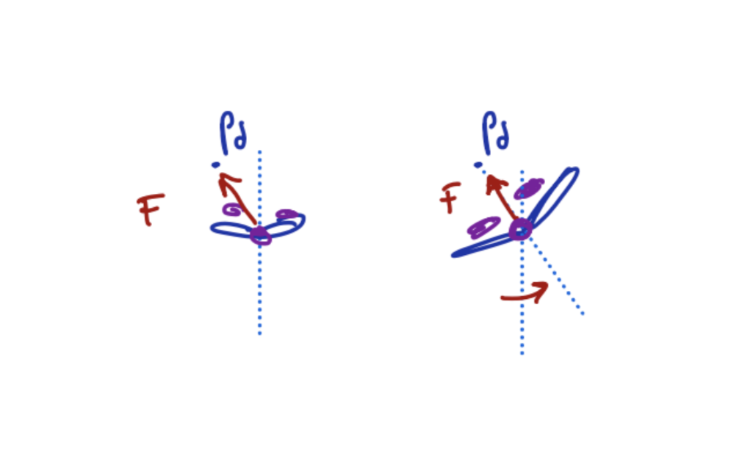
Trajectory Tracker
Rotate so that thrust is in the body longitudinal plane

Slide 10
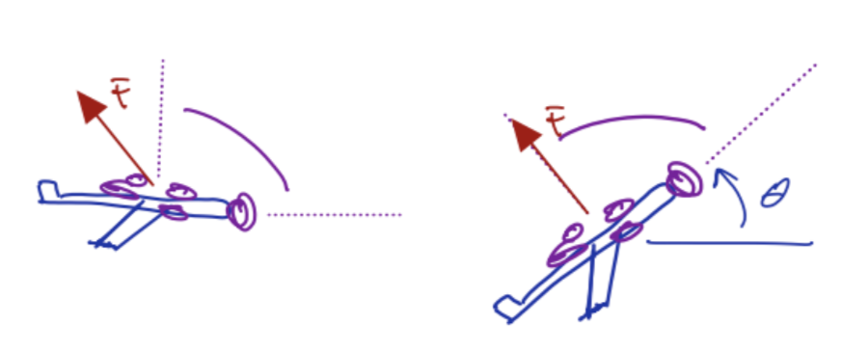
Pitch Adjuster
Rotate body about the pitch access to make force achievable

Slide 11
Attitude Control
Proportional attitude control

Slide 12
Rate Control
PID Controller

Slide 13
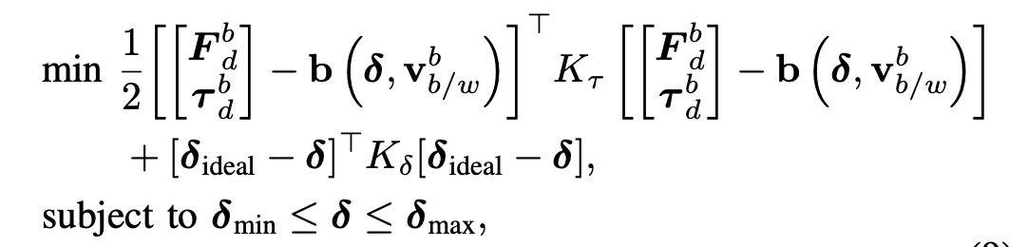
Control Allocation

Slide 14
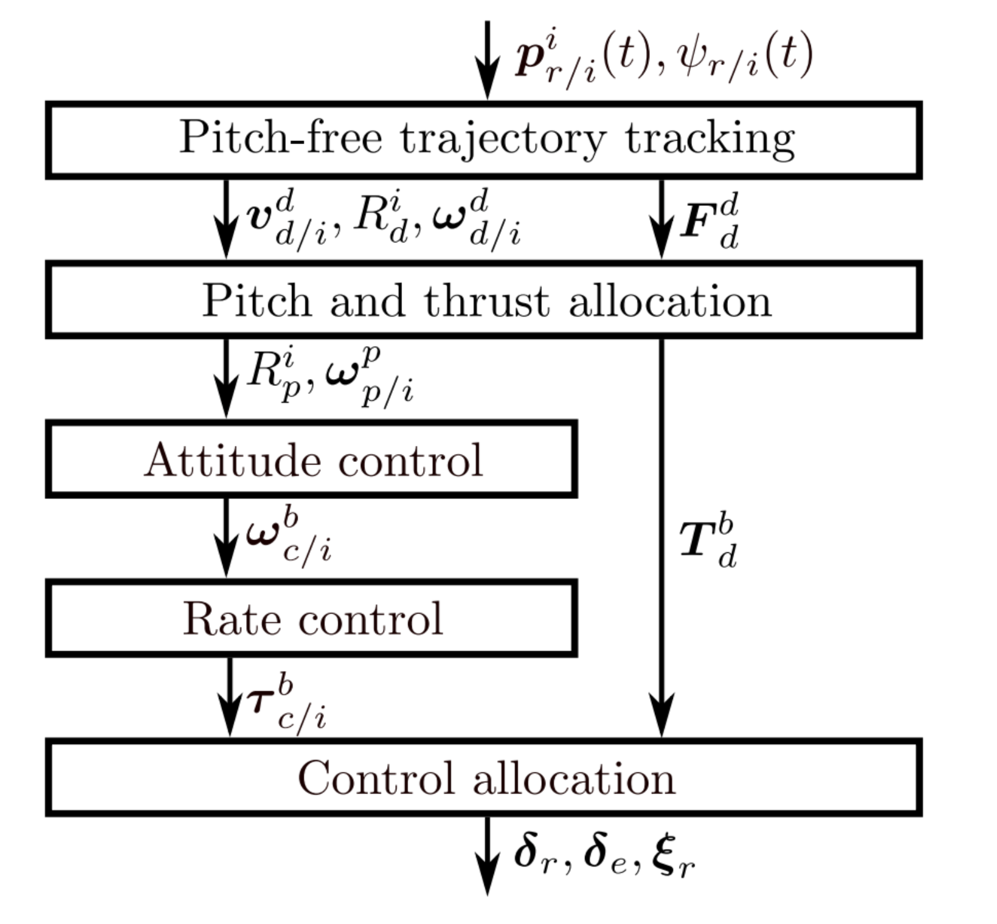
Implementing Jacob Willis’s eVTOL Trajectory Tracking Controller

