Slide 1

Software Development SIG
Australian Computer Society
South Australian Branch

Slide 2
Introduction
Why this SIG?
  Arose from discussions between myself (David Benn) and Sorin Buzilla (ACS SA committee members).
  ACS has an IT PM SIG, a common interest group with AJUG, and in the past, an eCommerce SIG, but…
  nothing specific to software development except for some special events (eg ‘Agility’).

Slide 3
Introduction
Software development is not something you “grow out of”.
  It’s at the heart of IT and computing in general;
  It’s what many of us plan to spend the forseeable future doing;
  It’s complex, part science, part craft.

Slide 4
Emphases
Proposed emphases of this SIG:
  A forum for practitioners, current or budding;
  Experience sharing re:
    tools, techniques, methodologies;
  What practices can we adopt to make it more likely we will want to work on our own or others’ code now and into the future?

Slide 5
Introduction
What you do depends upon where you work, but includes some or all of...

Slide 6
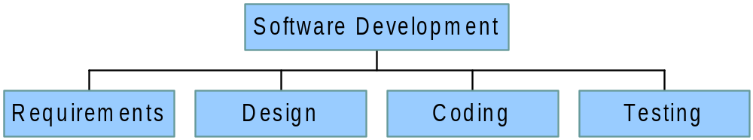
Software Dev Taxonomy

Slide 7
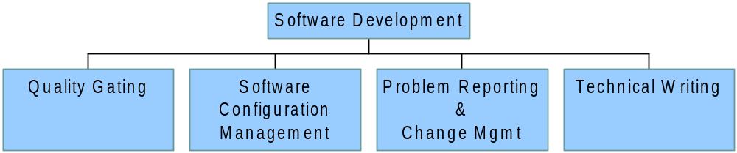
Software Dev Taxonomy

Slide 8
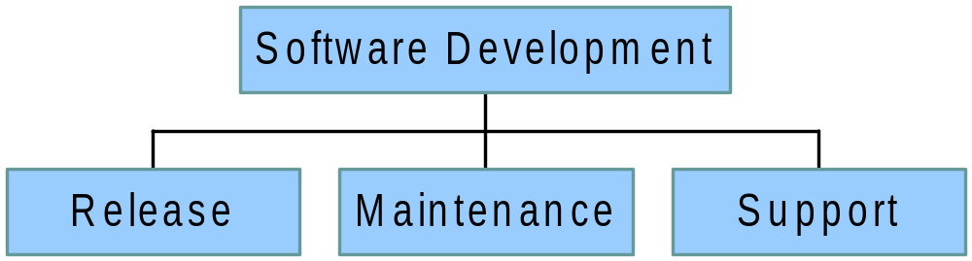
Software Dev Taxonomy

Slide 9
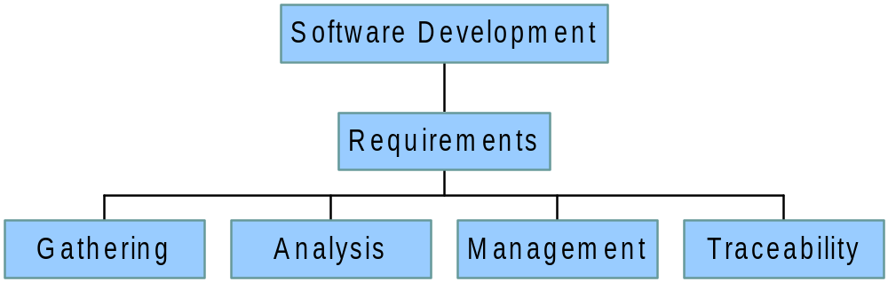
Software Dev Taxonomy

Slide 10
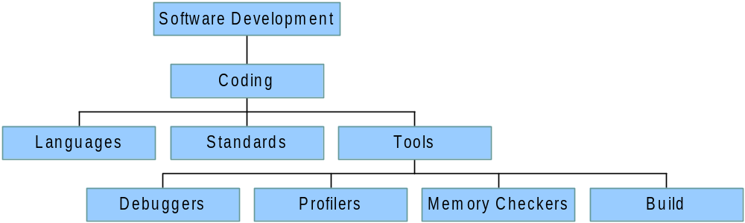
Software Dev Taxonomy

Slide 11
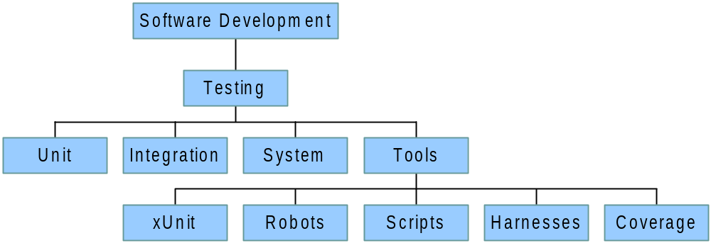
Software Dev Taxonomy

Slide 12
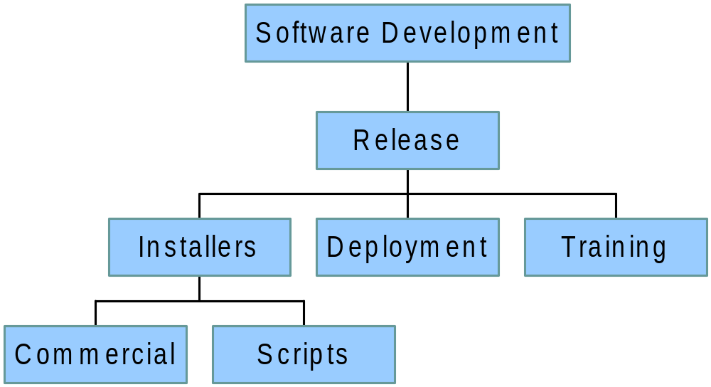
Software Dev Taxonomy

Slide 13
Possible Topics
A closer look at Agile etc methodologies.
Testing techniques and tools.
Patterns & pattern languages.
Programming paradigms new and old.
The role of use cases; examples.
Is Design Dead?
Habitability and piecemeal growth
  The quality without a name.

Slide 14
Sources of Speakers
Members of the Software Dev SIG.
Local industry practitioners.
Other ACS branches and contacts.
External speakers.
AJUG, SEA, IEEE, ACM etc joint events?

Slide 15
Future Meetings
Next
  February 2002 at Ngapartji
  Topic & speaker are TBD
Future
  Every two months, possibly more often.
  Depends upon speakers/convenors.
  Presentations, discussions.

Slide 16
Resources: Printed Journals
Dr Dobbs Journal
Software Development Journal
IBM’s Java developer journal
Microsoft developer journal
C/C++ Users Journal
The {C, C++, Java} Report
etc

Slide 17
Resources: Online
www.sdmagazine.com
www.martinfowler.com/articles
www.dreamsongs.com
java.sun.com
slashdot.org
etc

Slide 18
Resources: Books
Design Patterns (Gang of Four)
Effective C++
The Mythical Man Month
Patterns of Software
Code Complete
Debugging the Development Process
etc

