Slide 1
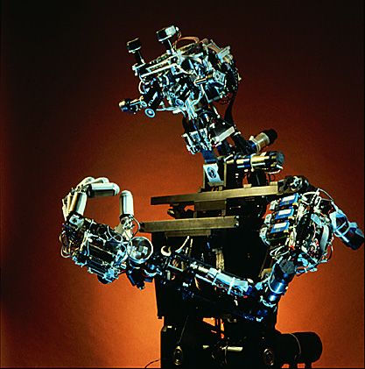
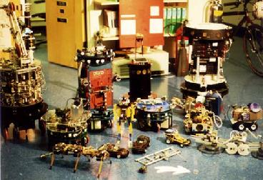


The Robot Visions of Rodney Brooks

Slide 2
Plan
Trace development of Brooks’ ideas and work with respect to traditional AI.
Give examples of early Brooksian robots.
Discuss shift in thinking required for human-level intelligence.
Discuss Cog.
Consider future prospects.

Slide 3
Who is Rodney Brooks?
Adelaide born. Flinders, Stanford, …, MIT
Fujitsu Professor of Computer Science and Engineering (EECS Dept) at MIT.
Director of the Artificial Intelligence Laboratory at MIT.
Companies: Lucid, IS Robotics Inc., Artificial Creatures.
Claims he is a pragmatist.
Notes:
Adelaide born and educated.
Moved to Stanford and did the rounds of robot labs at US universities.
That Brooks is now Director of the MIT AI Lab is a sign of the times.
Quite a change from the likes of McCarthy and Minsky.
Will say more about AI Lab’s charter at end, and Brooks’ influence will be obvious.
Brooks is a pragmatist since:
His emphasis is upon technical/engineering vs philosophical issues.
He wants to build robots that work in the real world rather than in simulations or special environments.
He has founded or is involved with companies (“Lucid’s main Lisp hacker” [Levy 92]).
But he has also written manifestos, and rejected symbol processing as the basis for intelligence.
This is probably just a means to an end for Brooks though.
Not totally uninterested in philosophical issues.

Slide 4
Approaches to Robotics
Dichotomy in robot implementation styles
  Behaviour-based robotics (eg. Walter)
  GOFAI (eg. Nilsson)
Shakey and the sense-model-plan-act framework.
Notes:
Dichotomy that still persist today ([Brooks 97] “From Earwigs to Humans”)
Behaviour-based robotics
Walter (1951) developed simple robots with a handful of switching elements (valves).
Reflexive behaviour to specific real world situations.
This approach largely ignored until mid-80s (see [Brooks 85]).
GOFAI (good old fashioned AI)
Typical exampledescribed by Nilsson (1969): Shakey which built a world model from perceptual inputs, proved theorems about that model, consulted goals given it, and produced actions to achieve those goals.
Brooks ([Brooks 91d] “New Approaches to Robotics”) discusses Shakey the robot and others which used sense-model-plan-act framework which could take 1-5 mins to carry out an action!
“Shakey only worked because of very careful engineering of the environment. Twenty years later, no mobile robot has been demonstrated matching all of Shakey’s performance in a more general environment, such as an office environment.” [Brooks 91d]

Slide 5
Criticisms of GOFAI
Evidence from biology and evolution.
GOFAI systems highly constrained.
Early work: formal systems, Blocks World.
Funding forced relevance and new slogan.
But this ignores knowledge acquisition!
Introspection is misleading.
Brooks rejects symbol system hypothesis.
Notes:
In terms of the development of life, evolution suggests that reason is easy, while reacting to a dynamic environment is hard ([Brooks 86], [Brooks 91a]).
Ie. evolution spent long time on fundamentals.
Brooks was influenced by examples from the biological world.
Early AI work was in games, symbolic logic, other formal systems.
BW in the 60s and 70s: a toy world which provided simple solutions to what were really more general problems.
Traditional AI abstracts away hard problems as not being AI, heavily constraining the small pieces of intelligence that remain.
A 70’s funding crisis forced AIers to become relevant. Led to slogan: Good representation is the key to AI. In practice: represent only pertinent facts .
But abstracting a complex world into an appropriate representation is the hard part (KA)! Brooks claims that because we perform all abstractions for our programs, most AI work is still done in BW.
Brooks claims that there is no clean division between perception and reasoning. Our introspective descriptions of internal representations may be quite different from how we work. Descarte’s error: introspection.
In short, Brooks rejects the symbol system hypothesis as the basis of intelligent systems, and along with it, the emphasis upon search and central world models [Ward 99 pp. 149-151], despite 1997 success of Deep Blue.

Slide 6
Behaviour-based Robotics
Groups at MIT and SRI independently began rethinking how to organise intelligence (around 1984). Requirements:
  Reactive to dynamic environment
  Operate on human time scales
  Robustness to uncertainty/unpredictability
All implemented simple systems with similar features.
Notes:
Dissatisfaction with real world performance of robots led 3 groups (Agre and Chapman (MIT), Rosenschein and Kaelbling (SRI), and Brooks (MIT)) to create systems that met the following requirements [Brooks 91d]:
Intelligence must be reactive to dynamic aspects of the environment
Mobile robots must operate on time scales comparable to animals
Mobile robots must be robust in the face of uncertain sensors and an unpredictable environment
The 3 groups implemented a variation on a network of simple computational elements which were hard-wired together, with sensors connected to actuators via a small amount of state updated on each clock cycle.
Agre and Chapman claimed that most of what people do everyday is not problem solving or planning, but routine activity in a dynamic world. [Brooks 91d]
They also claimed that representations of objects in the world need not be symbol-based but defined in terms of interactions with the world.
Rosenschein and Kaelbling agree with the latter and also suggest that “…an observer can legitimately talk about an agent’s beliefs and goals, even though the agent need not manipulate symbolic data structures at run time.” [Brooks 91d].
Cite John McCarthy’s: a thermostat has beliefs [McCorduck 79].
“…belief is all in the mind of an outside beholder…” [Brooks and Flynn 89]

Slide 7
Key Brooksian Ideas
Situatedness and embodiment.
Approximate evolution
  Incremental additions improve performance
  Each layer
    Corresponds to new behaviour
    Relies upon existing layers
    Has minimal interaction with other layers
    Is short connection between perception & actuation
Advantages
Notes:
Situatedness: robots must deal with the here and now that directly influences behaviour, not abstractions. [Brooks 91d]
Embodiment: robots must have bodies and directly “experience” the world. Actions are part of world and have immediate feedback on robot’s sensations of that world. [Brooks 91d]
Brooks [Brooks 97] argued that we should approximate evolution since:
Incremental additions to working systems improve their performance
Each layered addition should
Correspond to a new observable behaviour which can subsume lower layers
Be able to rely upon existing working layers
Have minimal interaction with other layers
Be a short connection between perception & actuation
Advantages [Brooks 86]
There are many parallel paths though the system, so it’s not dependent upon the weakest link failure. Existing working layers still function.
There may be more than one behaviour relevant to a given situation giving redundancy and robustness (along with possible conflict).
Lends itself to parallel implementation.

Slide 8
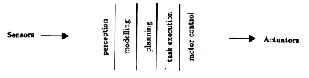
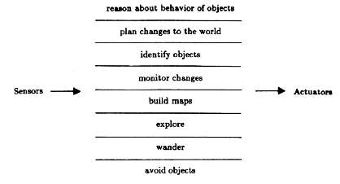
Subsumption Architecture
Functional decomposition
Decomposition on task achieving behaviours
Notes:
This is not unlike animals with layered nervous systems.
Notice also that the upper layers of the subsumption architecture don’t preclude the possibility of higher-level intelligence.
Computation consists of asynchronous networks of AFSMs.
Augmented with
Timers which initiate state changes after certain intervals [Brooks and Flynn 89]
Instance variables [Brooks 85]
There’s a fixed topology of connections between AFSMs. “Any communication path must be made quite explicit by specifying a wire.” Processing is distributed making a central world model difficult to achieve. [Brooks 89]
Numeric messages are sent over connections, arriving at input ports.
The meaning of messages depends upon the purpose of sender and receiver.
Sensors and actuators are directly connected to network.

Slide 9
Subsumption Architecture
No central model of world.
No separation into perception, central processing, and actuation.
Layering increases capabilities.
No hierarchical arrangement.
Messages on input ports when needed.
Behaviours run in parallel.
Notes:
Principles of organisation observed in mobots [Brooks 91f pp. 2-3] “The Role of Learning in Autonomous Robots”:
There is no central model of the world.
There is no separation into perception, central processing, and actuation systems. They are intertwined.
Adding more specific behaviours to the existing network (layering) increases its capabilities.
There is no hierarchical arrangement; one process does not call on another as a subroutine.
Messages are available on the appropriate input port when needed. There’s no notion of synchronisation between a producer and consumer.
Message reception buffers can be overwritten by new messages before consumer has looked at old one. A ratio of 1:10 of read to unread messages is not atypical.
Behaviours run in parallel, requiring conflict resolution when different behaviours attempt to control the same actuator in different ways.
This is done via a pre-wired priority scheme.

Slide 10

Examples: Allen
Sonars, odometry
Offboard Lisp machine
1st layer: avoid obstacles
2nd layer: random wandering
3rd layer: head toward distant places
Notes:
Early robot.
Uses an offboard Lisp machine running the subsumption architecture, written in a precursor to the Behaviour Language.
First layer
Avoid static and dynamic obstacles.
Robot sits in middle of room but scurries away when approached.
Sonar sensor returns represent a repulsive force with inverse square dropoff in strength (like gravity).
Repulsive forces from all sensors are used to determine heading.
Additional reflex halts robot when something in front of it.
Second layer
Every 10 seconds (AFSM: timer), a random heading is generated.
If halted, this would help robot move away from obstacle.
Heading combined with layer 1 heading.
Third layer
Sonar is used to look for distant places and generate a new heading.
Again, heading is combined with layer 1’s.
Monitors progress in world via odometry.
[Brooks and Flynn 89]

Slide 11

Examples: Herbert
24 8-bit processors, loosely coupled via slow interfaces.
30 IR sensors for obstacle avoidance.
Manipulator with grasping hand.
Laser striping system: 3D depth data.
Wanders office, follows walls.
Finds table, triggering can finder, which robot centers on.
Robot stationary: drives arm forward.
Hand grasps when IR beam broken.
Notes:
Wanders offices following walls, avoiding obstacles, and collecting empty drink (soda) cans.
Subsumption architecture run by 24 loosely coupled 8-bit processors.
Has 30 IR proximity sensors for avoiding obstacles.
Has a grasping hand with a break sensor (IR).
Has a laser light striping system which produces one 256x32 pixel image per second out to 12 feet covering a 60 degree field.
4 processors expend ~30 instructions per pixel permitting high-performance vision algorithms.
A table-like object finder drives robot closer to tables where a drink-can-like object finder is more likely to trigger.
Once the latter triggers, the robot centers on the detected object - without communication with other layers
The arm controller notices robot is halted, so moves arm forward to line up the grasper on either side of can.
The arm and hand don’t communicate
The grasp reflex activates when the IR beam is broken. Makes it possible for a human to pass a can to the robot for collection.
[Brooks and Flynn 89]

Slide 12

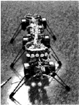
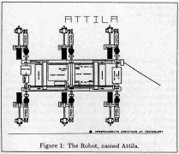
Examples: Genghis & Attila
Walk under subsumption control over varied terrain.
Each leg “knows” what to do.
Leg lifting sequence centrally controlled.
Additional layers suppress original layers when triggered.
Highest layer suppresses walking until person in field. Then Attacks.
Attila stronger and faster. Periodic recharging of batteries.
Notes:
Genghis walks over varied terrain.
Each leg “knows” what to do
If I’m a leg and I’m up, swing forward.
This causes other grounded legs to move back a little and the body to move forward.
If I’m a leg and I’m forward, put myself down.
The leg lifting sequence is the only part of the robot which is centrally controlled.
Additional layers suppress lower ones
e.g. If Genghis is climbing and one leg detects a high force before reaching the “down” position, that position is adjusted by suppressing the actuator command in the lowest layer.
The highest layer suppresses walking until a person is in the robot’s field, using pryoelectric sensors. Then “attacks”.
Some of the behaviours which correspond to layers are: Stand Up, Simple Walk, Force Balancing, Leg Lifting, Whiskers, Pitch Stabilising, Prowling.
57 FSMs, 48 of which are 6 copies of an 8-FSM control system for each leg.
The success of Genghis prompted the creation of Attila
Stronger and faster; can stand up from any position by leg rotation.
Periodic recharging of batteries required via solar cell.
[Brooks and Flynn 89], [Angle and Brooks 90]

Slide 13
Killer Application?
Brooks suggests using Attila as planetary rover.
Small rovers provide economic advantage.
Reduces need for 100% reliability.
Legs are much richer sensors than wheels.
Little need for long term state.
NASA's cheaper-faster-better strategy.
Notes:
Brooks suggests the use of Attila (and other robots) as planetary rovers.
Small rovers provide immediate economic advantage in payload costs.
Redundancy reduces the need for 100% reliability, also reducing cost.
Legs can provide support for much richer sensation than wheels due to volume covered by sweep and step.
There’s little need for long term state, so
Frequent reboots are possible to limit effects of radiation.
Also means cheaper components can be used.
[Brooks and Flynn 89], [Angle and Brooks 90]
In line with NASA’s cheaper-faster-better strategy of recent years.

Slide 14
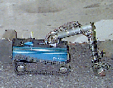
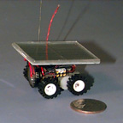
Mars Rovers
Work sponsored by NASA JPL (from around 1998).
Pebbles is a vision-based mobile robot that uses a single camera for obstacle avoidance in rough unstructured environments.
Goal of Rockettes project is to build small, 10 gram mobile robots for planetary exploration. Can send many microrobots instead of a single larger one.
Notes:
In line with NASA's cheaper-faster-better strategy.
Pebbles and Rockette are not dissimilar to Mars Pathfinder. [Ward 99]
To what extent was it influenced by Brooks’ robots?
Other ideas:
Subsumption based rovers in an ant colony formation shifting soil in preparation for a manned mission.
Small robots (1000s or more) covering portions of a planet’s surface signalling results of simple tests to an orbiter or larger rover.
[Brooks and Flynn 89], [Angle and Brooks 90]

Slide 15
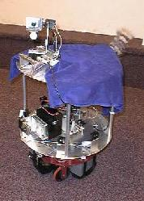
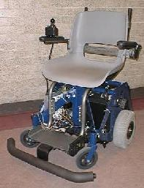
Other Recent Mobot Projects
Yuppy: a pet robot
Wheelesley: a robotic wheelchair system
  Developed for people unable to drive a traditional powered wheelchair
  Navigates indoor and outdoor environments

Slide 16
Towards Cognobotics
Brooks believes different decomposition necessary for human-level intelligence.
Some things needed for human-level intelligence:
  Vastly richer set of abilities in gaining sensor information
  Much more motor control
  Interaction with people
Notes:
Brooks believes that a different type of decomposition is necessary for human-level intelligence. [Brooks 97]
Interesting because in earlier papers (eg. [Brooks 91a], Brooks thought we didn’t have any idea what the correct decomposition should be.
Some basic things needed for human-level intelligence
Needs vastly richer set of abilities in gaining sensor information
Smoothly track eyes and neck
Correlate sound localisation and eye coordinates
Need much more motor control
Maintain body posture as head and arms are moved
Protect itself from self injury (Asimovian: part of 3rd Law)
Perform visually guided reaching
Do material estimation (e.g. don’t squeeze too hard if an egg)
Must interact with people
Distinguish human voices from other sounds
Detect faces and interpreting facial gestures
Recognise personal space

Slide 17
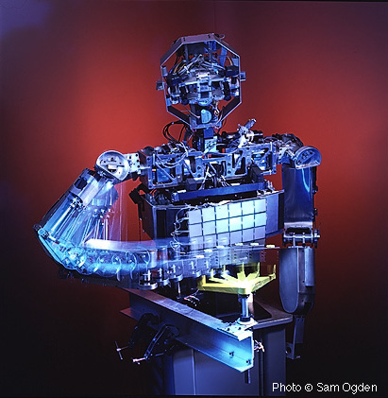
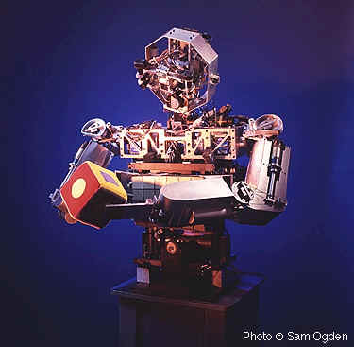
Towards Cognobotics
Issues more critical in complex robots:
  Bodily form
  Motivation
  Coherence
  Self-adaptation
  Development
  Historical contingencies
  Inspiration from the brain
Notes:
Bodily form
Critical for representations we develop & use for thought and language. A crude approximation may miss vital features.
Humans need to interact with it easily and naturally for HR to reciprocate. Need more than Holly!
Motivation
With simple task-based robots, this issue doesn’t arise. There’s no need to select between major activities, and no means to.
Humans can engage in more than one activity at a time which may lead to conflicts.
Why should a humanoid robot interact at all?
Coherence
When engaged in one task, when should a humanoid robot move to look at an object in its peripheral vision?
How should behaviours and reflexes be orchestrated without a central controller? He has historically been very much against this!
Self-adaptation: a HR must adapt to continually changing conditions
Development: Humans aren’t born fully formed physically or mentally. How to reinvent that? [Brooks et al 98]
Historical contingencies: Incorporating some aspects of humans may be a waste of time. Other, hidden aspects may be crucial during development.
Inspiration from the brain: be skeptical. May mean we’re just not ready yet!

Slide 18
Cog
Work has progressed since 1993.
Torso from waist up with arms, hand (3 fingers, 1 thumb), neck, head.
Torso on fixed base with 2 DOF.
Neck has 3 DOF. Eyes each have 2 DOF.
Arm has 6 DOF.
Notes:
Arms, neck, eyes, waist all have a fairly free range of motion.

Slide 19
Cog
Motors on eyes, neck, and torso have joints with limit switches.
Eyes part of high-performance vision system.
Eyes saccade with human speed & stability.
Gyroscope/inclinometer based vestibular system.
Arm compliant and safe for interaction.
Notes:
[Brooks 98] talks about how Cog’s arms can work in human-like fashion
When arms are coupled through for example, a a slinky, oscillators tune into the dynamics of motion and coordinated behaviour is achieved.
When not interacting with the environment, the arms are uncoordinated.
To do this requires no central controller, no modelling of arms or environment.

Slide 20
Cog
Processing system is a network of Motorola 68332s running multithreaded Lisp, L.
Taken until 1997 to get this far. Since then:
  Sound localisation system (Irie)
  Simple model of cerebellum
  3 kinds of NNs control hand
Notes:
Processing system is a network of Motorola 68332 running multithreaded Lisp, L.
Relationship to Behaviour Language?
It took from 1993 to ~1997 to get this far. Work since then includes:
Sound localisation system (Irie)
Uses similar cues to humans to determine direction.
A NN learns correlation of aural and visual location, on the assumption that aural events are often accompanied by motion.
Simple model of cerebellum
Over 8 hour training period, compensates for visual slip due to neck motions. Is a NN used to do this? Brooks doesn’t say.
3 kinds of NNs control the hand.
Hand covered by touch sensors.
Uses frictionally coupled tendons to accommodate shape of grasped object automatically.
[Brooks 97]

Slide 21
Cog: Recent Work
Orientation to noisy and moving object, then batting at it.
  Ferrell developed 2D topographic map structures
    Let Cog learn mappings from objects at periphery of vision to occulomotor coordinates.
  Others using similar maps to relate eye and hand coordinates to learn visual reach to target.
Notes:
You can’t help but notice the shift towards representation from the last two slides.
This is however, a trend that started with earlier robots (eg. Toto) which created spatial maps for moving around offices and hallways.
Brooks has admitted the need for such maps since [Brooks 85]!

Slide 22
Cog: Current and Future Work
Touch sensitive body skin
Utilising multiple complementary senses
Models of shared attention
Emotional coupling between robot and caregiver
Bipedal motion? See Future Prospects.
Notes:
Large scale touch sensitive body skin.
Utilising multiple complementary senses results in a reduction of computation overall
Cog uses an image stabilising system that features vestibular feedback
Using two sensory systems yields simpler, better performance than image processing alone
E.g. objects that make noise often move
Models of shared attention between robot and human.
Emotional coupling between robot and care-giver; no details (conclusion of [Brooks 98]).
Developmental models of human infants. Indeed, Angle and Brooks in [Brooks et al 97] “The Intelligent Room Project” mention a human infant simulation.
I found no mention of adding legs to get bipedal motion. How important is this to Cog’s development?
[Brooks 98]

Slide 23
Is this the right approach?
Brooks considers the possibility that all current approaches to building complex intelligent systems are wrong. Why? All biological systems are:
  More robust to change than artificial systems
  Learn an adapt faster than ML algorithms
  Behave in a lifelike way that robots don’t
From earwigs to humans?
Notes:
It’s interesting to note that in [Brooks 86] he was saying that his robotic insects were more reliable than any human-built systems!
Brooks seems genuinely to wonder whether his approach and all others are simply so wrong that they’re doomed to failure. Funding shortfalls probably didn’t help his attitude at the time! In [Brooks 97] he had this to say:
“Perhaps we have all missed some organising principle of biological systems, or some general truth about them…I am suggesting that perhaps at this point we simply do not get it, and that there is some fundamental change necessary in our thinking in order that we might build artificial systems that have the levels of intelligence, emotional interactions, long term stability and autonomy, and general robustness that we might expect of biological systems…”.
But this is exactly what he was saying (in the early 1990s) we couldn’t do until we had a lot more experience with simpler intelligences. [Brooks 91a]
Kirsh (1991) sarcastically wrote a response to one of Brooks’ early manifestos titled “Today the earwig, tomorrow man?” Since the Cog project started Brooks’ now agrees with the sarcasm. [Brooks 97]
Brooks is less negative in [Brooks 98], possibly because of funding and paper bound for AAAI-98 conference! (Now I’m being sarcastic).

Slide 24
Alternative Essences
In 1998 Brooks seems more self-assured.
Backs off from central models and representations.
  Humans have no monolithic internal models
    Minimal internal representation
  Humans have no monolithic control
    No evidence of organic CPU
  Humans are not general purpose
    Good at some things at expense of others; emotional
Notes:
Some beliefs espoused by Brooks in a 1998 manifesto [Brooks 98]:
Humans have no monolithic internal models
Humans tend to minimise their internal representation of the world, eg. humans don't build internal model of entire visible scene when copying a stack of blocks. The world serves as a representation to which a human repeatedly refers. How does this explain my ability to recall a scene completely (perhaps with errors) later?
Humans have no monolithic control
There’s no evidence from cognitive science for anything like an organic CPU.
eg. patients with severed corpus callosum show characteristics of 2 independent control systems.
Humans are not general purpose
A popular view is that human brain is good at everything. But humans are only proficient in particular skills at the expense of others.
Humans are better at deductive logic when symbols are given meaningful names.
Humans don't seem to use subroutine-like rules when making decisions.
Humans are often more emotional than rational and emotion plays an important role in decision making.

Slide 25
Challenges
Scaling and development
Social interaction
  Communication, caregiver behaviour, motivations
Physical coupling
  Scaling complexity, new skills with old
Integration
  Coherence, measuring performance
Notes:
Scaling and development
What learning structures and organisational principles will yield successful systems?
Social interaction
How can a robot elicit care-giver behaviour from humans?
What motivations and emotions are necessary for effective communication with humans?
Physical coupling
How can the system scale complexity of coordinated motion while still exploiting dynamics?
eg. putting jug of milk into fridge allows pendulum action of arm to be exploited
How to combine new with already learned spatial skills. How is the associated memory to be organised?
Integration
How to get coherence and stability from a conglomerate of subsystems with different goals and behaviours?
What are good measures of performance for socially interacting systems?
[Brooks 98]

Slide 26
What has Brooks achieved?
Humans are a long way from insects.
Brooks new ideas seem to still be evolving.
Shunning NNs etc for so long a mistake?
Brooks has produced some convincing artificial insects.
Barely begun to attain human intelligence.
Notes:
If everyone has missed something, it’s what Brooks is concerned about in [Brooks 97] but seems less worried by only a year later: that humans are a long way from insects.
We shouldn’t be surprised that creating an artifice with similar capabilities will be really hard!
Brooks’ ideas on cognobotics seem to still be evolving. The earlier insect-level work is a lot simpler and self-contained. In [Brooks 97] he seems to be realising that he’s bitten off more than he can chew.
Brooks seems happy to take the engineering approach and try anything if he thinks it will work, while still maintaining some tension with remaining true to biology.
He is getting results in general robotics
Convincing artificial insects and applications for them. Increasingly complex emergent behaviour seems likely from this, depending upon layer conflicts. [Brooks 91a]
"We have built a humanoid robot that operates and develops in the world in ways that are similar to the ways in which human infants operate and develop.” [Brooks et al 98] Wow! That's quite a claim. It’s misleading too. Some progress has been made towards isolated problems relating to sensorimotor coordination and bodily function, but there’s a long way to go.

Slide 27
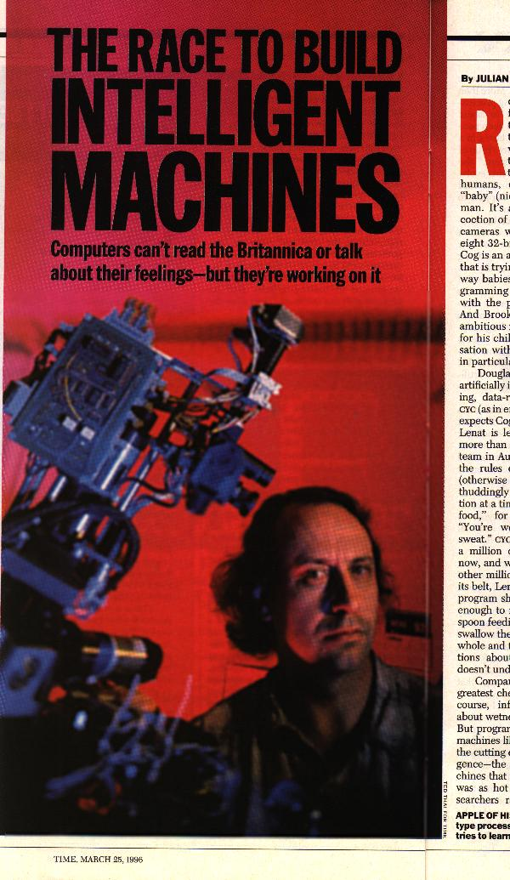
Future Prospects
Several robotics groups now at MIT
  Mobile Robotics
  Humanoid Robotics
  Robot Hands
  Leg Laboratory
  Cognitive Robotics
  Vision groups, etc
Director’s Introduction sets the tone
Notes:
Several robotics groups now at MIT
Director’s introduction has set the tone for AI research at MIT
A number of events are converging that make this time one of great promise for our research:
There has been a realisation amongst many people at our Lab that the keys to intelligence are self adapting perceptual systems, motor systems, and language related modules. This is in marked contrast to earlier approaches that focused on reasoning, planning, and knowledge representations as the keys to Artificial Intelligence. A whole host of new techniques for imaging the brain while it perceives, acts, and produces utterances are giving new insights into how components of human intelligence interact. The answers all look very different from earlier models derived from introspection and protocol analysis.
We are thus armed with a new direction, we have new data on how natural systems work, and we have significant new levels of computation available.
Our challenge is to take these three components that have been thrust upon us...and synthesise new scientific results, create new engineering applications, and to answer the big question: How does the human mind work?
So, if Brooks has his way, the face of AI early next century will be quite different from its beginnings near the middle of this century.

Slide 28
Additional References
McCorduck, P., 1979, Machines Who Think, Freeman.
Ward, M., 1999, Virtual Organisms, MacMillan.
URLs
Mars Rover Research, http://www.ai.mit.edu/projects/mars-rovers/
MIT AI Lab Director’s Introduction, http://www.ai.mit.edu/director/introduction.html
The Cog Shop, http://www.ai.mit.edu/projects/cog/
The MIT AI Lab Mobot Group, http://www.ai.mit.edu/projects/mobile-robots/robots.html

