Slide 1
An Implementation of Conceptual Graph Processes
Coursework Masters Thesis
University of South Australia
School of Computer and Information Science
December 2000
Student: David Benn
Supervisor: Dan Corbett

Slide 2
Plan
Conceptual Graphs
Processes
Thesis Content
Results
A Room Allocation Problem
Some Future Directions

Slide 3
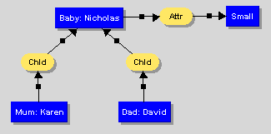
Conceptual Graphs
Sowa’s CST (1984) permits knowledge representation via bipartite CGs:
  Concepts
  Conceptual Relations, e.g. thematic roles
  Type Lattices
  (Attr)-
-> [Small]
  <- [Baby: Nicholas]-
  <- (Chld) <- [Mum: Karen]
<- (Chld) <- [Dad: David]

Slide 4
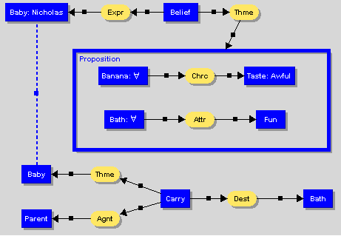
Conceptual Graphs

Slide 5
Conceptual Graphs
Display and Linear forms, and CGIF.
CST primitives model static knowledge.
Modification of knowledge base (KB) via:
  Copy
  Restriction
  Join
  Simplification
  Projection (π)

Slide 6
Processes
Addressing a lack in CST:
  CGs represent declarative information;
  By themselves they are insufficient for:
    doing computation;
    simulating events and processes.
  Some kind of truth maintenance engine is required: assertion and retraction of graphs over time.
  Mineau’s (1998) CG Processes are one such approach.

Slide 7
Processes
Key notions:
  state transitions;
  knowledge-based precondition matching: conjunction of CGs;
  post-conditions modify Knowledge Base (KB) by graph assertion and retraction; may use matched information;
  process p(in g1, out g2,...) is
{ r_{i} = pre_{i}, post_{i} ∀_{i}∈[1, n] }
  forward chaining.

Slide 8
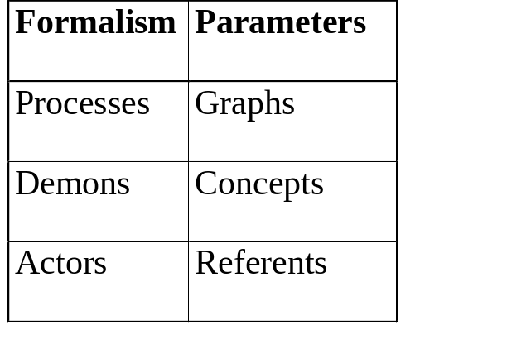
Processes
Generalisation of Delugach’s (1991) demons, and Sowa’s actors or dataflow graphs.
    process > demon > actor
Process mechanism also uses actors in practice when referent computation required.

Slide 9
Thesis Content
Current work:
  provides a primer on CGs;
  surveys literature re: dynamic CG formalisms & tools, and Petri Nets (coloured, actor mechanism description);
  presents a general-purpose programming language, pCG, developed by the author which embodies Mineau’s process formalism (http://www.adelaide.net.au/~dbenn/Masters/);
  presents and discusses pCG experiments;
  suggests future directions.

Slide 10
Results
pCG:
  permits process definition and invocation;
  provides capabilities for working with conceptual graphs, processes, actors, and functions as first class values;
  general-purpose programming language; permits imperative, object-based, functional, and declarative styles.

Slide 11
Why pCG?
Paper-based exercise ⇒ process programs.
Design goals:
  Making those entities of primary interest to the developer first class. Could have implemented an API, but programs would not be concise.
  Rapid development: interpreted, complex built-in types, GC.
  Portability: Java, ANTLR: Java-based compiler development language.
  Easy extensibility: attributes, operations, types can easily be added via Java code.
Emphasis upon CGs and processes.
Simple language; focus upon new semantics.
Possible to change source language: interpreter & library do the hard work.

Slide 12
Results
Refinement of Mineau’s process formalism in the course of developing pCG and applying it, e.g. negation vs retraction, process statement minutiae, actors in processes.
Application of pCG to examples other than Mineau’s 1998 iterative factorial test process, e.g. the Sisyphus-I room allocation problem (Linster, 1999).

Slide 13
Sisyphus-I
Constraint satisfaction problem. A means by which to test knowledge acquisition and reasoning strategies.
Research group of people with varied needs must be allocated rooms.
Constraints detailed in problem description impose certain order on any solution, e.g.
  allocate head of group to large room;
  smokers & non-smokers can’t share rooms.

Slide 14
Sisyphus-I
Perl script extracts most information from HTML, yielding simple CGs, e.g.
[Person:*a'Michael T.'][Role:*b'Researcher'](Chrc?a?b)
[Person:*a'Michael T.'][Project:*b'BABYLON Product'](Member?a?b)
[Person:*a'Michael T.'][Smoker:*b'No'](Chrc?a?b)
[Person:*a'Michael T.'][Hacker:*b'Yes'](Chrc?a?b)
[Person:*a'Michael T.'][Person:*b'Hans W.'](Coworker?a?b)
Graphs for different people are separated by a blank line.

Slide 15
Sisyphus-I
pCG code reads all such CGs from file, yielding 1 graph per person via Join, e.g.
  [Person:*a'Michael T.']
  [Role:*b'Researcher']
  [Project:*c'BABYLON Product']
  [Smoker:*d'No']
  [Hacker:*e'Yes']
  [Person:*f'Hans W.']
    (Chrc?a?b)
    (Member?a?c)
    (Chrc?a?d)
    (Chrc?a?e)
    (Coworker?a?f)
  [Person:'Michael T.'] –
    (Chrc) -> [Role: 'Researcher']
    (Member) -> [Project: 'BABYLON Product']
    (Chrc) -> [Smoker: 'No']
    (Chrc) -> [Hacker: 'Yes']
    (Coworker) -> [Person: 'Hans W.']

Slide 16
Sisyphus-I
        yqt = file inFilePath;
        lines = yqt.readall();
        yqt.close();
        g = "";
        foreach line in lines do
        if line.length > 0 then
        if g is graph then
        g = g.join(line.toGraph());
        end else
        g = line.toGraph(); // first for a person
        end
        end else
        assert g; // in top-level KB
        g = "";
        end
        end

Slide 17
Sisyphus-I
Room CGs asserted:
rooms = { "[LargeRoom:*b'C5-117'][Location:*c'Central'][Integer:*d 2]" +
"(Chrc?b?c)(Vacancy?b?d)",
"[LargeRoom:*b'C5-119'][Location:*c'Central'][Integer:*d 2]" +
"(Chrc?b?c)(Vacancy?b?d)",
.
.
"[SingleRoom:*b'C5-115'][Location:*c'Central'][Integer:*d 1]" +
"(Chrc?b?c)(Vacancy?b?d)",
"[SingleRoom:*b'C5-116'][Location:*c'Central'][Integer:*d 1]" +
"(Chrc?b?c)(Vacancy?b?d)" };
foreach room in rooms do
assert room.toGraph(); // in top-level KB
end

Slide 18
Sisyphus-I
rule allocateFirstSecretary
pre
`[Person:*a'*name'][Role:*b'Secretary'](Chrc?a?b)`;
`[LargeRoom:*a'*roomLabel'][Location:*b'Central'][Integer:*c 2]
(Chrc?a?b)(Vacancy?a?c)`;
end
post
`[PROPOSITION:[Person:*a'*name'][Room:*b'*roomLabel'](Occupant?a?b)]`;
option export;
mkErasureGraph(_MATCHES[1]); // erase person
`[ERASURE:[LargeRoom:*a'*roomLabel'][Location:*b'Central']
[Integer:*c 2] (Chrc?a?b)(Vacancy?a?c)]`;
`[PROPOSITION:[LargeRoom:*a'*roomLabel'][Location:*b'Central']
[Integer:*c 1] (Chrc?a?b)(Vacancy?a?c)]`;
end
end // allocateFirstSecretary

Slide 19
Sisyphus-I
rule allocateFirstSecretary
pre
action
println "Need to allocate room for first secretary?";
end
`[Person:*a'*name'][Role:*b'Secretary'](Chrc?a?b)`;
  ...
end
post
action
label = getRoomLabel();
name = getPersonName();
showAllocation("First secretary", name, label);
plotName(name, label, 1, secretaryColor);
end
`[PROPOSITION:[Person:*a'*name'][Room:*b'*roomLabel'](Occupant?a?b)]`;
  ...

Slide 20
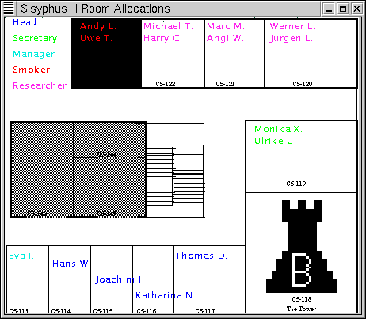
Sisyphus-I

Slide 21
Sisyphus-I
Script started on Mon Nov 27 09:32:13 2000
[david@twist ~/cgp]$ pCG examples/sisyphus-1/scg-1.cgp
Asserting YQT member graphs.
Asserting more information about certain YQT members.
Need to allocate room for the head of YQT?
--> Head of YQT 'Thomas D.' allocated to C5-117
Need to allocate room for the head of YQT?
Need to allocate room for second secretary?
Need to allocate room for first secretary?
--> First secretary 'Monika X.' allocated to C5-119
Need to allocate room for the head of YQT?
Need to allocate room for second secretary?
--> Second secretary 'Ulrike U.' allocated to C5-119
.
.

Slide 22
Sisyphus-I
Room allocation graphs:
[Person:*a"Thomas D."][Room:*b"C5-117"](Occupant?a?b)
[Person:*a"Monika X."][Room:*b"C5-119"](Occupant?a?b)
[Person:*a"Ulrike U."][Room:*b"C5-119"](Occupant?a?b)
[Person:*a"Eva I."][Room:*b"C5-113"](Occupant?a?b)
[Person:*a"Hans W."][Room:*b"C5-114"](Occupant?a?b)
[Person:*a"Joachim I."][Room:*b"C5-115"](Occupant?a?b)
[Person:*a"Katharina N."][Room:*b"C5-116"](Occupant?a?b)
[Person:*a"Werner L."][Room:*b"C5-120"](Occupant?a?b)
[Person:*a"Jurgen L."][Room:*b"C5-120"](Occupant?a?b)
[Person:*a"Marc M."][Room:*b"C5-121"](Occupant?a?b)
[Person:*a"Angi W."][Room:*b"C5-121"](Occupant?a?b)
[Person:*a"Michael T."][Room:*b"C5-122"](Occupant?a?b)
[Person:*a"Harry C."][Room:*b"C5-122"](Occupant?a?b)
[Person:*a"Andy L."][Room:*b"C5-123"](Occupant?a?b)
[Person:*a"Uwe T."][Room:*b"C5-123"](Occupant?a?b)

Slide 23
Sisyphus-I
concept Person;
...
concept Room > SingleRoom;
concept Room > LargeRoom;
relation Attr;
relation Chrc;
relation Member;
relation Coworker;
relation Vacancy;
relation Occupant;
rule allocateRemainingResearcher
pre
`[Person:*a'*name'][Role:*b'Researcher'](Chrc?a?b)`;
`[Room:*a'*roomLabel'][Location:*b'*somewhere'](Chrc?a?b)`;
end
post
`[PROPOSITION:[Person:*a'*name'][Room:*b'*roomLabel'](Occupant?a?b)]`;
option export;
end
end // allocateRemainingResearcher

Slide 24
Results
Uniform representation of actor and process invocation via standard actor node as per notation of the proposed ANSI CG Standard (Sowa, 1999), instead of non-standard node of Mineau (1998) and Delugach (1991), e.g.
  n = 4;
  mySqrGrStr = “[Num:*a ” + n + “][Num:*b'*y']<sqr?a|?b>”;
  g = activate mySqrGrStr.toGraph();
  s = "[PROPOSITION:*a[Line:*b'#L0'](to_do?b)]" +
  "[PROPOSITION:*c[Integer:*d'*z5']]" +
  "<fact?a|?c>";
  x = activate s.toGraph();

Slide 25
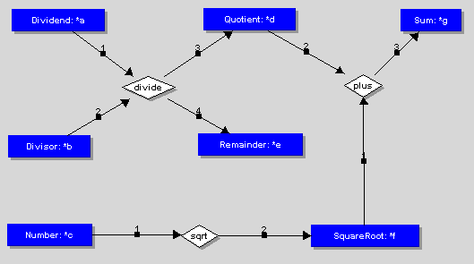
Actors

Slide 26
Actors
CGIF generated by Delugach’s CharGer:
[Remainder:*a'*e';CGHSD2.3b&Concept|243|232,190,117,25|&]
[Divisor:*b'*b';CGHSD2.3b&Concept|240|20,192,92,25|&]
[Dividend:*c'*a';CGHSD2.3b&Concept|238|24,51,104,25|&]
[Number:*d'*c';CGHSD2.3b&Concept|234|19,291,95,25|&]
[Sum:*e'*g';CGHSD2.3b&Concept|231|458,51,68,25|&]
[Quotient:*f'*d';CGHSD2.3b&Concept|229|238,50,103,25|&]
[SquareRoot:*g'*f';CGHSD2.3b&Concept|227|358,292,121,25|&]
<divide?c?b|?f?a;CGHSD2.3b&Actor|237|147,126,59,25|&>
<sqrt?d|?g;CGHSD2.3b&Actor|233|213,292,41,25|&>
<plus?g?f|?e;CGHSD2.3b&Actor|226|395,124,42,25|&>/*CGHSD2.3b&Graph|225|0,0,40,25|&*/

Slide 27
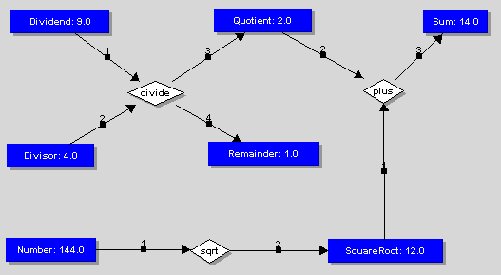
Actors
  r = file (dir + "Figure1.CGF");
  actor Figure1(a,b,c) is r.readGraph();
  g = Figure1(9,4,144);
  out_path = dir + "Figure1Out.cgf";
  w = file (">" + out_path);
  w.writeln(g);

Slide 28
Results
The development of anonymous recursive actors in pCG, obviating the need for an actor type definition in the special case of a recursive actor, e.g. in preconditions:
function multiply(a,b,result)
first = a.designator;
second = b.designator;
result.designator = first * second;
end
  pre
  ...
  `[Integer:*a'*fValue'][Variable:*b'#f']
  [Integer:*c'*iValue'][Variable:*d'#i']
  [Integer:*e'*product']
  (val?b?a)
  (val?d?c)
  <multiply?a?c|?e>`;
  ...
  end

Slide 29
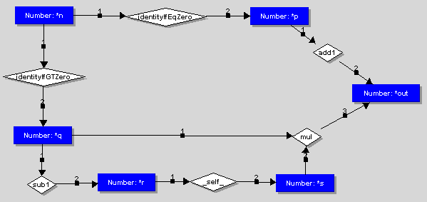
Results
An anonymous recursive actor:
_self_ refers to this defining graph
r = file (dir + "Factorial.CGF");
actor Factorial(n) is r.readGraph();
⇐ unnecessary

Slide 30
Some Future Directions
Conjunction of preconditions in a rule should be treated as a goal. Internal backtracking required, e.g. for Sisyphus-I constraint re: room sharing and project members.
Process constraints for real truth maintenance.
Conformity relation should be implemented.
Process algorithm needs to be reconciled with the CG Rules of Inference (Sowa, 1999); incorporate into pCG.
Aspects of process algorithm bear re-examination, e.g. stopping criteria, graph morphology, π efficiency.
Environment: IDE, Emacs mode.
Expts/Apps: invoking a process within a process, temporal logic, business processes.
Comparison against CLIPS, other CG mechanisms.

Slide 31
References
Delugach, H., Dynamic Assertion and Retraction of Conceptual Graphs, Proceedings of the 6th Annual Workshop on Conceptual Graphs, Eileen C. Way, editor, SUNY Binghampton, New York, pp. 15-26, July 1991.
Linster, M., Documentation for the Sisyphus-I Room Allocation Task, [Accessed Online: November 2000], URL: http://ksi.cpsc.ucalgary.ca/KAW/Sisyphus/Sisyphus1/
Mineau, G., From Actors to Processes: The Representation of Dynamic Knowledge Using Conceptual Graphs. In Proceedings of the 6th International Conference on Conceptual Structures, Montpellier, France, pp. 65–79, August 1998.
Sowa, J.F., Conceptual Structures: Information Processing in Mind and Machine, Addison-Wesley, 1984.
Sowa, J.F. et al, Conceptual Graph Standard, draft proposed American National Standard (dpANS) NCITS.T2/98-003, 1999. [Accessed Online: November 1999], URL: http://www.bestweb.net/~sowa/cg/cgdpansw.htm

