Slide 1
Progress Toward Implementing Conceptual Graph Processes
Coursework Masters Thesis
University of South Australia
School of Computer and Information Science
September 2000
Student: David Benn
Supervisor: Dan Corbett

Slide 2
Plan
The Idea
Motivations for Processes
Motivations for pCG
Work so far
pCG examples
Scope finalisation

Slide 3
The Idea
Addressing a lack in CST:
  CGs represent declarative information;
  By themselves they are insufficient for:
    doing computation;
    simulating events and processes to modify the description of a system.
  Some kind of truth maintenance engine is required, permitting assertion and retraction of graphs over time.
  Mineau’s CG Processes are one such approach.

Slide 4
The Idea
The key notions are:
  state transition based;
  knowledge-based precondition matching;
  postconditions modify Knowledge Base (KB) state via graph assertion and retraction; may incorporate information from matching;
  may parameterise pre/postcondition graphs;
  process p(in g1, out g2,...) is
{ r_{i} = pre_{i}, post_{i} Ž_{i}[1, n] }

Slide 5
Motivations for Processes
R&D project to capture knowledge about corporate processes, e.g. fabrication of windows [Gerbe´, Keller & Mineau 1998].
  Precondition of frame building: fabrication order;
  Postcondition of frame building: window frame;
  Precondition of window assembly: window frame;...
Dynamic KB updates based upon arbitrarily complex knowledge matching.
Temporal logic: p true in future, past.

Slide 6
Motivations for pCG
To prove (or not) that processes work!
  “…there is only a theory which needs to be refined, implemented, and applied.” (Mineau, 1999)
Make fundamental entities first class.
Embody Process engine.
Avoid becoming lost in the “trees”.
Demonstrate Mineau’s factorial example (Turing completeness) and move on.
Progress toward Mineau’s CPE.

Slide 7
Work so far: Literature Review
Executable CGs, e.g.
  Actors: individuals of particular concept types in and out (example coming up);
  Demons: retract & assert arbitrary concepts (e.g. wood to ashes); processes subsume these since concepts are singleton graphs;
  Other mechanisms for executing CGs.
CG-based tools: Synergy, Prolog+CG...
Petri Nets: process description and modelling; Sowa favours these.

Slide 8
Work so far: pCG
Interpreted, object-based, dynamically typed, lexically scoped, portable, easily extensible, few special constructs.
Types (objects): number, string, boolean, list, concept, graph, file.
Processes, actors, functions (first class).
Written using Java 2, ANTLR, Notio.
Tested under Linux, Solaris, Win98.

Slide 9
Work so far: pCG
pCG examples
Emphasis has been upon understanding Mineau’s Processes and getting the mechanism working.
Actual: actors, proposal’s while loop, Mineau’s iterative factorial, Blocks World.
Possible: Mineau’s recursive factorial, NLP, application to health informatics? Others from CG literature. What else?

Slide 10
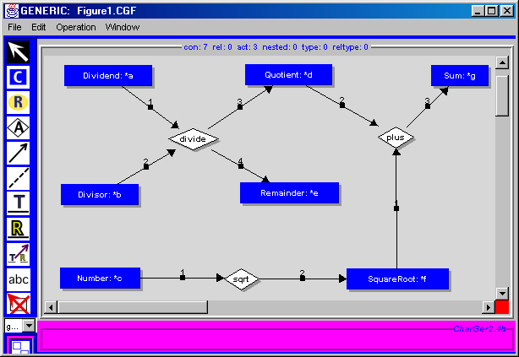
pCG example: actor

Slide 11
pCG example: actor
function plus(x,y,z)
operand1 = x.designator;
operand2 = y.designator;
if not (operand1 is number) or not (operand2 is number) then
exit "Operand to " + me.name + " not a number!";
end
z.designator = operand1 + operand2;
end
function divide(x,y,q,r)
q.designator = (x.designator / y.designator).round();
r.designator = x.designator mod y.designator;
end
function sqrt(x,y)
y.designator = (x.designator).sqrt();
end

Slide 12
pCG example: actor
f = file (dir + "Figure1.CGF");
actor Figure1(a,b,c) is f.readGraph();
println "Resulting graph for " + "Figure1(9,4,144) is:";
g = Figure1(9,4,144);
println g;
out_path = dir + "out.cgf";
f = file (">" + out_path);
f.writeln(g + "");
f.close();

Slide 13
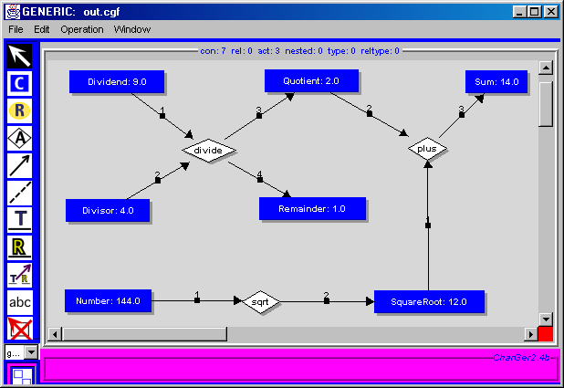
pCG example: actor

Slide 14
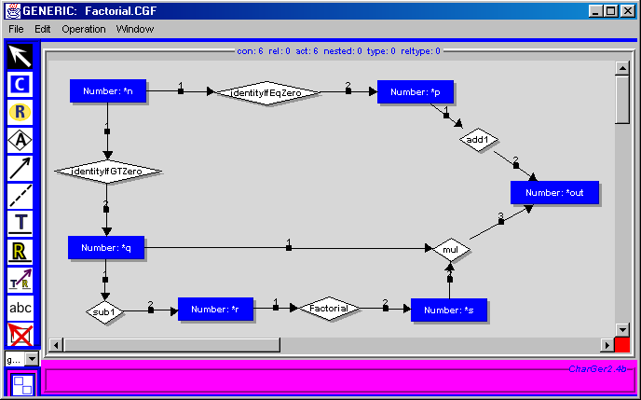
pCG example: actor

Slide 15
pCG example: actor
function mul(x,y,z)
operand1 = x.designator;
operand2 = y.designator;
if not (operand1 is number) or not (operand2 is number) then
exit "Operand to " + me.name + " not a number!";
end
z.designator = operand1 * operand2;
end
function identityIfGTZero(x,y)
operand = x.designator;
if not (operand is number) then
exit "Operand to " + me.name + " not a number!";
end
if operand > 0 then
y.designator = operand;
end
end

Slide 16
pCG example: actor
f = file (dir + "Factorial.CGF");
actor Factorial(n) is f.readGraph();
n = 7; // try making this a string
println Factorial(n);
f = file (">" + out_path);
f.writeln(g + ""); or
f.close();
g = r.readGraph();
foreach c in g.concepts do
if c.designator == "*n" then c.designator = 7; end
end
println activate g;

Slide 17
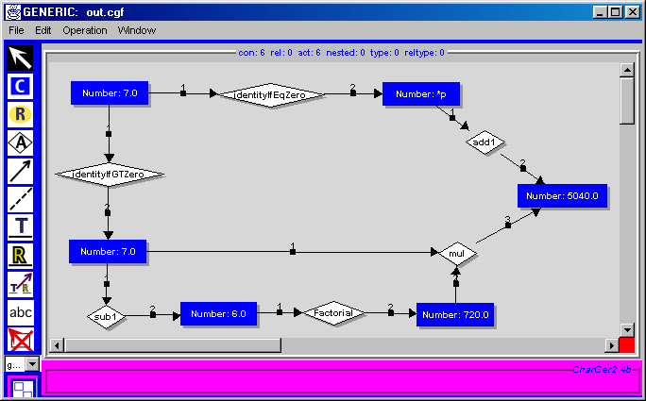
pCG example: actor

Slide 18
pCG example: process
The C code from [Mineau 1998]:
L0: int fact(int n)
L1: { int f;
L2: int i;
L3: f = 1;
L4: i = 2;
L5: while (i <= n)
L6: { f = f * i;
L7: i = i + 1;
L8: }
L9: return f; }

Slide 19
pCG example: process
n = 7;
varN = "[Integer:*a " + n + "][Variable:*b'#n'](val?b?a)";
assert varN.toGraph();
s = "[PROPOSITION:*a[Line:*b'#L0'](to_do?b)]" +
"[PROPOSITION:*c[Integer:'*result']]" +
"<fact?a|?c>";
g = s.toGraph();
println "Before process 'fact'. Graphs: " + _KB.graphs;
x = activate g;
println "After process 'fact'. Graphs: " + _KB.graphs;
Before process 'fact'.
Graphs: {[Integer:*a 7.0][Variable:*b'#n'](val?b?a)}
After process 'fact'.
Graphs: {[Integer:*a 7.0][Variable:*b'#n'](val?b?a),
[Integer: 5040.0]}

Slide 20
pCG example: process
process fact(in trigger, out result)
// L0: int fact(int n)
rule r1
pre
`[Integer:*a'*nValue'][Variable:*b'#n'](val?b?a)`;
`[Line:*a'#L0'](to_do?a)`;
end
post
`[NEGATION:[Line:*a'#L0'](to_do?a)]`;
`[PROPOSITION:[Line:*a'#L3'](to_do?a)]`;
end
end // rule r1
Negation vs Erasure

Slide 21
pCG example: process
// L3: f = 1;
rule r2
pre
`[Line:*a'#L3'](to_do?a)`;
end
post
`[PROPOSITION:[Integer:*a 1][Variable:*b'#f'](val?b?a)]`;
`[NEGATION:[Line:*a'#L3'](to_do?a)]`;
`[PROPOSITION:[Line:*a'#L4'](to_do?a)]`;
end
end // rule r2
Similar rule for setting value of variable i on line 4.

Slide 22
pCG example: process
// L5: while (i <= n) [false case]
rule r5
pre
`[Line:*a'#L5'](to_do?a)`;
`[Integer:*a'*iValue'][Variable:*b'#i']
[Integer:*c'*nValue'][Variable:*d'#n']
[Boolean:*e"false"]
(val?b?a)
(val?d?c)
<LTorEq?a?c|?e>`;
end
post
`[NEGATION:[Line:*a'#L5'](to_do?a)]`;
`[PROPOSITION:[Line:*a'#L9'](to_do?a)]`; // exit loop
end
end // rule r5

Slide 23
pCG example: process
// L6: { f = f * i;
rule r6
pre
`[Line:*a'#L6'](to_do?a)`;
`[Integer:*a'*fValue'][Variable:*b'#f']
[Integer:*c'*iValue'][Variable:*d'#i']
[Integer:*e'*product']
(val?b?a)
(val?d?c)
<Multiply?a?c|?e>`;
end
post
`[NEGATION:[Integer:*a'*fValue'][Variable:*b'#f'](val?b?a)]`;
`[PROPOSITION:[Integer:*a'*product'][Variable:*b'#f'](val?b?a)]`;
`[NEGATION:[Line:*a'#L6'](to_do?a)]`;
`[PROPOSITION:[Line:*a'#L7'](to_do?a)]`;
end
end // rule r6

Slide 24
pCG example: process
// L9: return f; }
rule r8
pre
`[Line:*a'#L9'](to_do?a)`;
`[Integer:*a'*result'][Variable:*b'#f'](val?b?a)`;
end
post
`[NEGATION:[Line:*a'#L9'](to_do?a)]`;
end
end // rule r8

Slide 25
Scope finalisation
Complete literature review
One or two interesting example programs
Improve pCG language and interpreter
Finish write-up of pCG and examples
Discuss results and suggest future work, e.g. KB consistency, IDE, LF
Final talk will provide: details of algorithms, major outcomes, other examples.

