Slide 1
JEAN DE LA FONTAINE NFT
Driss Bensaid - Zachary Gagnou - Sylvanie Duchelle Kepsu Tchahou - Alexandra Mille-Egea

Slide 2
Work REport
Introduction and context​
NLP script deployed for random fables
​Convert text into images
Smart contract
​Example of results

Slide 3
Most important link
Github: https://github.com/dbensaid/Nouvelles-Fables-Technologiques-NFT-
Where to buy our NFT: https://testnets.opensea.io/collection/ticket-event-t9gkqifqc3
​Mumbai actions: https://mumbai.polygonscan.com/address/0x7259B0AF918a902Fe4Bb8464546e8687A8B3834D

Slide 4




Introduction AND CONTEXT
The goal of this project is to launch our NFT project.
We decided to generate Jean de la Fontaine’ fables randomly through an NLP algorithm.
Concerning the context, the Fabre museum has put its hands on the last 100 fables of the famous Jean de Lafontaine. In order to respect the last words of this illustrious deceased, the Fabre Museum has decided to return them in NFT
We need the funds to launch this project, and with the buzz it has generated so far, we are confident of a return on investment

Slide 5
NLP script
To generate random fables

Slide 6
NLP script
We can use sequence models to write text.
• Learning from a text corpora from the author, a sequence model can perform predictions and output text that looks like it was written by this author (hopefully).
• N Grams are used to compute a probability for a sequence of n words to be one after the other. Based on this, we can predict the following word by looking at the higher probability for a word to after another.
So we just have to give the beginning of each verse, and see what happen !
About the dataset :
We created it by hand from this website, which collects every fables from Jean de la Fontaine. http://www.la-fontaine-ch-thierry.net/fables.htm#top

Slide 7
Text to images
To fables images NFT

Slide 8
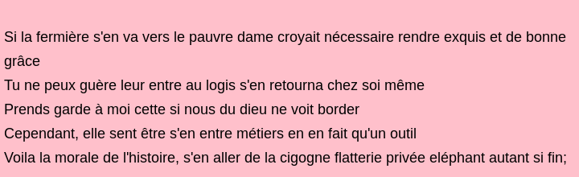
Text to images
We used this link and add some modifications to transform the text generated before in images (python).
First, we read the file where the raw text of the poems are
Next, we create a list of all poems. There are separated by a “;”
We convert each of them using the function textToImage() and export them as png files. We have created about 30 NFT !
Example of NFT result :
*A little code to generate a part of the meta-data associated to each picture/futur nft was also implemented in this step

Slide 9
Smart contract
To generate NFT

Slide 10
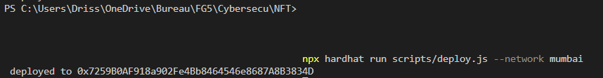
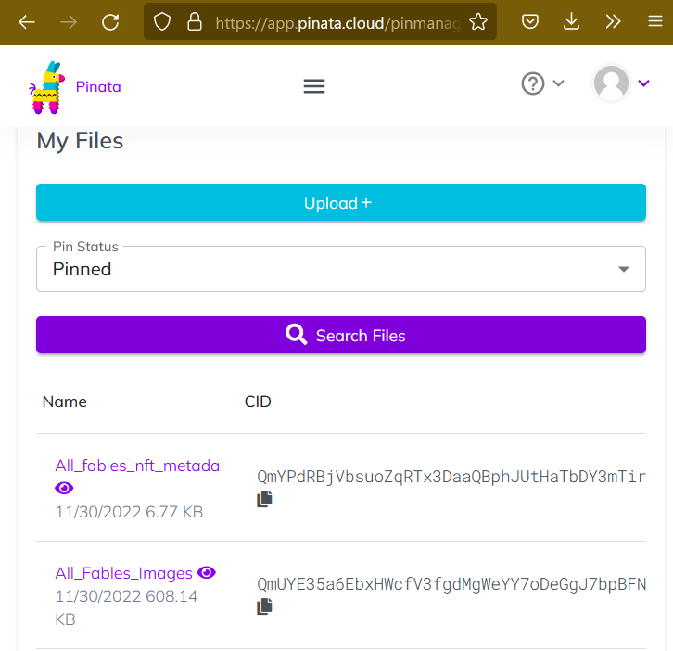
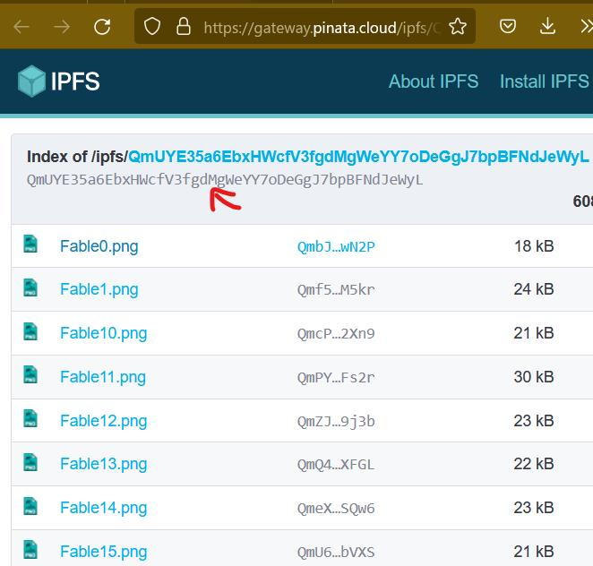
Smart contract
Create NFT with hardhat:
In this part we will no explain what has been done during the lab. For a further comprehension of the code look at this link:
https://capbloc.notion.site/Create-NFT-with-hardhat-9a20a10237924d518597656cad8de7b0
Thus we will show through screenshot the principals steps of our project for the smart contract used to implement our nft in the blockchain:
1-Smart contract genaration to connect with the bloc chains:
2 - Creation of a folder with all the fables pictures injected in pinata (https://app.pinata.cloud/pinmanager)
Thus for each picture we will have a TOKENURI

Slide 11
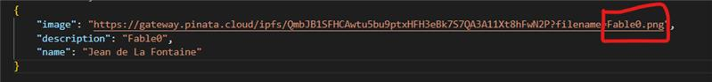
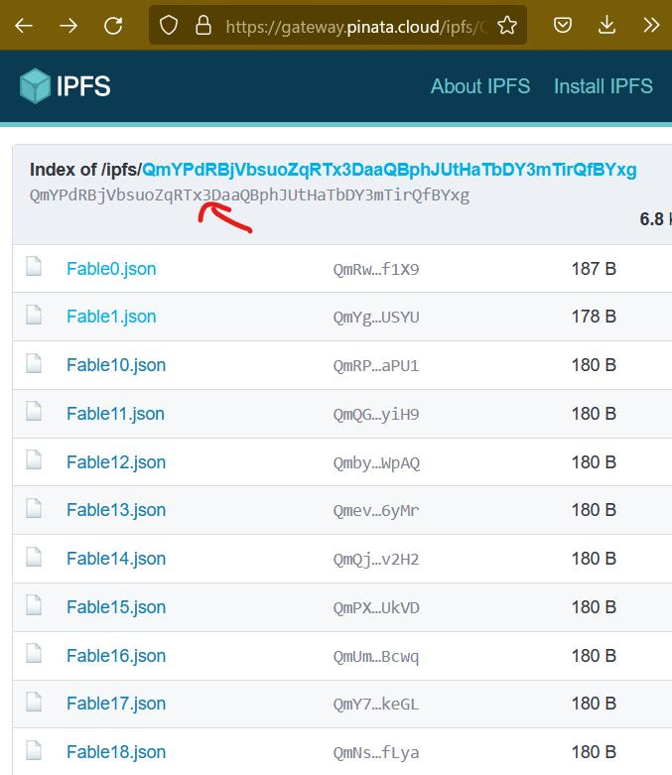
Smart contract
3 – Use the TOKENURI picture retrieve from pinata and insert it as an image link in the metadata json file (the adventage of having inserted a folder on pinata before allowed us to only change the end of the link/tokenuri)
4- Insert all the metadata on pinata like was done for the pictures before.

Slide 12
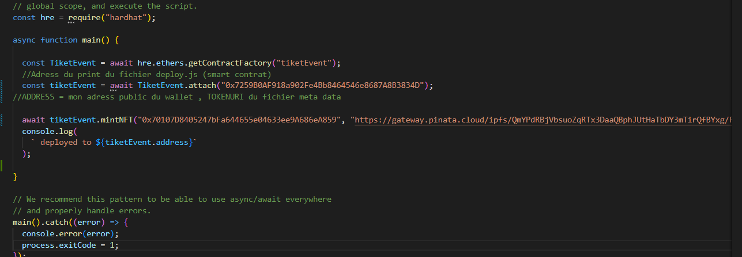
Smart contract
5 – Change the mint file by inserting (in the order) :
- The smart contract adress (printed during the deploy)
- Public wallet adress retrieved from my metamask account
-The metada Tokenuri retrieved from pinata
4- Insert all the metadata on pinata like was done for the pictures before.
6- Mint the NFT

Slide 13
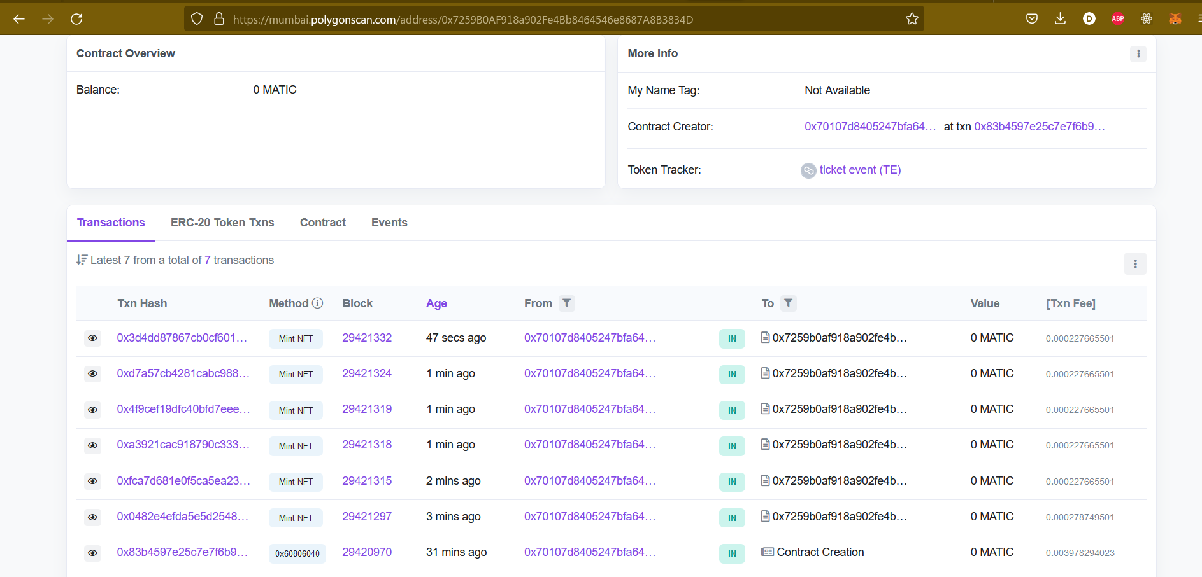
Smart contract
7 – The creation of the smart contract and all the nft minted can be seen in https://mumbai.polygonscan.com/address/0x7259B0AF918a902Fe4Bb8464546e8687A8B3834D
8- We can see all our NFT on https://testnets.opensea.io/collection/ticket-event-t9gkqifqc3

Slide 14
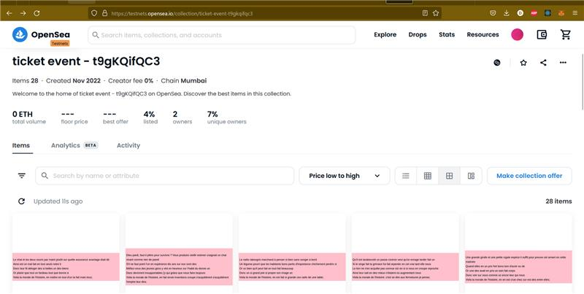
Smart contract
8- We can see all our NFT on https://testnets.opensea.io/collection/ticket-event-t9gkqifqc38a902Fe4Bb8464546e8687A8B3834D

Slide 15
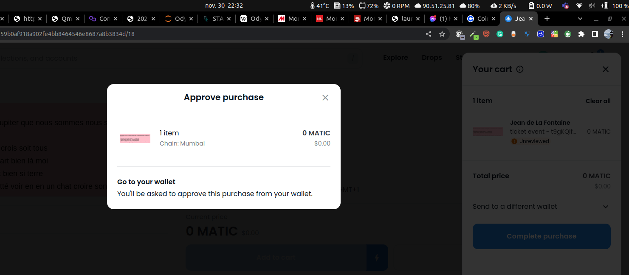
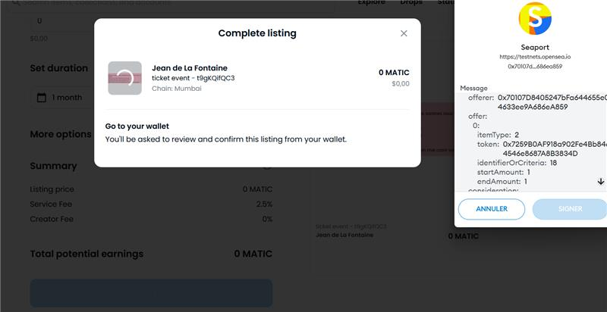
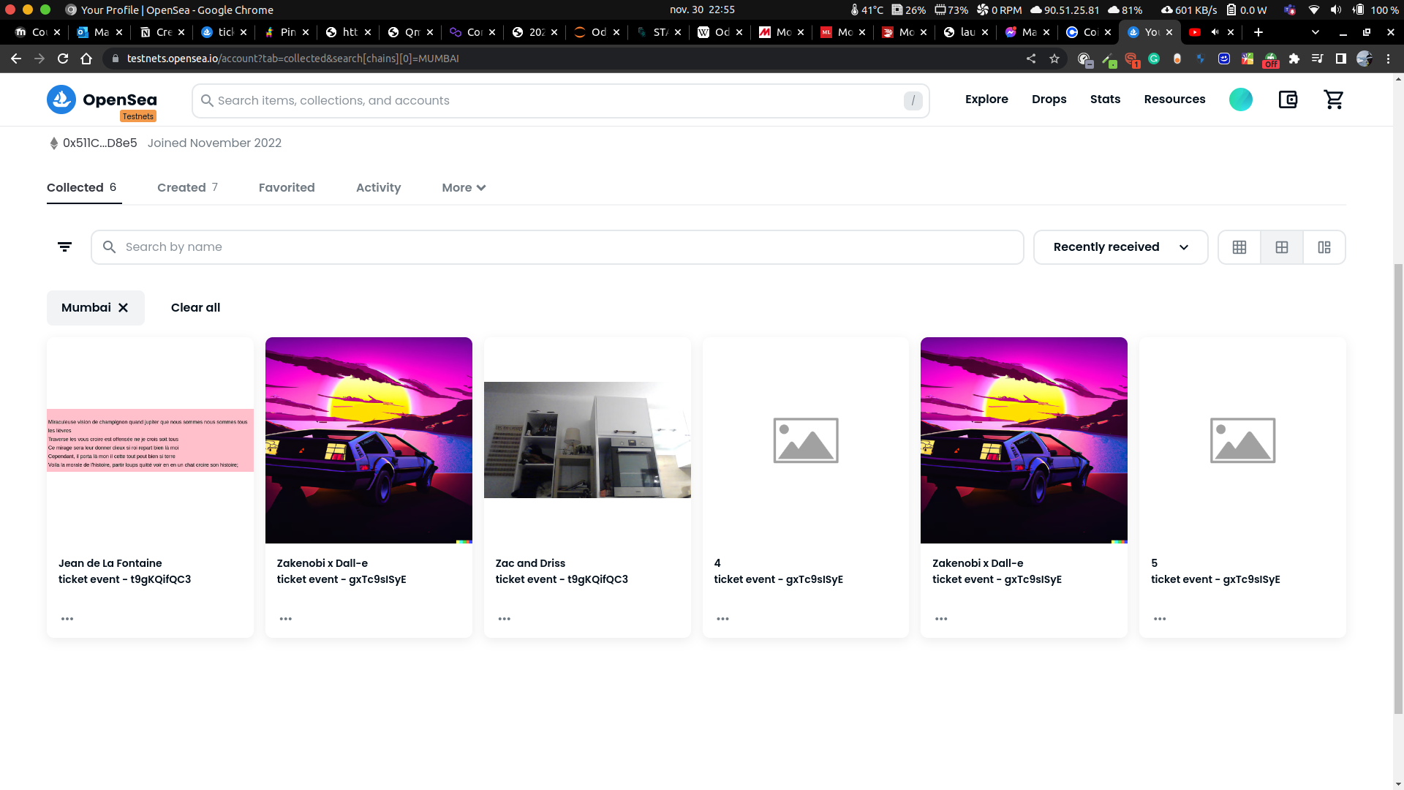
Smart contract
9- Bonus Sell/buy the NFT
Selling with the wallet used in the mint
Buying with another account

Slide 16
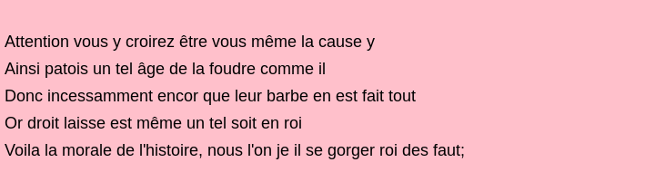
Examples of results

Slide 17
BUSINESS OPPORTUNITIES ARE LIKE BUSES. THERE'S ALWAYS ANOTHER ONE COMING.
“
”
Richard Branson

Slide 18





PLAN FOR PRODUCT LAUNCH
PLANNING
MARKETING
DESIGN
STRATEGY
LAUNCH
Synergize scalable e-commerce
Disseminate standardized metrics
Coordinate e- business applications
Foster holistically superior methodologies
Deploy strategic networks with compelling e- business needs

Slide 19
TIMELINE
SEP 20XX
NOV 20XX
JAN 20XX
MAR 20XX
MAY 20XX
Synergize scalable e-commerce
Disseminate standardized metrics
Coordinate e- business applications
Foster holistically superior methodologies
Deploy strategic networks with compelling e- business needs

Slide 20
AREAS OF FOCUS
B2B MARKET SCENARIOS
CLOUD-BASED OPPORTUNITIES
Develop winning strategies to keep ahead of the competition
Capitalize on low-hanging fruit to identify a ballpark value
Visualize customer directed convergence
Iterative approaches to corporate strategy
Establish a management framework from the inside

Slide 21



HOW WE GET THERE
ROI
NICHE MARKETS
SUPPLY CHAINS
Envision multimedia-based expertise and cross-media growth strategies
Visualize quality intellectual capital
Engage worldwide methodologies with web-enabled technologies
Pursue scalable customer service through sustainable strategies
Engage top-line web services with cutting-edge deliverables
Cultivate one-to-one customer service with robust ideas
Maximize timely deliverables for real-time schemas

Slide 22
SUMMARY
At Contoso, we believe in giving 110%. By using our next-generation data architecture, we help organizations virtually manage agile workflows. We thrive because of our market knowledge and great team behind our product. As our CEO says, "Efficiencies will come from proactively transforming how we do business."

Slide 23
THANK YOU
Mirjam Nilsson​
mirjam@contoso.com
www.contoso.com

