Slide 1
Some Lessons I Have Learned
… or …
“That's Life”
Daniel Berleant, June 20, 2011, University of Central Arkansas

Slide 2
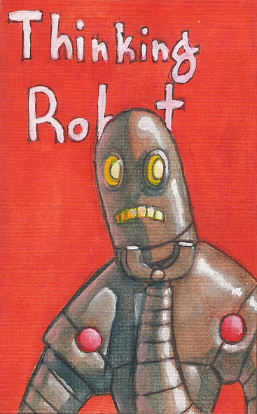

A Few Words About
My Research
Wouldn't it be cool to make machines think??!
  So, I pursued AI for my dissertation
Image by Kyle Galbraith, http://www.elfwood.com/~kbriggs/Thinking-Robot.3512714.html
Image: http://www.rocksandrobots.com/files/uploads/RobotIcon.jpg

Slide 3
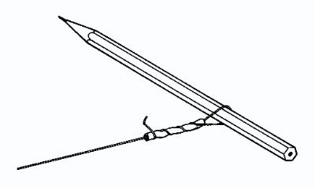
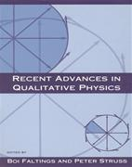
The Excitement of AI
My AI work was in “Qualitative Physics”
  It was interesting, it got me a Ph.D., but...
    I learned little about how machines could think!
Image: http://www.practicalphysics.org/go/Experiment_214.html

Slide 4
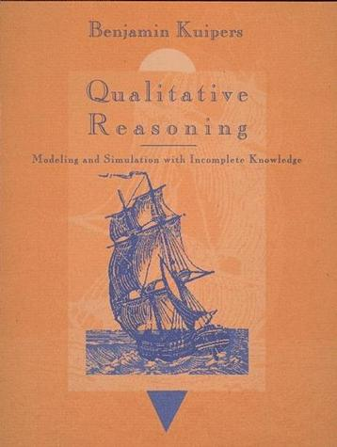
My Advisor Wrote this Book

Slide 5
Lesson #1: Share Authorship With Your Students
When possible I put my students' names first
Does this make my cv look worse?
  L. Zhang*, D. Berleant, J. Ding, T. Cao, and E. S. Wurtele, “PathBinder - text empirics and automatic extraction of biomolecular interactions,” BMC Bioinformatics, 10(suppl 11)(2009):S18, doi:10.1186/1471-2105-10-S11-S18.
How about now?
- Publications and other products (“ * ” indicates student author)
In fact it makes my cv look better!

Slide 6
As a New Assistant Professor, AI was Hard to Work On
Luckily, I branched out
  Text mining got my first research grant
    ...and colleagues that I still communicate with
  Interval-valued probability
    ...this tied into a very welcoming community
    Life is a lot more fun when people are encouraging you!

Slide 7

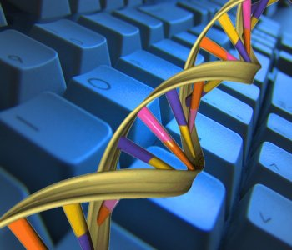
Lesson #2: Sniff Out the Opportunities
Text mining:
  Important in the early '90s
    ...but a lot of people didn't realize it
  Mid '90s – the Web was invented
    ...suddenly, text mining heaven!
  Late '90s – mining biomedical texts ramps up
    ...an opportunity to join the bioinformatics field
Source: http://cores.montana.edu/index.php?page=bioinformatics-core-facility

Slide 8
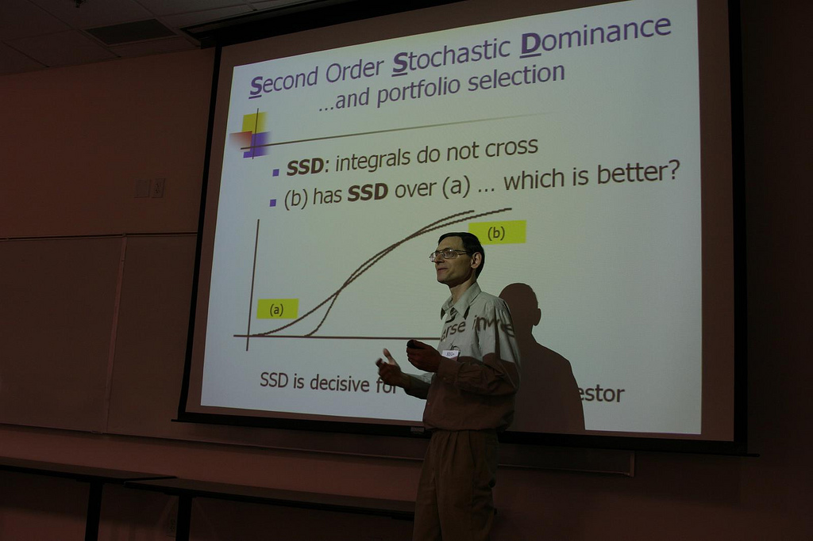
Lesson #3: Find Applications
(even though it's not easy)
Interval-valued probability:
  Develop the theory
  Find an application
  Application demands new theory
  Repeat!

Slide 9
Text Mining and Probability Intervals...isn't that too much?
You can't do everything
In most cases, focusing on one field yields the most progress and career success
But it's risky!
  You “put all your eggs in one basket”
1 ½ fields can be better in some cases
But trying to do 2+ is probably a bit too much
And now I am trying to do technology foresight...
  Why ??!

Slide 10
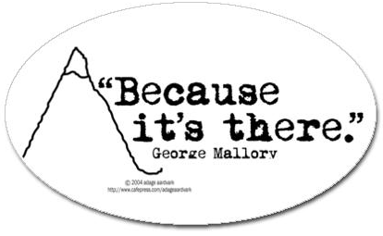
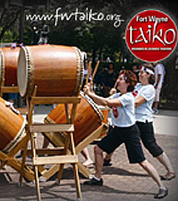
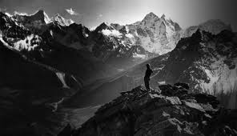
Lesson #4: Know Your Drummer
Some people “follow the beat of a different drummer”
If 2+ fields is too much...why do it?
http://www.cafepress.com/+because_its_there_sticker_oval,18626298
http://www.rolex.com/en#/rolex-watches/explorerii/sir-edmund-hillary
ipfw.edu/news/print-size-image.html?imgURI=/dotAsset/240216.jpg

Slide 11
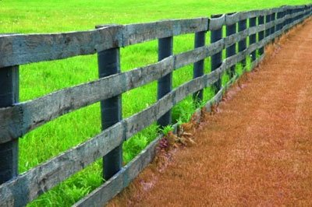
Lesson #5: The Grass is
Always Greener on the
Other Side of the Fence
“If only I had done that instead of this, life would have been so much better” *sob*
  Well, maybe...but maybe not! (what was that movie?)
http://blog.sagar.org/archives/2008_05_01_ukdiveboy_archive.html

Slide 12
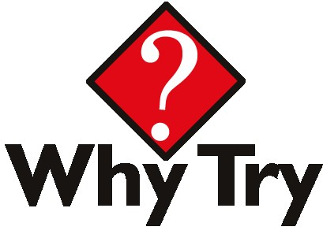

Lesson #6: If You Don't ____, then You Won't ____
http://www.communicationultd.com/product_images/e/687/why-try__86870_zoom.jpg
https://www.ocps.net/cs/services/student/SSHS/Pages/WhyTry.aspx
Because...
  If you don't work on important problems, you won't get important results
  If you don't write grant applications, you won't get any funds
  If you don't ask, you won't get, etc.

Slide 13
Lesson #7: There is Good Luck, and Bad Luck...You'll Get Both
I have a one-off paper in a 3rd-rate conference that is well-cited
  Someone referenced it in a wikipedia article
My “best” papers have sometimes been cited few or no times
  Aaaargh!!
I have an IEEE Computer Society “Top Ten” paper that has been cited only once
  What does that mean??!

Slide 14
Have a Great Day!

Slide 15
For another time: collaboration; Milankovitch approach to choosing the right question

