Slide 1

The PathBinder Project
Dan Berleant (Electrical and Computer Engineering, ISU)
Jing Ding, M.S. (Toxicology, ISU) and M.S. candidate
(Electrical and Computer Engineering, ISU)
with acknowledgements to…
Dan Ashlock (Math, ISU)
Julie Dickerson (Electrical and Computer Engineering, ISU)
Andy Fulmer (Procter and Gamble Corp.)
Wenxin Qi, M.S. candidate
(Electrical and Computer Engineering, ISU)
Eve Wurtele (Botany, ISU)

Slide 2
What is PathBinder?
A repository of sentences…
  containing 2 protein names
  heirarchically browsable (like Yahoo)
  mined from “all” of MEDLINE
  with a protein synonym list
    (mined mostly from SwissProt)
  …a work in progress

Slide 3
Status
Goal: a static Web directory of mined sentences
  Should have all relevant sentences in MEDLINE
  Should have Yahoo-style drill-down browsing
  Given 2 biochemicals, user obtains list of…
    …all sentences containing both biochemicals
  Click sentence to get abstract from external source
Current size is 11 GBytes
URL is www.vrac.iastate.edu/~berleant/MedRep

Slide 4
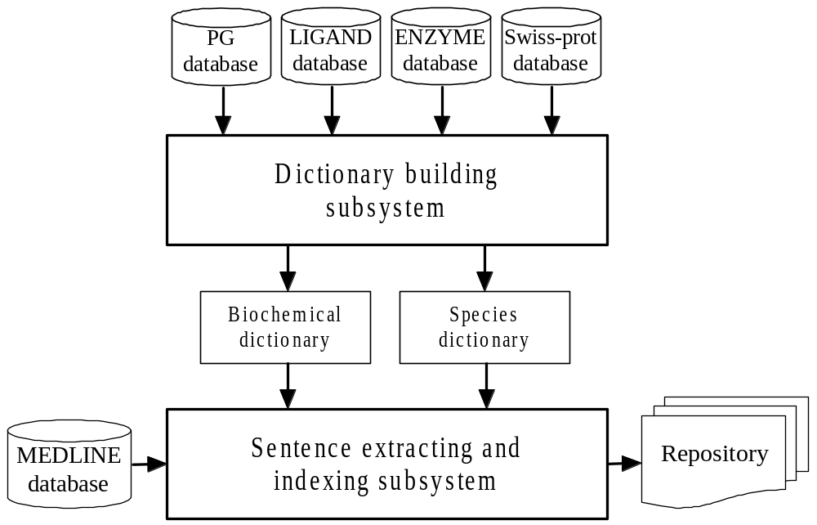
Building PathBinder

Slide 5
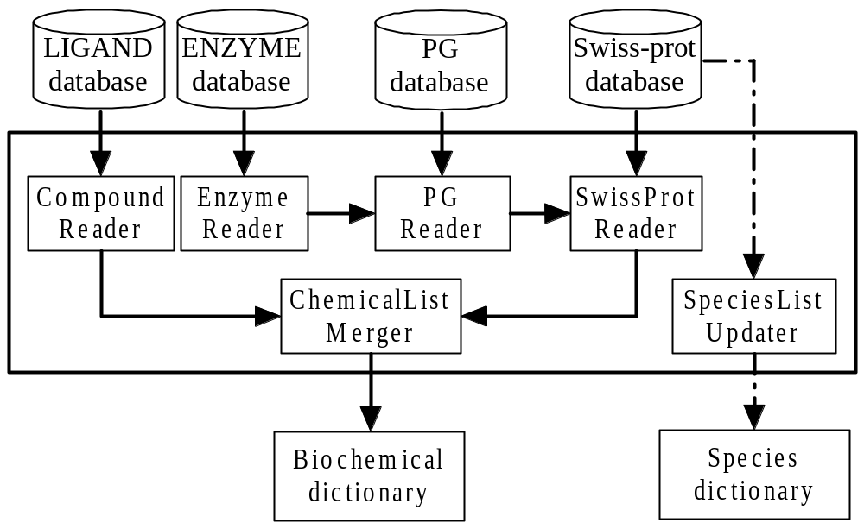
Building the Dictionary

Slide 6
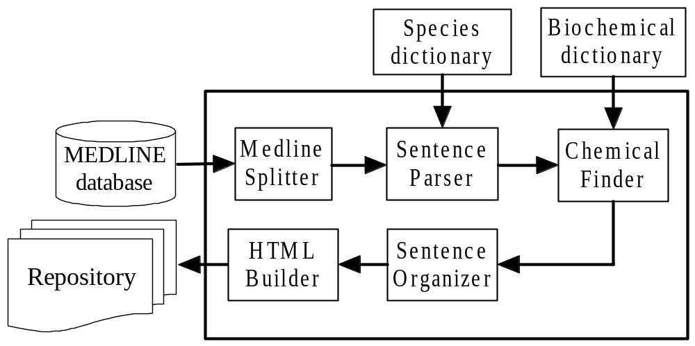
Building the Sentence Repository

Slide 7
Demo

Slide 8
Phrases, Sentences or Abstracts? An investigation
What text unit is best for interaction extraction?
Information retrieval metrics were used:
  Precision, Recall, and Effectiveness
Phrases win on precision
Abstracts win on recall
Sentences win on effectiveness
Paper presented at PSB 2002

Slide 9
Why not Phrases?
If focus is on precision, phrases are better
A phrase version of PathBinder:
  Straightforward to mine from current version
  Delete sentence co-occurrences that are not also phrase co-occurences
PathBinder could also be converted to other forms as well

Slide 10
Distances and Patterns: an Investigation
Two biochemical terms in a sentence…
  …may or may not interact
We found that probability of interaction
  …is affected by
    how near/distant the terms are
    presence, location of relevant verb(s)
Paper is currently under revision
PathBinder could be annotated accordingly

Slide 11
Verbs: an Investigation
Certain words (usually verbs)
  Are used to indicate interactions
  Some words are better indicators than others
We call these words interactors
  (because they are not always verbs)
We have raw data on relative abilities of different words to indicate interactions
  We plan to analyze the data
PathBinder could be updated accordingly

Slide 12
PathBinder: Future Paths
Making a phrase repository
  (in IR terms we get higher precision, lower recall)
Mining out subsets
  (e.g. based on species, interaction, precision, etc.)
Transforming into database format
  (for use by pathway simulating systems, etc.)
Make available as an online literature search tool
  (more efficient searches = more efficient research)
Add ontology component
  (UCP1 is a UCP; raspberry is a bramble)
Annotate sentences with their quality
  (Easier lit. searches, more accurate simulation)

Slide 13
PathBinder: Future Paths II
Mine repository for paths and path reliabilities
  (If A activates B and B inhibits C, A inhibits C)
Add more vocabulary to extraction dictionary
  (Pull more relevant passages from MEDLINE)
Integrate Agricola and other repositories
  (Make PathBinder a more comprehensive repository)
Incorporate parsing, lexical bundle analysis, etc.
  (Account for more than just word presence)
. . .

Slide 14
Research Strategies
Focus on problems defined by the bioinformatic text processing field
Apply to needs of other areas – those problems help motivate advances in bioinformatic text processing

Slide 15
Questions?

Slide 16
Discussion Item
How might PathBinder, text processing in general, synergize with other ISU efforts?

Slide 17
(Optional Slide #1)
Let’s get acquainted…
  Briefly explain to a neighbor a research interest
  Listen to your neighbor’s research interest
  If you don’t know his/her name, get that too
  Feel free to change seats to find someone you don’t already know
We’ll each introduce our neighbor and the neighbor’s interest

