Slide 1
The Future of
Computing-Inspired Biotechnology
...or is that...
Biotechnology-Inspired Computing
?
by Daniel Berleant, Ph.D., Dept. of Information Science, University of Arkansas at Little Rock
for the Summer REU program, University of Central Arkansas, June 6, 2012

Slide 2
Brief Personal Background
My training is in computer science...
...specializing in artificial intelligence
Research interests include...
...bioinformatics:
mining the biomedical bibliome
extracting biomolecular interactions
inference under uncertainty
technology foresight
Disclaimer: not a biologist, so I admire and collaborate with them. Usually, this is fun!

Slide 3
Sources of this talk
Based in part on an inspiring lecture by
  Andrew Hessel at Singularity University*
Based in part on my manuscript
  The Human Race to the Future
    Unpublished so far (but ask me for the free half!)
Based in part on my research collaborations
*http://singularityu.org/synthetic-biology-executive-program-december-2011/

Slide 4
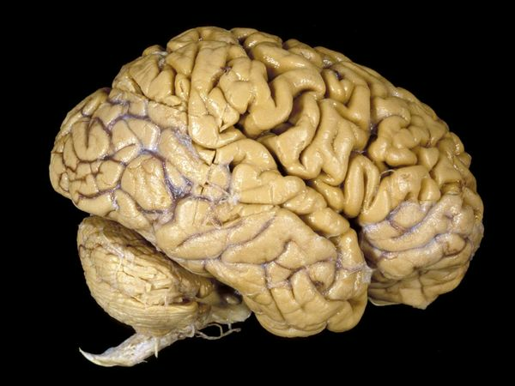
The Most Powerful Computer
The brain!
  But it's a blob of meat
    Digital computers are improving fast
      (E.g. Moore's Law)
    Meat improvement is limited in speed
      But genetic engineering is improving fast
Source: http://science.nationalgeographic.com/science/photos/brain/

Slide 5
Are brains in jeopardy?
It took nature 4.54 billion years to produce...
  Champion Jeopardy! players
    Ken Jennings and Brad Rutter
It took under 4.54 hundred years to produce...
  IBM's Watson system
    ...which beat Jennings and Rutter, Feb. 16, 2011
That's a >10,000,000-fold speedup factor
Will genetic engineering change brains as we know them?

Slide 6
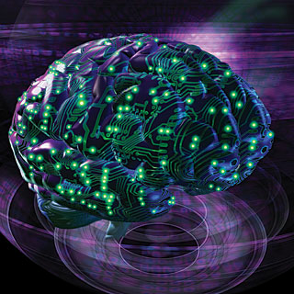
Is the Human Brain a Computer?
What do you think?
Source: http://biomechanism.com/implanted-neurons-grown-in-the-lab-take-charge-of-brain-circuitry/

Slide 7
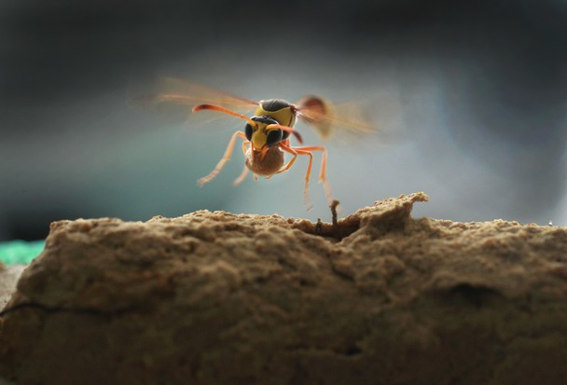
The Sting of Truth
A true story
  We have wasps (which can sting!)
  Our wasps make mud chambers
    These require many trips to make
      What's in the chambers?
      Why would a wasp hover motionless...
        twice?
Source: http://ngm.nationalgeographic.com/ngm/photo-contest/2011/entries/115835/view/

Slide 8
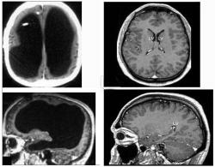
Is the Wasp Brain a Computer?
Source: http://www.topnews.in/tiny-wasp-brains-display-amazing-adaptability-2224891

Slide 9
The Most Advanced Life Form
Which life form is the most advanced?
  A. Humans
  B. Wasps
  C. Creosote bushes
  D. Bacteria

Slide 10
The Most Advanced Life Form
Which life form is the most advanced?
  A. Humans
  B. Wasps
  C. Creosote bushes
  D. Bacteria
To illustrate, let's build a cladogram...

Slide 11
Some Interesting Facts
Bacteria are the most advanced...
  ...in terms of streamlined, no-frills, simple-is-better efficiency
Humans are the most advanced...
  ...in terms of intelligence
Creosote bushes are the most advanced...
  ...in terms of life span (up to 11,700 yrs)
  ...howeve Turritopsis nutricula may live forever
Lions...etc.

Slide 12
Re-engineering genomes (i)
(What is a genome?)
Humans have long, complicated ones
  Hard to modify (ethics issues too)
  3 billion base pairs
Many plants & animals have even more
Bacterial genomes
  Short...elegant...highly refined!
  Most genomes under 10 million bp

Slide 13
Re-engineering genomes (ii)
Bacterial genomes are...
  short...elegant...highly refined
Computer programmers prefer that
  easier to modify as desired!
Whoa!
  What's with the leap from
    genomes to
    programming?!

Slide 14
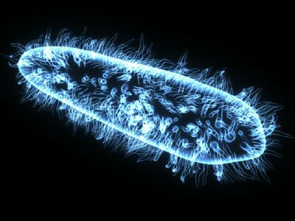
Bacteria and Computers
Is the human brain a computer?
Is the wasp brain a computer?
Is a bacterium a computer?
Source: http://www.adobelibrary.org/archive/Today-08-Sept.html

Slide 15
Bacteria as Computers
Bacteria don't have brains
  but...
They run software
  Let's squash a bacterium and see the software that pops out...

Slide 16
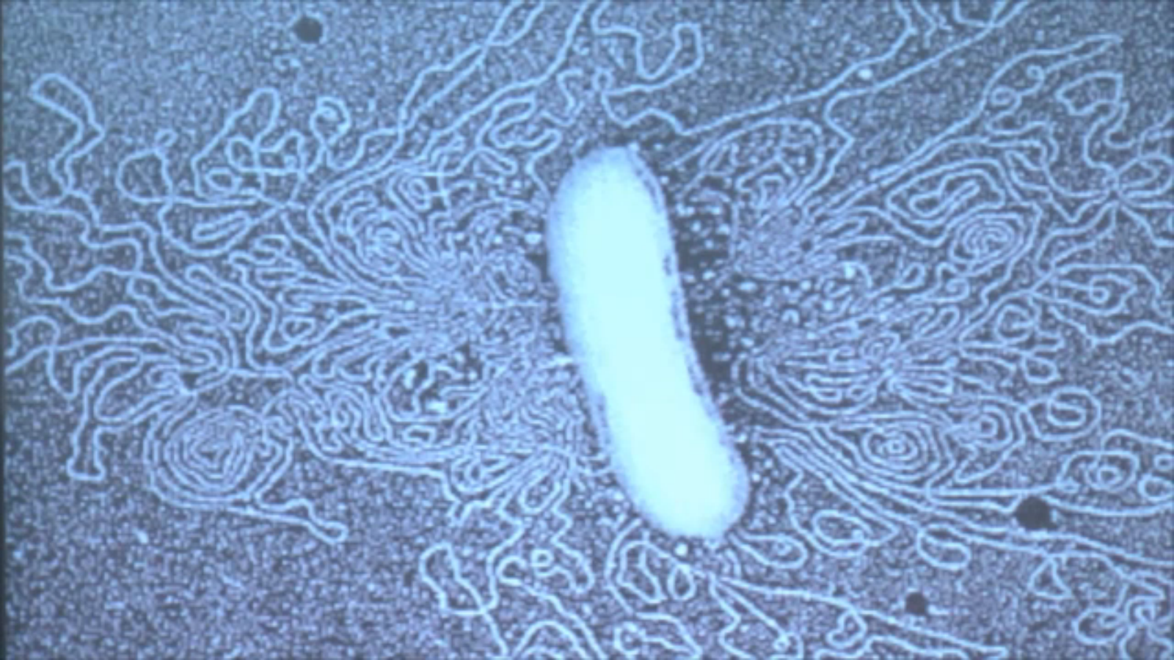
DNA !
Source: e.g. singularityu.org/synthetic-biology-executive-program-december-2011, 6:18

Slide 17
Bacteria as Computers (cont.)
Bacteria receive & process input signals
They determine & produce output actions
They do it with a hardware platform
  (the cell)
...running software
  (the genome)

Slide 18
More on the bacteria/computer analogy
Electronic components – proteins
Logic gates – biomolecular interactions
Genome – operating system code
Transcription – run time environment
Bacterium (or any cell) – computer
Tissue – network
Body – digital ecosystem
Do you agree?

Slide 19
Bacteria/computer analogy, more notes
Cells as self-replicating robots
  Way farther along than today's digital robots
    Is there a trend?
Cells as miniaturized robots
  Again, way farther along
    Miniaturization clearly a trend
Bacteria are especially well-designed cells

Slide 20
The point is...
The genome is software
  The language is the genetic code
  We'd like to program in that language!
Result:
  Design and synthesize new bacteria
  (Easier: modify existing bacteria)
  Why?
  Bacteria are just a start!

Slide 21
To program life we must be able to...
1. Read DNA sequences
2. Design DNA sequences
3. Write DNA sequences

Slide 22
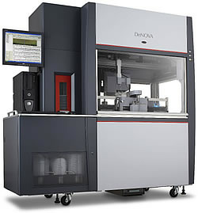
Read, Design & Write
1. Read DNA sequences
  This is abbreviated as just "sequencing"
    "second generation sequencing technology"
    "the Human Genome Sequencing Project"
    "DNA sequencing instrument“
    "DNA sequencer"
    etc.
2. Design DNA sequences
3. Write DNA sequences
Source: http://www.shimadzu.com/pharma/sequence/denova.html

Slide 23
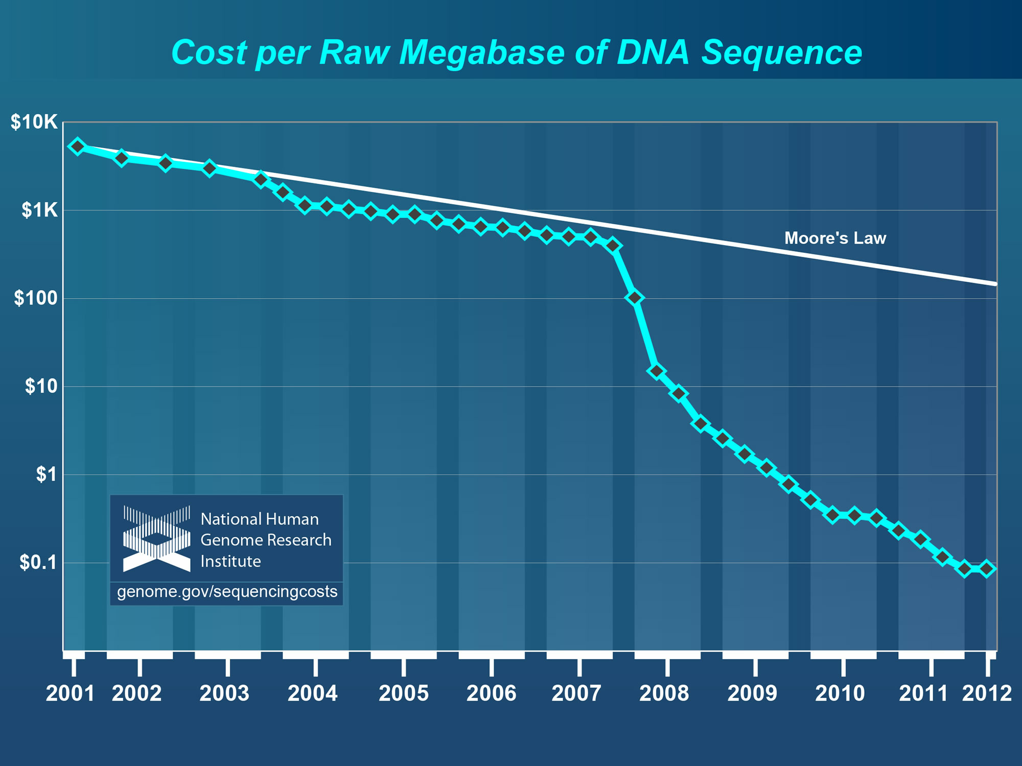
1. Reading DNA

Slide 24
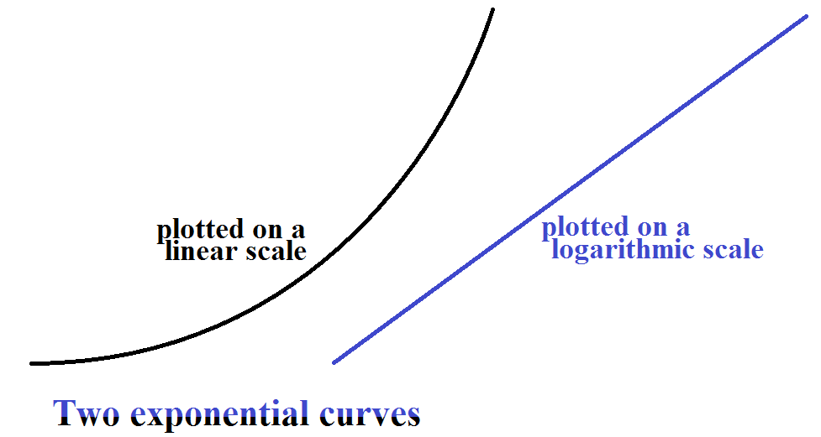
Logarithmic vs. linear plots

Slide 25
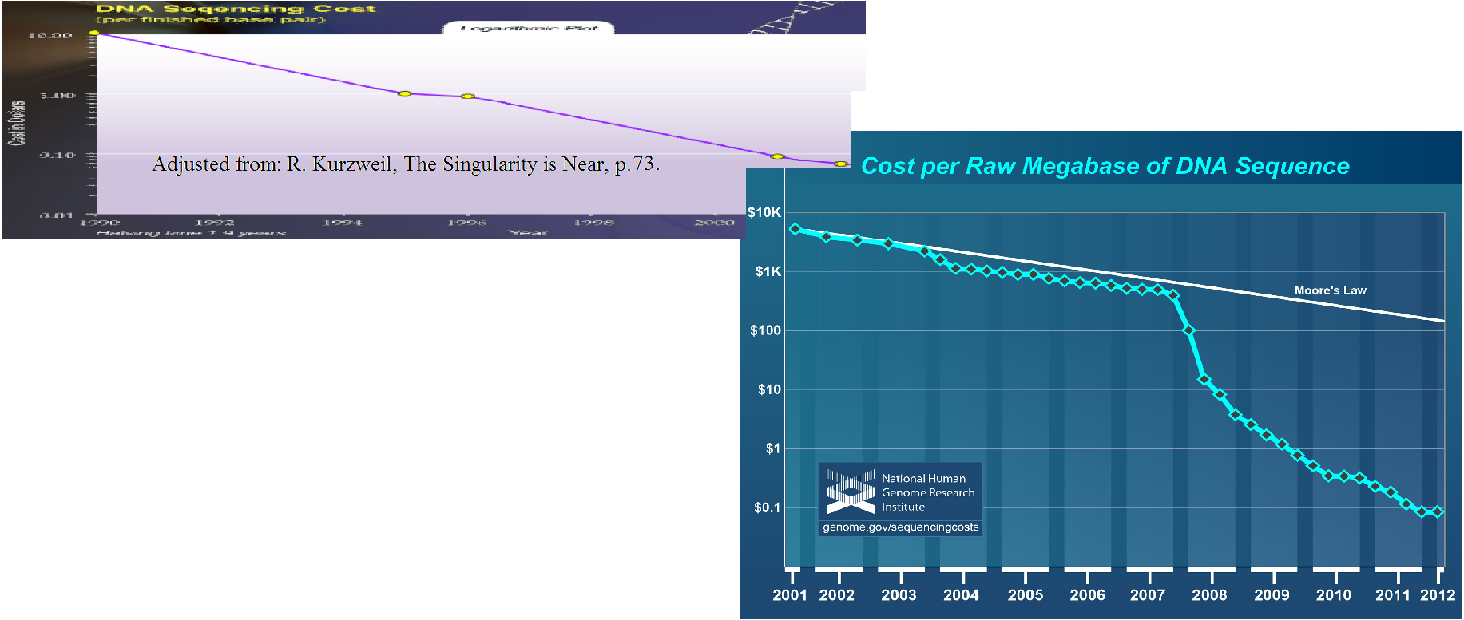
(1990-2012)
1990

Slide 26
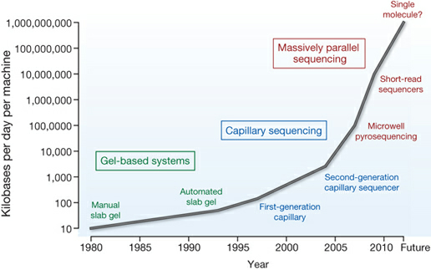
Sequencing technology shifts
Source: http://www.wellcome.ac.uk/Education-resources/Teaching-and-education/Big-Picture/All-issues/Genes-Genomes-and-Health/WTDV027167.htm

Slide 27
Sequencing technology shifts (ii)
Google (5/30/12):
"first generation sequencing"
340,000 hits
"second generation sequencing"
267,000 hits
"third generation sequencing"
115,000 hits
"fourth generation sequencing"
47,500 hits
"fifth generation sequencing"
1 hit
Source: http://www.wellcome.ac.uk/Education-resources/Teaching-and-education/Big-Picture/All-issues/Genes-Genomes-and-Health/WTDV027167.htm
See e.g. TP Niedringhaus et al., Landscape of Next-Generation Sequencing
Technologies, Analytical Chemistry, 2011, 83, 4327–4341.

Slide 28
3. Writing DNA
1. Read DNA sequences
  √ discussed
2. Design DNA sequences
  will discuss soon
3. Write DNA sequences
  next

Slide 29
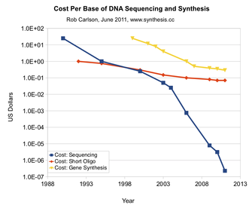
3. Writing DNA
Writing is the inverse of reading
Conjecture:
3 curves have the same shape
Then what will happen?
Source: http://www.synthesis.cc/2011/06/new-cost-curves.html

Slide 30
Writing DNA
Here is the old-fashioned,
expensive way to write DNA...

Slide 31
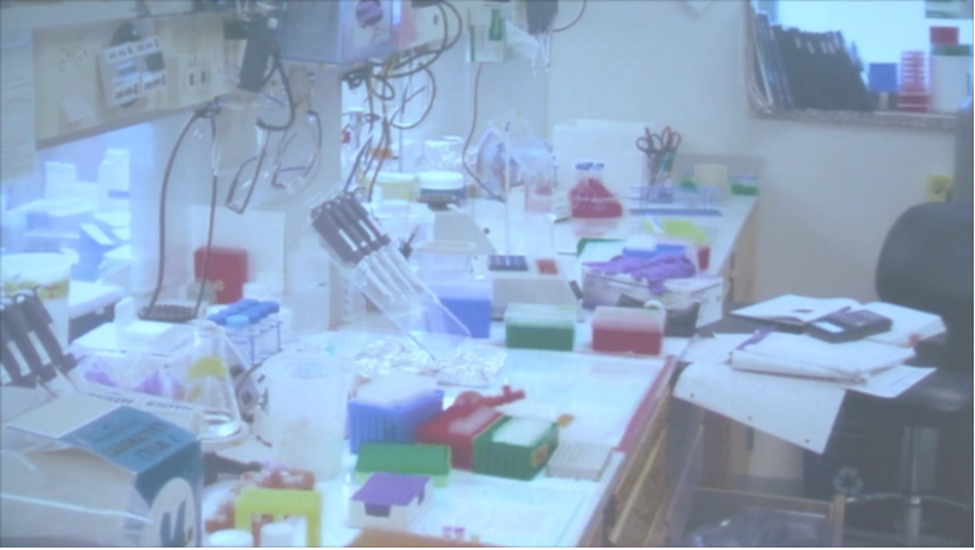
3. Writing DNA
Source: http://singularityu.org/synthetic-biology-executive-program-december-2011/ 13:56

Slide 32
Writing DNA
Here is the new-fangled,
much cheaper approach

Slide 33

Mail order sequences with a web browser and credit card!
E.g.
(Disclaimer: I consulted for this company, but there are others. I like IDT personally but do not endorse any particular company.)

Slide 34
Writing DNA
DNA sequence manufacturing
Short sequences are called oligonucleotides
  "Oligos" for short
Oligos are used by the pharmaceutical industry
Imagine a huge open floor, with
row after row of person-sized machines,
fed by tubes to chemical vats.

Slide 35
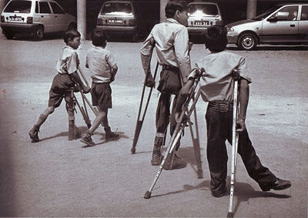
Synthesizing Polio
1st genome to be written
Took about
  2 years,
  $500,000
  7,500 bp
    Why so small? It is a virus
Source: http://www.takegreatpictures.com/photo-tips/photo-book-reviews/i-the-end-of-polio-global-effort-to-end-a-disease-i-by-sebasti-227-o-salgado-essay-by-siddharth-dube

Slide 36
Polio II
The polio genome was ordered from IDT
  But IDT didn't know it
  It was ordered in pieces
    Researchers stuck them together
Big question:
  Why did IDT not wonder why they were sending DNA to an Al Qaeda-controlled area of Waziristan?!

Slide 37
Polio III
  Why did IDT not wonder why they were sending DNA to an Al Qaeda-controlled area of Waziristan?!
Ok, I was just kidding about that
  The DNA was actually sent to
    Stony Brook University (in NY)
    Research was DoD funded
But...what if...some day...

Slide 38

Polio IV
"Dr. Eckard Wimmer, professor of molecular genetics and microbiology at Stony Brook and leader of the project, said they made the virus to send a warning that terrorists might be able to make biological weapons without obtaining a natural virus."
  A. Pollock, "Traces of terror: the science; scientists create a live polio virus," New York Times, July 12, 2002, http://www.nytimes.com/2002/07/12/us/traces-of-terror-the-science-scientists-create-a-live-polio-virus.html

Slide 39
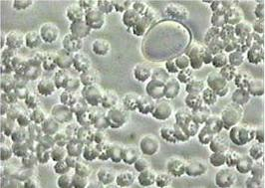
Synthesizing Mycoplasma
Mycoplasma is a genus of bacteria
More challenging than polio virus:
  Must be implanted into a cell
  Genome size = 1 mbase, + or -
    size depends on species
Can cause pneumonia and other things
Source: http://bigfigure.blogspot.com/2010/07/mycoplasma-infection.html

Slide 40
Mycoplasma II
2010: Venter & Smith
  wrote the genome of one species
  stuffed it into a cell
  the cell lived and replicated
Scary?
Wider implications of this
  Humankind can no longer permanently destroy disease organisms that have been sequenced

Slide 41
Writing: the future
We should record (i.e., read) genomes of endangered species
  Some day we could recreate them
    (maybe)
Could there really be a Jurassic Park?
  How about a Pleistocene Park?
    (Mammoths, giant sloths, glyptodonts...)

Slide 42
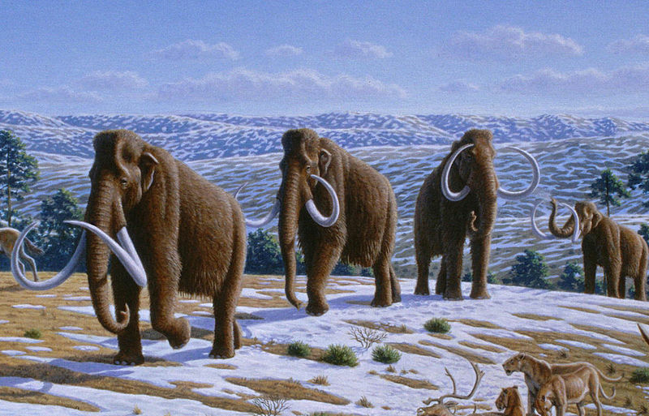
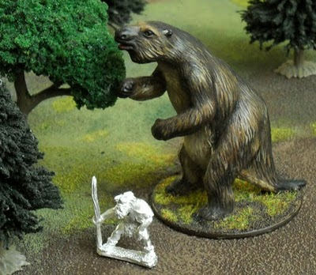
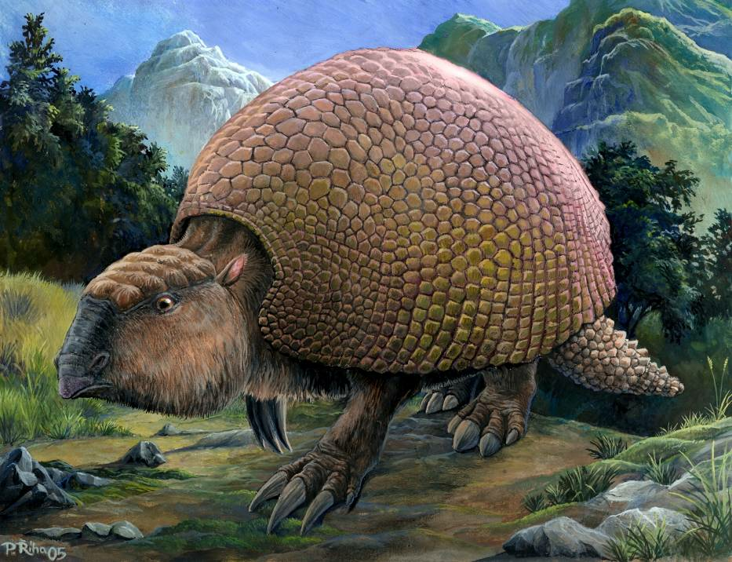
Source: http://www.plosbiology.org/article/info:doi/10.1371/journal.pbio.0060099
Author: Mauricio Antón
Source: http://www.ferrouslands.com/2009/12/marx-megatherium.html
Source: http://en.wikipedia.org/wiki/File:Glyptodon_(Riha2000).jpg
Author: Pavel Riha

Slide 43
To program life we must be able to...
1. Read DNA sequences
2. Design DNA sequences
3. Write DNA sequences

Slide 44
iGEM
International Genetically Engineered Machines
A "jamboree" and competition
  Teams design (then write) modified life forms
Registration deadline is this Friday
  http://igem.org/Main_Page
    We could take a look

Slide 45
iGEM (cont.)
The program has developed a library of modules
Teams can modify bacterial genomes using modules
  Like building with Legos

Slide 46
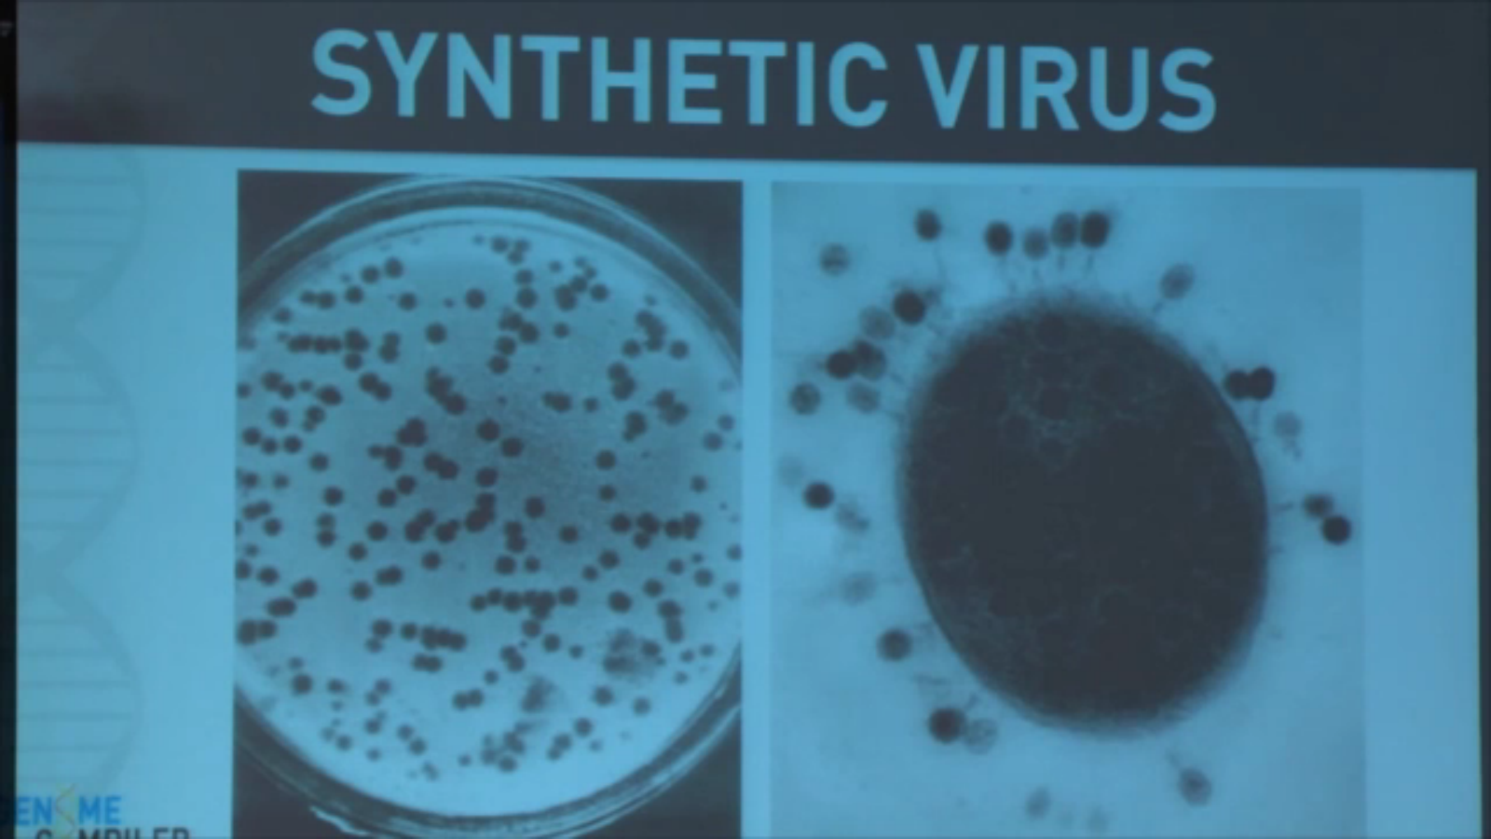
Another virus, a bacteriophage
(screen shot, http://singularityu.org/synthetic-biology-executive-program-december-2011/, 42:00)

Slide 47
Why design new organisms?
Microbes that secrete
  Oil, diesel, …
  Plastic base material
  High-value chemicals

Slide 48
Why design new organisms?
Microbes that secrete
  New flu vaccines
    Much faster than current production method
Synthesize new oncolytic viruses
  A new way to fight cancer cells
  Problem: bioweapons
    could fight any kind of cell

Slide 49
Why design new organisms?
New multicellular organisms
  Potatoes with meatballs in them
  Trees that grow metal nuggets
    Gold, thorium, etc., etc.
"X doesn't grow on trees"
  This should be a false statement!
If you can imagine it, you should be able to grow it!

Slide 50
A Few Conclusions
Biology and computing overlap greatly
Computer technology revolutionized society
Biotechnology will revolutionize society more
Moore's law drives computing advances
Moore's law-like trends are driving biotechnology

