Slide 1

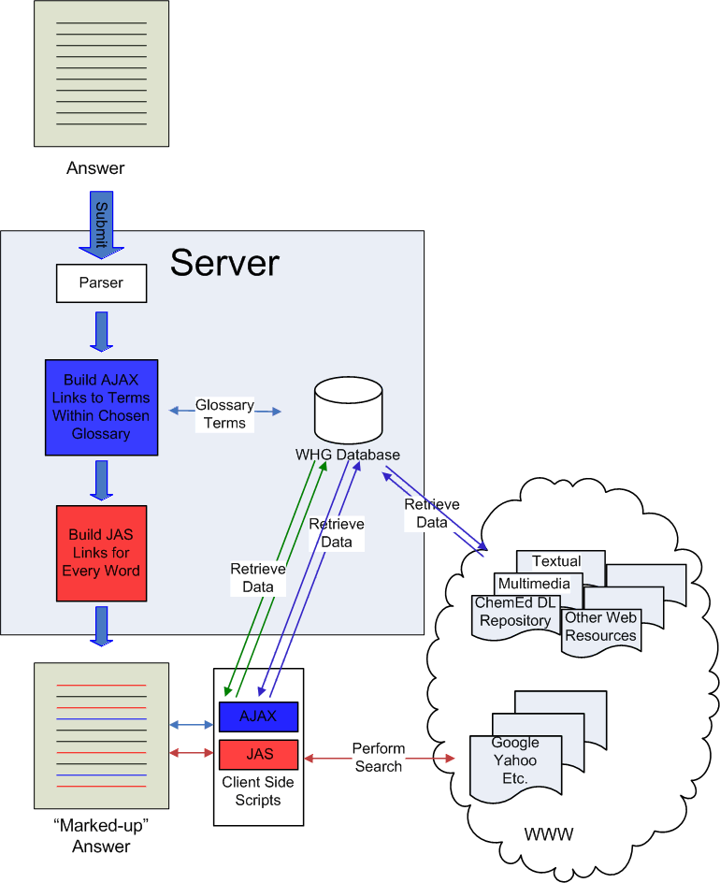
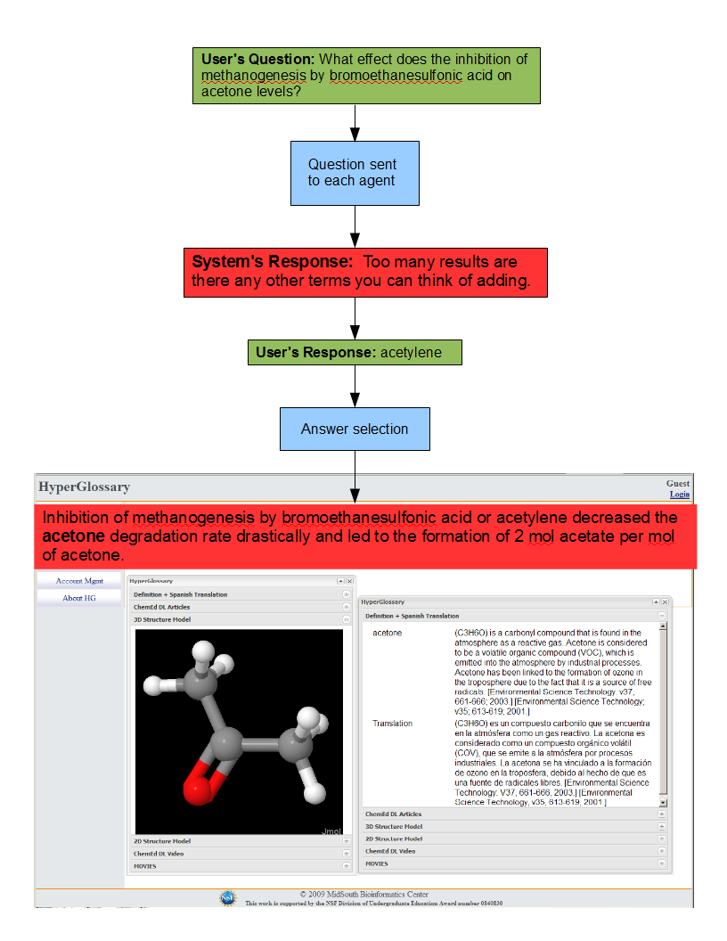
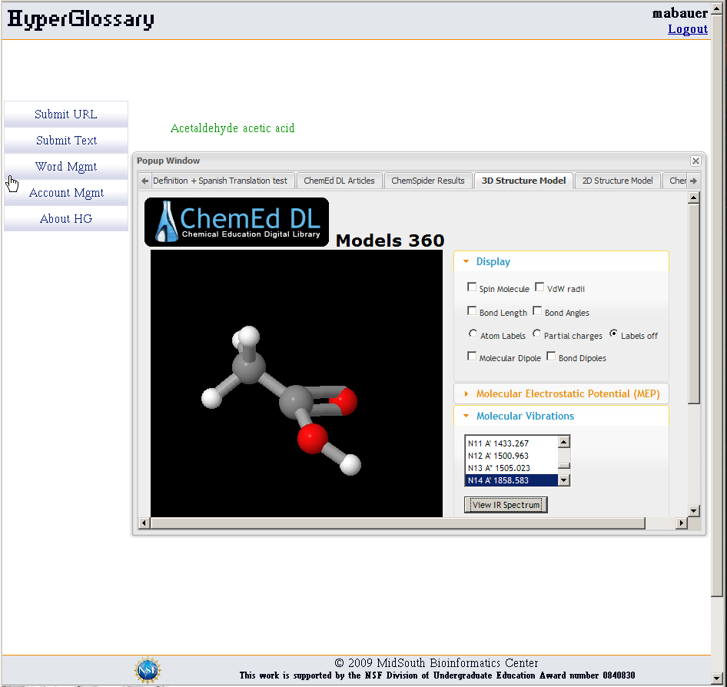
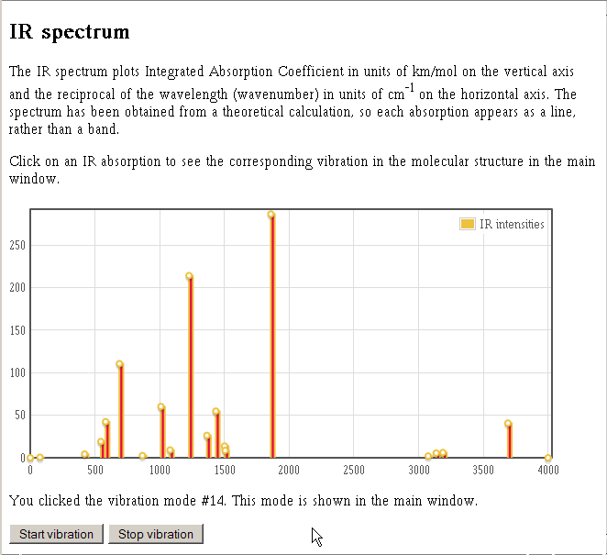


Integrating the HyperGlossary with a Question Answering System
Michael A. Bauer^{1,2}, Daniel Berleant¹, Robert E. Belford¹, and Roger A. Hall¹
¹University of Arkansas at Little Rock
²University of Arkansas for Medical Sciences
INTRODUCTION
HyperGlossary INTEGRATION
EXAMPLE CASE
In clinical and biomedical settings researchers use specialized search engines to acquire answers to technical questions or to quickly get verification of experimental results. The outcome of such queries result in the reading and scanning of multiple Web pages and documents. Question answering (QA) is a specialized type of information retrieval with the aim of returning precise short answers to queries posed as natural language questions
The HyperGlossary (HG), located at www.hyperglossary.org,is a tool that we developed to automate the insertion of hyperlinks into a digital text document or Web page which can connect words or phrases to relevant textual material such as definitions of words, multimedia content, or multidimensional structures for molecules. When a user reads a word or phrase in a document that is connected to a glossary term, the information associated with the term can be viewed without leaving the original document.
An example interaction with the system:
The user asks the system a question that is sent to each of the agents to process in its own way.
In this case more information was needed to reduce the number of possible answers so the system asked if the user could provide any additional terms.
The additional information allows the system to find an answer that is processed by the HyperGlossary.
The term ‘acetone’ was matched in the chosen glossary.
A definition of acetone is presented with a Spanish translation and the 3D structure of the molecule.
Basic Information Retrieval System
Select Term
HyperGlossary Core
Information
Need
Textual Information
Term Type
?
Gene
(Gene ID)
Protein
(GI Number)
Chemical
(InChI)
Query
Formation
Create Intermediate Form
Query by ID
1
Basic Elements of a QA System
Similarity Measure
Information Need
Selecting Sources
Information Retrieval and Extraction
Answer Determination
Answer Presentation
Question Understanding
Sources
2
NCBI Gene
PubChem
NCBI Protein
ChemEd DL
ChemSpider
3
Relevant
Information
Display Relevant Information
4
Structures
Sequences
Definitions
Terms that are designated as a particular type will have a common ID for the type and be used to access additional resources. Highlighted in yellow are the ID and sources currently implemented in the HG.
Answers will be automatically marked up and linked to semantically relevant content in other databases using the HyperGlossary.
5
SYSTEM DIAGRAM
WHG Word Management Features
Select Term
Document Management
Chemical Identifier Field
Query by InChI
Jmol allows you to interact with molecules in multiple ways beyond simple measurements, like connecting vibrations to IR Spectra and visualizing symmetry operations
Document
Representations
Knowledge Base
HyperGlossary
Glossaries
ChemEd DL
Question Answering System
JMOL
Returned
CONCLUSIONS AND IMPLICATIONS
Search Agents
Score and Rank
Answers
Parse and Identify Glossary Terms
Display
Mol2 file
Available on Local Server
The HG does not just insert link but is also a Glossary Generating Program which can be used to develop glossaries for any field at any competency level. Terms in a glossary can be given a type, such as protein, gene, or chemical, and be used to access the appropriate supplemental data sources.
JMOL
Information Accessibility - The QA system is designed to be a tool used by biomedical domain experts and also be useful and informative to students.
Biological Data Mashup - The integration of the HyperGlossary will allow the answer to not only be linked back to the original document, but also keywords and phrases found in a chosen glossary will be linked to additional sources of information. The system brings together traditional textual information and dedicated biological databases to present a concise answer to the user.
Open Babel
InChI -> Smile
Display
JMOL
Client Browser
External Sources
Balloon
Smile -> mol2
Question
Results
Marked-Up Answers
ChemEd DL
PubChem
NCBI
Save mol2 file
Potential answers chosen by the QA system will be piped through the HyperGlossary before being returned to the user.
In the event that a resource does not have the information requested for a chemical term, the HG has the ability to generate its own structure file from the ID. Open Babel and Balloon, two open source chemistry resources, are used to create a JMOL file on the fly.
This work is supported by the NSF Division of Undergraduate Education Award number 0840830 and the IDeA Networks of Biomedical Research Excellence (INBRE) Program of the National Center for Research Resources.
Notes:
1

