Slide 1
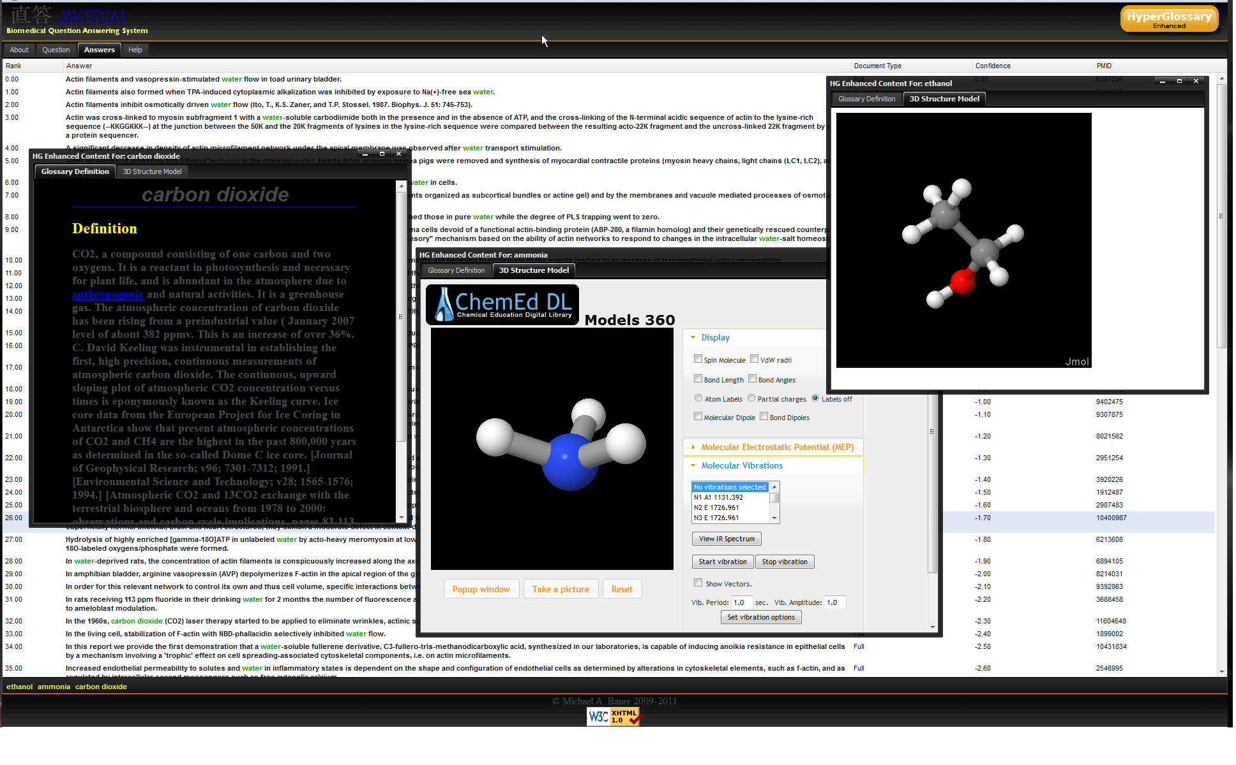
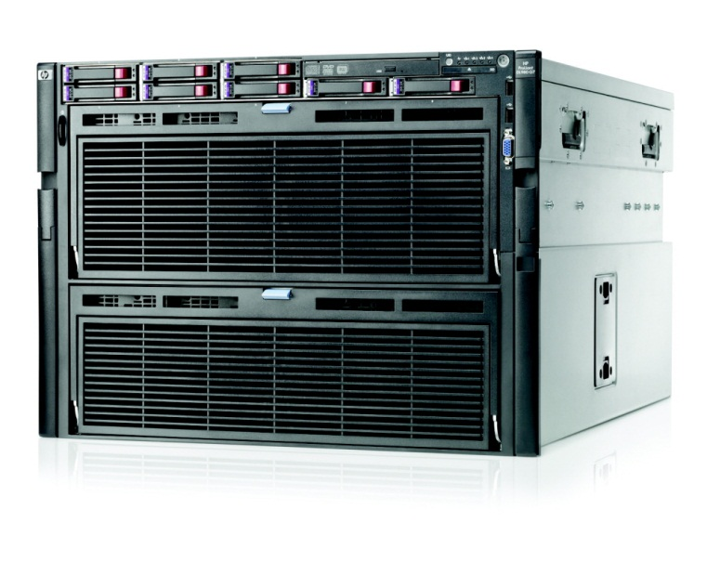
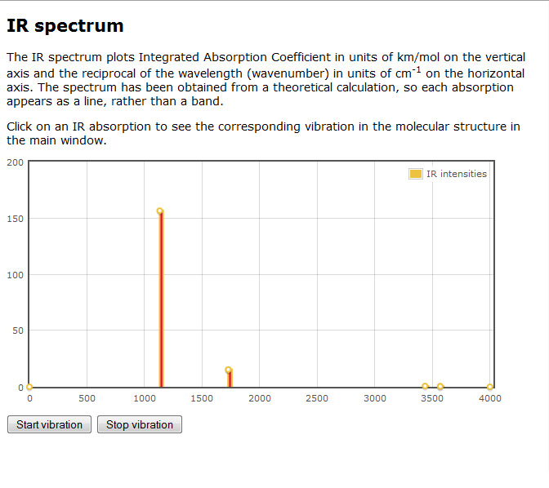
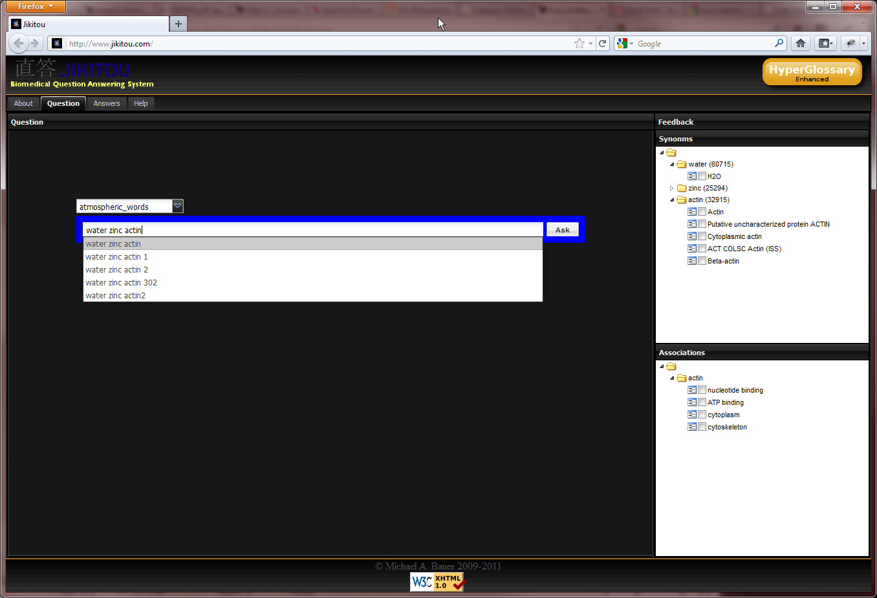
The Jikitou Biomedical Question Answering System: Using High-Performance Computing to Preprocess Possible Answers Michael A. Bauer^{1,2}, Daniel Berleant¹, Robert E. Belford¹, and Roger A. Hall¹ ¹University of Arkansas at Little Rock ²University of Arkansas for Medical Sciences
Introduction
High-Performance Computing
HyperGlossary
We live in an age where researchers have access to unprecedented amounts of biological information. This access to information cuts both ways; it allows for a more informed and empowered researcher but the deluge of information can become overwhelming when using traditional search engines. There is a need for intelligent information retrieval systems that can summarize relevant textual information while also incorporating multiple sources of information from reliable sources to satisfy a user’s query.
Due to the complexity and length of sentences found in biomedical literature, natural language parsing can be a very CPU intensive process. Preprocessing the sentence knowledgebase, using powerful multi-core servers, is required to eliminate the need to parse sentences on the fly. Therefore, increasing the responsive ness of the system.
Perl scripts were written for each parser, which started the desired number of child processes and partitioned the approximately 4.5 million sentences into chunk of data to be processed in parallel.
Initial preprocessing was done on a Dell Powerdege server using 8 of the available cores and took over 150 hours for the Link Grammar Parser and over 200 hours for the Stanford Parser. Using the HP ProLiant DL980 Server (Figure 3,4) reduced these times to 20 hours and 37 hours respectively. Figure 5 is a graph that shows the difference in processing time between the two systems for each parser.
A literacy tool, that we developed and integrated with Jikitou
Automates the insertion of hyperlinks into the text answers.
Connects them to textual definitions, multimedia content, and in the case of many molecules, 2D and 3D representations.
Takes advantage of authoritative knowledge sources on the Internet.
Glossary definition
JMOL view of an HG generated structure files
Question Answering
HP ProLiant DL980 Server
CPU sockets | 8
Cores per socket | 10
Threads per core | 2
CPUs | 160
Question answering (QA) is a specialized type of information retrieval with the aim of returning precise short answers to queries posed as natural language questions.
We have developed a QA system, named Jikitou, which answers natural language questions with sentences taken from Medline abstracts.
Fig. 3 HP ProLiant DL980 server specifications
Fig. 4 Image of a HP ProLiant DL980 server
Fig. 7 Connection to the ChemEd Digital Library returns Jmols which allows you to interact with molecules in multiple ways beyond simple measurements, like connecting vibrations to IR Spectra
Dell PowerEdge Vs. HP ProLiant Server
Preprocessing time (Hours)
Discussion
Information Need
Selecting Sources
Information Retrieval and Extraction
Answer Determination
Answer Presentation
Question Understanding
Once potential answers are returned to the system, we rank them based on a combination of the semantic distance of key terms that we determined using the Link Grammar Parser and on the similarity of grammar structure found using the Stanford Parser.
The system brings together traditional textual information and dedicated and vetted biological databases to present a concise answer to the user.
The use of HPC enabled the preprocessing of the sentences in days instead of weeks which will be invaluable when the system is scaled up to include more sentences.
Fig. 5 Graph showing the preprocessing times of the Dell PowerEdge Vs. the HP ProLiant server
A Quick Tour of Jikitou
Fig. 1 Basic Elements of a QA System
Natural Language Parsers
Autocomplete
Synonyms
A natural language parser is a program used to determine the grammatical structure of a sentence. In this project we use this structure to match answers based on the semantics of sentences instead of just matching terms.
Two parsers are used in this project, Linked Grammar Parser and Stanford Parser:
Associations
Fig 6. As a user types a question the system suggests additional terms that can be added to refine the initial query.
References
Synonyms Suggestions: The WordNet and Gene Ontology databases are queried to find synonyms to terms entered.
Autocomplete: Aspell, spell checking software, is used to suggest spellings for terms and simulate autocomplete functionality. A medical term dictionary has been added to account for biomedical domain specific terminology.
Associations: Gene Ontology database is used to find associations with biological terms such as biological process, cellular components, or function.
Zweigenbaum P, Demner-Fushman D, Yu H, Cohen KB. 2007. Frontiers of biomedical text mining: Current progress. Brief. Bioinform 8(5):358-75.
Sleator D and Temperley D. 1991. Parsing English with a Link Grammar. Carnegie Mellon University Computer Science tech. report CMU-CS-91-196, October 1991.
 | Link Grammar Parser | Stanford Parser
Description | The system is based on link grammar , it takes a sentence and assigns to it a syntactic structure, which consists of a set of labeled links connecting pairs of words. | A probabilistic natural language parsers that uses knowledge of language gained from hand-parsed sentences to assign the most probable structure to new sentences .
Language | C | Java
Fig. 2 Overview of the two parsers used in this project
www.jikitou.com
This work is supported by the NSF Division of Undergraduate Education Award number 0840830 and the IDeA Networks of Biomedical Research Excellence (INBRE) Program of the National Center for Research Resources.

