Slide 1

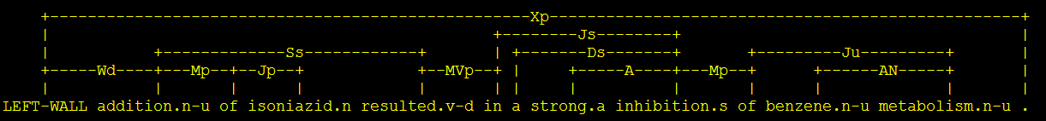
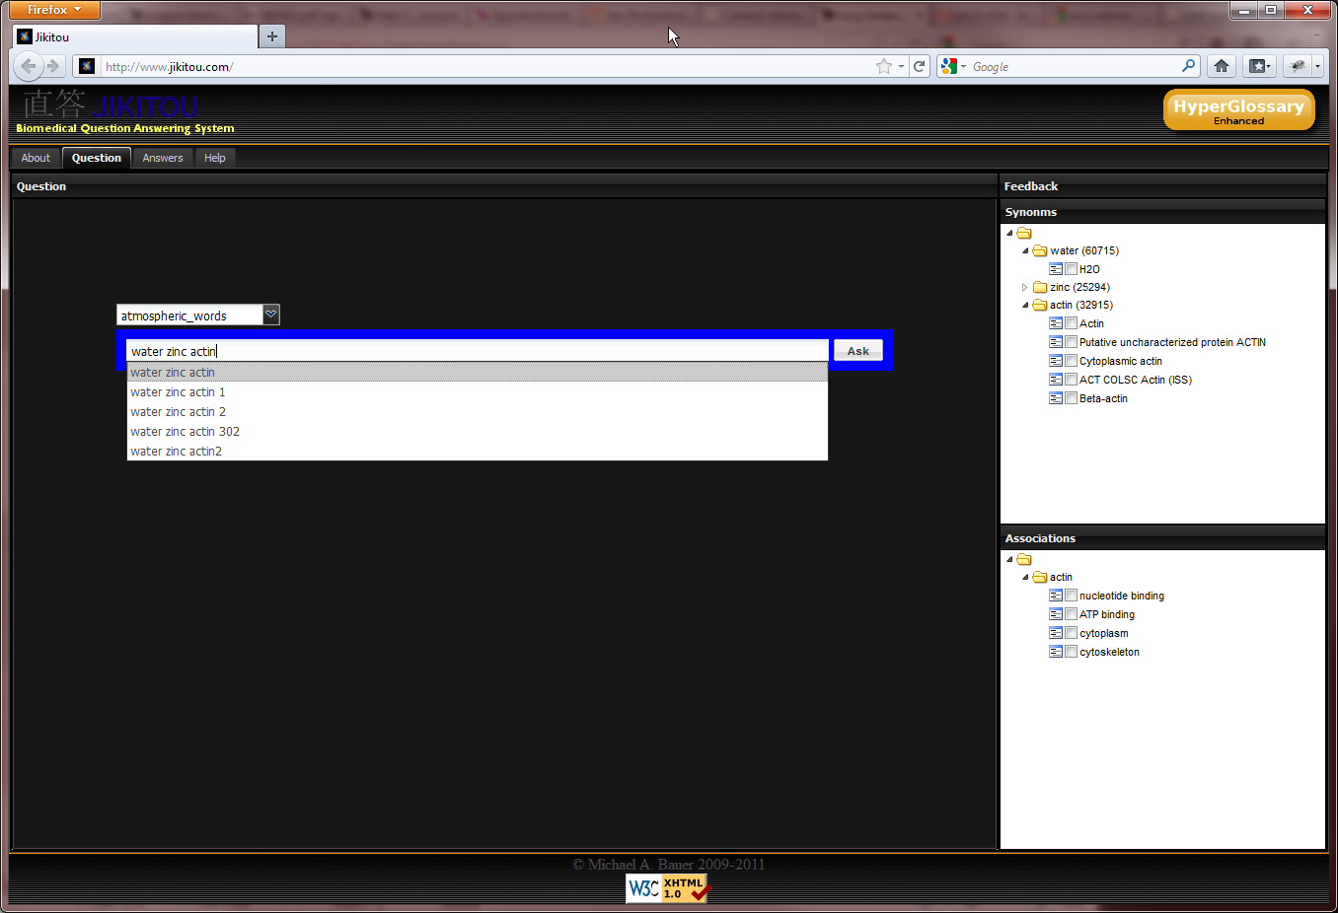
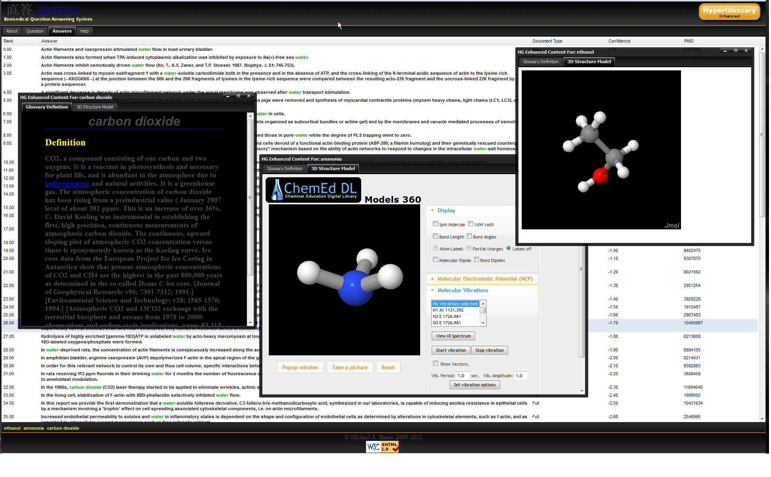
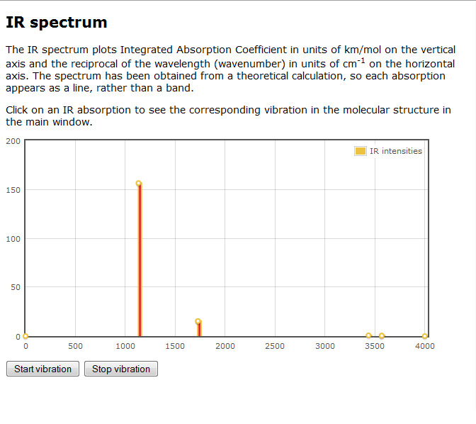
The Jikitou Biomedical Question Answering System:
Using a Syntactic Parser to Rank Possible Answers Michael A. Bauer^{1,2}, Daniel Berleant¹, Robert E. Belford¹, and Roger A. Hall¹ ¹University of Arkansas at Little Rock ²University of Arkansas for Medical Sciences
Introduction
Link Grammar
High-Performance
Computing
System Diagram
We live in an age where researchers have access to unprecedented amounts of biological information. This access to information cuts both ways; it allows for a more informed and empowered researcher but the deluge of information can become overwhelming when using traditional search engines. There is a need for intelligent information retrieval systems that can summarize relevant textual information while also incorporating multiple sources of information from reliable sources to satisfy a user’s query.
Query: What inhibits the metabolism of benzene?
The system is modular in design and follows the Model View Controller paradigm, which separates the interface logic from the application logic. As new search strategies are developed the module design allows them to be easily integrated into the system.
Potential Answer: Addition of isoniazid resulted in a strong inhibition of benzene metabolism.
Due to the complexity and length of sentences found in biomedical literature, natural language parsing can be a very CPU intensive process. Preprocessing the sentence knowledgebase using powerful multi-core servers was required.
A Perl script was written which started the desired number of child processes and partitioned the approximately 4.5 million sentences into chunk of data to be processed in parallel.
Using the HP ProLiant DL980 Server reduced these times from about 150 hours to 20 hours of processing time on the Dell PowerEdge. Figure 5 is a graph that shows the difference in processing time between the two servers.
Send to Link Grammar Parser
Code | Connects
Xp | periods at ends of sentences
Wd | main clause back to the wall
AN | noun-modifiers to nouns
S | subject-nouns to finite verbs
MVp | verbs (and adjectives) to modifying phrases like adverbs
J | prepositions to their objects
A | pre-noun ("attributive") adjectives to nouns
Sematic Structure
Fig 2. Resulting semantic structure after being sent to the link grammar parser
Fig 3. Explanation of some of the labeled links in the semantic structure
Build Semantic Adjacency Matrix
Question Answering
Adjacency matrix of pairs of keywords found in the semantic graph. Contains the semantic distance between the words according to the link grammar parser.
Question answering (QA) is a specialized type of information retrieval with the aim of returning precise short answers to queries posed as natural language questions.
We have developed a QA system, named Jikitou, which answers natural language questions with sentences taken from Medline abstracts.
Once potential answers are returned to the system, we rank them based on the semantic distance of key terms. The naïve method to assess strength of evidence of interaction in a sentence is their lexical separation in the sentence. Semantic distance is expected to give a more accurate measure of term relatedness. In the example answer the semantic distance between isoniazid and benzene, 4, is closer than their lexical distance of 6.
Dell PowerEdge
Vs.
HP ProLiant Server
Preprocessing time (Hours)
Fig. 7 Jikitou system diagram, showing the module design and technologies used
Discussion
Jikitou is designed to be a tool used by biomedical domain experts, and useful and informative to students.
Potential answers are returned to the system and we rank them based on a combination of the semantic distances of key terms that we determined using the Link Grammar Parser .
The system brings together traditional textual information and dedicated and vetted biological databases to present a concise answer to the user.
The use of High-Performance Computing has enabled the preprocessing of the sentences in days instead of weeks which will be invaluable when the system is scaled up to include more sentences.
Information Need
Selecting Sources
Information Retrieval and Extraction
Answer Determination
Answer Presentation
Question Understanding
Fig. 4 Graph showing the preprocessing times of the Dell PowerEdge Vs. the HP ProLiant server
A Quick Tour of Jikitou
Glossary definition
Autocomplete
Synonyms
JMOL view
Fig. 1 Basic Elements of a QA System
Natural Language Parser
Associations
Fig. 5 As a user types a question the system suggests additional terms that can be added to refine the initial query.
Fig. 6 Connection to the ChemEd Digital Library returns Jmols which allows you to interact with molecules in multiple ways beyond simple measurements, like connecting vibrations to IR Spectra
A natural language parser is a program used to determine the grammatical structure of a sentence. In this project we use this structure to match answers based on the semantics of sentences instead of just matching terms.
The Link Grammar Parser takes a sentence and assigns to it a syntactic structure, which consists of a set of labeled links connecting pairs of words.
System Feedback
The WordNet and Gene Ontology databases are queried to find synonyms to terms entered.
A medical term dictionary has been added to provide biomedical domain specific terminology suggestion with autocomplete.
Gene Ontology database is used to find associations with biological terms such as biological process, cellular components, or function.
The HyperGlossary, a literacy tool, that we developed and integrated with Jikitou
Automates the insertion of hyperlinks into the text answers.
Connects them to textual definitions, multimedia content, and in the case of many molecules, 2D and 3D representations.
Takes advantage of authoritative knowledge sources on the Internet.
直答
Direct Answer
www.jikitou.com
Jikitou
This work is supported by the NSF Division of Undergraduate Education Award number 0840830 and the IDeA Networks of Biomedical Research Excellence (INBRE) Program of the National Center for Research Resources.

