Slide 1
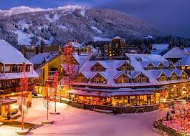
Big Mountain Ski Resort
Ticket Pricing Model
Prepared By Dawn Betzel

Slide 2
Problem Statement
The purpose of this project is help the Big Mountain Resort executive team make decisions about ticket pricing or whether they would be better off cutting costs.
The Big Mountain Resort executive team suspects that it has not optimized it's ticket pricing strategy.
This project aims to build a predictive model for ticket prices and cost reductions.
This model can also be used to advise Big Mountain Resort management in future facility investments.

Slide 3
Modeling Results
The model provided insight into what Big Mountain Resorts pricing strategy under different scenarios.
First the model indicated cutting costs by removing runs was not going to add to revenue.
The model indicated that the best scenarios were to add a run, increase the vertical drop by 150 feet, and install an additional chair lift. Doing this would allow Big Mountain Resort to raise prices by $8.67 or by $10.62 if they also add 4 acres of snow making capability.

Slide 4
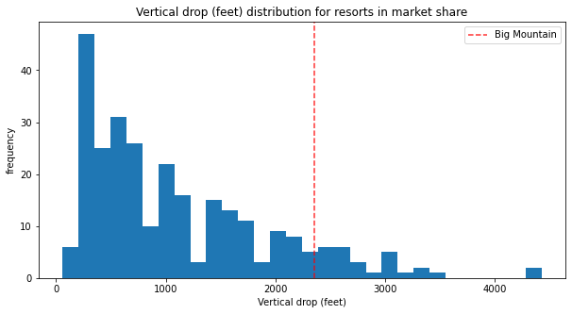
Analysis – Vertical Drop
Big Mountain is doing well for vertical drop, but there are still quite a few resorts with a greater drop.

Slide 5
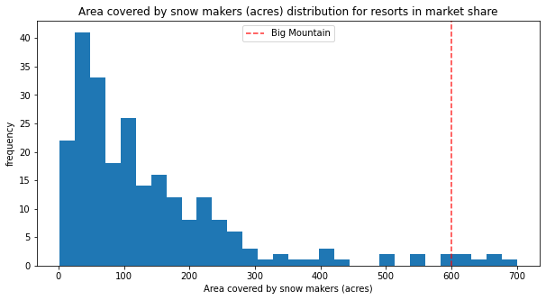
Analysis – Area Covered By Snow
Big Mountain is very high up the league table of snow making area.

Slide 6
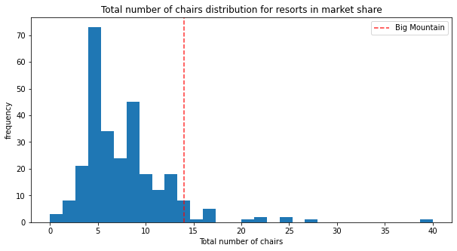
Analysis – Number of Chairs
Big Mountain has amongst the highest number of total chairs, resorts with more appear to be outliers.

Slide 7
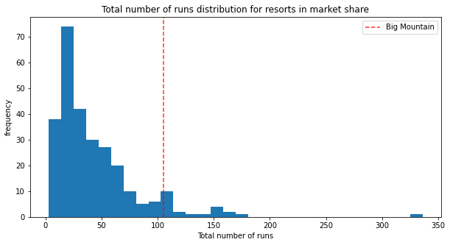
Analysis – Number of Runs
Big Mountain compares well for the number of runs. There are some resorts with more, but not many.

Slide 8
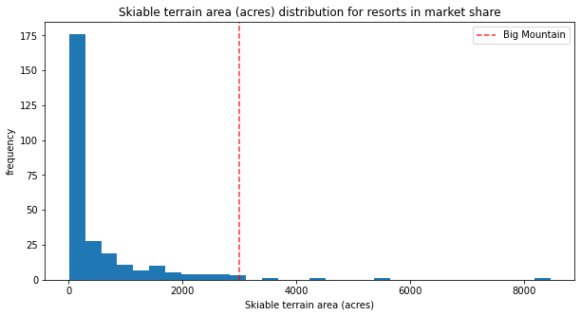
Analysis – Skiable Area
Big Mountain is amongst the resorts with the largest amount of skiable terrain.

Slide 9
Summary and Conclusion
In summary, Big Mountain Resort compares well with others in the same market. The model suggests with just adding a few more features, Big Mountain Resort could increase it price by at least $8.67 or at most $10.62 which would greatly increase revenue by $15217391 or $18,590,580 respectively.
In conclusion at this point in time, I recommend gathering the data about the cost of adding 2 acres of snow making. Then evaluating whether the cost justifies the greater revenue that would be generated.

