Slide 1

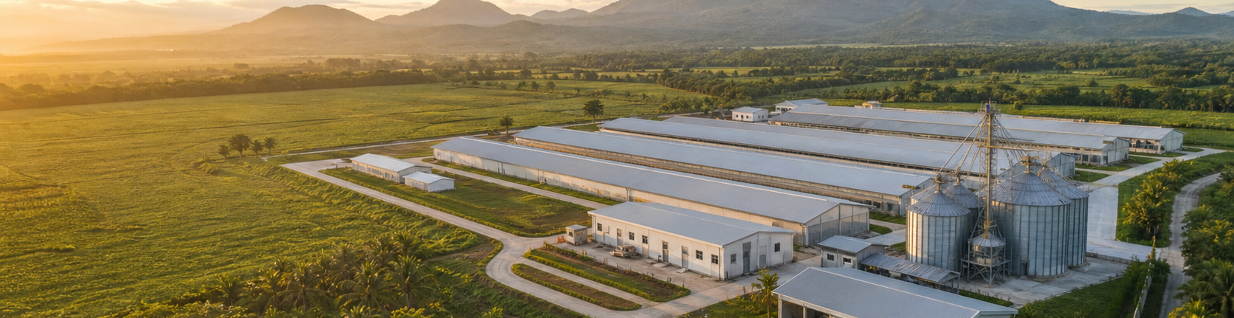
VITARICH • VITA FMS
TOTAL PROJECT
UPDATE
May 1 – August 25, 2026
A connected view of operational delivery, module dependencies, release boundaries, and the decisions needed to convert build momentum into controlled adoption.

Slide 2
EXECUTIVE READ
The project is now an operating model—not a set of isolated screens.
02
ONE CONNECTED
OPERATING SPINE
98
What this means
• Broiler now has an end-to-end lifecycle from placement through clean-up.
integrated commits on dev-main
• Inventory is the shared posting and traceability backbone.
• Hatchery and Breeder have material workflow coverage, with specific branch-only boundaries.
469
• Governance shifted from route-level controls toward hierarchy, permissions, approvals, and centralized events.
Farm identity, access control, inventory movement, production workflows, traceability, approvals, and notifications increasingly share the same foundation.
files changed from the April baseline
4
contributors across audited refs
VITA FMS • CEO PROJECT UPDATE • 25 AUG 2026

Slide 3
DELIVERY EVIDENCE
Sustained execution across four consecutive months
03
INTEGRATED COMMITS BY MONTH
85,930
MAY
24
lines added from the April 29 baseline
JUNE
27
7,483
JULY
26
lines removed—evidence of replacement and cleanup
AUG*
21
3
98 integrated commits
feature commits still outside dev-main
*Through August 21 integrated history; report current through August 25.
Source: refreshed GitHub remote refs and local Git history.
VITA FMS • CEO PROJECT UPDATE • 25 AUG 2026

Slide 4
PORTFOLIO ARCHITECTURE
What is connected to what
04
FARM + USER
→
FMS WORKFLOWS
→
INVENTORY LEDGER
→
REPORTING + TRACE
Canonical farm identity • FMS scope • permissions
Broiler • Hatchery • Breeder
Receipts • issues • transfers • signed postings
Warehouse balances • document lineage
CONFIGURATION LAYER
↕
CONTROL LAYER
Settings govern operational behavior: cycle rules, DOC placement, Flock Card, Harvest & Delivery, Clean-up, item groups, batch logic, and approvals.
Central permissions, approval routing, notification rules, event catalog, deduplication, and farm-scoped recipient resolution.
Design principle
Operational modules publish business outcomes; shared services decide authorization, routing, reporting, and delivery.
VITA FMS • CEO PROJECT UPDATE • 25 AUG 2026

Slide 5
FMS CATEGORY • BROILER
A governed production lifecycle from placement to close-out
05
CYCLE MASTER
→
DOC PLACEMENT
→
GROWING & FARM CONDITION
→
HARVEST & DELIVERY
→
CLEAN-UP
Farm-cycle authority
Route: /inv/doc-receiving
Flock Card
Batch allocation
Closure + reconciliation
SETTINGS → OPERATIONS
SETTINGS → OPERATIONS
DOC Placement Settings → DOC Placement
Harvest & Delivery Settings → Harvest & Delivery
Flock Card Settings → Growing & Farm Condition
Clean-up Settings → Clean-up
END-TO-END
CONTROLLED
TRACEABLE
placement, daily operations, delivery, and closure
date windows, batch rules, closure criteria
document, batch, farm, and source lineage
Inventory postings and farm cycle state connect each stage.
Exact business rules are centralized in settings and shared validation.
Warehouse reporting provides the reconciliation view.
VITA FMS • CEO PROJECT UPDATE • 25 AUG 2026

Slide 6
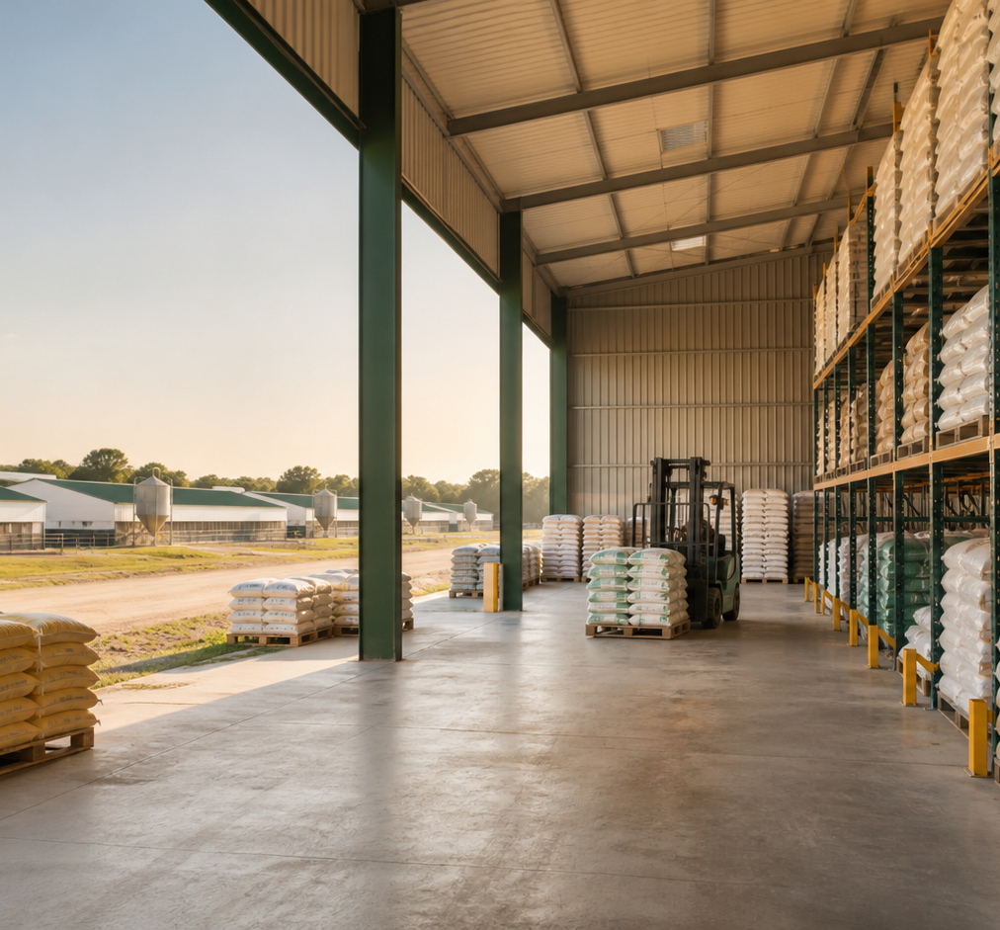
FMS CATEGORY • INVENTORY
The shared transaction and reconciliation backbone
06
ITEM MASTER
→
ITEM GROUP + UOM
→
BATCH
ITEM STOCK IN
→
SIGNED POSTINGS
→
WAREHOUSE REPORT
Goods receipt
Canonical ledger
Running balance + exports
ITEM STOCK OUT
→
TRANSFER
→
AUDIT TRAIL
Goods issue
Origin ↔ destination
Document lineage
Connected consumers
DOC Placement receives chicks • Flock Card consumes feed and mortality items • Harvest & Delivery allocates flock batches • Hatchery Receiving posts source inventory.
VITA FMS • CEO PROJECT UPDATE • 25 AUG 2026

Slide 7
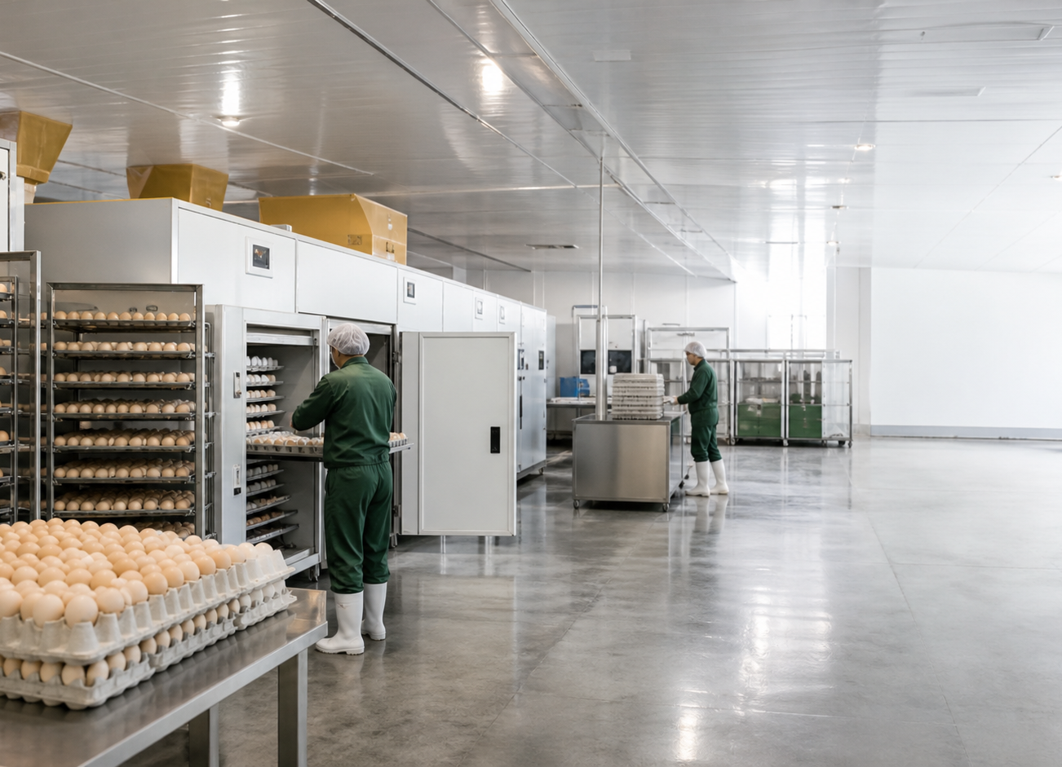
FMS CATEGORY • HATCHERY
Receiving and egg-to-DOC process coverage
07
RECEIVING
→
CLASSIFICATION
→
STORAGE
→
PRE-WARMING
SETTER
→
TRANSFER
→
HATCHER
→
CHICK PULLOUT
DOC CLASSIFICATION
→
DOC DISPATCH
→
DISPOSAL
Connected services
Hatchery Receiving is a distinct module from Broiler DOC Placement.
Receiving → Inventory postings • Process steps → shared batch/source trace • Dispatch → downstream placement lineage • Permissions and notifications → centralized control.
Current boundary: module coverage is substantial; end-to-end browser, SQL, and notification delivery verification remains an operational gate.
VITA FMS • CEO PROJECT UPDATE • 25 AUG 2026

Slide 8
FMS CATEGORY • BREEDER
Production records are integrated; logistics enhancements remain branch-only
08
PLACEMENT
→
POPULATION RECORD
→
LAYING PRODUCTION
→
VACCINATION + MEDICATION
→
REPORTS
INTEGRATED ON DEV-MAIN
BRANCH-ONLY: DEV-BAJA
Growing and grading workflows • Breeder navigation • core production records • shared farm and permission controls.
Breeder Dispatch • Clean-up • Transfer • History/Card enhancements. These are visible in remote history but not counted as released on dev-main.
Release implication
Decide whether the branch-only logistics chain is production-ready, requires reconciliation with dev-main, or should be staged behind a controlled acceptance gate.
VITA FMS • CEO PROJECT UPDATE • 25 AUG 2026

Slide 9
SHARED PLATFORM
The controls that connect every FMS category
09
GOVERNANCE
SPINE
IDENTITY
ACCESS
DECISIONS
User Management
FMS Type
Farm assignments
User Permissions
User Groups
Activation controls
Approval Setup
Approval Management
Week Lock boundary
Authorization and configuration are moving from scattered route logic into shared, farm-aware services.
EVENTS
FARM SETUP
OPERABILITY
Notification catalog
Central dispatcher
Farm-aware routing
Farm Management
Setup Wizard
Warehouse hierarchy
Navigation + search
Theme consistency
Offline/reliability work
VITA FMS • CEO PROJECT UPDATE • 25 AUG 2026

Slide 10
MAY–AUGUST 2026
The build moved from visibility to integration to control
10
MAY
JUN
JUL
AUG
Visibility + adoption
Inventory foundation
Connected operations
Governance + readiness
Hatchery views/APIs • receiving trace • permissions templates • table standardization
Reversal validation • Item Group • UoM • Batch • stock-in/out • breeder growing/grading
Broiler lifecycle • Flock Card • Harvest & Delivery • Clean-up • transfers • warehouse reports
Cycle Master • access hierarchy • notifications • reliability • hierarchy refinement • WIP validation
24
27
26
21
May commits
June commits
July commits
August commits through Aug 21
The sequencing matters: shared inventory and traceability foundations enabled the Broiler lifecycle; that lifecycle then exposed the need for stronger farm identity, permissions, approvals, and notification controls.
VITA FMS • CEO PROJECT UPDATE • 25 AUG 2026

Slide 11
RELEASE BOUNDARY
Built is not the same as integrated, deployed, or verified
11
INTEGRATED
BRANCH-ONLY
LOCAL WIP
VERIFICATION
98
3
52
OPEN
commits on origin/dev-main
feature commits outside dev-main
pre-existing changed/untracked code paths
browser, SQL/RPC, RLS, Supabase, and delivery checks
RELEASE CONTROL
OPERATIONAL CONTROL
RISK CONTROL
Promote by evidence
Pilot by workflow
Protect the data contract
Require commit/branch identity, migration status, automated checks, browser acceptance, and owner sign-off for every release candidate.
Validate the connected chain—not a single page: settings → document → posting → report → notification/approval.
Preserve farm identity, signed ledger behavior, source lineage, retry deduplication, and safe notification no-op behavior.
Management message: delivery momentum is strong; the immediate value unlock is disciplined integration and operational acceptance.
VITA FMS • CEO PROJECT UPDATE • 25 AUG 2026

Slide 12
CEO PRIORITIES
Six decisions to turn build momentum into measurable operating value
12
01
02
03
Approve a controlled release gate
Prioritize Broiler pilot adoption
Resolve branch-only Breeder scope
One evidence pack covering code, SQL/RPC, browser, RLS, notification, and rollback readiness.
Run placement → Flock Card → delivery → clean-up with reconciled warehouse balances.
Accept, reconcile, or defer Dispatch/Clean-up/Transfer/History as an explicit release decision.
04
05
06
Freeze canonical farm identity
Name operational owners
Track three value measures
Complete numeric farm-ID migration and stop ambiguous farm code/name routing.
Assign one accountable owner per FMS category for acceptance, adoption, and master-data quality.
Posting accuracy • cycle close time • exception resolution time—reported by farm and workflow.
CONNECTED • CONTROLLED • PROVABLY LIVE
VITA FMS • CEO PROJECT UPDATE • 25 AUG 2026

