Slide 1
SCA2AMALTHEA LLVM-CLANG SETUP

Slide 2
Softwares Required
LLVM-CLANG Setup
Microsoft Visual Studio 2015
cmake 3.3.2
SVN Checkout
2

Slide 3
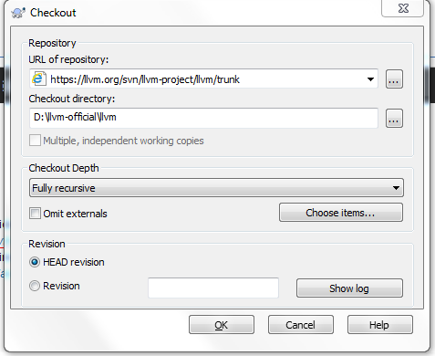
Checkout clang-llvm sources
LLVM-CLANG Setup
Right click inside the folder where you intend to download and say SVN Checkout
3

Slide 4
Checkout clang-llvm sources
LLVM-CLANG Setup
Url for clang 4.0.1 official sources : http://llvm.org/svn/llvm-project/cfe/tags/RELEASE_401/final
Url for LLVM 4.0.1 official sources:http://llvm.org/svn/llvm-project/llvm/tags/RELEASE_401/final
Enter these urls in the text box in the screenshot(previous slide) each for clang and llvm and then provide the check-out directory where the clang and llvm sources have to be checked out.
Copy the clang source folder in the path (“LLVM source folder”/tools)
Copy the sca source folder inside ("LLVM source folder"/tools/clang/tools)
Open the CMakeLists.txt present in the path ("LLVM source folder"/tools/clang/tools) and add the below line at the top of the file (as we copied “sca” folder in previous step)
add_subdirectory(sca)
4

Slide 5
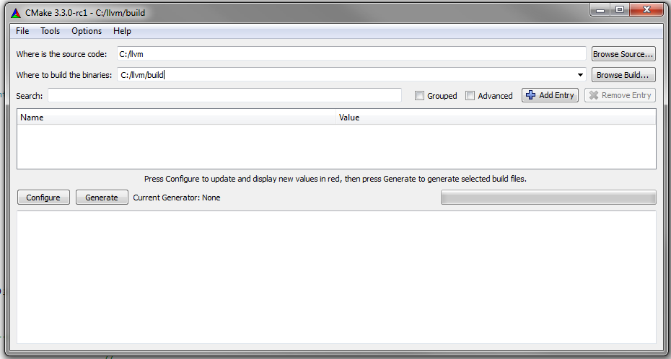
Building using cmake
LLVM-CLANG Setup
Create a build directory where the sources of the code will be built (e.g. c:\llvm\build)
Open cmake-gui for to generate the MS Visual Studio project files to be built:
From there, select the sources and the build directories, then click on configure and finish by generate when the console advise you to do so:
5

Slide 6
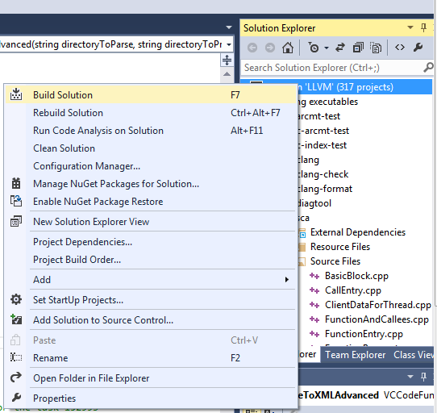
Building using Visual Studio
LLVM-CLANG Setup
After this step, the necessary files for the build have been generated inside the build directory
Go inside the build directory and start the file ALL_BUILD.vcxproj with MS Visual Studio
From Visual Studio, build the project by right-clicking on the “Solution LLVM”->Build Solution
6

Slide 7
Building using Visual Studio Continued …
LLVM-CLANG Setup
This should take some time but at the end, it should have built all the necessary parts of LLVM and clang(follow the output on the console).
sca.exe can be found in (“Build Directory”/Release/bin or “Build Directory”/Debug/bin) depending on the solution configuration given in the visual studio.
Copy sca.exe and libclang.dll to a separate location on your hard disk for later use in SCA2AMALTHEA
7

Slide 8
SCA2AMALTHEA AMALTHEA Generation

Slide 9
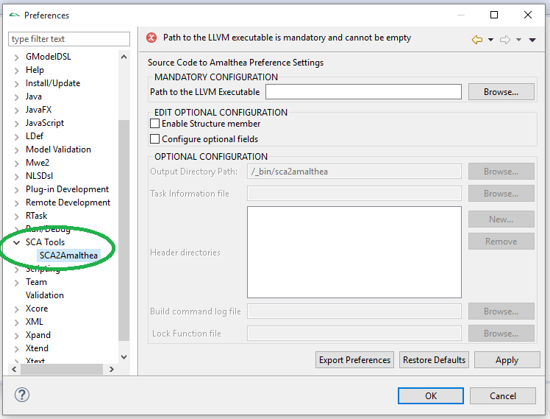
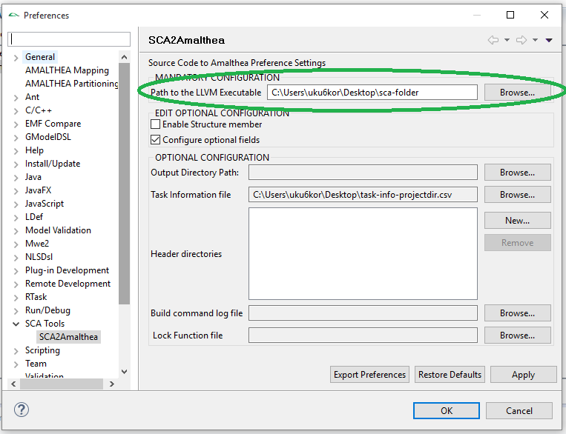
Using Built SCA Executable
SCA2AMALTHEA
Go to eclipse Windows->Preferences->SCA2AMALTHEA (see Figure 1)
In “Path to LLVM Executable” option provide the path where your sca.exe is placed on your hard drive(see Figure 2)
8

Slide 10
Configuration Options
SCA2AMALTHEA
Enable Structure Member – When selected shall generate the complete access to the member level of a structure, otherwise it shall just report access to any member of structure as an access to structure. By this option is false
Output Directory Path – Can be configured to place the output to other directory then default ones
Task Information file – A comma separated file which contains names of the Tasks/ISRs to categorize C functions to their respective AMALTHEA software model element. If file is not provided all functions shall be generated as Runnables in AMALTHEA Model. For a sample configuration please refer to sample_task_isr_info_file.csv file.
Header directories: This is a list of header directory paths to be included. If not configured then the entire project directory is considered as header directory.
Build command log file: This field is for providing absolute path of the build_cmd.log file which contains the c file names to be parsed. If not provided then the c files from the entire project directory are parsed.
Lock Function file – A comma separated file which contains names of the C functions which should be considered as lock acquire/release C functions. The name shall appear as semaphore in AMALTHEA OS Model. The lock acquire function call shall be modelled as acquire <semaphore-name> and lock release function call will be modelled as release <semaphore-name>. For a sample configuration please refer to sample_lock_function_info.csv file.
8

Slide 11
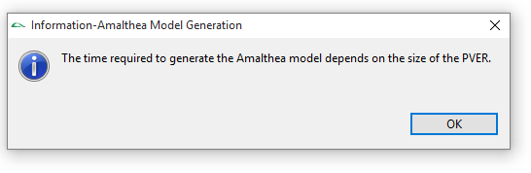
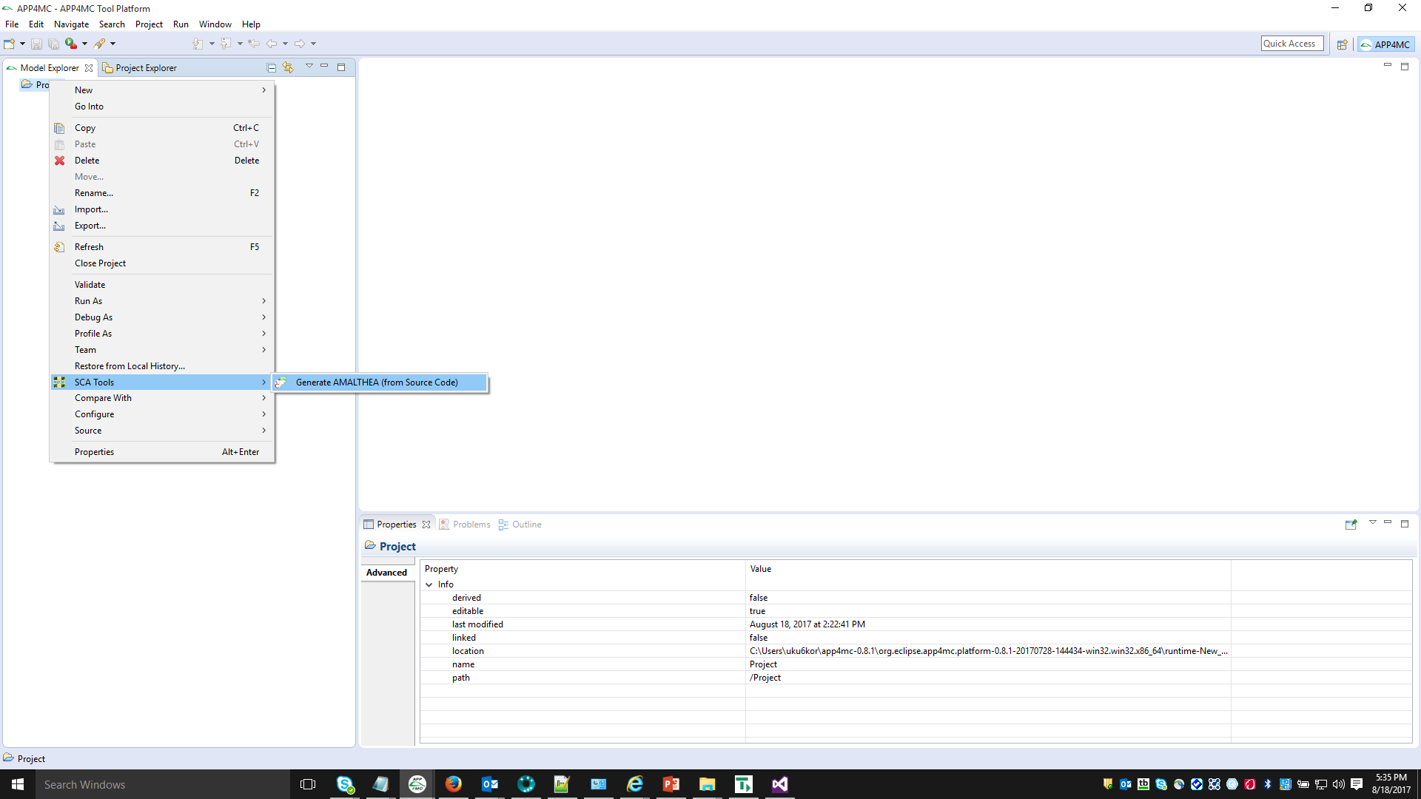
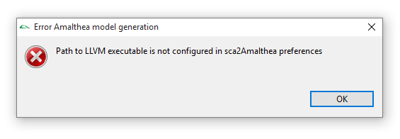
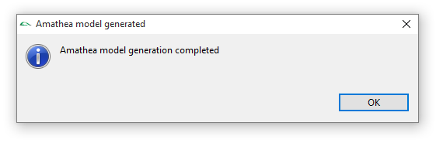
Launching from Menu
SCA2AMALTHEA
Right click on the project and click on SCA Tools ->Generate AMALTHEA(from source code) as shown in figure 1.
If the Path to LLVM executable is not configured in sca2Amalthea preferences then a popup as shown is figure 2 comes up.
If the Path to LLVM executable is configured in sca2Amalthea preferences then the Amalthea generation job starts and a popup shown in figure 3 pops up.
Once the Amalthea model generation job completes then the popup shown in figure 4 comes up.
figure3
figure1
figure2
8
figure4

Slide 12
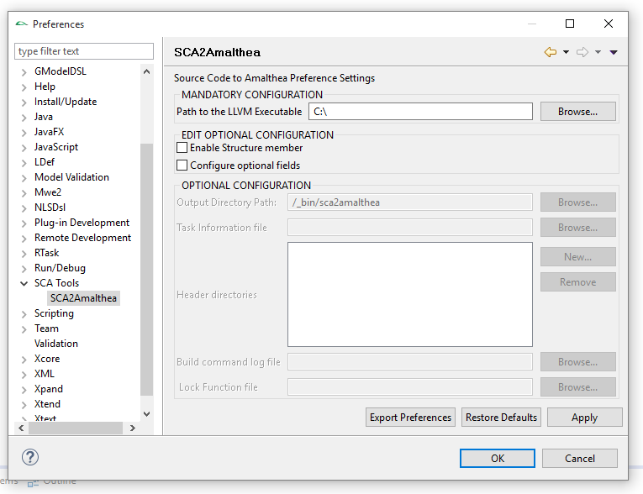
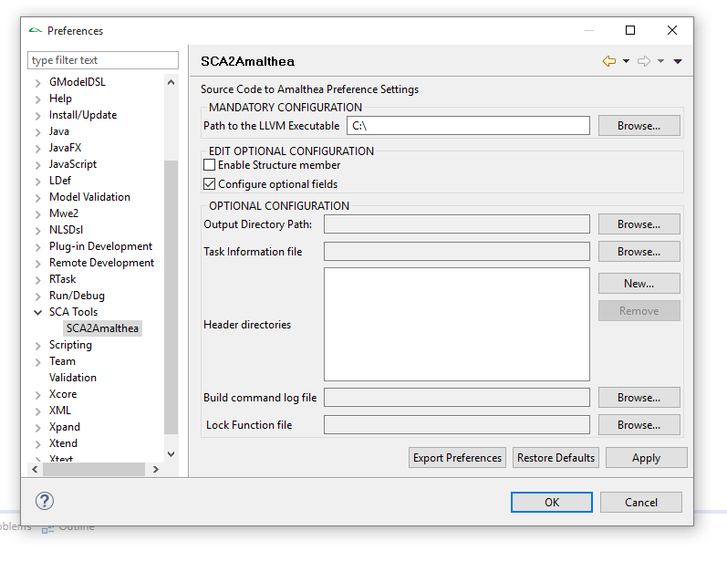
SCA2Amalthea Preference Page
SCA2AMALTHEA
Sca2Amalthea preference page consists of mandatory and optional configuration.
Optional configuration can be enabled and disabled using the “Configure Optional fields” check box as shown in figure 1(disabled) and figure 2(enabled).
Figure 1
Figure 2
8

Slide 13
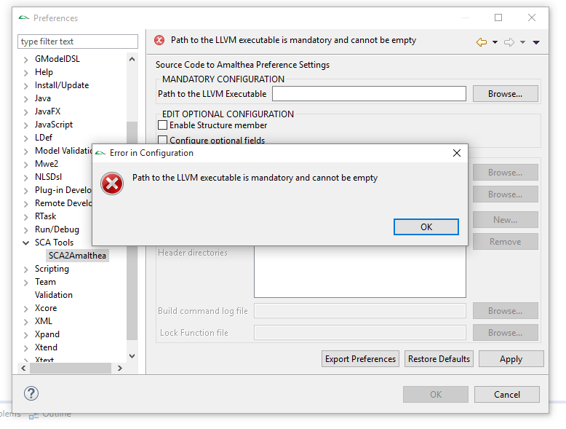
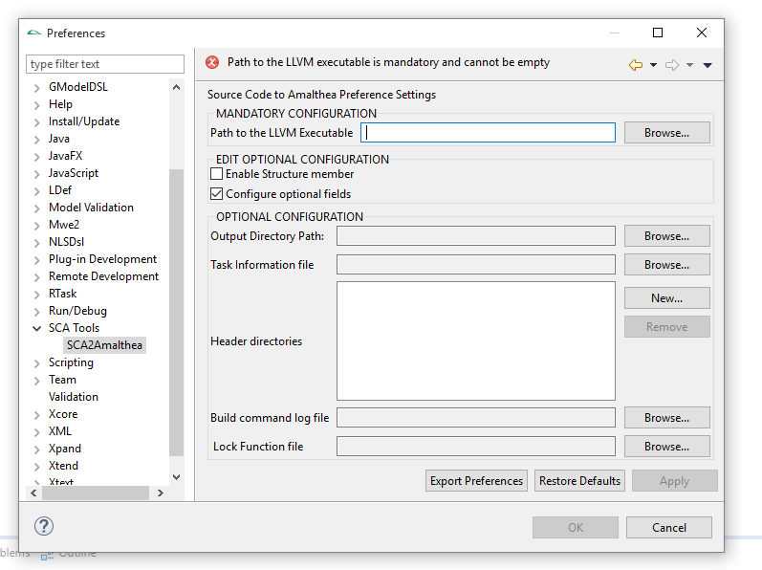
SCA2Amalthea Preference Page –Mandatory Configuration
SCA2AMALTHEA
Mandatory Configuration consists of only one field “Path to the LLVM Executable”.
When the sca2Amalthea preference page is loaded for the first time and Ok button is clicked without configuring the “Path to the LLVM Executable” field then the popup as shown in figure 1 is shown.
For subsequent loads of the sca2Amalthea preference page ,error as shown in figure 2 is shown if the “Path to the LLVM Executable” is not configured.
8
Figure 1
Figure 2

Slide 14
SCA2Amalthea Preference Page –Optional Configuration
SCA2AMALTHEA
When checked struct members would be present in the Amalthea model.
This is a the path where all the output files are stored. If the output directory path is not configured then the generated Amalthea file is present in the (project dir/_bin/sca2amalthea)
This is a csv file containing task/ISR information. If the task information file is not provided then all the functions present in the Project are treated as runnables.
This is a list of header directory paths to be included. If not configured then the entire project directory is considered as header directory.
This field is for providing absolute path of the build_cmd.log file which contains the c file names to be parsed. If not provided then the c files from the entire project directory are parsed.
This field takes in a .csv file which contains the names of the C functions which should be considered as locks. If not provided all the functions are considered as runnables.
8

Slide 15
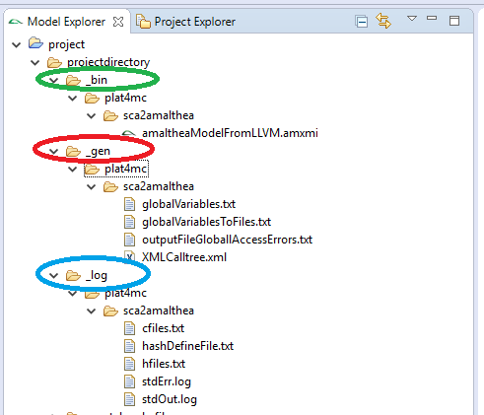
SCA2Amalthea Preference Page –Output Directory
SCA2AMALTHEA
If the output directory is configured in the sca2Amalthea preferences then all the below files will present in the directory that is configured else the files will be present in the directories as shown.
This is the generated Amalthea model file.
This contains all the global variable names declared inside the c/h files of the project.
This contains all the global variable names, file name in which they reside and also the line and column where they are declared.
It contains all those label accesses whose names are not present in the labels section of the xmlCallTree.xml
This is an intermediate representation file which is basically the output of sca.exe. It contains the call tree information, label accesses ,type-def info and so on.
It contains all the c file names to be parsed
It contains all the macros and their values that would be used while parsing.
It contains all the h file names to be parsed
It contains all the error messages logged by sca.exe while parsing.
8
It contains all the output info messages logged by sca.exe while parsing.

