Slide 1
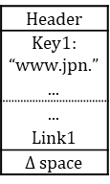
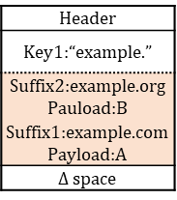
Header
Key1:“example.”
Suffix2:example.org Pauload:B
Suffix1:example.com Payload:A
$Δ$ space
Header
Key1: “www.jpn.”
...
...
Link1
$Δ$ space
Posting
list

