Slide 1
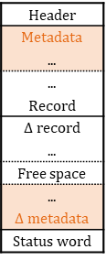


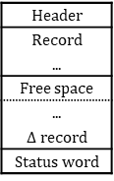
$B^{C}$tree
Header
Metadata
...
...
Record
$Δ$ record
...
Free space
...
$Δ$ metadata
Status word
$B^{C}$-forest
Header
Record
...
Free space
...
$Δ$ record
Status word
固定長key
固定長pointer （＋フラグbit）
可変長key
固定長pointer

