Slide 1

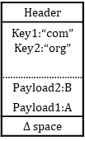

Header
Key1: “www.jpn.”
...
...
Link1
$Δ$ space
Header
Key1: “example.”
Link1
$Δ$ space
Header
Key1:“com” Key2:“org”
Payload2:B
Payload1:A
$Δ$ space

