Slide 1
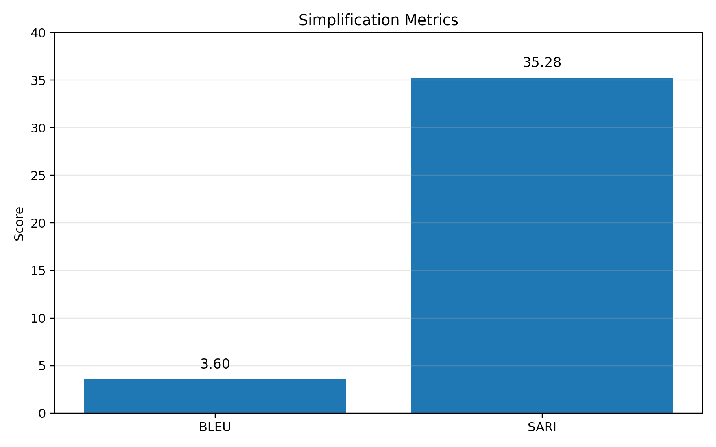
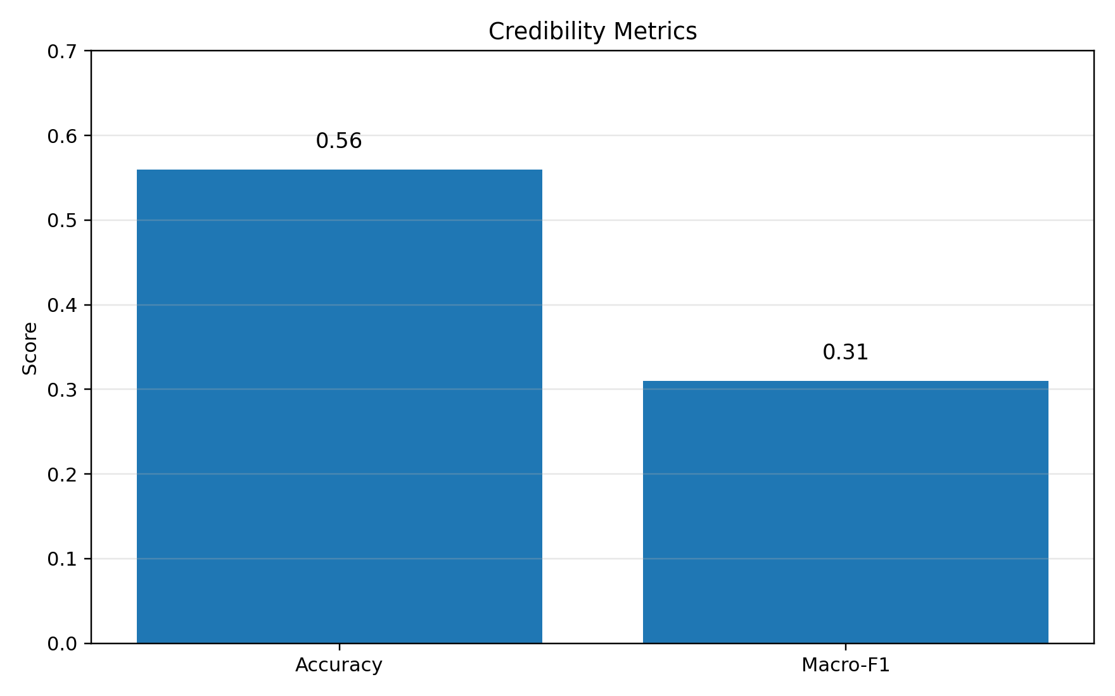

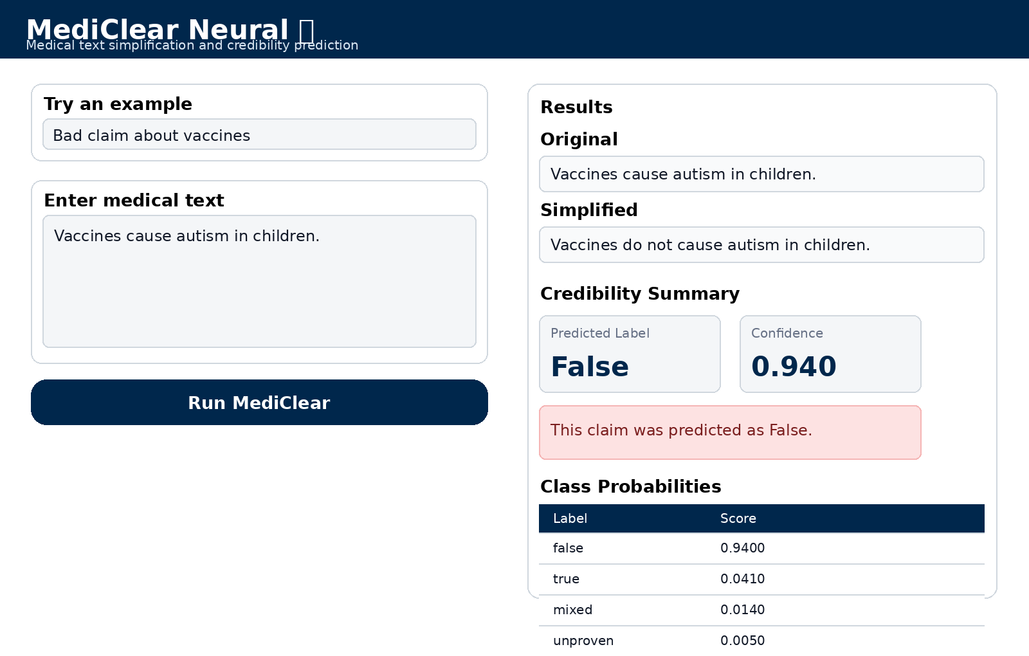
University of Michigan
MediClear: Medical Text Simplification with Credibility Scoring
UMIR 2026 · OpenReview Submission #5
Dhruv Bhagavatula, Thomas Connor Klein, Neha Kanneganti, Kenny Jun Woo Bay
University of Michigan · EECS 486: Information Retrieval and Web Search · github.com/dbhag/Mediclear
Introduction
Project Description
Results
Discussion
Motivation
MediClear is a Python-based NLP system for two medical tasks: (1) text simplification and (2) health-claim credibility assessment. Given a source passage or claim, the system produces a plain-English rewrite and a credibility label with confidence. The design goal is practical rather than purely benchmark-driven: help users understand medical language more comfortably while also flagging claims that may deserve skepticism or follow-up. The prototype is delivered through a Streamlit interface for interactive inference.
What worked
• Online health information is easy to access, but much of it is written in specialized medical language.
• Patients and caregivers often need a fast plain-English explanation before advice becomes actionable.
• The same search space also circulates misleading or false health claims that are difficult to judge quickly.
• MediClear tackles both problems in one workflow: simplify the text, then score the claim's credibility.
• A single input returns both a plain-English rewrite and a credibility estimate.
• Streamlit makes the prototype easy to demo without local setup or command-line interaction.
• Qualitative outputs show helpful replacements such as hypertension → high blood pressure.
T5 Simplifier
DistilBERT
Streamlit App
Key interpretation: SARI better captures meaningful simplification edits than BLEU, while the credibility branch is functional but still uneven across classes.
Current limitations
fine-tuned on Cochrane
trained on PUBHEALTH
interactive demo
Task | Metric | Score
Simplification | BLEU | 3.60
Simplification | SARI | 35.28
Credibility | Accuracy | 0.56
Credibility | Macro-F1 | 0.31
• BLEU is harsh on good paraphrases, so simplification quality looks worse than it feels qualitatively.
• Macro-F1 remains low because PUBHEALTH is heavily imbalanced toward true claims.
• The credibility model scores claims but does not retrieve supporting evidence or counter-evidence.
• No human study was run, so readability gains and user trust were not clinically validated.
36%
The project paper highlights limited health literacy as a major barrier for users making sense of online medical information.
Methods
• Fine-tuned T5 encoder-decoder on complex–simple sentence pairs from the Cochrane medical simplification dataset.
• Trained DistilBERT on PUBHEALTH, a fact-checked collection of public-health claims.
• Simplification favors meaning-preserving paraphrase instead of exact surface overlap with references.
• Credibility output includes a predicted label and a confidence score for user-facing interpretation.
Representative example
Simplification examples
Original
Original | Simplified
Patients with hypertension should reduce sodium intake. | People with high blood pressure should reduce salt intake.
The patient is experiencing dyspnea during mild exertion. | The person has shortness of breath with light activity.
Persistent edema may indicate underlying cardiac dysfunction. | Ongoing swelling may be a sign of a heart problem.
Topical corticosteroids can reduce inflammation and pruritus. | Steroid creams can lessen swelling and itching.
“The patient is experiencing dyspnea during mild exertion.”
Related Work
Simplified
T5
PUBHEALTH
“The person has shortness of breath with light activity.”
Task formulation
Raffel et al. (2020)
Kotonya & Toni (2020)
Representative term changes
text-to-text transfer learning
public-health claim checking
Medical term | Plain-English output
hypertension | high blood pressure
dyspnea | shortness of breath
pruritus | itching
edema | swelling
metastatic disease | cancer has spread
Here, x is the source medical text, y is the simplified rewrite, and c is the predicted credibility class.
Credibility examples
Cochrane
DistilBERT
System Pipeline
Claim | Pred. | Conf.
Drinking lemon water cures cancer instantly. | FALSE | 0.94
Vaccines cause autism in children. | FALSE | —
Getting vaccinated can reduce the risk of influenza infection. | TRUE | —
Some studies suggest that exercise may improve mental health. | TRUE | —
Devaraj et al. (2021)
Sanh et al. (2019)
User input: complex medical text
medical simplification pairs
smaller, faster BERT
Goals
Future Work
• Reduce jargon in medical text with a T5-based sequence-to-sequence model.
• Predict true / false / mixed / unproven labels with a DistilBERT classifier.
• Return both outputs through a lightweight Streamlit web app for non-technical users.
• Support patients, caregivers, and those reading web-based medical explanations.
T5 Simplifier
DistilBERT Classifier
• Try stronger biomedical backbones such as BioGPT or PubMedBERT.
• Address class imbalance with oversampling, augmentation, or weighted loss.
• Expand simplification corpora and run longer fine-tuning.
• Add explanation features that highlight which medical terms were simplified.
• Run user studies with patients and caregivers to measure real readability gains.
• Add evidence retrieval for credibility decisions instead of label-only scoring.
trained on Cochrane
trained on PUBHEALTH
Discussion
Simplified text
Credibility label + confidence
• The end-to-end pipeline runs reliably and is easy to demonstrate through the web interface.
• SARI indicates meaningful edits even when BLEU remains low because simplifications are paraphrastic.
• Accuracy is moderate, but macro-F1 shows that minority classes remain substantially harder to predict.
plain-English rewrite
true / false / mixed / unproven
Streamlit web app
Target use cases
Demo interface
References
• Search snippets and online health articles
• Discharge instructions and medication guidance
• Plain-language medical definitions on the web
• Quick checks on suspicious or confusing claims
Overall assessment
[1] Raffel et al. Exploring the Limits of Transfer Learning with a Unified Text-to-Text Transformer. JMLR, 2020.
[2] Devaraj et al. Paragraph-level Simplification of Medical Texts. NAACL, 2021.
[3] Kotonya & Toni. Explainable Automated Fact-Checking for Public Health Claims. EMNLP, 2020.
[4] Sanh et al. DistilBERT: a distilled version of BERT. NeurIPS Workshop, 2019.
[5] Ondov et al. A survey of automated methods for biomedical text simplification. JAMIA, 2022.
[6] Basu et al. Med-EASi: Controllable Simplification of Medical Texts. AAAI, 2023.
MediClear is a working end-to-end prototype for medical simplification plus credibility scoring. The current results are promising enough for demos, but both models need more tuning, more balanced data, and stronger evaluation.
The interface returns the rewrite, predicted label, confidence, and class probabilities in one screen.
Takeaway: MediClear is most convincing as a readable, demoable prototype — not yet as a clinically validated trust signal.
EECS 486: Information Retrieval and Web Search
Notes:
[Sources] - User-provided file: MEDICLEAR poster dataset and poster requirements. - User-provided file: EECS 486 Information Retrieval and Web Search project guidelines. - User-provided file: MediClear draft paper with methods, related work, and background framing. - User-provided sample poster image used only as a visual style reference for typography, spacing, and section structure. - Streamlit interface mockup synthesized from the uploaded streamlit_app.py code and labels. [/Sources]

