Slide 1

Git and GitHub
Bhakti Dahal

Slide 2
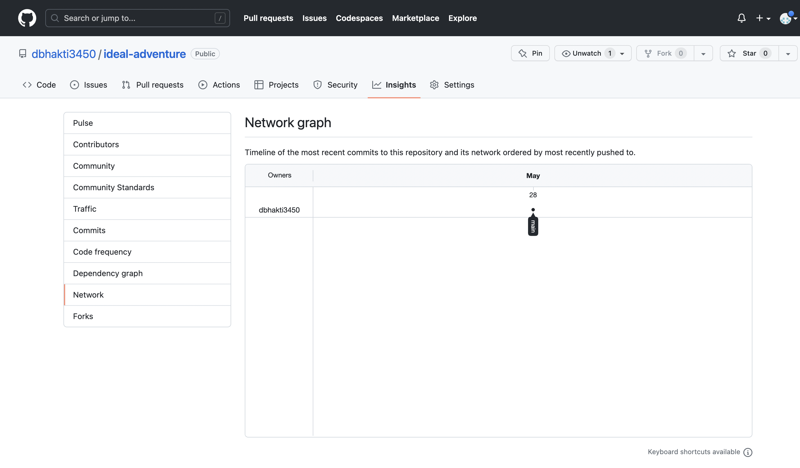
GitHub
Insight
Shows data of repository
Contributor history
Community discussion on the repository/projects
Traffic: clones
Commits: shows changes made
Network: timeline of most recent commits

Slide 3
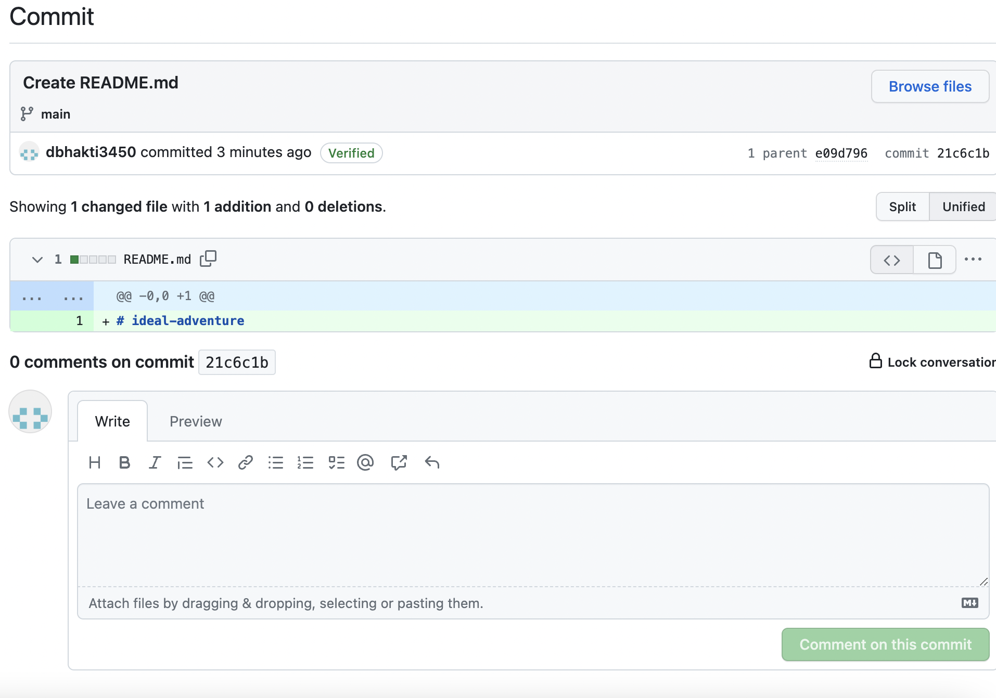
Network/Commits/Changes
Allows you to pull/view all the prior changes
Versions/drafts for changes
Convenient for group projects

Slide 4
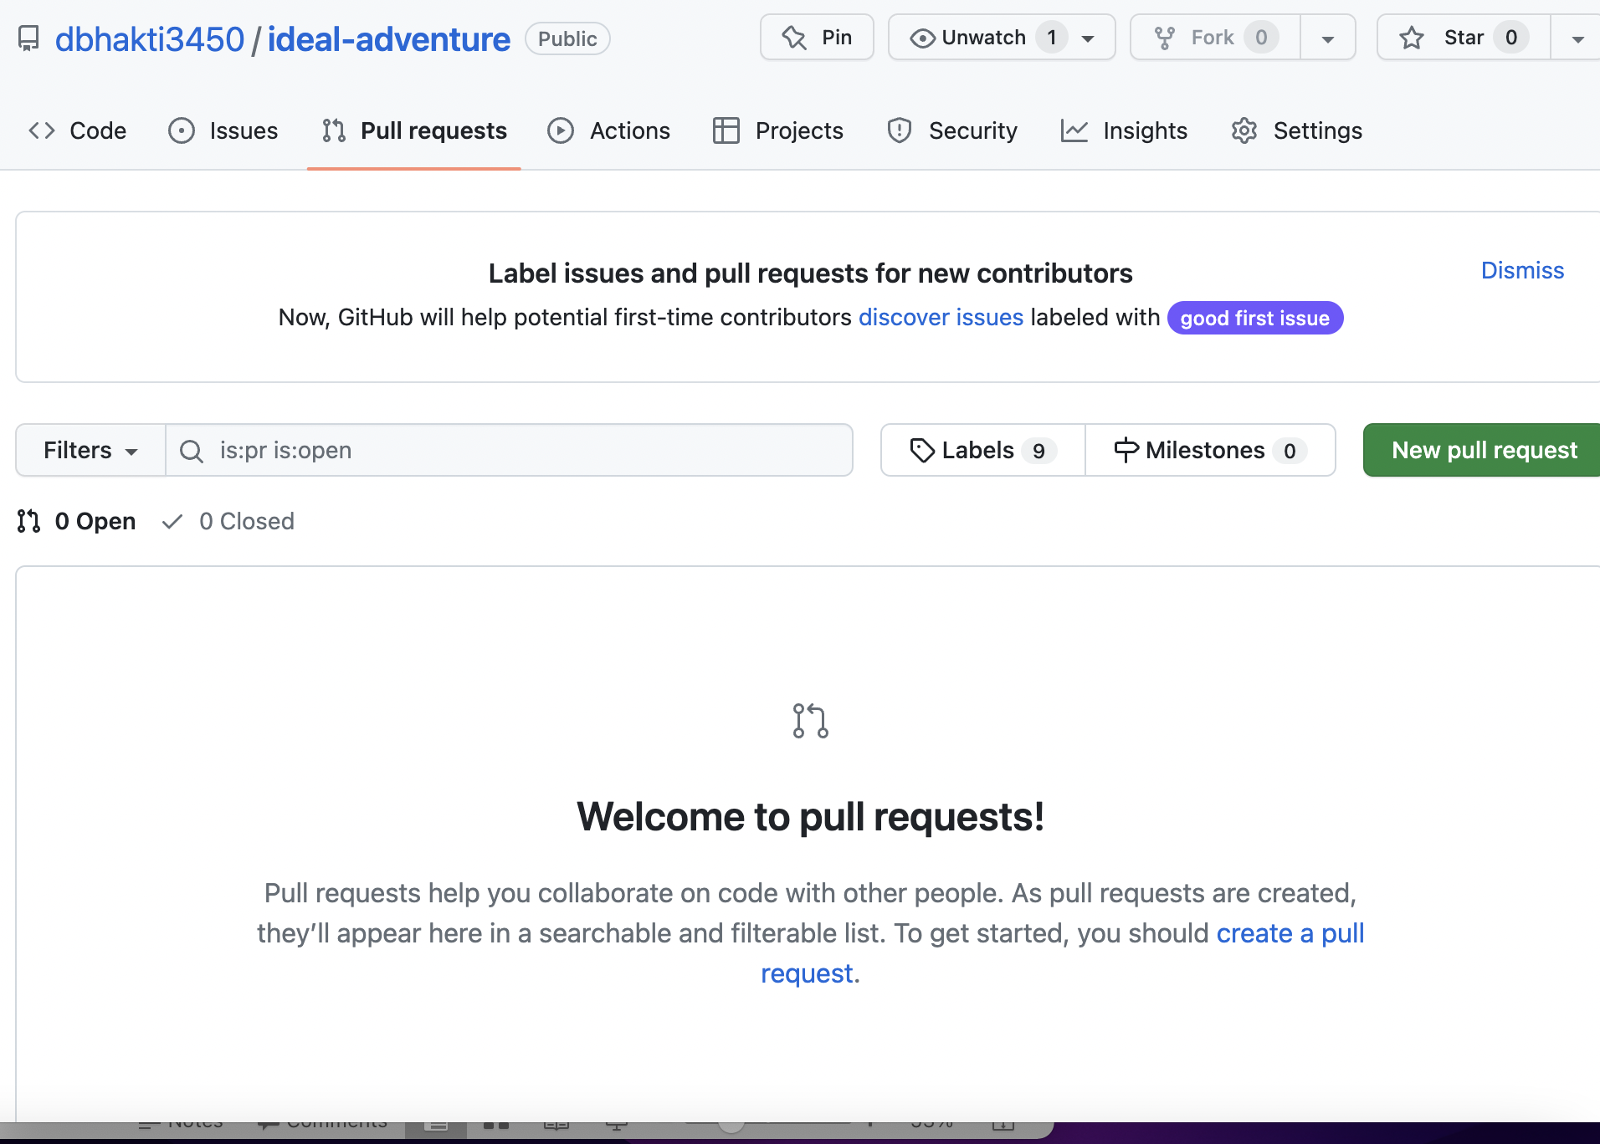
Pull requests
Let’s you request contributors
Resourceful
Detailed instructions for first time users on Github

Slide 5
Code Space
GitHub
Smart code space
Recognized the language and labeled the notebook
Python
Terminal
You can utilize your local space and terminal for your projects

Slide 6
Confusion
Learning curve
There are many resources for first-time users.
However, I learned that the first way to learn is with trial and error
Join project groups and learn from it.
Cloning
You can clone repository and work and learn from it

Slide 7
Conclusion
Useful space to showcase your technical skills
Share link to your projects and repository on LinkedIn and/or to your future employers
Learn from Community
Utilize the talents on the platform

