Slide 1

Semantic Profiling
By C.Rama swaroop

Slide 2
Sematic Profiling is the process for to analyzing data , text , code or datasets is base on to understand what they really are and what they present as one liner : Understanding and Extracting meaning from data (or) meaning.

Slide 3
Example :
"Apple released a new iPhone."
Semantic profiling identifies:
Apple → company/organization
released → action
new iPhone → product
Overall meaning → Apple launched a new product

Slide 4
In NLP (Natural Language Processing)
Semantic profiling can involve identifying:
1.Meaning of words
2.Relationships between words
3.Entities — people, companies, places, products, etc.
4.Context
5.Intent behind a sentence
6.Sentiment — positive, negative, neutral

Slide 5
Example
Example
Text:
"I loved the movie. The acting was excellent!"
Semantic profile:
Topic → Movie
Sentiment → Positive
Opinion → Loved
Attribute → Acting
Evaluation → Excellent

Slide 6
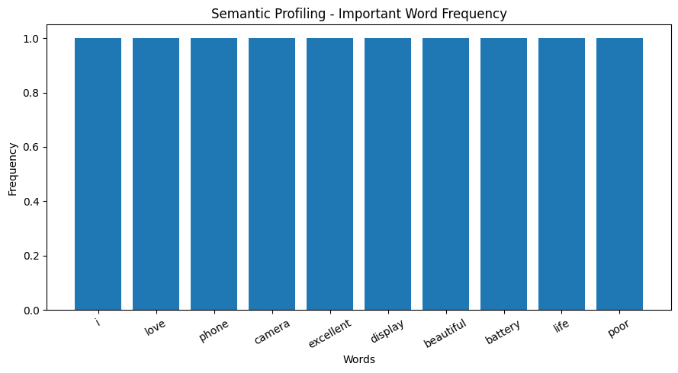
Semantic Profiling in words frequency by graph

Slide 7
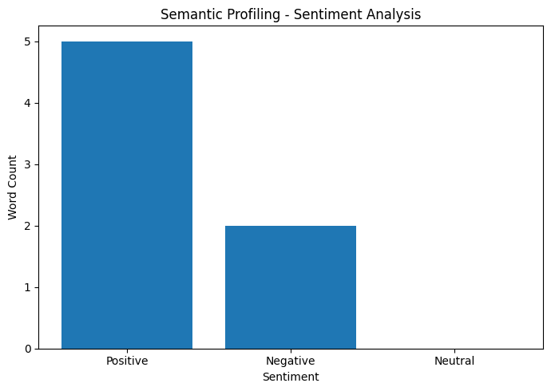
Semantic profiling by sentiments

Slide 8
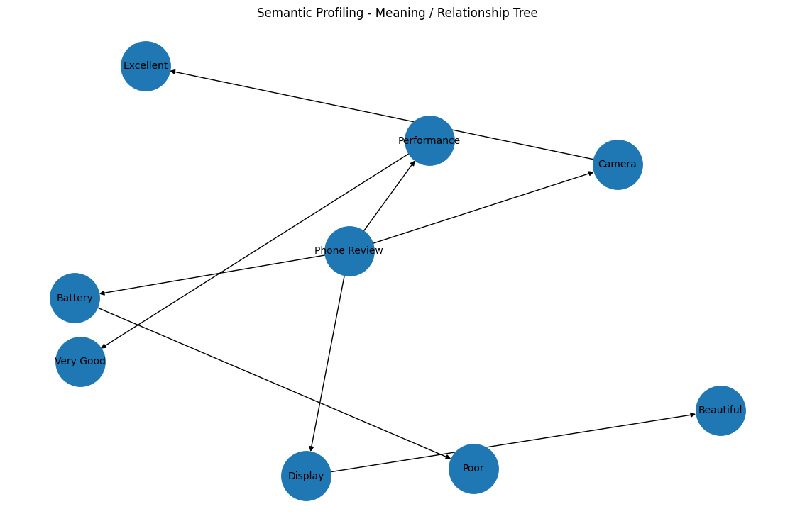
Semantic Profiling by tree relationship

Slide 9
Example |Tree representation by code|
“I love this phone. The camera is excellent, but the battery is poor.” Phone Review
├── Camera
│ └── Excellent
├── Display
│ └── Beautiful
├── Battery
│ └── Poor
└── Performance
└── Very Good

