Slide 1
◐
Lucid Voice
Speak again — in your own voice.
On-device AAC that turns 2–3 tapped words into a full, situationally-correct sentence —
spoken in a cloned version of the user's own voice.
On-device & private
Your cloned voice
Personal-memory layer
A 90-second setup — then a live demo
01 / 05

Slide 2
◐ Lucid Voice
THE LEAP
Tap two words. Speak a whole
sentence — in their own voice.
~8 wpm on a tap-board today → ~150 wpm of ordinary speech
She taps
cold
window
“Could you close the window? I'm getting cold.”
→
SPOKEN IN HER OWN VOICE
Lucid Voice
02 / 05

Slide 3
◐ Lucid Voice
THE THESIS — AND THE MOAT
The same input → a different, correctly-registered reply, depending on who is listening.
→
TO SOFIA (DAUGHTER)
tired · maybe
“I'd love to, sweetie, but I've been so tired. Can I tell you Saturday?”
→
TO MATEO (GRANDSON)
tired · maybe
“I'm a little tired right now, mijo. Maybe after my nap? I love you.”
The moat: a personal-memory layer + on-device privacy + your own preserved voice — not the text generation, which any LLM can do.
Lucid Voice
03 / 05

Slide 4
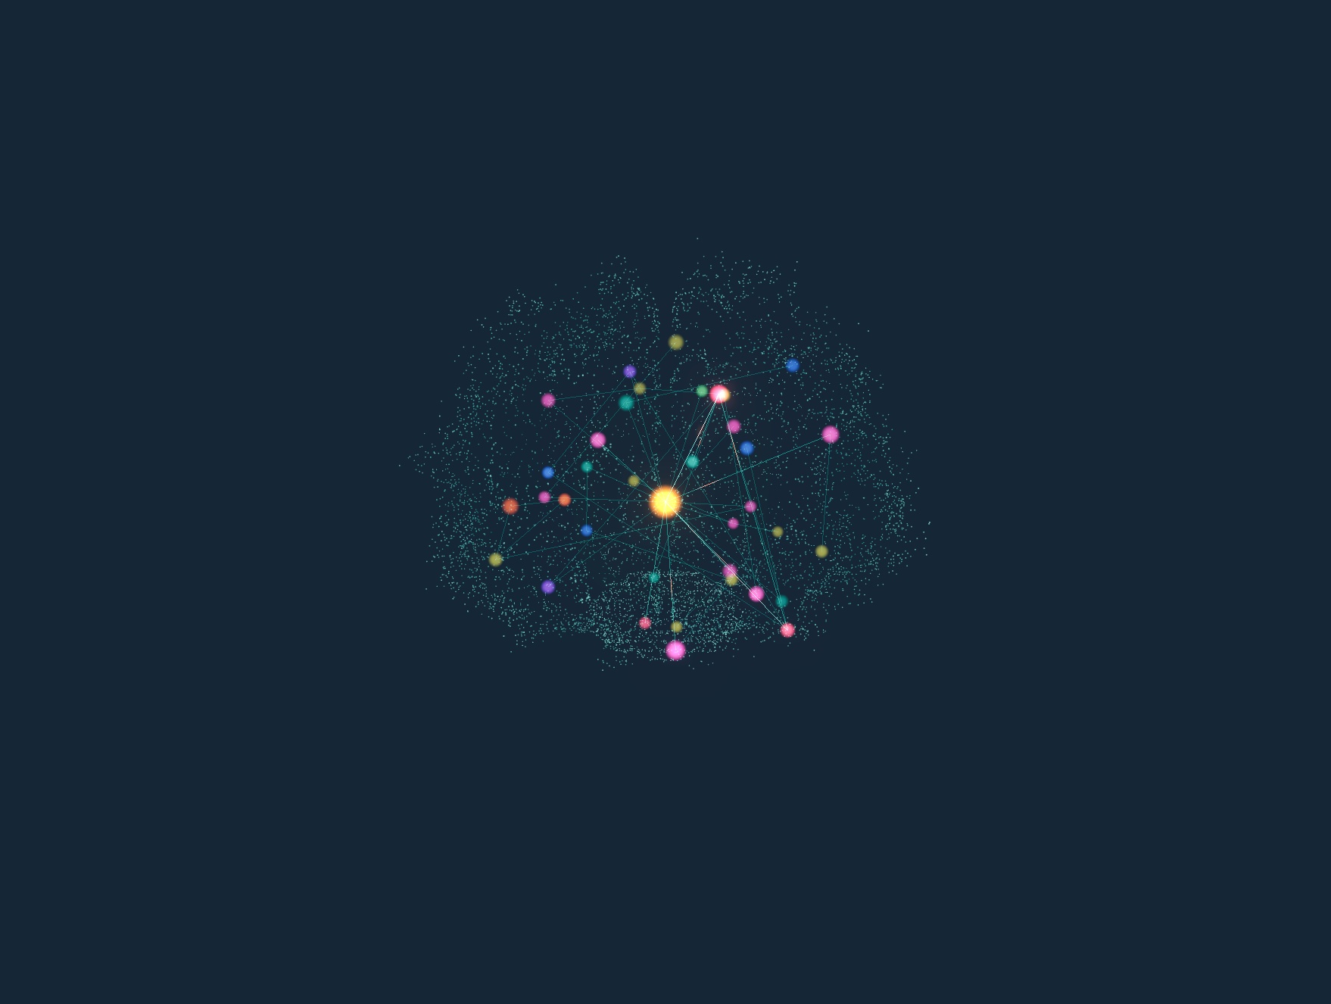
NOT A BLACK BOX
Watch your
memory fire.
Every reply is grounded in your personal knowledge graph — and the exact memories that shaped it light up, live. This is a real screen, not a mockup.
Build your brain — a warm AI interviews you, and each answer blooms a new memory onto the graph.
Lucid Voice
04 / 05

Slide 5
◐ Lucid Voice
ON-DEVICE, AND RUNNING TODAY
Private by design — demo-safe by
the very same property.
RUNS LOCALLY
OPT-IN CLOUD — SPONSORS
Personal knowledge graph + retrieval
Local LLM · Whisper STT · XTTS voice clone
Airplane-mode capable — no Wi-Fi needed
ElevenLabs — premium voice cloning / TTS
Deepgram — fast partner speech-to-text
Claude — the reconstruction reasoning
Now — let's show you live.
ElevenLabs · Deepgram · Claude
Thank you
05 / 05

