Slide 1
EPIC 2D SHOOTING GAME
Dev Bhatia, Ryuichi Ohhata, James Wasson, Justin Lam, Zhiyuan Liu

Slide 2

IN THE BEGINNING THERE WAS NOTHING:

Slide 3
Then... there was something!

Slide 4
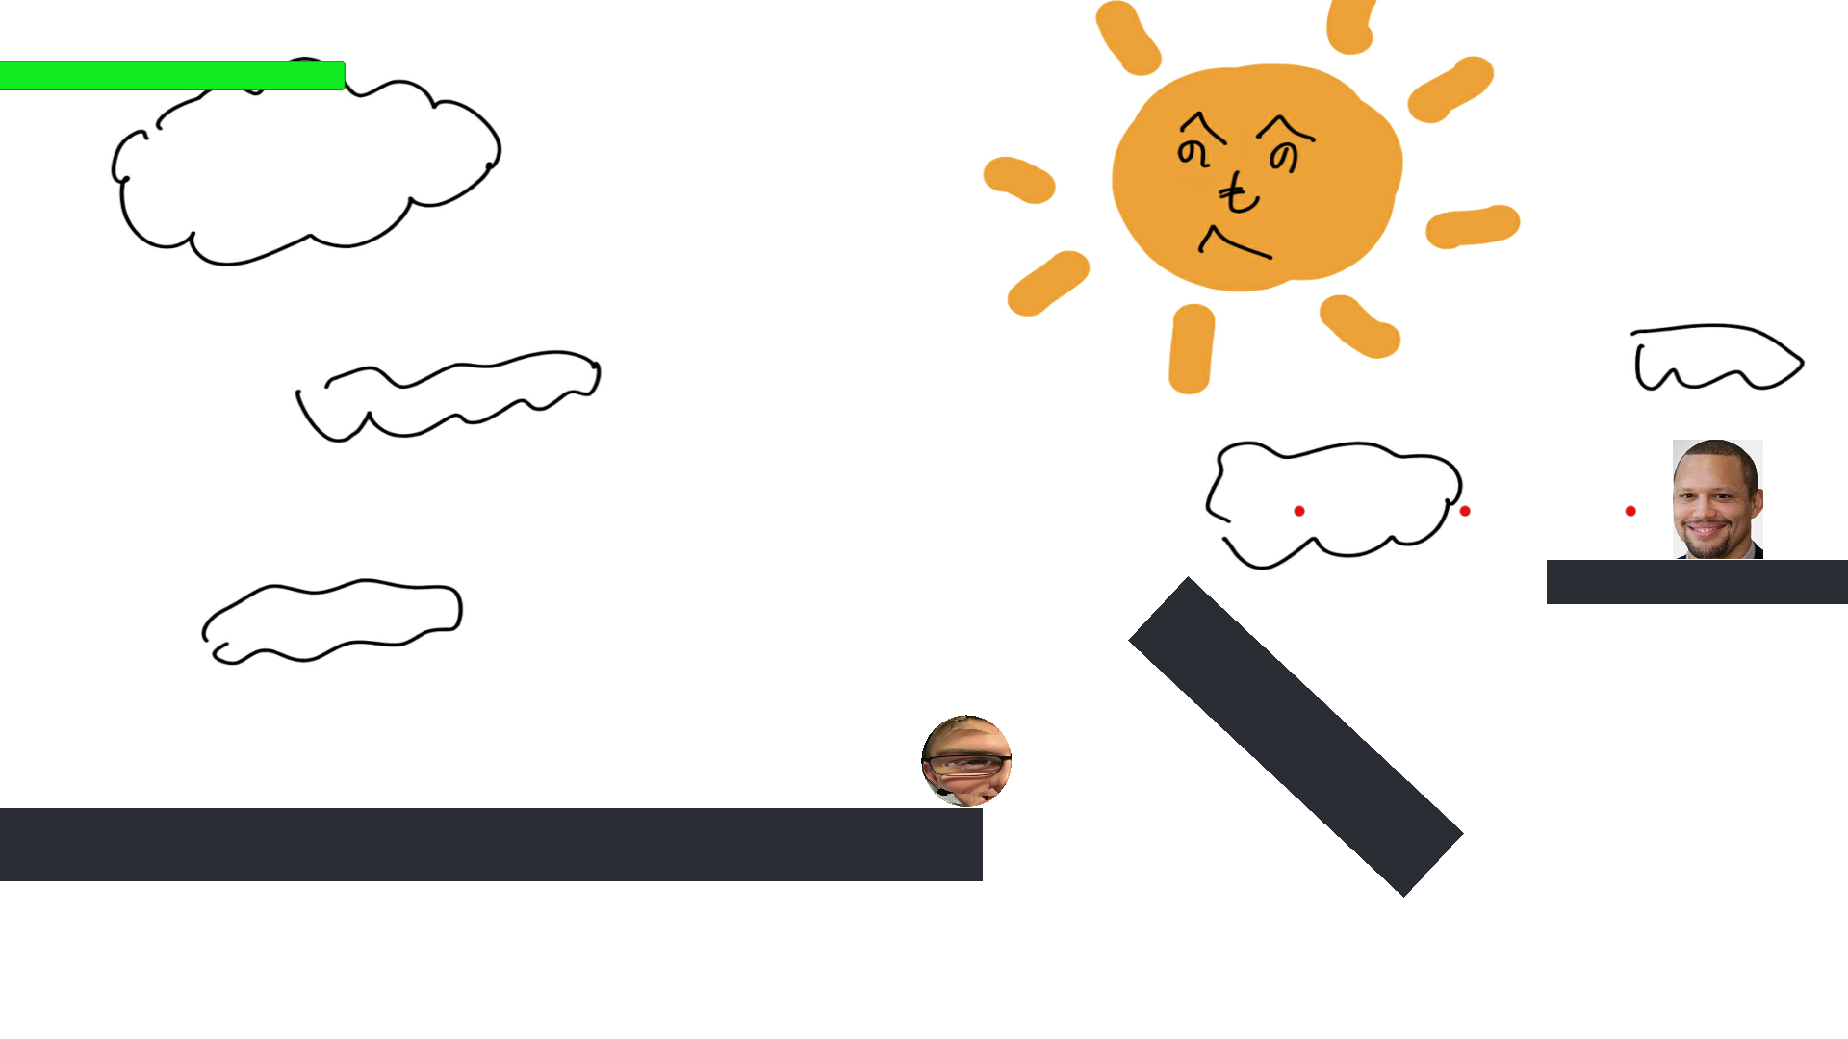

Slide 5
Two Possible Outcomes:

Slide 6
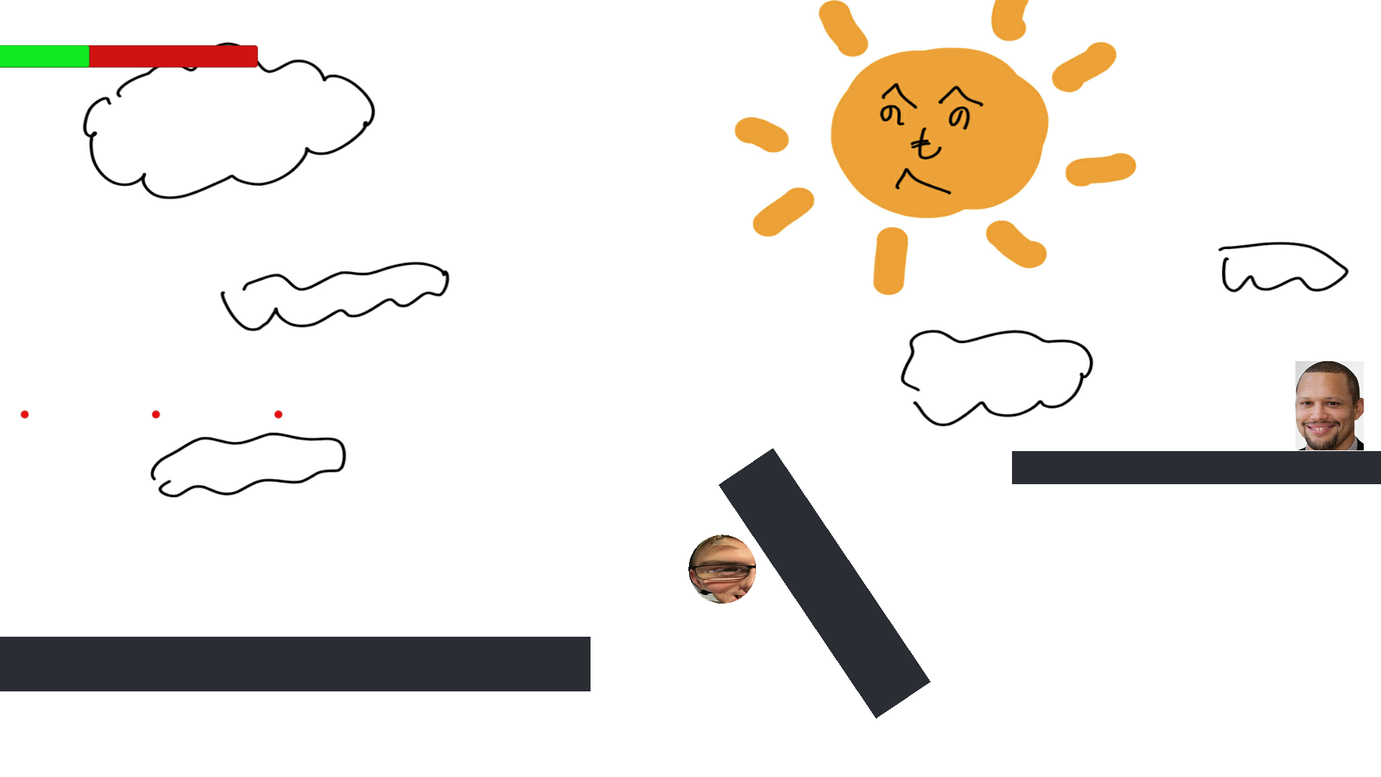
Death By Falling:

Slide 7
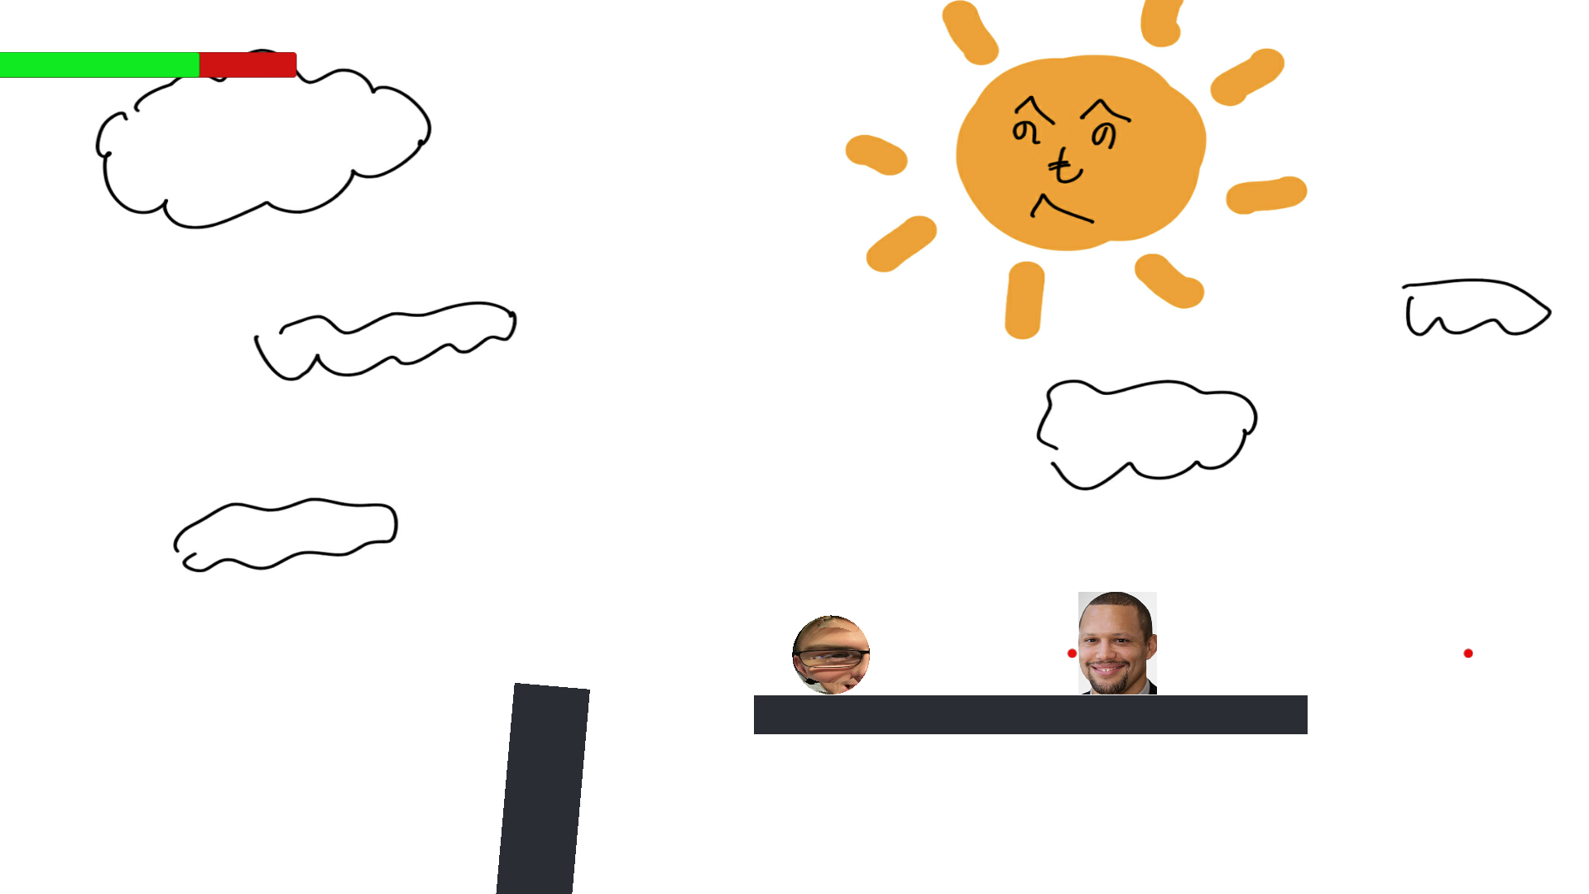
Land on Platform:

Slide 8
Land on Platform-> Two More Outcomes:

Slide 9
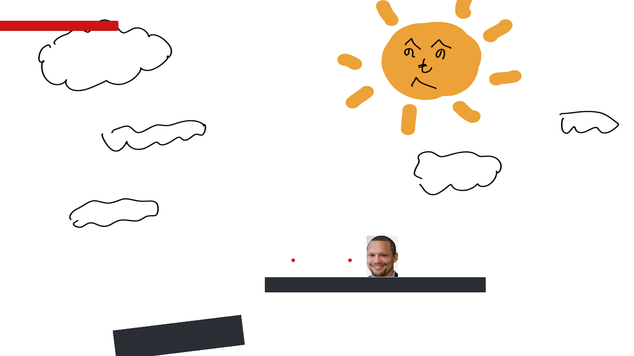
Death by Enemy:

Slide 10
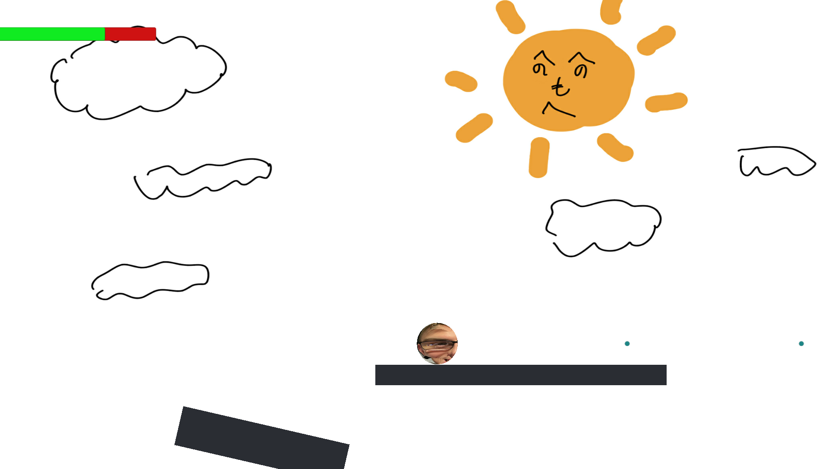
Beat Enemy and Move onto Next Stage:

Slide 11
Wait! There’s More!

Slide 12
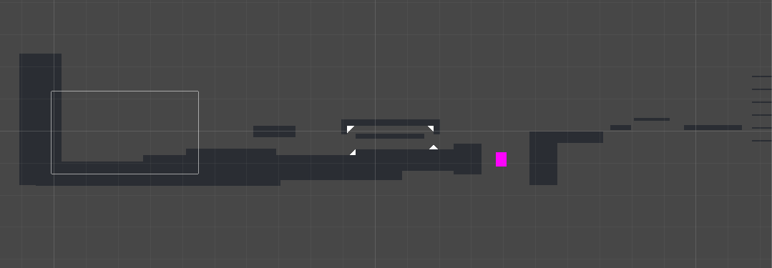
We have this stage to implement into the game:

Slide 13
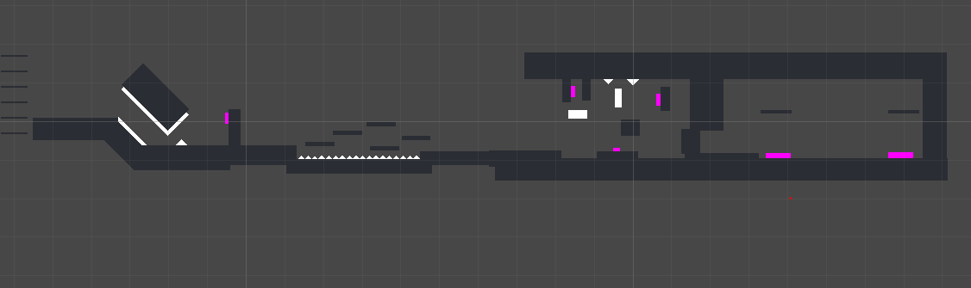
The last box will include a final boss!

Slide 14
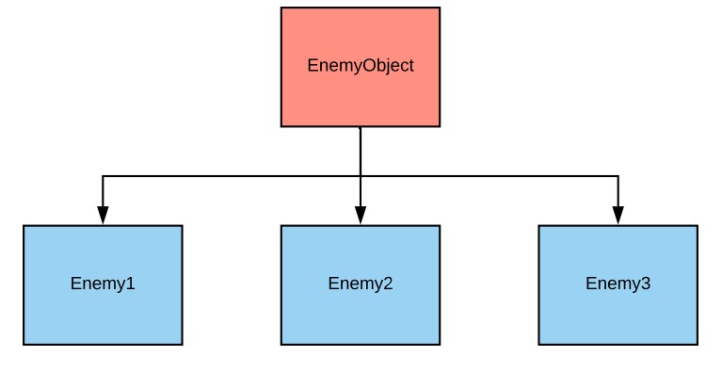
Enemy Class Hierarchy:

Slide 15
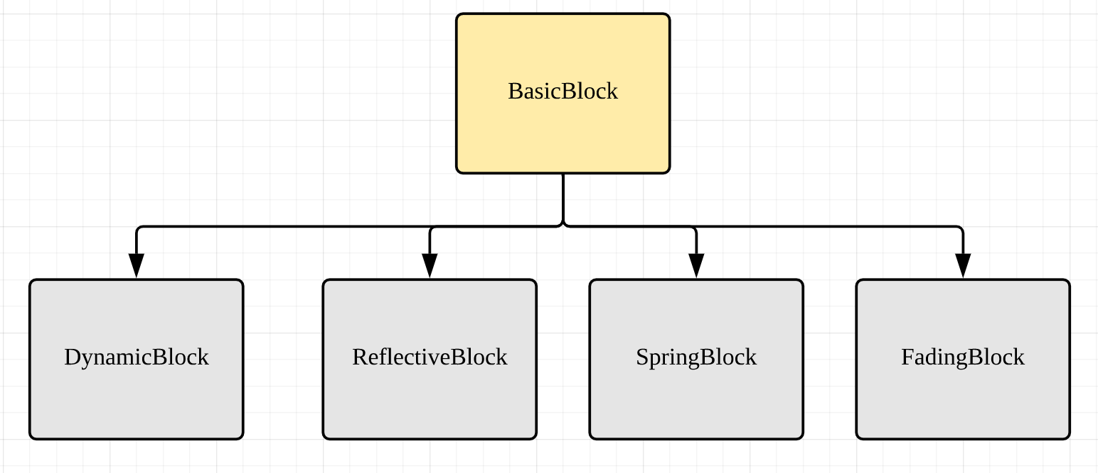
BasicBlock Class Hierarchy:

Slide 16
Explanation:
More minor enemies from the base class EnemyObject are included in the new stage
The stage also includes a final boss with more attack capabilities and health than previous enemies
Both the player and the boss have a health bar that indicates how much damage each has taken
You can see this in previous examples of gameplay
The health bar also follows the player and final boss
This means that both the player and the final bosses invoke the CharacterHealth class

Slide 17
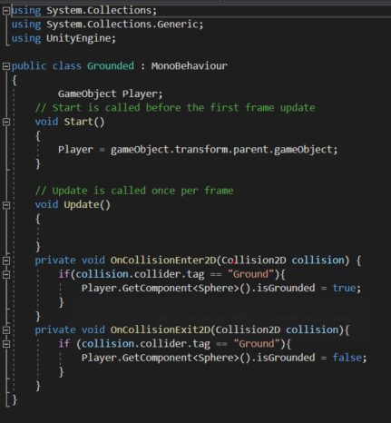
Difficulties:
This grounded class, we couldn’t get to work
Originally tried to use this to make the player jump, but we ended up finding a work around

Slide 18

exit(EXIT_SUCCESS)

