Slide 1
Update - Week 6 & 7
Dev Bhatia
Ultrafast Optics Laboratory
Boston University

Slide 2
Paper Analysis
Ganguly, M., Jenkins, M. W., Chiel, H. J., &amp; Jansen, E. D. (2016). Modeling the effects of elevated temperatures on action potential propagation in unmyelinated axons. Clinical and Translational Neurophotonics; Neural Imaging and Sensing; and Optogenetics and Optical Manipulation. doi:10.1117/12.2211048

Slide 3
Introduction
Using IR lasers, it is possible to deliver infrared light to tissue with high spatial and temporal specificity to control excitable tissues
Sought to analyze the potential mechanism of thermal inhibition by using computational models of a well-studied invertebrate model - the squid giant axon
Sought to test Huxley’s hypothesis that activation of voltage-dependent potassium ion channels was primarily responsible for thermal inhibition.

Slide 4
Model Axon Geometry
Length of 100mm
Diameter of 0.5mm
Current Injected for 250ms
Simulation timer for 500ms
If model ion axon diameter > 10 um -> depolarizing current = 2000na
If model ion axon diameter < 10 um -> depolarizing current = 100na

Slide 5

Model Axon Geometry
In order to assess the effect of axonal diameter on temperature response, axon diameter was varied from .5 to 500 um
Because axial radii vary with temperature in the HH model, the model was fitted with varying axial resistances
Segmental Current over j different segments

Slide 6
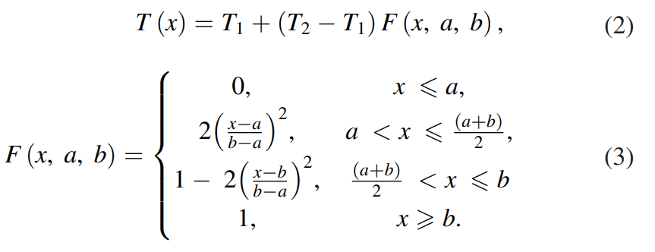
Simulating Temperature Changes
One half of the axon would remain at a base temperature (6.3 °C) while the other half’s temperature would be varied
Done to ensure that the transient currents induced by the initiation of an action potential were minimized

Slide 7
Simulation Temperature Change – Alt. Method
Temperature change is applied along the central region of a three-section axon
Used to determine the minimum length of the elevated temperature region that could block action potentials
An action potential is considered “blocked” if the potential at the end of the axon never exceeds -60mV

Slide 8
Temperature dependent parameters

Slide 9
Experimental Error

Slide 10
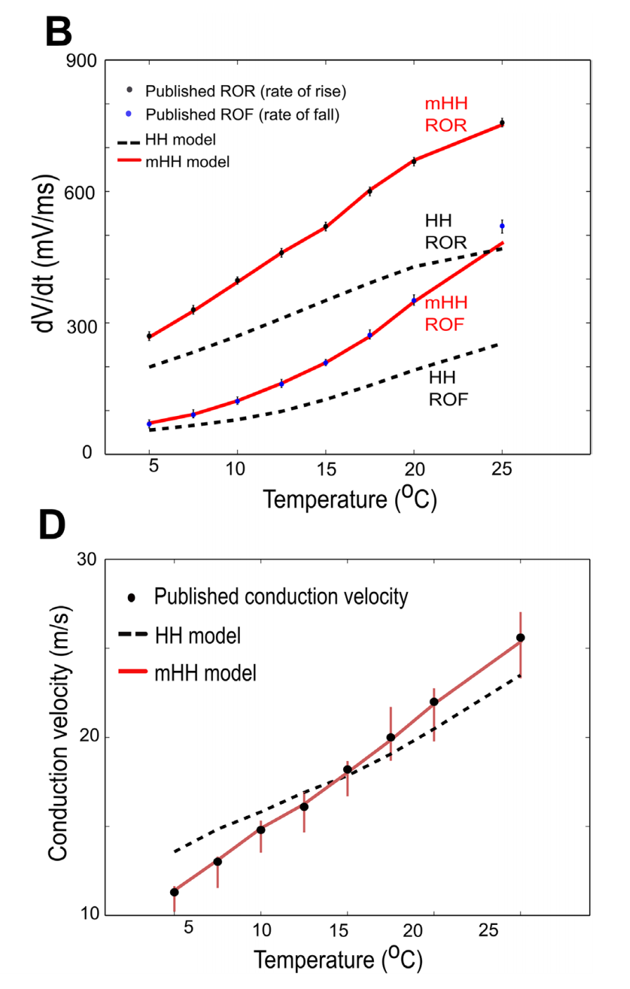
Results – Model Verification

Slide 11
Codebase Structure

Slide 12
Conclusion

Slide 13
Former Simulation Updates

Slide 14
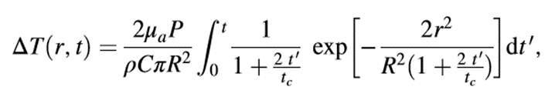


Varying Alternate Parameters
Taken from:
Li, Xinyu, Jia Liu, Shanshan Liang, and Changsen Sun. "980-nm Infrared Laser Modulation of Sodium Channel Kinetics in a Neuron Cell Linearly Mediated by Photothermal Effect." Journal of Biomedical Optics 19, no. 10 (2014): 105002-105002.
μa = 73.9 cm^-1 Optical Absorption Coefficient
R = 93.41 μm Beam waist at axial distance
z = 164.56 μm Axial Distance
tc = .01523 s Characteristic time of the thermal lens
P = variable wattage irradiation laser power, obeys Beer-Lambert law with the initial laser power Po
κ = 0.6 W/mK thermal conductivity
ρ = 1000 kg/m^3 density of water
c = 4188 J kg^-1 K^-1 heat capacity
r = 25 μm radius of the fiber core

Slide 15
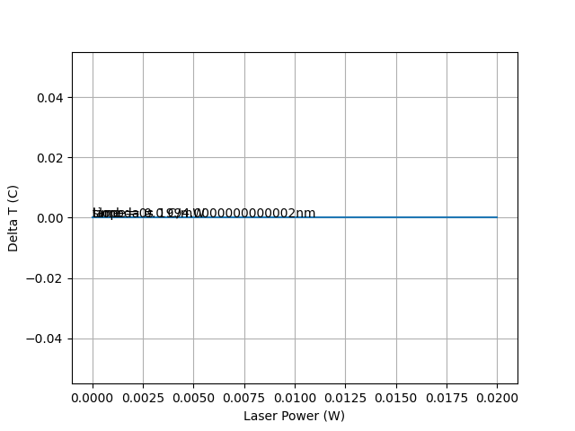
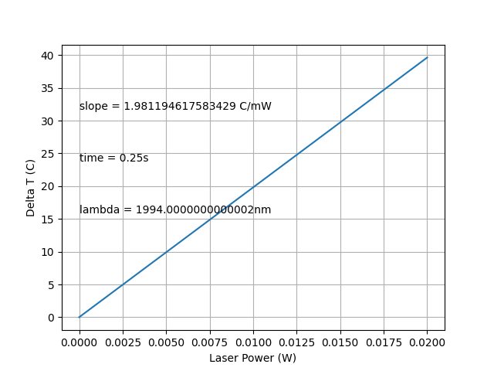
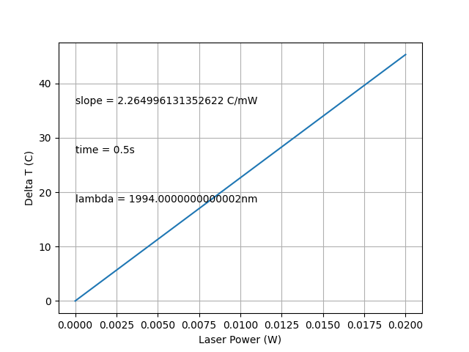
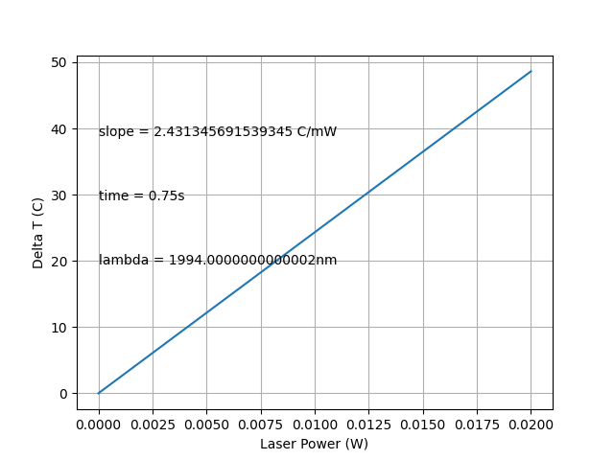
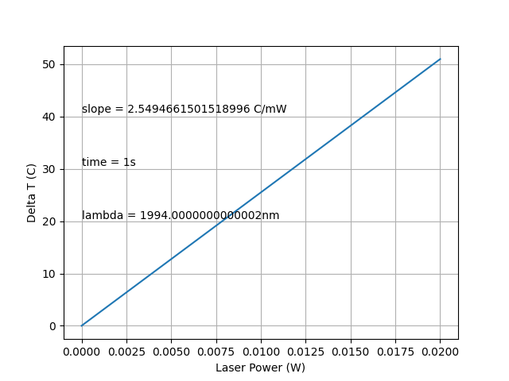
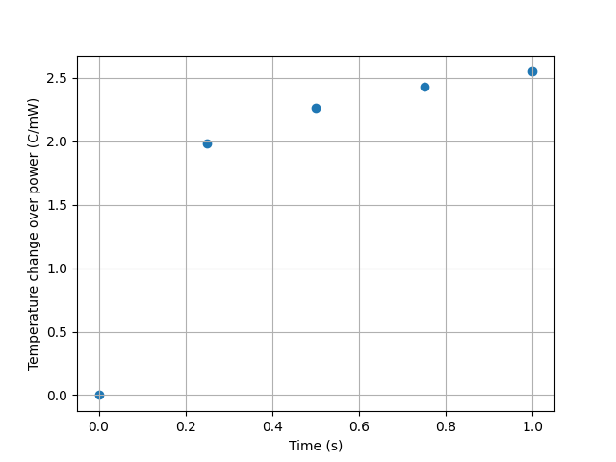
Varying Time

Slide 16
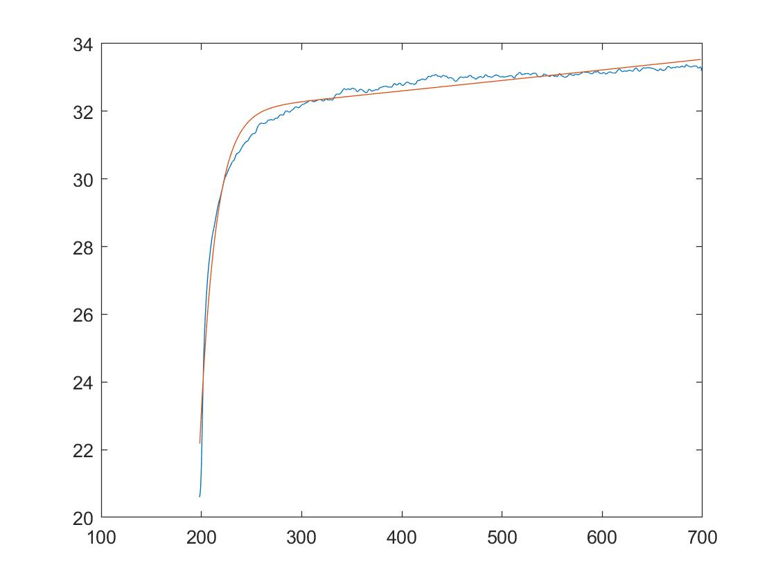
Comparison to Temperature Data

Slide 17
Next Steps
Looking for Neuron-based files in the codebase yielded only one result
Move through the rest of the repository (Jupyter Notebook / CSV files) in order to see the origin for the other graphs
Implement Varying Radius (accounting for elliptical shape)

