Slide 1




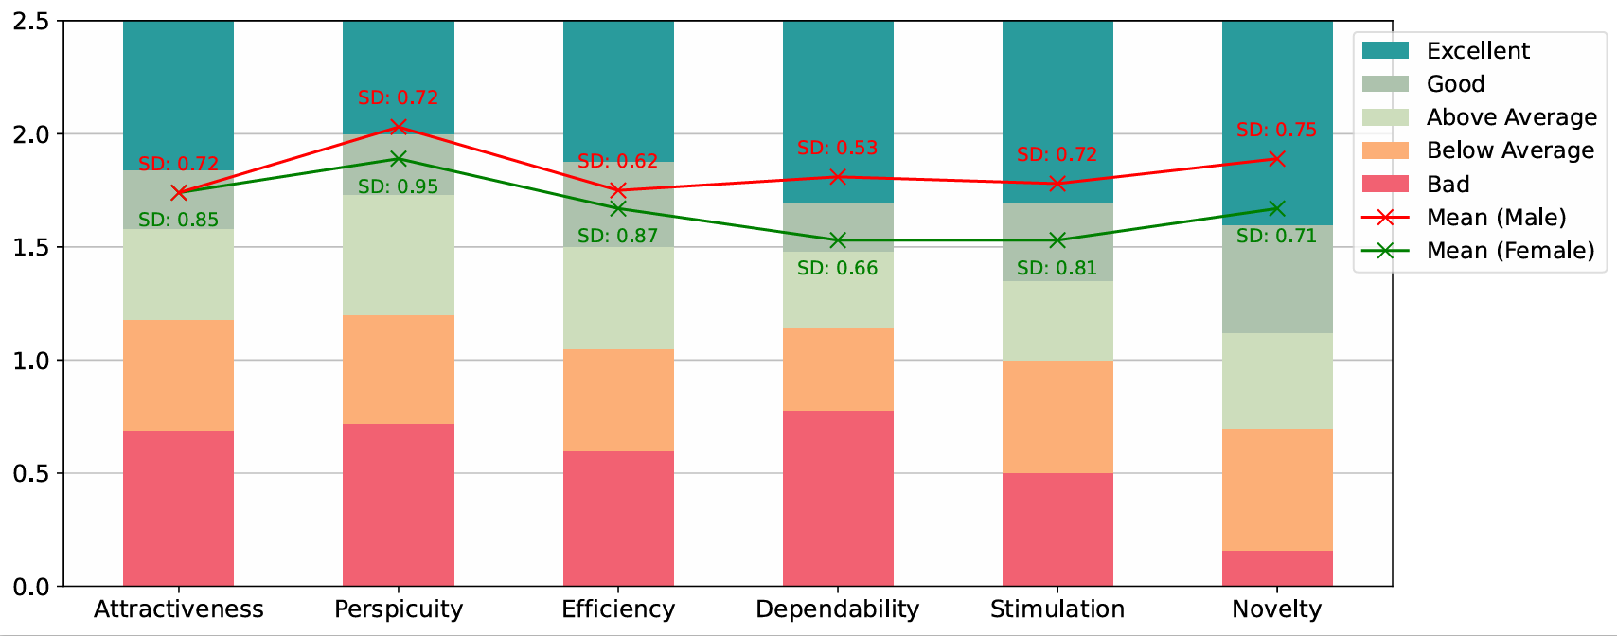
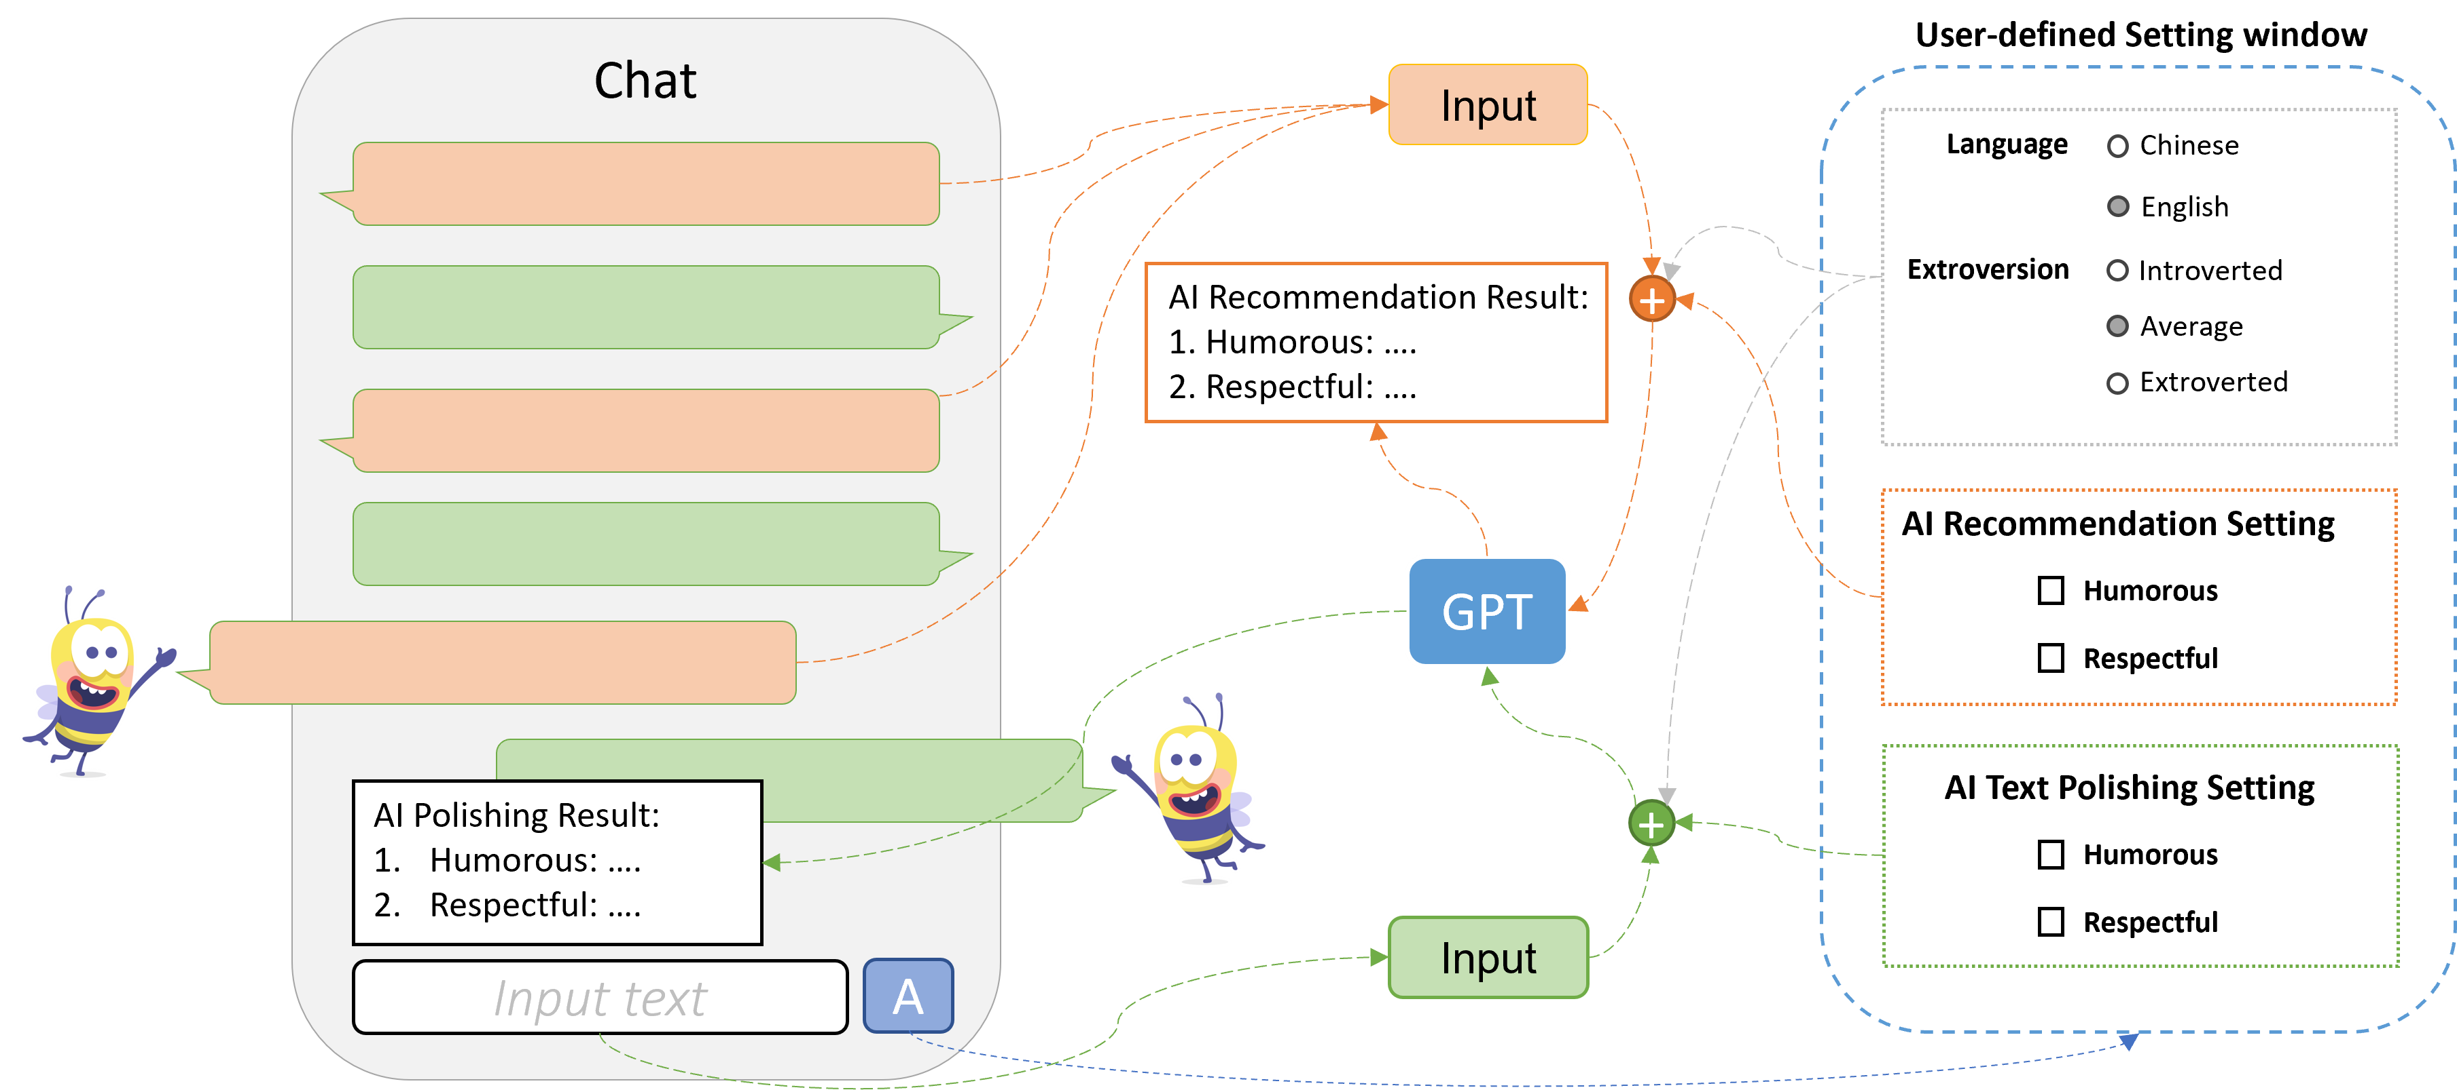
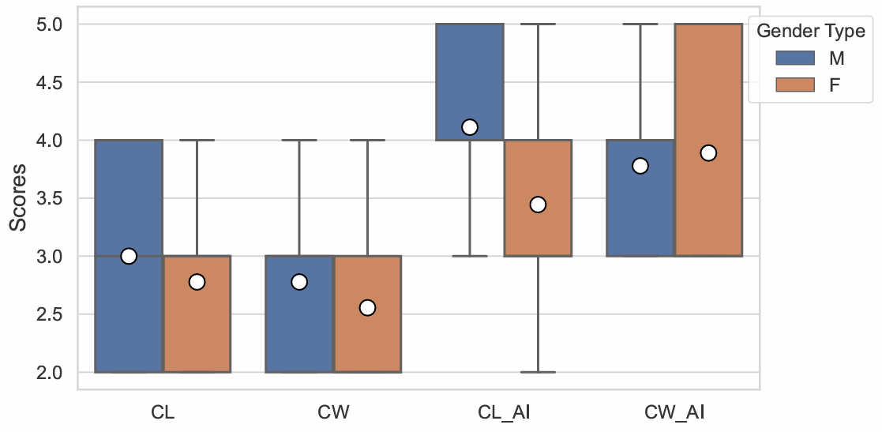
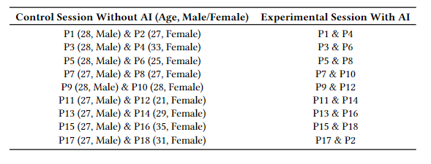
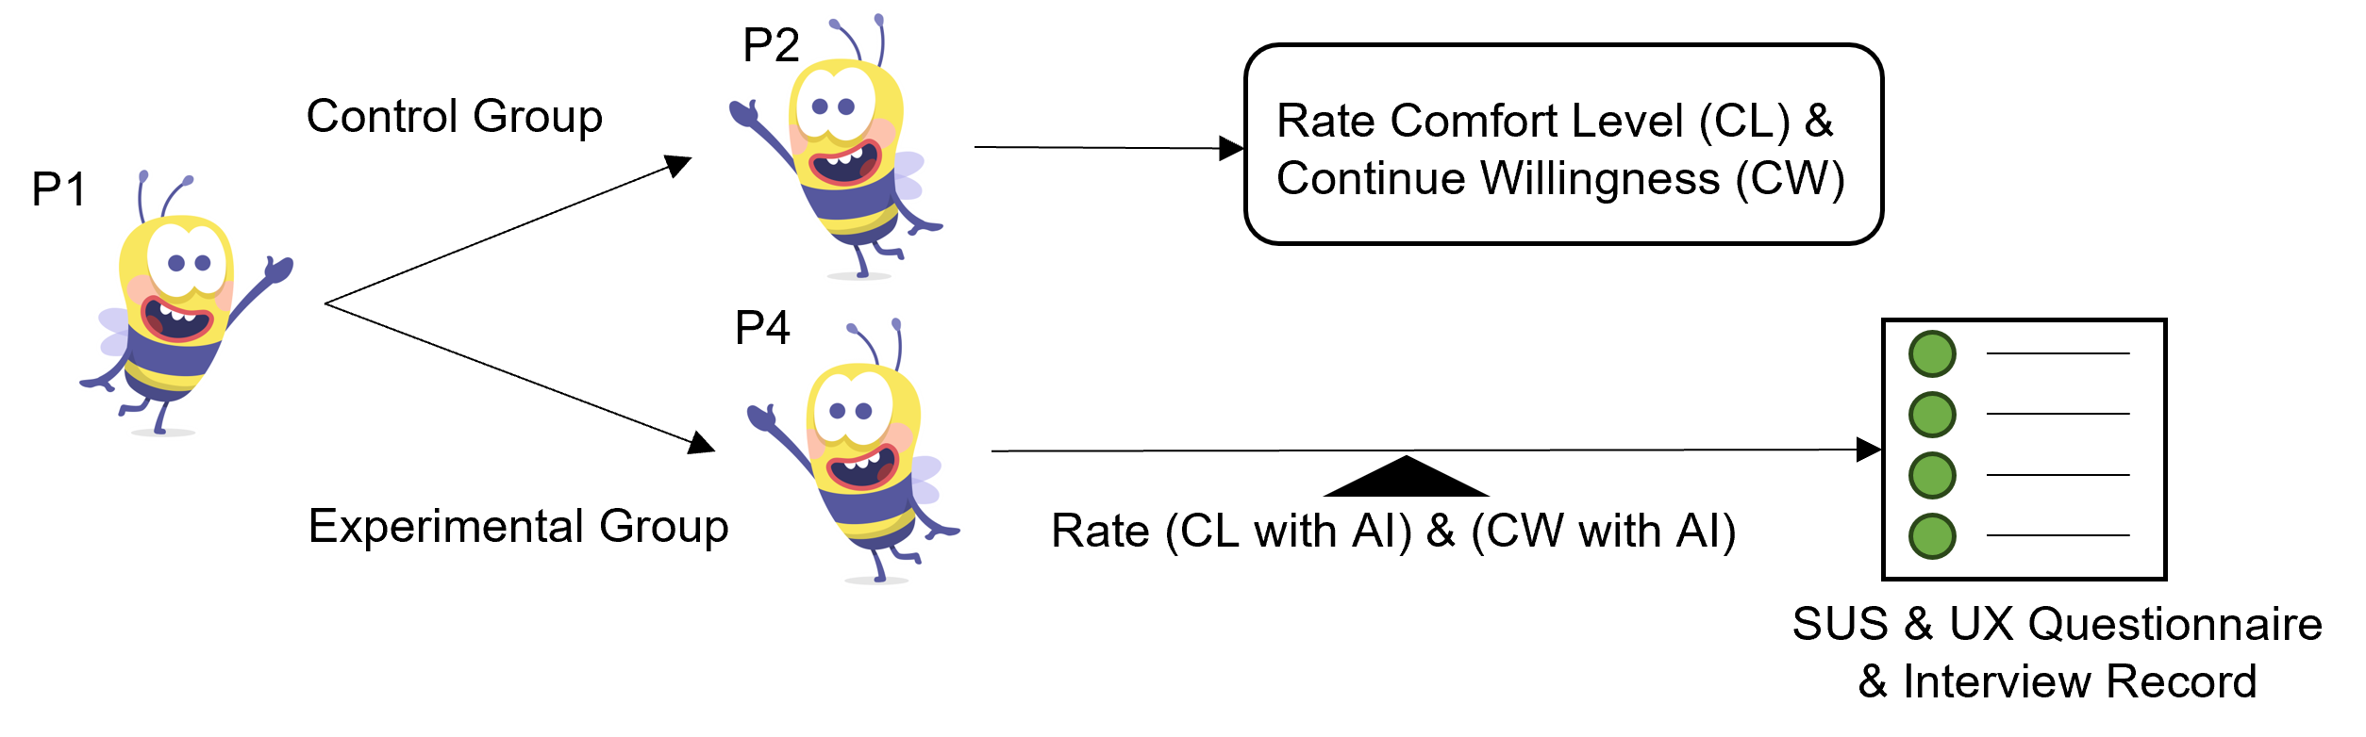
Impact of Personalised AI Chat Assistant on Mediated Human-Human Textual Conversations: Exploring Female-Male Differences
Abstract: In text-based communication, the enhancement of user experiences during the earliest stages of contact, particularly while establishing rapport, is of utmost importance. This research investigates differences between males and females in the utilisation of an AI conversation assistant at the beginning of a conversation. The system has text ``Recommendation'' and ``Polishing'' capabilities and can customise the linguistic style, selecting either a humorous or a respectful tone. Users could also choose between three different levels of AI extraversion. In user evaluation studies, the system received a favourable usability rating, confirming its efficacy. Generally, male users reported a greater level of user experience compared to female users. However, both male and female users indicated an elevated sense of comfort and a greater inclination to sustain connections while utilising the AI system.
Jindi Wang, Durham University
Ioannis Ivrissimtzis, Durham University
Zhaoxing Li, University of Southampton
Lei Shi, Newcastle University
ACM Conference on Intelligent User Interfaces (ACM IUI) 2024
Contact: jindi.wang@durham.ac.uk
Scan for Full Paper
Introduction
Recent progress in AI and language models, particularly GPT-4, has revolutionized text-based communication. These models are now capable of analyzing sentiment, understanding context, and mimicking diverse writing styles. AI-powered chat assistants signify a transformative shift in how we interact with technology, enhancing efficiency and altering fundamental aspects of human connection. In both digital and face-to-face communication, the initial encounter, often referred to as "icebreaking", plays a crucial role. These early interactions set the tone and influence the trajectory of subsequent dialogues in professional and personal settings. Integrating AI in these initial stages offers unique opportunities to shape user experience positively. While much attention has been given to Conversational AI in task-oriented scenarios, their potential in enhancing human-human dialogues, particularly at the onset, remains underexplored. This study delves into the utilisation of personalised AI chat assistants in initial text-based interactions, with a specific focus on discerning the differential impacts on male and female users. It aims to unveil how gender influences the interaction with AI in early conversation phases.
Metrics
Quantitative metrics such as the System Usability Scale (SUS) and User Experience (UX) questionnaire were utilised to assess the AI system's performance.
Comfort Level (CL) and Continue Willingness (CW) were measured to understand engagement dynamics.
Result
Implementation
The core of the AI chat assistant is powered by OpenAI's GPT-3.5 API, enabling sophisticated natural language processing and generation capabilities as shown in Figure 1. Users can personalise their interaction with the AI, adjusting its level of extraversion (introverted, average, extroverted) and choosing between linguistic styles (humorous or respectful). This customisation enhances user experience by aligning the AI's responses with individual preferences.
(Figure 3)
(Figure 1)
(Figure 4)
User Study
To evaluate the impact of a personalised AI chat assistant on the user experience during initial text-based interactions, with a focus on understanding gender differences in user engagement and perception. A cohort of 18 Chinese participants was involved as shown in Table 1, with an even gender split to ensure a balanced representation. Participants were randomly paired for text-based conversations, with each pair consisting of one male and one female participant. To maintain consistency, all participants discussed a predefined topic: travel.
Discussion
Interpretation of Findings: The study revealed notable gender differences in user experience with AI chat assistants. Male participants generally reported higher levels of comfort and user experience, indicating potential gender-specific preferences or perceptions towards AI interactions.
SUS and UX Insights: The AI chat assistant was well-received in terms of usability and overall user experience, as reflected in SUS scores and UX dimensions. This highlights its potential as a tool for enhancing text-based initial interactions.
AI's Role in Facilitating Communication: The increase in comfort level and willingness to continue interaction when using AI assistance suggests that AI can play a crucial role in easing initial communication barriers and fostering more engaging conversations.
Reflection on Gender Differences: The differences observed between male and female participants underscore the need for more nuanced AI designs that can cater effectively to diverse user groups, taking into account their unique preferences and interaction styles.
Challenges and Future Directions:
Despite the positive outcomes, the study points to the need for further research, particularly in understanding the long-term effects of AI assistance on communication skills and self-expression.
Future iterations of AI chat assistants should focus on dynamic adaptation to user preferences and personalities, ensuring a more personalised and inclusive user experience.
(Table 1)
Control and Experimental Sessions:
Two distinct sessions were conducted for each participant:
Control Session: Engaged in a text conversation with a new acquaintance without AI assistance. Post-interaction, comfort levels and willingness to continue the interaction were assessed.
Experimental Session: Similar setup but with the inclusion of the AI chat assistant. Participants utilised text recommendation and polishing features, with evaluations conducted afterward.
Conclusion
AI Influence on Initial Interaction: AI chat assistants significantly enhance the user experience during initial text-based interactions.
Gender-Specific Experiences: Noticeable differences in user experience and comfort levels between male and female users when interacting with AI chat assistants. Generally, male users reported a greater level of user experience compared to female users.
Improved Comfort and Continuation Willingness: Both male and female users experienced an increased sense of comfort and showed a greater willingness to sustain connections while using the AI system.
Implications for AI Assistant Design:
Insights into gender differences can inform more nuanced and effective designs of AI chat assistants.
Customizable features catering to individual user preferences are crucial for the success of such systems.
(Figure 2)

