Slide 1

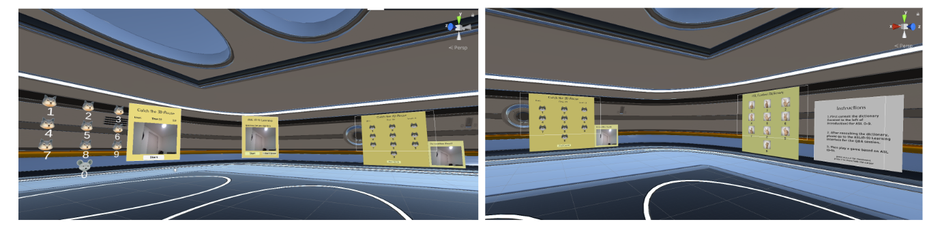
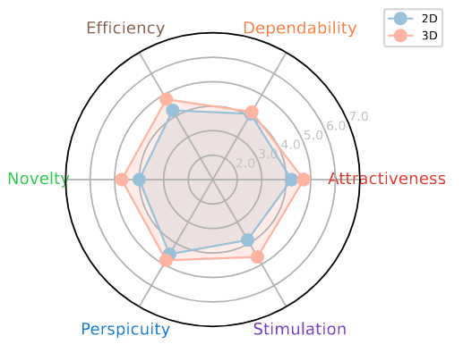
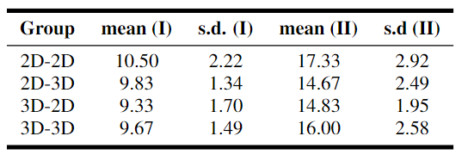
Comparative Efficacy of 2D and 3D Virtual Reality Games in American Sign Language Learning
Abstract: With ongoing advancements in virtual reality and gamification, researchers have started exploring their application in sign language learning, aiming at enhancing communication between hearing individuals and the deaf community. This study compares the impact of 2D and 3D games on American Sign Language (ASL) learning, using questionnaires to assess user experience. Results show that 3D games enhance engagement, attractiveness, usability, and efficiency, although user performance remains similar in both environments. The findings suggest the potential of 3D game-based approaches to improve ASL learning experiences while also identifying areas for enhancing their dependability and clarity.
Scan for Full Paper
Jindi Wang, Durham University
Ioannis Ivrissimtzis, Durham University
Zhaoxing Li, University of Southampton
Lei Shi, Newcastle University
Contact: jindi.wang@durham.ac.uk
Introduction
This poster presents a comparative study of 2D and 3D game-based environments in teaching American Sign Language (ASL) numbers. Our research addresses a gap in understanding how different virtual environments affect learning outcomes, user experience, and system usability in ASL education. By contrasting 2D and 3D settings, we aim to uncover insights that can guide the development of more effective and inclusive digital learning tools. This study is particularly relevant for designing accessible educational technologies that cater to diverse learning needs, contributing to a more inclusive approach in language learning and technology design.
(Figure 1)
Results
The study yielded the following key findings:
High Usability Scores: Both 2D and 3D environments scored well in usability, with the 3D version slightly outperforming the 2D. These scores indicate good user-friendliness in both modalities.
Superior User Experience in 3D: In terms of user experience, the 3D environment rated higher in aspects such as attractiveness, efficiency, and novelty as shown in Figure 2. However, both versions showed room for improvement in dependability.
Similar Learning Outcomes: Despite the differences in user experience, the learning effectiveness of both 2D and 3D environments was comparable. This was evident in the participants' similar performance in learning ASL numbers in both settings as shown in Table 1.
Impact of Environment Switching: Participants who switched between 2D and 3D environments showed a slight decrease in performance compared to those who remained in the same environment, suggesting a minor adaptation challenge when changing learning modalities.
Implementation
Game Design: Our study features two versions of a "whack-a-mole" style game designed for learning ASL numbers 0-9. The 2D version presents a simple grid interface on a standard display, while the 3D version utilizes virtual reality (VR) for an immersive experience. Both versions share a common gameplay mechanic: players "whack" a mole by correctly signing the ASL number corresponding to its location.
Technology: The 3D game is experienced through an HTC Vive Pro headset, harnessing eye-tracking for interaction. Gesture recognition across both versions is powered by Mediapipe, a versatile open-source library, ensuring accurate tracking and interpretation of ASL signs.
Gameplay Elements: Both game variants challenge players to quickly and accurately sign the ASL numbers. A time limit of 3 seconds per mole encourages fast-paced play, while a total game duration of 30 seconds ensures a focused and engaging learning experience. Players earn points for correct signs, offering a quantitative measure of their learning progress.
Focus on Learning: The design of both versions emphasizes intuitive gameplay to minimize cognitive load and maximize focus on learning ASL. This approach aligns with the objective to make sign language learning accessible and enjoyable, leveraging the interactive nature of games.
(Figure 2)
(Table 1)
Discussion
Enhanced Engagement in 3D: The immersive nature of the 3D environment notably improved user engagement, suggesting that such technologies can enhance motivation in learning contexts.
Comparative Learning Effectiveness: Despite the higher user experience ratings for the 3D environment, both 2D and 3D versions showed similar effectiveness in teaching ASL numbers. This highlights that effective learning can be achieved in various technological formats.
Design and Accessibility Considerations: The study emphasizes the need for thoughtful design in educational games. While 3D environments offer immersion, they require careful design to ensure ease of use. In contrast, 2D environments are more accessible and user-friendly, especially in settings with limited resources.
Implications for Future Research: Further studies should investigate long-term learning retention, explore different learner profiles, and examine the scalability of these technologies in diverse educational contexts.
Broader Educational Implications: This research contributes to the discussion on inclusive education, underscoring the potential of digital tools in making learning accessible and engaging for various learner groups.
Methodology
Participant Profile: The study involved 24 participants, aged 23-34, with no prior experience in ASL and no hearing impairments. This demographic was chosen to assess the effectiveness of our game in introducing ASL to beginners.
Study Design: Participants were randomly divided into two groups to interact with either the 2D or 3D game versions. A crossover approach was employed, where participants switched between 2D and 3D environments in a second session, allowing for a comprehensive comparison of experiences across both modalities.
Learning Stages:
Learn: Participants explored the virtual platform, becoming familiar with its interface and the ASL numbers.
Practice: A Quiz interface tested their understanding of ASL numbers through interactive questions.
Assess: The whack-a-mole game served as a practical assessment tool, with their performance in signing ASL numbers recorded as game scores.
Evaluation Metrics: Our evaluation focused on three key areas:
Usability: Assessed through the System Usability Scale (SUS) questionnaire.
User Experience: Measured using a user survey with scales such as Attractiveness, Efficiency, and Novelty.
Learning Outcomes: Determined by analyzing game scores as indicators of ASL proficiency.
Conclusion
Our study provides evidence that both 2D and 3D environments are effective for ASL number learning, with 3D offering enhanced user engagement and experience. Key takeaways include:
3D Enhances User Experience: The immersive nature of 3D environments significantly improves attractiveness, usability, and efficiency.
Effective Learning in Both Environments: Both modalities are effective in teaching ASL, showing similar learning outcomes.
Design Improvements Needed: There's room for enhancing the dependability and clarity in both environments, particularly in the 3D version.

