Slide 1
The hitchhiker's guide to Puerto Rico
IronHack Puerto Rico
Dan Bigman
Dylan Rodríguez Flores

Slide 2
TABLE OF CONTENTS
01.
02.
03.
Project
OVERVIEW
Datasets
Exploratory Data Analysis
04.
05.
06.
Methodology
Implementation
Conclusion
Project description and outcome expectations.
Insight into the datasets used in the project.
Data cleaning and preprocessing.
Steps taken to create the assistant.
UI for interaction with the user.
Key takeaways from the project.

Slide 3

Project Overview
In this project, you are going to use all the Data Science and Machine Learning skills you have acquired during the bootcamp to build an interactive travel planner for the beautiful island of Puerto Rico.
present a working application that cooperates with a visitor to help them build a travel itinerary suitable to their personal preferences.

Slide 4
Datasets
Municipalities
Landmarks
News articles
Info on all 78 municipalities of Puerto Rico.
Information about the landmarks on Puerto Rico
News articles that span across 40 years of history..

Slide 5


Exploratory Data Analysis
Municipalities
Landmarks
News Articles
78 Files of Raw HTML
Special Characters not properly encoded
Change Example:
Gu\xc3\xa1nica -> Guánica
574 files of Raw HTML
Special Characters not properly encoded
Missing coordinates
Replaced missing coordinates with N/A
1668 text files
Some misinterpreted characters
Empty files
Deleted empty files

Slide 6



Methodology
01.
02.
Converted municipalities and landmark files into a .json format for better, and cleaner, storage and retrieval.
{
"name": "Adjuntas, Puerto Rico",
"latitude": 18.162777777777777,
"longitude": -66.72222222222223,
"summary": “brief description”
},
Vectorization of the datasets with the help of chroma library.

Slide 7




Methodology
03.
04.
Function set up for logging, chatting and displaying responses.
Retrieve context from the vectors

Slide 8



Methodology
05.
06.
Response from the LLM using openai API.
Streamlit UI generation for user interaction on the frontend.

Slide 9
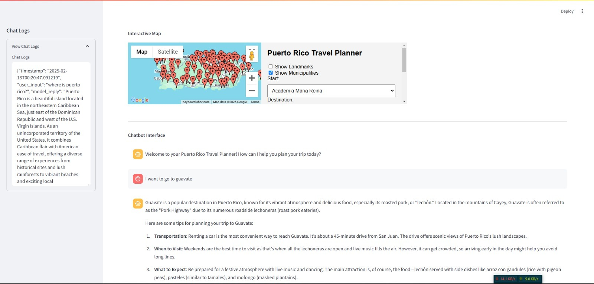
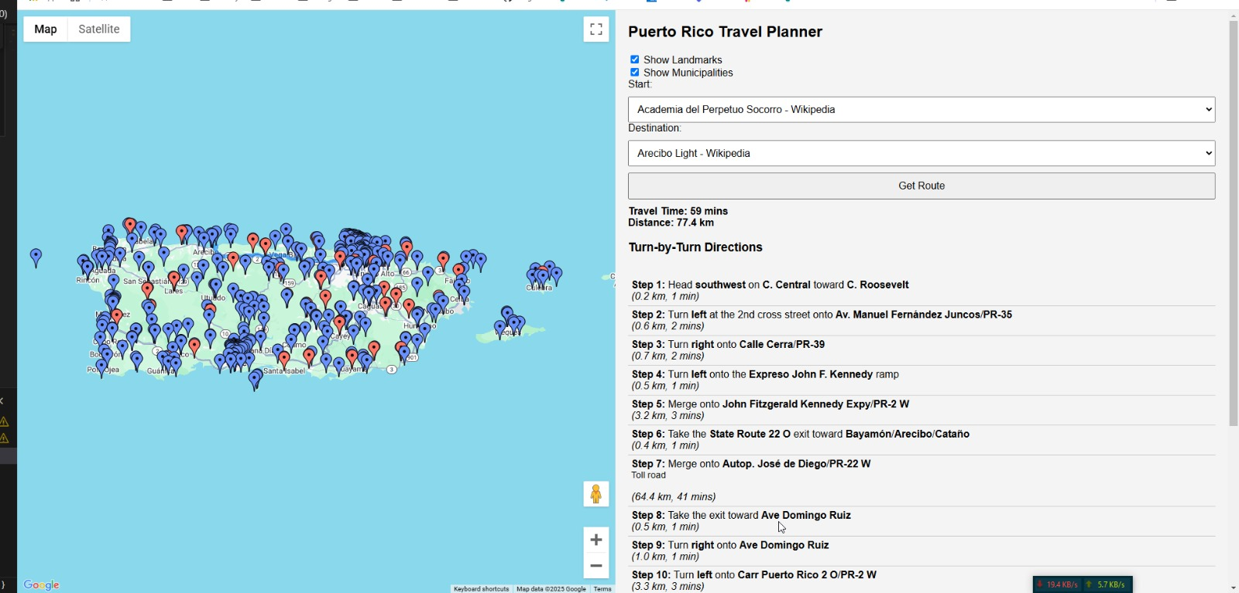
Implementation
Turn by turn route with time.
Persistent logging system
Guide that pulls up relevant points.

Slide 10
Conclusion
There were a lot of challenges during the development of the project and we learned how to overcome them by applying all the knowledge gained throughout the past 10 weeks. More importantly, the key takeaways from this projects are:
How important clean and organized datasets are.
Proper project structure and flow save a lot of time and effort.
API’s have limitless potential in enhancing applications.
When dealing with AI, “simple” tasks can be very computationally intensive.

Slide 11
Thank You!

