Slide 1
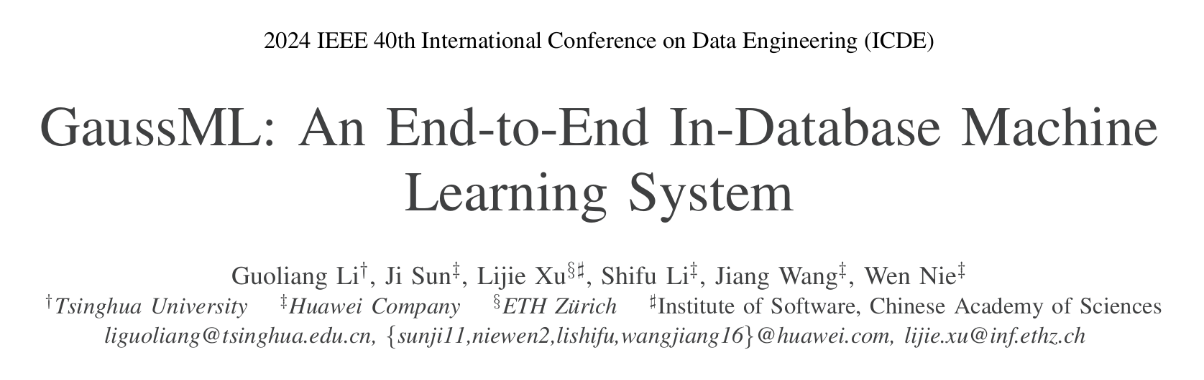

Slide 2
Contents
Introduction
In-DB ML
Problems & How GaussML Solve them
Overview
Query Planning Optimization
Query Execution
Experiment

Slide 3
Introduction on In-DB ML
API-based
UDF-based
SQL-native
(not strictly in-db)
(This paper)
DB and ML framework are uncoupled.
ML framework gets data with API given by DB.
In OS perspective, 2 processes run data management and ML separately.
In DB perspective, someone unknown directively extracts the data.
There are no ML framework outside DB.
DB supports UDFs that can run ML task.
Language in UDFs can be different from DB source code language.
In OS perspective, 1 process only.
When executing ML task, an additional thread is created for UDF execution.
In DB perspective, it treats the UDF as a black box with formatted output.
What is going on inside the UDF is unknown.
ML tasks are write and compiled in DB source code language.
DB related optimization can be applied to ML operators.
In OS perspective, there is no difference whether or not DB runs a ML task.
In DB perspective, ML related operators can be adjusted with SPJ or other parts of a query.
DB
ML

Slide 4
Problems & How GaussML Solve Them
UDF-based approaches suffer from Security risks and efficiency limitations.
GaussML designs native executors to avoid data transfer.
GaussML can make co-optimization on traditional query execution path and machine learning operators.
GaussML contains specific optimizations for ML operators like SIMD and data prefeching.

Slide 5
Contents
Introduction
Overview
GaussML Architecture
Query Planning Optimization
Query Execution
Experiment

Slide 6
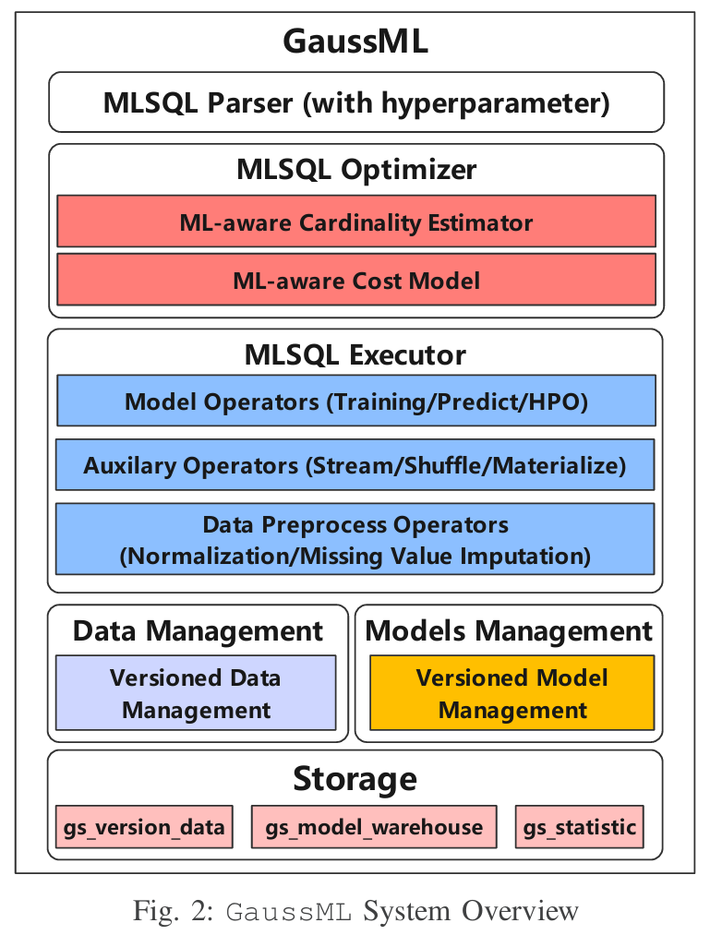
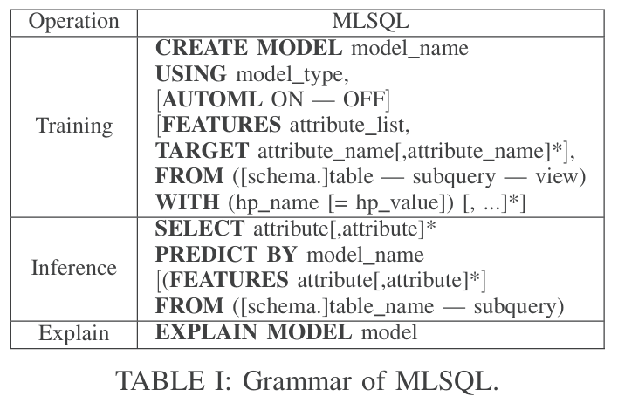
GaussML Architecture
Model-aware cost estimator to find optimal data visit path and model prediction orders.
Interleaving optimizations between data visit operators and model training operators.
In-database cardinality estimation (基数估计) component customized for ML operations.

Slide 7
OP = operator
GaussML Architecture
4 basic OPs divided by computing method:
- Matrix computation OP
- Statistic OP
- Gradient descent OP
- Distance computation OP
Parallel training (on single instance or distributed)
Auxiliary OPs to optimize training process:
- Shuffle OP for accelerating SGD
- Materialized OP (物化视图) for reducing IO overhead
Data preprocessing OPs
Cross-nodes data management

Slide 8
Contents
Introduction
Overview
Query Planning Optimization
Traditional backwards
ML-DB hybrid DDL(create) query planning
ML-DB hybrid DML query planning
Selectivity estimation for ML predicates
Cost estimation for ML inferences
Query Execution
Experiment

Slide 9
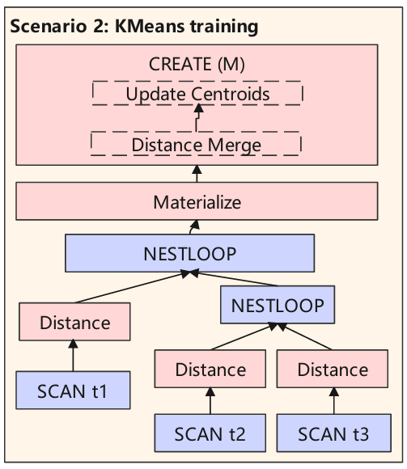
Query Planning Optimization
Traditional optimizer in database cannot handle end-to-end ML scenarios.
Traditional query planner cannot mount ML OPs on the plan tree, and make related performance optimal.
Traditional query planner does not reorder the execution order of traditional predicates on one relation based on cost because the performance gain is little.
UDF-Based In-DB ML

Slide 10
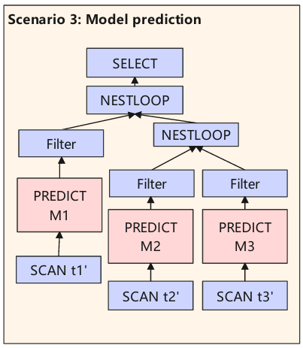
Query Planning Optimization
Traditional optimizer in database cannot handle end-to-end ML scenarios.
Traditional cardinality estimator cannot estimate the conjunctive predicates with
both ordinary conditions and database cannot catch correlations between model
labels and data in other columns model prediction because.
(iv) Database doesn’t have cost model for model prediction expressions.

Slide 11
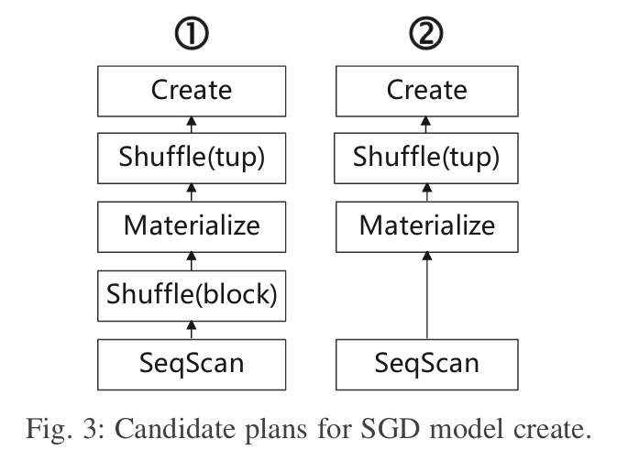
A. ML-DB hybrid DDL(create) query planning
② If the data size is smaller than maximal process memory, then we materialize all the data in memory and then do the shuffle and iterative training.
① Otherwise, we shuffle the data blocks on disk first, and then read and materialize each block
Statistic-based models generally need only a small sample of data. The sample data can be placed in the memory.

Slide 12
A. ML-DB hybrid DDL(create) query planning
If the input data comes from subquery with joins, the distance computation can be divided into partial distance OP and distance merge OP to reduce join overhead
Partial distance OP can be pushed down to scan node.

Slide 13
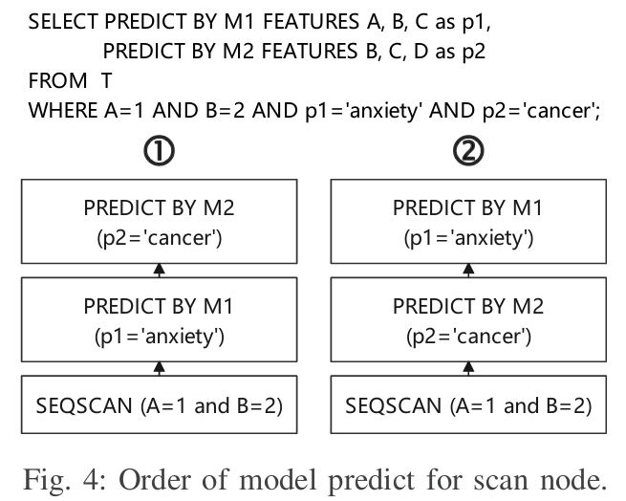
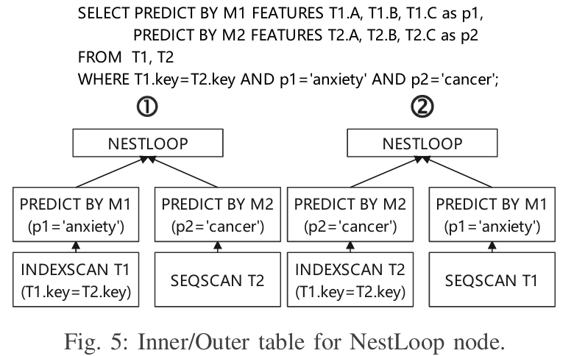
B. ML-DB hybrid DML query planning
For each ML models, GaussML first estimates the input cardinality and computes the cost of predicting the model, and then GaussML selects an execution plan with lower execution cost.
① C(SEQSCAN)∗N+C(M1)∗n+C(M2)∗n∗s1
② C(SEQSCAN)∗N+C(M2)∗n+C(M1)∗n∗s2
① C(m2)∗N2+C(m1)∗N2∗s2∗N1∗s3
② C(m1)∗N1+C(m2)∗N1∗s1∗N2∗s4

Slide 14
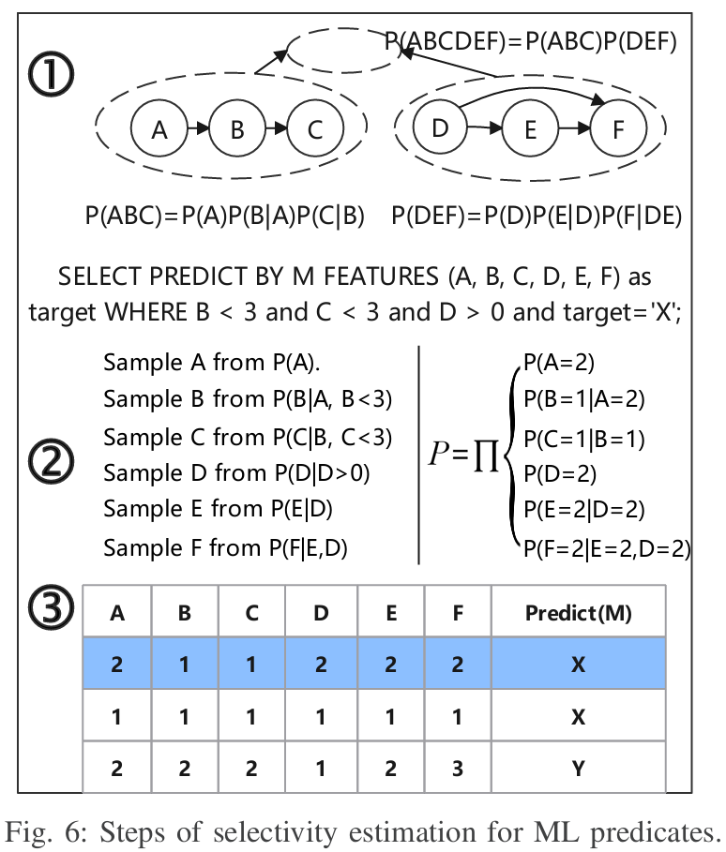
C. Selectivity estimation for ML predicates
Definition: Selectivity is the number of tuples selected by predicates divided by number of table tuples.
Two challenges:
1. Statistics of labels produced model cannot be read directly.
2. Random sampling is hard to get conditional distribution of data falling into the predicates.
Methodology: Step 1. Analyze correlations between columns on data samples. Group correlated columns together and select joint distribution model within each group.
Step 2. Sample n rows of data from predicates on feature columns progressively and compute probability of each row.
Step 3. For each sample row, obtain the result by model predicting and estimate the target distribution in samples.

Slide 15
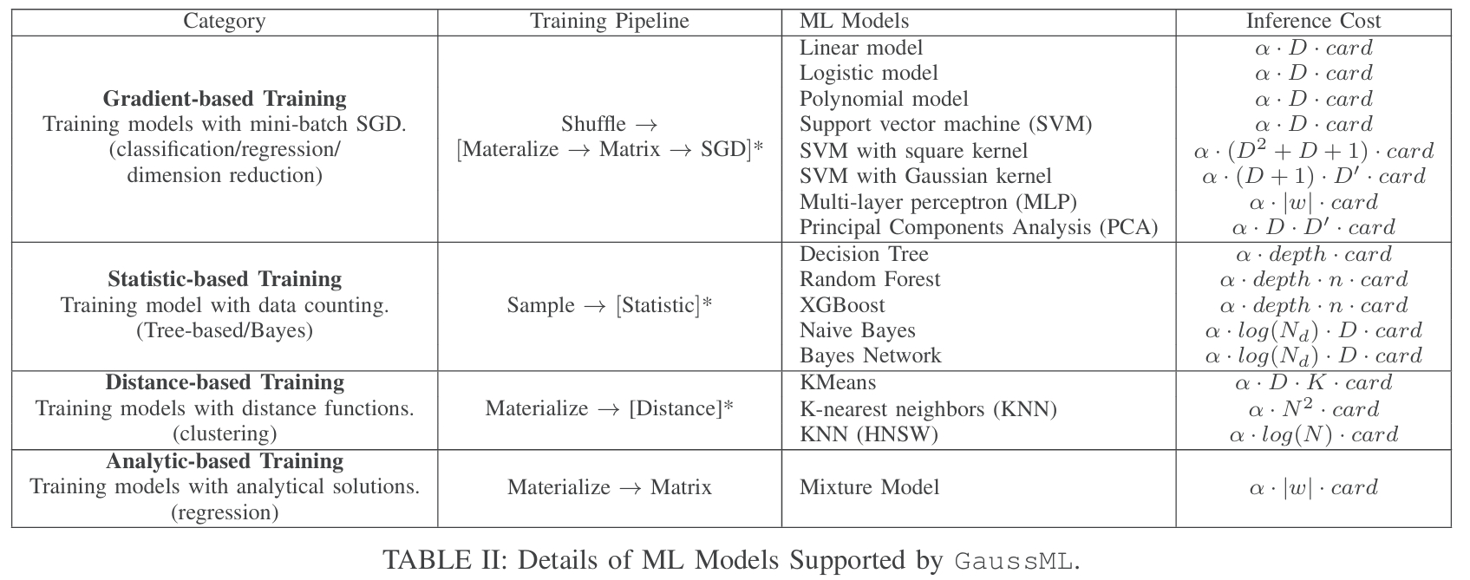
D. Cost estimation for ML inferences
3 metrics related: dimension of features for ML model (denoted as D)
the estimated cardinality of precedent execution nodes (denoted as card)
model structures

Slide 16
Contents
Introduction
Overview
Query Planning Optimization
Query Execution
Model training (HPO Engine, Operators, parallel/distributed training)
Model Persistence & Prediction
Data shuffle Operators
Data Processing
Experiment

Slide 17
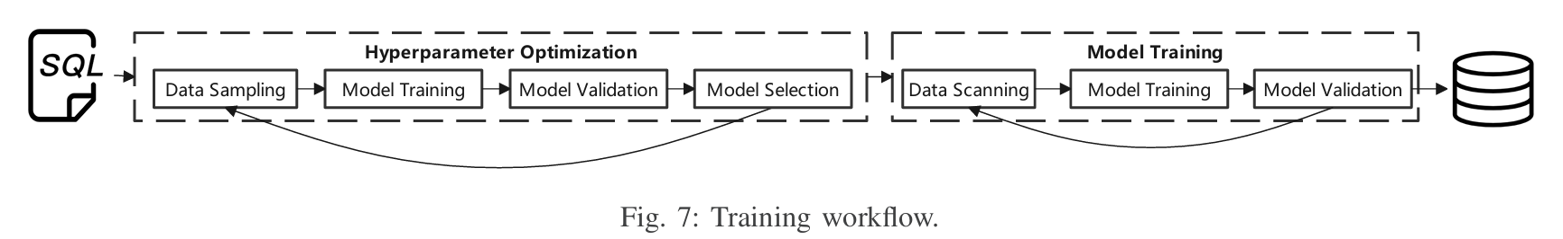
Query Execution
A. Model Training (Hyperparameter optimization engines)
Hyperparameter optimization engines first read a list of hyperparameters parsed from system catalog, and then train models with different hyperparameters in parallel.
GaussML throws away hyperparameters with errors higher than the average constantly until only one model left
At last, executor trains the model on full data again until convergence, and then stores the model in the system.

Slide 18
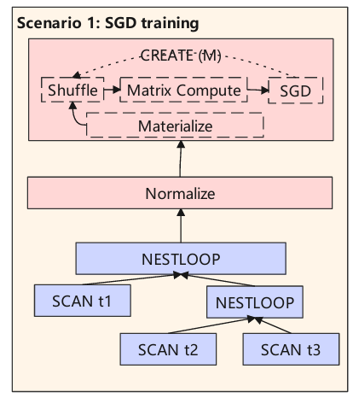
A. Model Training (Basic Training OPs)
Distance OP: Composed of distance compute OP and distance merge OP.
SGD OP: Update the model according to gradients. Control Materialize OP.
Matrix OP: Compute all kinds of matrix calculations. (SIMD accelerated)
(SIMD accelerated)

Slide 19
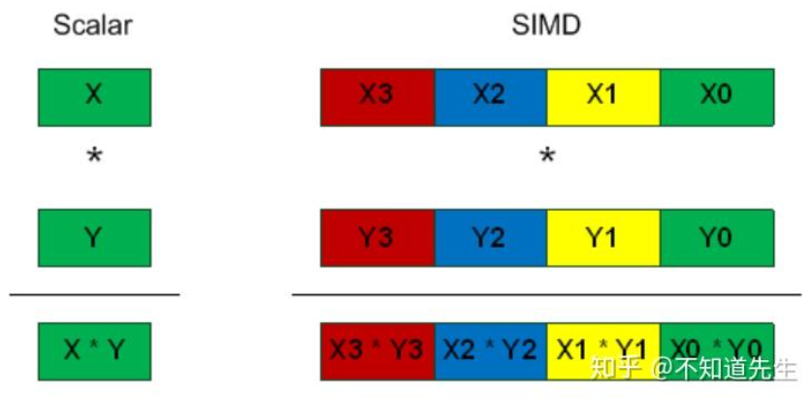
SIMD (Single Instruction, Multiple Data，单指令多数据流)
SISD：
Add a[0] to b[0] and store in c[0]
Add a[1] to b[1] and store in c[1]
Add a[2] to b[2] and store in c[2]
Add a[3] to b[3] and store in c[3]
SIMD：
Pack a[0], a[1], a[2], a[3] in a single register
Pack b[0], b[1], b[2], b[3] in a single register
Perform single instruction add on packed data
Store result in register holding c[0], c[1], c[2], c[3]

Slide 20
A. Model Training (Basic Training OPs)
Materialize OP: Responsible for loading data from disk into memory.
Sample OP: Support sampling based on number of rows or sample ratio.
Shuffle OP: First shuffle the blocks and get a random page. Then shuffles the tuples in the block before return the result.
Disk
Memory
Page 1
Tuple 1
Page 2
Tuple 2
Page 3
Tuple 3
Materialize
Block shuffle
Tuple shuffle

Slide 21
A. Model Training (Parallel/Distributed Training)
(overview)
Parallel Training on single node:
Each thread trains each iteration independently on part of training data.
Broadcast parameters/gradients by global shared memory after each iteration.
Each thread updates model according to synchronized parameters/gradients
Data
Thread 1
System
Global
Area
Thread 1
Thread 2
Thread 2
Thread 3
Thread 3

Slide 22
A. Model Training (Parallel/Distributed Training)
(overview)
Distributed training:
Each executor trains model on its local data.
Use streaming OPs on all data nodes to exchange parameters/gradients between executors.
Each data node should receive updated models from all other nodes before starting a new training iterations
Data
Thread 1
Thread 1
Data
Thread 2
Thread 2
Data
Thread 3
Thread 3

Slide 23
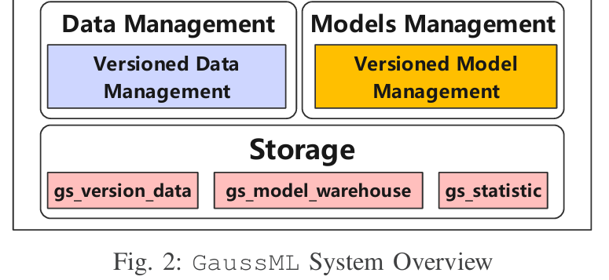
B. Model Persistence & C. Model Prediction
Save the trained model in system table gs_model_warehouse in structural data.
Model parameters are stored as a binary sequence where all parameters are arranged one by one in a predefined structure.
Indexes built for object id and name of each model to accelerate the model search.
Cache the deserialized model for avoiding repeated
costly model loading process
If the model is not found in memory,
executor searches the system table
gs_model_warehouse by name

Slide 24
D. Data Shuffle
Data shuffle not only is vital to convergence speed of machine learning optimizer like SGD, but also balance the data distribution between different data partitions.
Local Shuffle OP
GaussML supports tuple shuffle and block shuffle.
- Block ids are shuffled within each page read by heap scan function.
- Tuple shuffle node fetches tuples into buffer from precedent nodes, and shuffles tuple ids in buffer.
Block
Block
Block
Page
Buffer
Tuple
Page that stores block ids
Block ID 1
Block ID 2
…

Slide 25
D. Data Shuffle
Cross-node Shuffle OP
Labels are likely to be bias according to time/nodes.
Full Redistribution
The query optimizer in GaussML will check the bias of training labels according to the partition-level statistics in system table gs_statistic.
Redistribution when Fine-tuning
When training, streaming (broadcast) OP is used for sharing a small set of sampled data with the updated model
Broadcast Items
Thread 1
Model
Thread 2
Underfitting tuples
Test with received models
Local Data
Thread 3

Slide 26
E. Data Processing
Normalization:
Related information (like max, min, μ, σ) is stored in system table gs_statistic.
Missing Value Imputation:
GaussML utilizes the distribution of the column or the whole dataset for missing value inference.

Slide 27
Contents
Introduction
Overview
Query Planning Optimization
Query Execution
Experiment
Overview
Exp on different models
Exp on different components
Ablation study

Slide 28
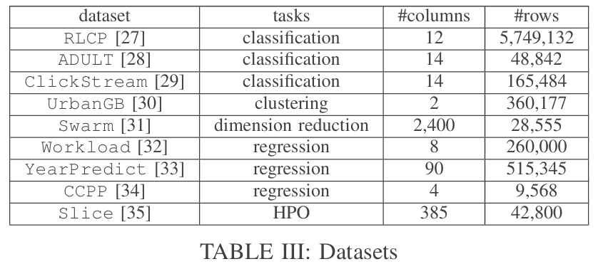
Experiment
Methods:
GaussML (this paper), build in native openGauss
MADlib (UDF-based), related functions are integrated
ML-A (API-based), implemented by using Python script with openGauss connector

Slide 29
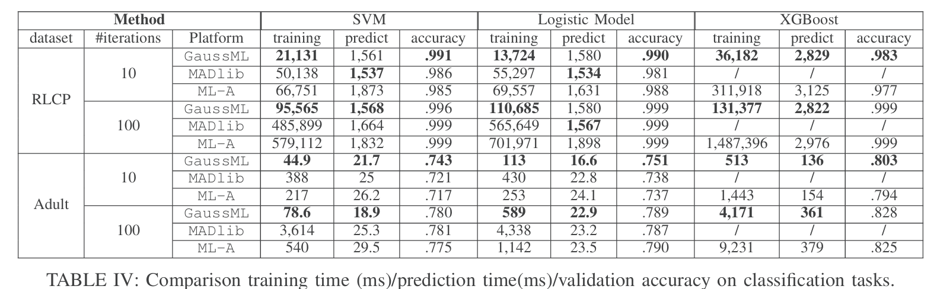
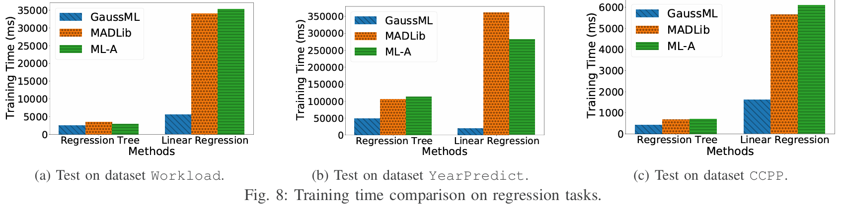
Exp1-2: Training time (less training time for big cache, similar prediction time)

Slide 30
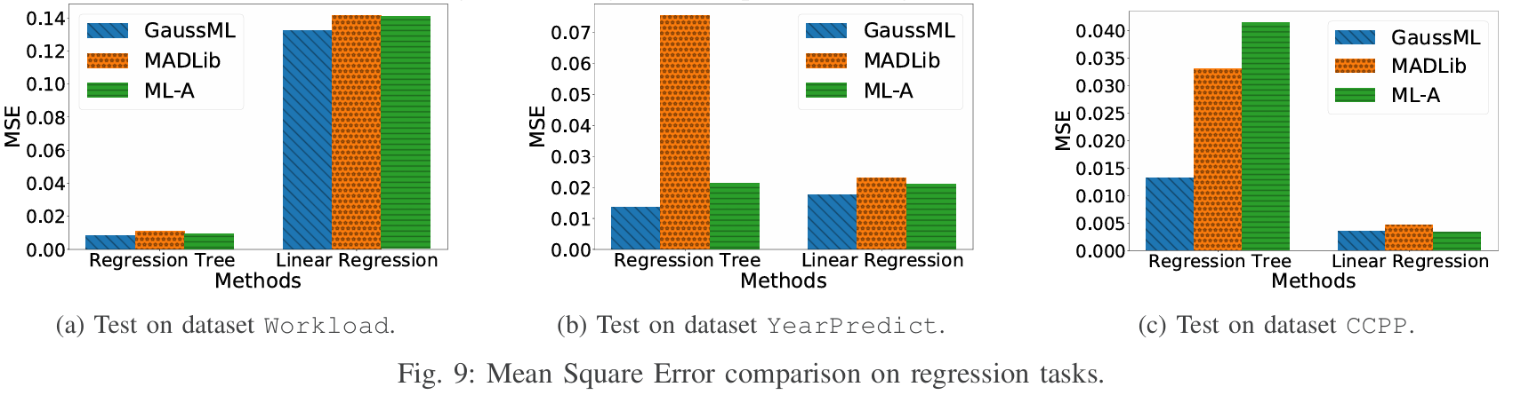
Exp3: MSE(shuffle OP works well)

Slide 31
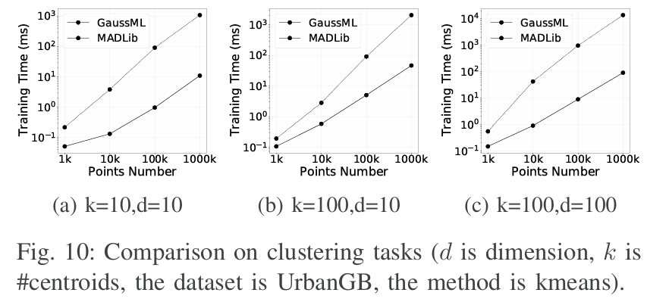
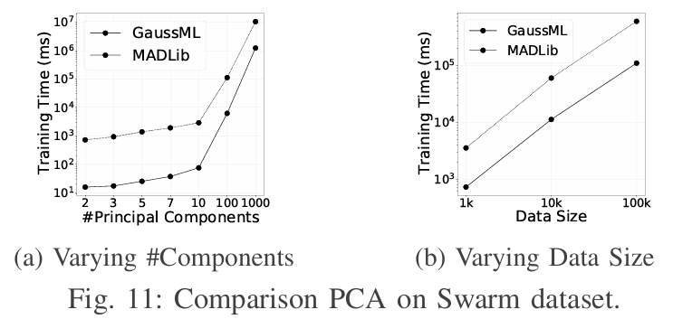
Exp4-5: Training time
(single-thread model training in GaussML is faster than other systems for all ML tasks)

Slide 32
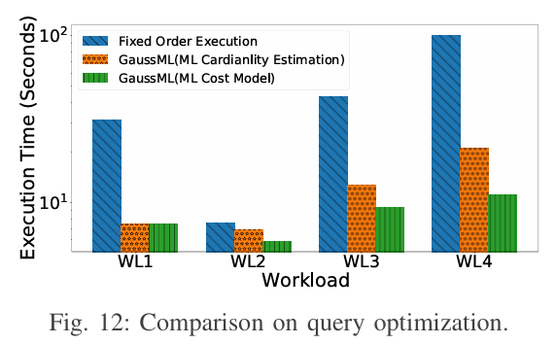
Exp6: Query Optimization Techniques
(ML-aware query optimizer in GaussML can generate better execution plan)
WL1: complex data preprocessing (union, join)
WL2: multiple ML filter conditions
WL3 & WL4: hybrid workloads

Slide 33
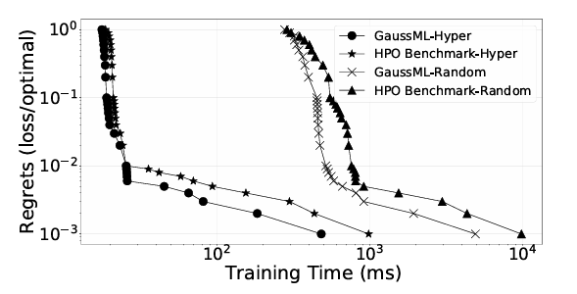
Exp7: HPO Engine Test
(Hyperband strategy outperforms Random in training efficiency by 1 order of magnitude)

Slide 34
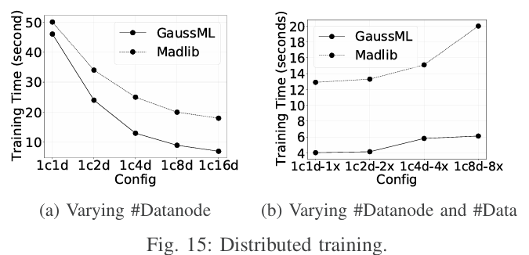
Exp8: GaussML with multiple nodes
With the number of data nodes increasing, the training time decreases significantly.
Training time becomes stable after 8 data nodes.
(redistribution/communication)

Slide 35
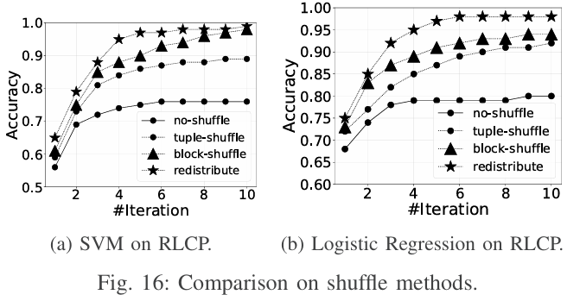
Exp9: Shuffle methods
(Note that shuffle is faster than redistribution)

Slide 36
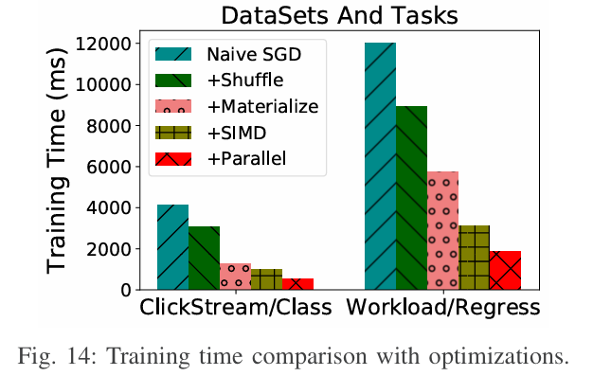
Exp10: Ablation Study on Time
Shuffle technique decreases training time by 15-45%.
Data materialize decreases training time by another 40-70%.
SIMD/parallel technique makes training time to halve further.

Slide 37
Summary
GaussML takes advantage of native SQL and designs in-DB ML optimization.
On query planning:
GaussML introduces ML-DB hybrid query planning optimization and
specific ML selectivity & cost estimation.
On query execution:
GaussML supports 4 types of ML models based on well-designed OPs.
SIMD technique is used for acceleration.
GaussML also supports multiple nodes training, with a series of shuffle/redistribution methods.
GaussML introduces a Hyperparameter optimization engine to select optimal models.

Slide 38
Thank you！

Slide 39
A. Model Training (Parallel/Distributed Training)
(detail)
Parallel SGD
- Each thread firstly fetches one part of data in mini-batches and shuffles them, and then computes local gradients of model.
- In the distribute phase, each thread sends local model gradients to other threads in each iteration.
- In the merge phase, each thread updates the model parameters by gradients produced by all threads.
KMeans
- Guarantee the consistency of the initial centroids in different threads.
- Each thread obtains centroids from other threads and computes the mean as new centroids.
- Each thread re-clusters local data and calculates centroids and exchanges them.

Slide 40
A. Model Training (Parallel/Distributed Training)
(detail)
Bayes Related
- Each thread generates data distribution table for its local data in parallel.
- Aggregates the frequencies and computes the probabilities for each Bayes node in merge phase.
KNN
- Each thread receives the current distance upper bound
- Finds the nearest tuple whose distance to the query is smaller than bound
- Shares the top-k smallest distances in each iteration

