Slide 1

BOSS - An Architecture for Database Kernel Composition
中国人民大学
Hubert Mohr-Daurat, Xuan Sun, Holger Pirk
Imperial College London
VLDB 2024

Slide 2

PPT模板下载：www.1ppt.com/moban/ 行业PPT模板：www.1ppt.com/hangye/
节日PPT模板：www.1ppt.com/jieri/ PPT素材下载：www.1ppt.com/sucai/
PPT背景图片：www.1ppt.com/beijing/ PPT图表下载：www.1ppt.com/tubiao/
优秀PPT下载：www.1ppt.com/xiazai/ PPT教程： www.1ppt.com/powerpoint/
Word教程： www.1ppt.com/word/ Excel教程：www.1ppt.com/excel/
资料下载：www.1ppt.com/ziliao/ PPT课件下载：www.1ppt.com/kejian/
范文下载：www.1ppt.com/fanwen/ 试卷下载：www.1ppt.com/shiti/
教案下载：www.1ppt.com/jiaoan/ PPT论坛：www.1ppt.cn
1
Why Composable?
2
DeToX Overview
目录
CONTENTS
3
Optimizations
4
Evaluation

Slide 3
第一部分
Why Composable?
The Composable Data Management System Manifesto
1

Slide 4

What is Decomposing?
Software Decomposing: decomposing software complexity into smaller subsets of relatively independent components.
Decomposing Goal:
encapsulating as much complexity as possible
APIs should be narrow：
preventing implementation details from leaking through the API
minimizing dependencies across components
Component
No Dependency
API
API
Component
Component
The Composable Data Management System Manifesto
1

Slide 5
Decomposing Benefits
Benefits:
Engineering Efficiency and Faster Innovation
Coevolution: enable software and hardware to evolve closer together
Better User Experience: reduce learning curve
Decomposing goal for data management systems：
define and agree on a standard set of logical components across data management systems;
define stable (yet extensible) APIs for communication between these components;
provide canonical implementations for these components and APIs which are efficient and consistent;
provide extensibility APIs in every layer of the stack to allow developers to implement specialized behavior
Take Out the TraChe: Maximizing (Tra)nsactional Ca(che) Hit Rate
1

Slide 6
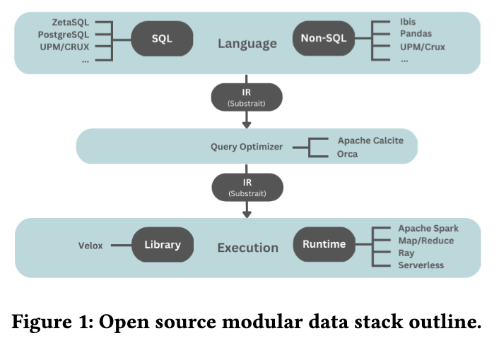
Why can data processing systems be decoupled?
Logical Components of Modern Specialized Data Systems
Language Frontend
Intermediate Representation(IR): usually in the form of a logical and/or physical query plan;
Query Optimizer
Execution Engine
Execution Runtime: responsible for providing the (often distributed) environment in which query fragments can be executed.
The Composable Data Management System Manifesto
1

Slide 7
第二部分
BOSS - A Composable Framework
BOSS - An Architecture for Database Kernel Composition

Slide 8
Motivation
Data Management Systems (DMSs) account for many kinds of heterogeneity:
workload heterogeneity, OLTP, OLAP...
data model heterogeneity, relations, graphs, documents, kv, trained...
hardware heterogeneity, CPUs, GPUs, FPGAs...
Method1: extend the DMS to support all heterogeneity —— high developing cost
Method2: wrap special-purpose libraries —— low performance
BOSS - An Architecture for Database Kernel Composition
1

Slide 9
Solution & Challenges
Query
Query are processed across a sequence of stages, each of which progresses toward the final result.
Stage 1
data transformation
pipeline
Stage 2
……
Stage n
final result
How to combine kernels following fundamentally different designs
How to reduce boilerplate code and transformation cost
BOSS - An Architecture for Database Kernel Composition
1

Slide 10
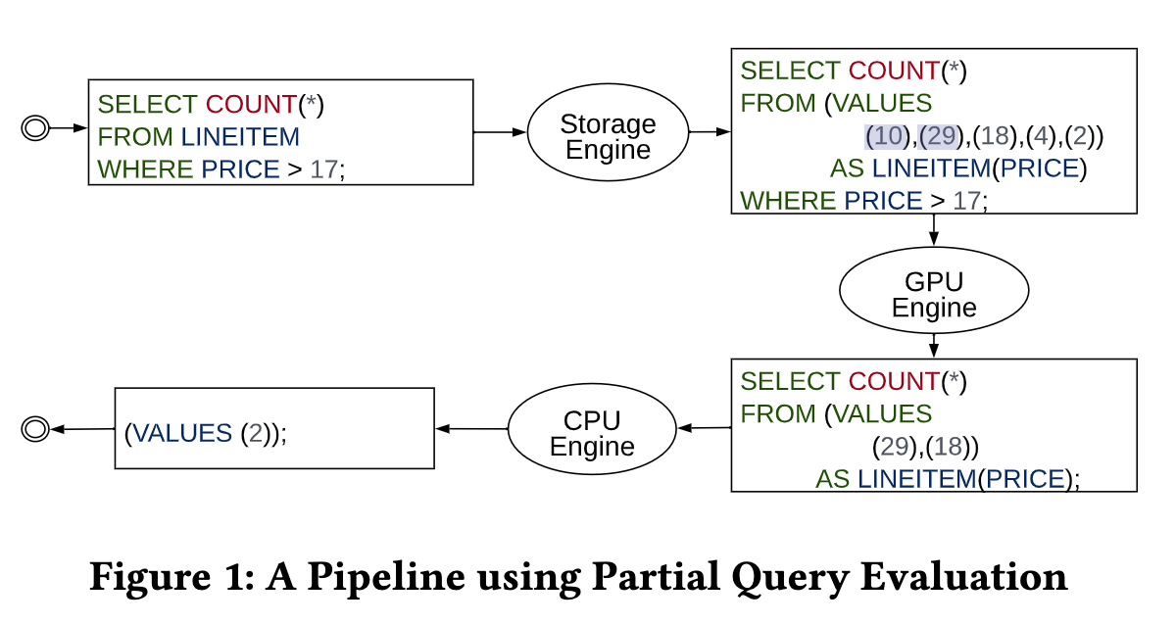
Design Principle & Overview
Remain Unopinionated
Minimize Boilerplate
Zero Copies, Minimal Transformations
Language over Library
1

Slide 11
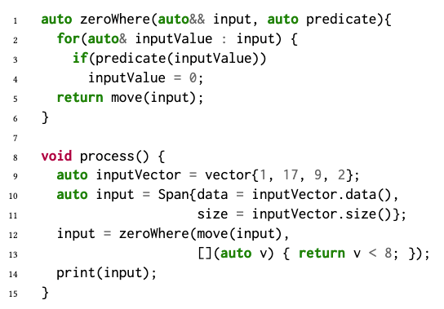
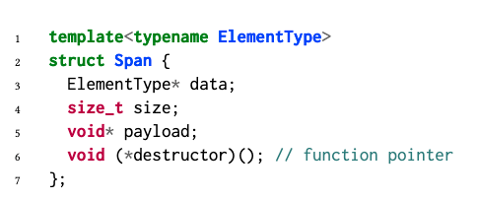
Cross-kernel Communication
Memory-Managed Spans for Data Exchange
C-arrays
Move-only
1

Slide 12
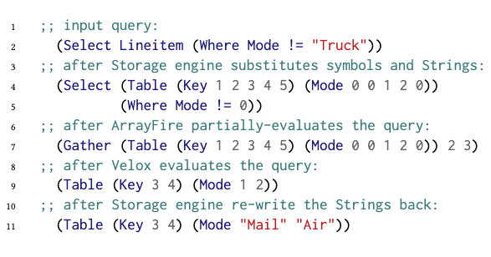
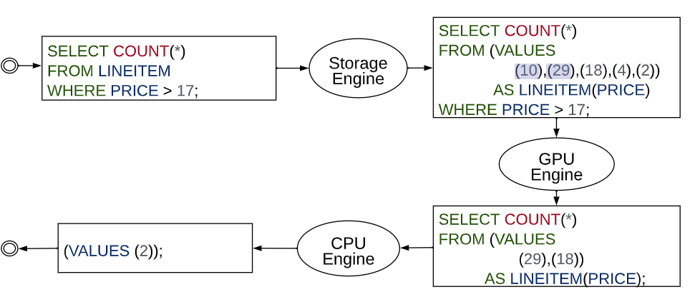
Query evaluation in a staged pipeline
Storage Engine -> GPU Engine (ArrayFire) -> CPU Engine(Velox)
Strings are stored with an integer column whose values are indexed into a list of unique strings.
Predicates are operated directly on integer keys.
1

Slide 13
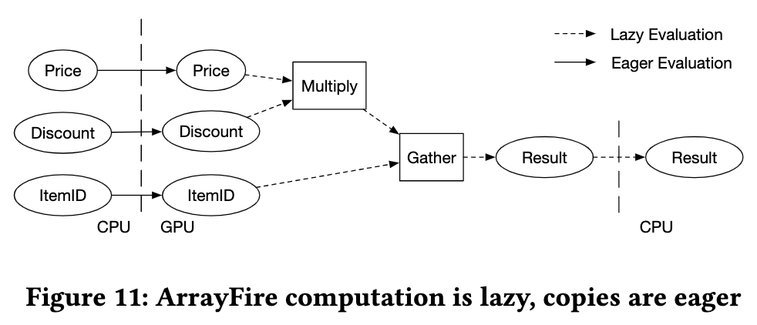
Acceleration on GPU
Lazy GPU Transfer & Evaluation (data transferring is eager while computation is lazy):
Each computation task is completed by a ArrayFire function. Each function is wrapped as a closure.
When the closure’s result is required by the CPU task, data are transferred to the GPU to perform the computation.
1

Slide 14
第四部分
Evaluations
Take Out the TraChe: Maximizing (Tra)nsactional Ca(che) Hit Rate
1

Slide 15
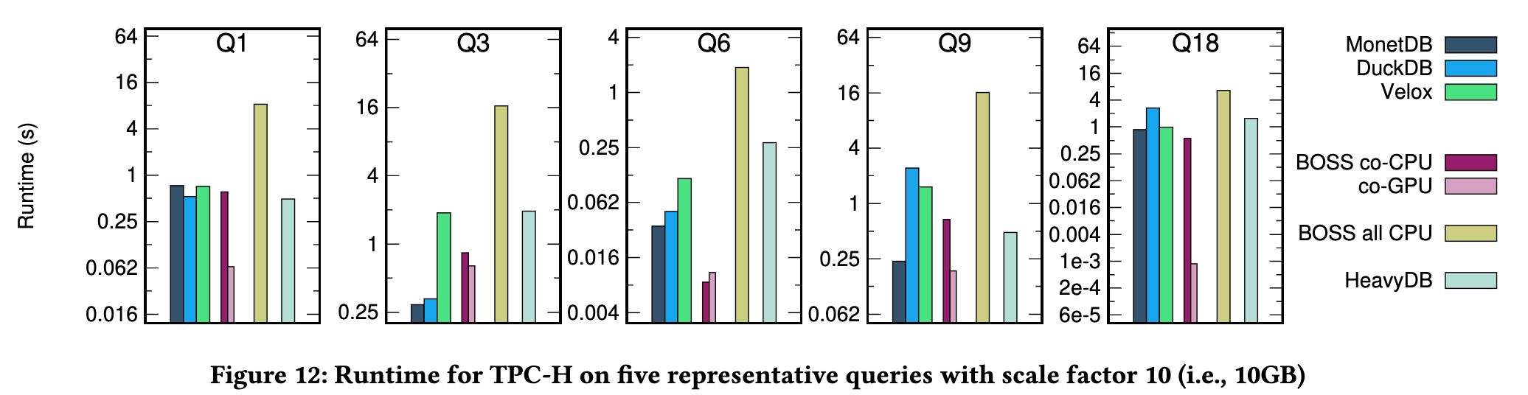
Overall Evaluation
Velox, MonetDB, DuckDB: CPU engine
HeavyDB: GPU engine
Take Out the TraChe: Maximizing (Tra)nsactional Ca(che) Hit Rate
1
Notes:
with WO, the PilotDB throughput reaches 97.0% of MySQL-ideal, with at least a 1.53× improvement over the other three baselines.

Slide 16
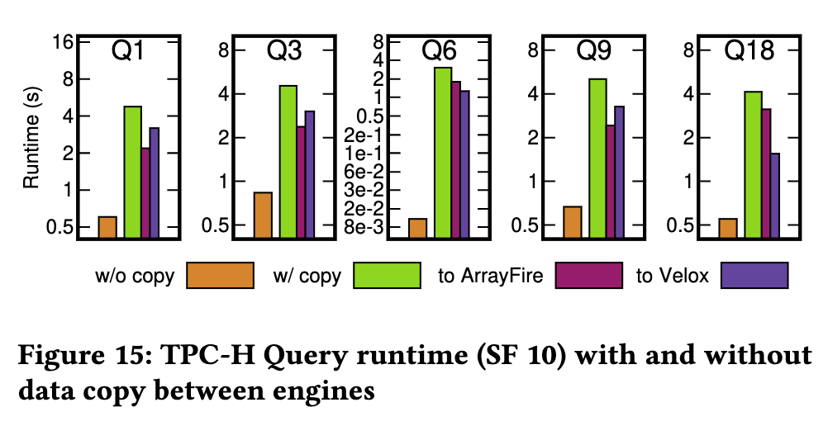
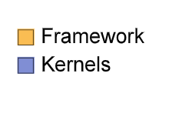
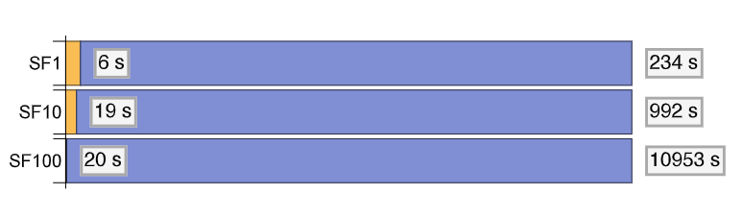
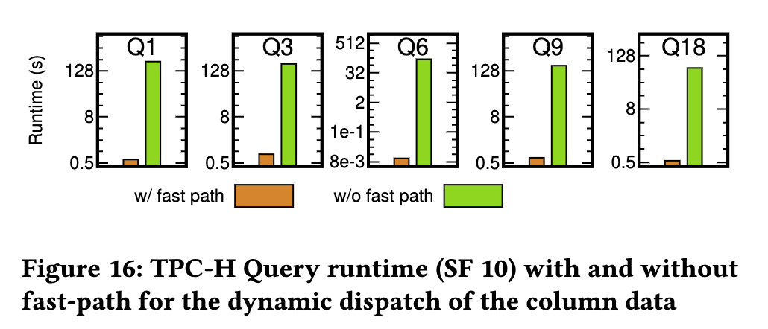
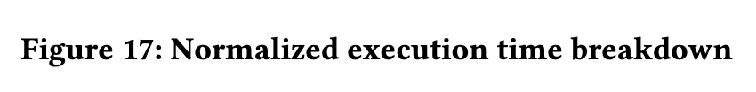
Ablation Study
1
Notes:
with WO, the PilotDB throughput reaches 97.0% of MySQL-ideal, with at least a 1.53× improvement over the other three baselines.

