Slide 1


DistServe: Disaggregating Prefill and Decoding for Goodput-optimized Large Language Model Serving
汇报人：史心悦
2024年12月19日
Notes:
各位老师好，我是赵泓尧，接下来我对博士论文选题进行报告。我拟定的论文题目是基于RDMA事务处理的关键技术研究，是由卢卫老师和杜小勇老师指导我在这个方向上开展研究。

Slide 2
Outline
Background & Motivation
Tradeoff Analysis
Method
Evaluation

Slide 3
LLM Inference
Input: prompt from users
Output: tokens in the sequence
Prefill phase
process a user’s prompt to generate the first token of the response in one step
measured by TTFT (the time to first token)
Decode phase
sequentially generates subsequent tokens in multiple steps
measured by TPOT (the time per output token)

Slide 4
Problem and Opportunities
Goal: maintaining both high service quality and low cost, in the presence of SLOs.
Varying resource requirements
Varying demands on each metric:
real-time chatbots:
low TTFT for response promptness
TPOT only remains important until it is faster than human reading speed (250 words/min)
document summarization:
low TPOT for faster generation of the summary
maximize per-GPU goodput

Slide 5
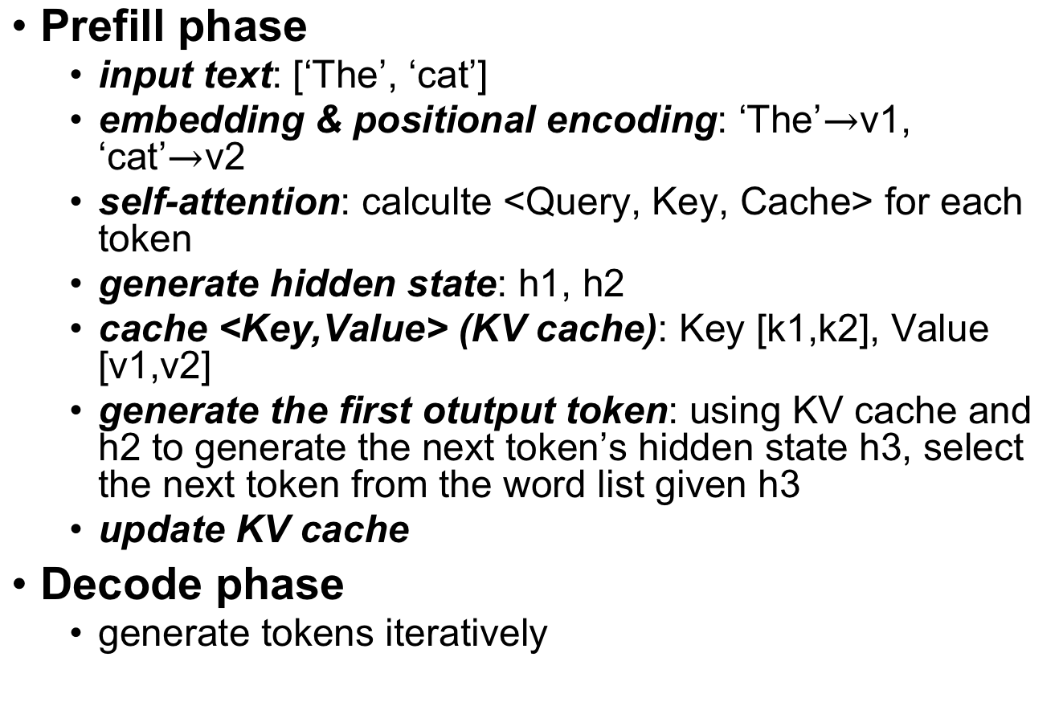
LLM Inference
Prefill phase
input text: [‘The’, ‘cat’]
embedding & positional encoding: ‘The’$→$v1, ‘cat’$→$v2
self-attention: calculte <Query, Key, Cache> for each token
generate hidden state: h1, h2
cache <Key,Value> (KV cache): Key [k1,k2], Value [v1,v2]
generate the first otutput token: using KV cache and h2 to generate the next token’s hidden state h3, select the next token from the word list given h3
update KV cache
Decode phase
generate tokens iteratively

Slide 6
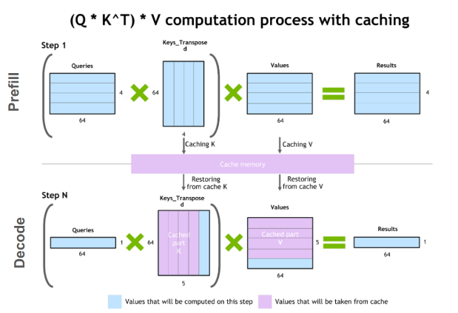
Varying resource requirement
Prefill phase
compute-bound operation,
deal with a new sequence, comprising many tokens.
Decode phase
memory-bound operation,
process one new token generated by the previous step, the speed at which the data (weights, keys, values, activations) is transferred to the GPU from memory dominates the latency

Slide 7
Existing LLM serving optimizations
Batching.
batch the prefill of new requests with the decoding of ongoing ones
segmenting long prefill into chunks and attaching decoding jobs with a chunked prefill
limitation: trade-offs between TTFT and TPOT
Model parallelism.
intra-operator parallelism
partition operators like matrix multiplications
cause substantial communications
inter-operator parallelism
organize LLM layers into stages, each running on a GPU to form pipelines
increase execution time, but linearly scale

Slide 8
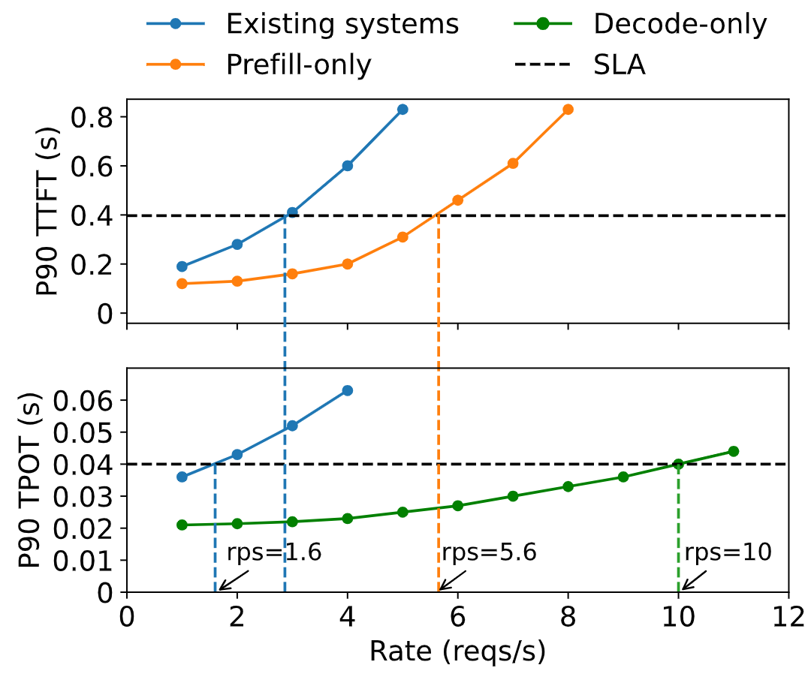
Problem and Opportunities
P90 TTFT and TPOT when serving a 13B LLM
the SLO attainment of 90%

Slide 9
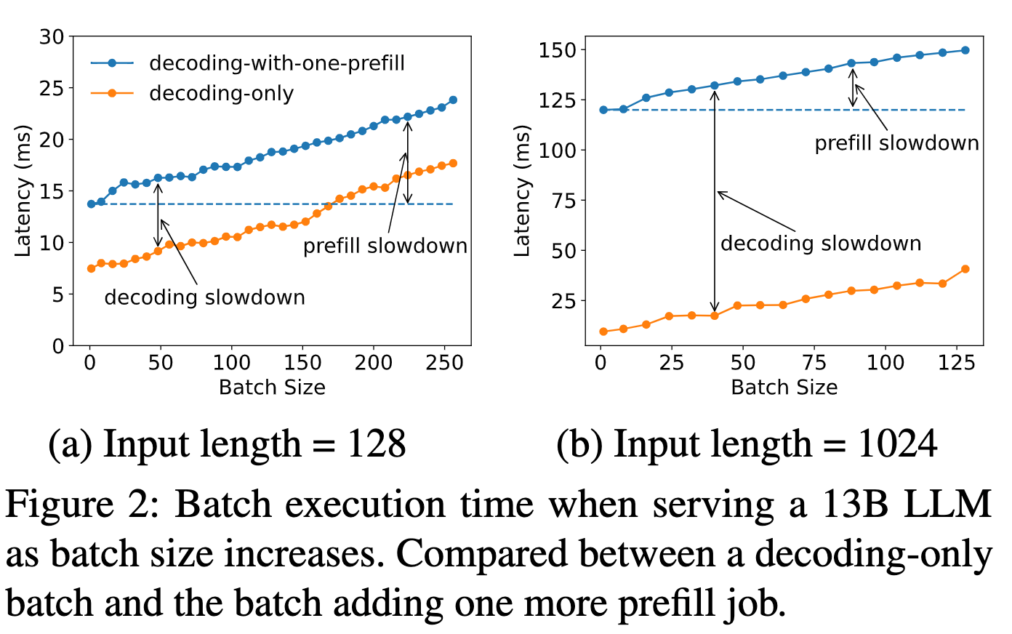
Prefill-decoding Interference
Adding a single prefill job to a batch of decoding requests significantly slows down both processes.
The slowdown intensifies with a longer prefill

Slide 10
Prefill-decoding Interference
Due to coupling, resource allocation and parallelism plans are tailored to satisfy more demanding of TTFT and TPOT, leading to resource over-provisioning to meet both SLOs.
Disaggregation
one instance: a unit of resources that manages exactly one complete copy of model weights
prefill instances and decoding instances
Challenges
the best resource allocation and parallelism plan for each phase.

Slide 11
Outline
Background & Motivation
Tradeoff Analysis
Method
Evaluation

Slide 12
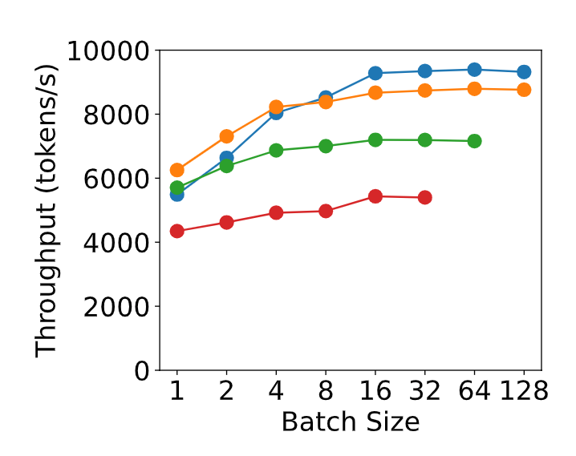
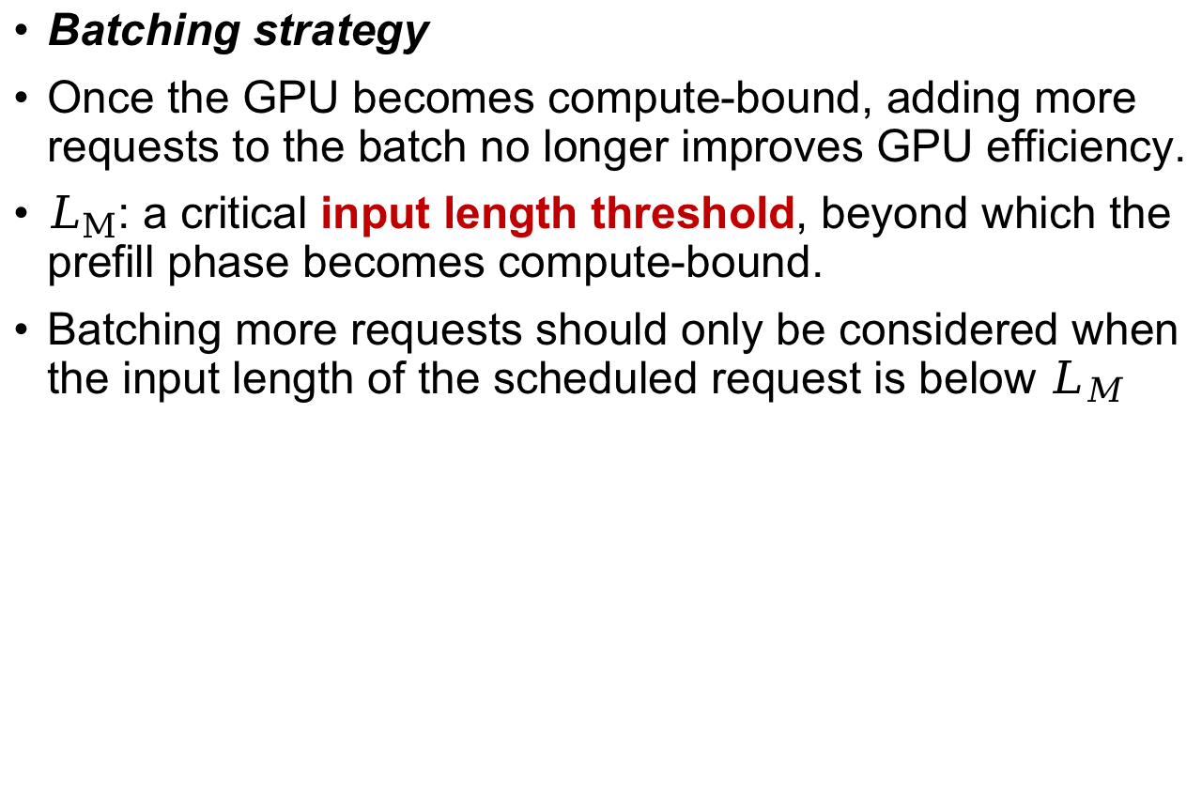
Analysis for Prefill Instance
Batching strategy
Once the GPU becomes compute-bound, adding more requests to the batch no longer improves GPU efficiency.
$L_{M}$: a critical input length threshold, beyond which the prefill phase becomes compute-bound.
Batching more requests should only be considered when the input length of the scheduled request is below $L_{M}$

Slide 13
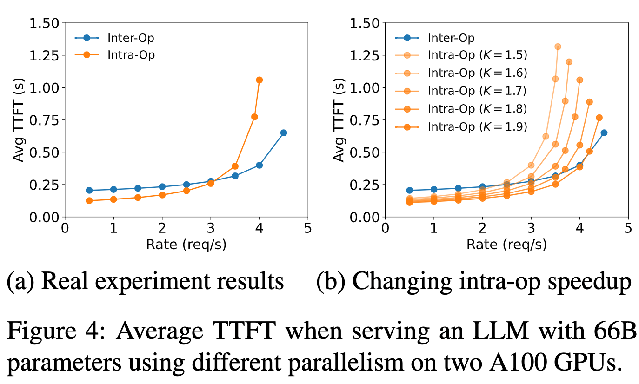
Analysis for Prefill Instance
Parallelism plan.
Intra-op parallelism is more efficient at lower arrival rates, while inter-op parallelism gains superiority as the rate increases

Slide 14
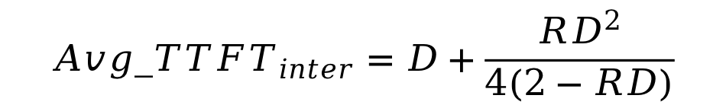
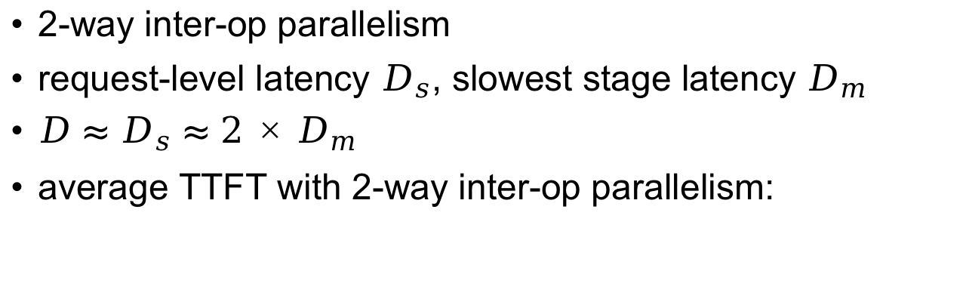
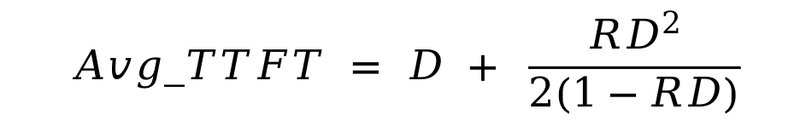
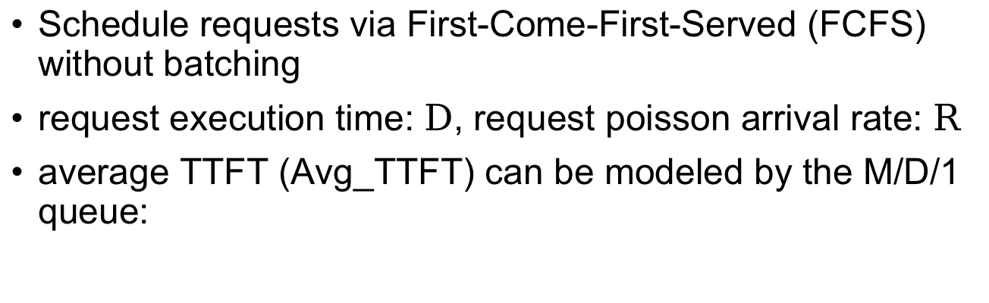
Analysis for Prefill Instance
Schedule requests via First-Come-First-Served (FCFS) without batching
request execution time: $D$, request poisson arrival rate: $R$
average TTFT (Avg_TTFT) can be modeled by the M/D/1 queue:
$$Avg_TTFT = D + \frac{{RD}^{2}}{2(1−RD)}$$
2-way inter-op parallelism
request-level latency $D_{s}$, slowest stage latency $D_{m}$
$D≈D_{s}≈2×D_{m}$
average TTFT with 2-way inter-op parallelism:
$${Avg_TTFT}_{inter}=D+\frac{{RD}^{2}}{4(2−RD)}$$

Slide 15

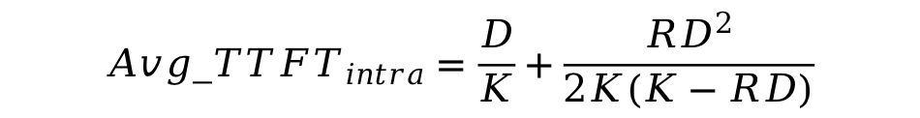
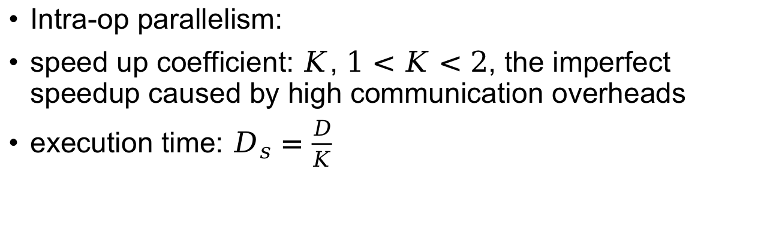
Analysis for Prefill Instance
Intra-op parallelism:
speed up coefficient: $K$, $1<K<2$, the imperfect speedup caused by high communication overheads
execution time: $D_{s}=\frac{D}{K}$
$${Avg_TTFT}_{intra}=\frac{D}{K}+\frac{{RD}^{2}}{2K(K−RD)}$$
$${Avg_TTFT}_{inter}=D+\frac{{RD}^{2}}{4(2−RD)}$$
Low request rate R, the first term is the primary factor
lower intra-op TTFT
Higher rate, the second term is the primary factor
lower inter-op TTFT

Slide 16

Analysis for Prefill Instance
Intra-op parallelism efficiency under various $K$.
higher K, higher efficiency
K depends on factors such as the input length, model architecture, communication bandwidth, and placement.

Slide 17
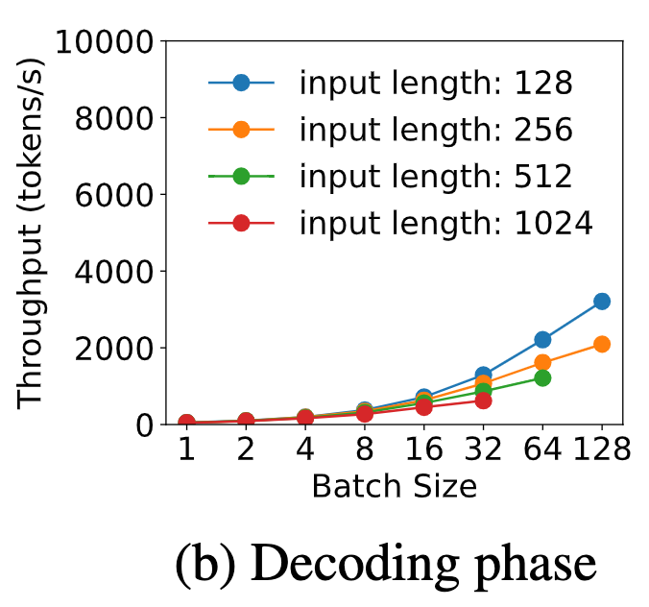
Analysis for Decoding Instance
Batching strategy
A single decoding job is bandwidth-bound, batching can avoid low GPU utilization
Existing systems
the prefill and decoding phases are colocated
sharing GPUs cause competition between prefill and decoding jobs, leading to trade-off between TTFT and TPOT
increasing the decoding batch size is difficult

Slide 18
Analysis for Decoding Instance
Parallelism plan.
Problems for post-disaggregation decoding:
The batch size is constrained by GPU memory capacity, as it is necessary to maintain the KV caches for all active requests.

Slide 19
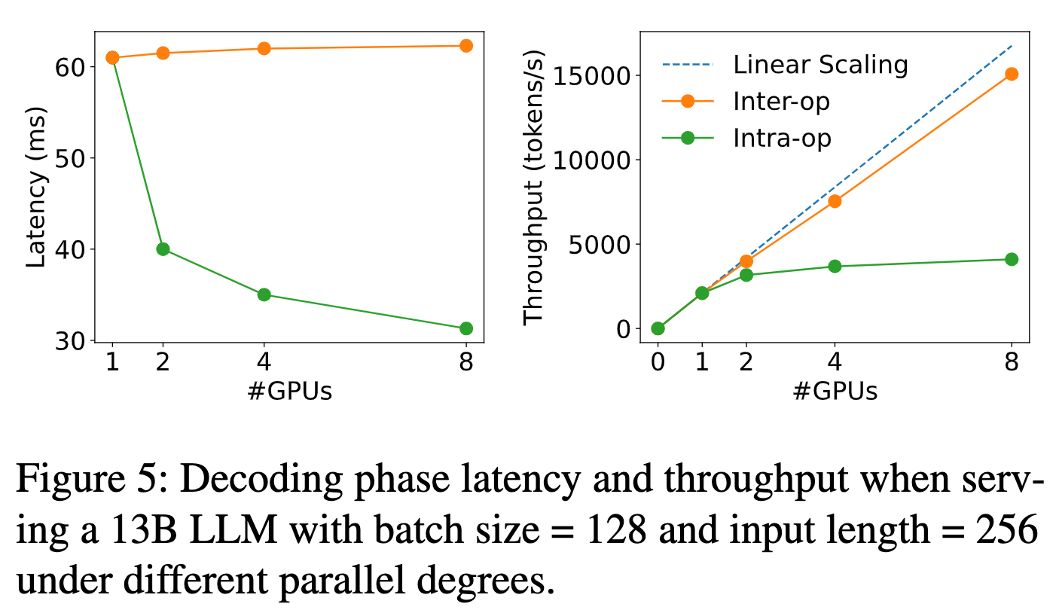
Analysis for Decoding Instance
Intra-op parallelism reduces latency with diminishing returns, caused by communication and reduced utilization after partitioning.
Inter-op parallelism can almost linearly scale the throughput.
Stringent TPOT: intra-op, others: inter-op

Slide 20
Key parameters in designing the disaggregated serving system
Variable prefill length in real-applications:
pipeline bubbles for prefill instances applying inter-op parallelism
Solution: search for parallelisms based on workloads, and resort to scheduling to minimize the bubbles
Communication overhead:
Transferring KV caches from prefill to decoding instances:
512-token request on OPT-66B: 1.13GB
Solutions:
Infiniband between nodes, bandwidth 800GB/s
peak bandwidth for intra-node NVLINK between GPUS: 600GB/s
additional constraints on the placement of prefill and decoding instances

Slide 21
Key parameters in designing the disaggregated serving system
workload pattern
placement constraints
SLO requirements
parallelism strategies
resource allocation

Slide 22
Outline
Background & Motivation
Tradeoff Analysis
Method
Evaluation

Slide 23
Design Goal
Placement:
(a) the parallelism strategies for prefill and decoding instances
(b) the number of each instance type to deploy
(c) how to place them onto the physical cluster
Design Goal:
find a placement that maximizes the per-gpu goodput
Placement strategies:
clusters with high-speed cross-node networks
clusters lacking such infrastructure (introduces additional constraints)

Slide 24
Placement for High Node-Affinity Cluster
High node-affinity clusters equipped with Infiniband
KV caches transmission overhead across nodes is negligible
no placement constraints
Two-level placement algorithm
(1) optimize the parallelism configurations for prefill and decoding instances separately to attain phase-level optimal per-gpu goodput
(2) use replication to match the overall traffic rate

Slide 25
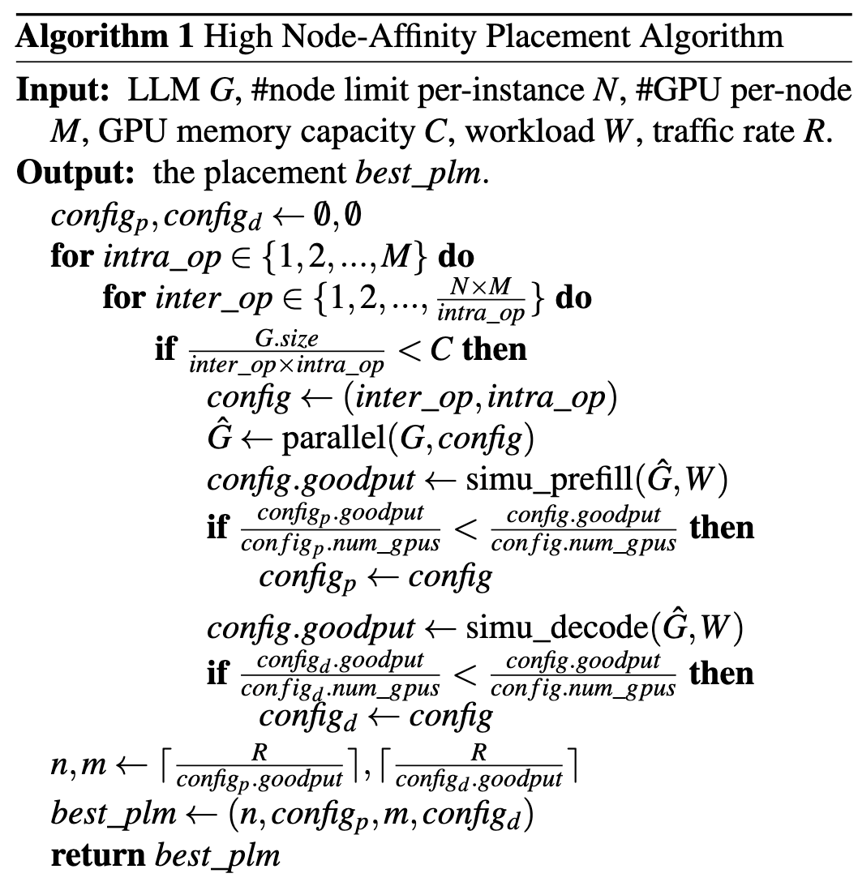
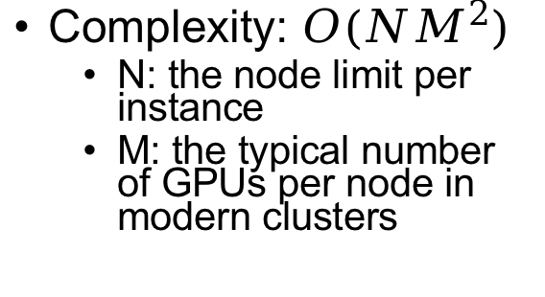
Placement for High Node-Affinity Cluster
Fitted distribution from the history request traces
enumerate all feasible parallel configurations and calculate the maximum goodput meets the SLO
Complexity: $O(NM^{2})$
N: the node limit per instance
M: the typical number of GPUs per node in modern clusters

Slide 26
Placement for Low Node-Affinity Cluster
Placement constraints:
GPUs inside a node access to high-bandwidth NVLINK
GPUs distributed across nodes have limited bandwidth.
Solution:
inter-op parallelism: group layers into stages, divide each instance into segments (instance segments)
colocating prefill and decoding segments of the same stage within a single node to reduce KV cache transfer cost.

Slide 27
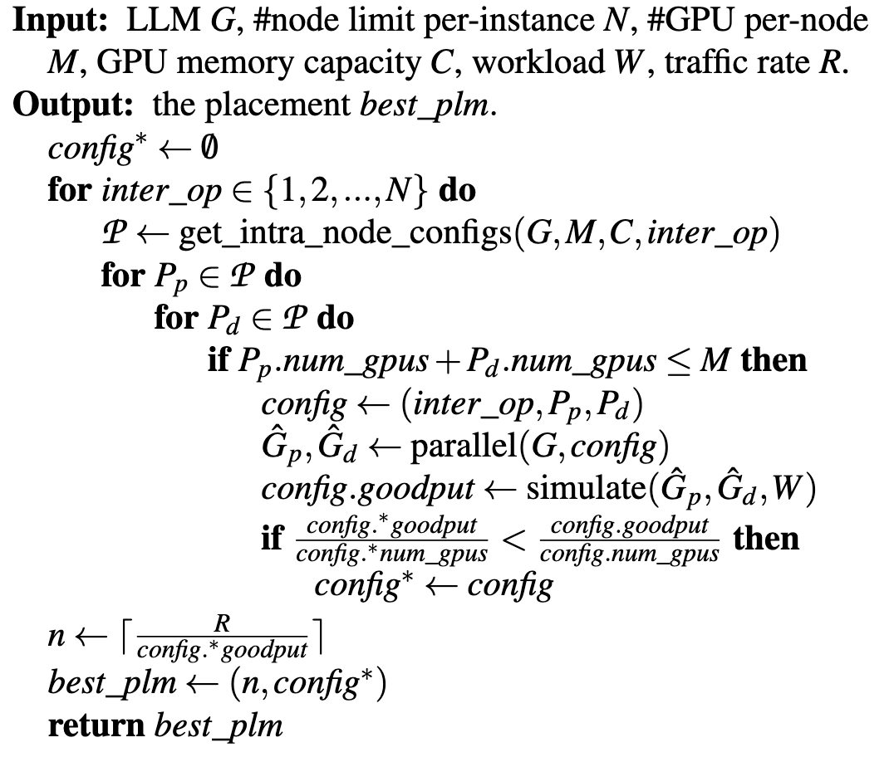
Placement for Low Node-Affinity Cluster

Slide 28
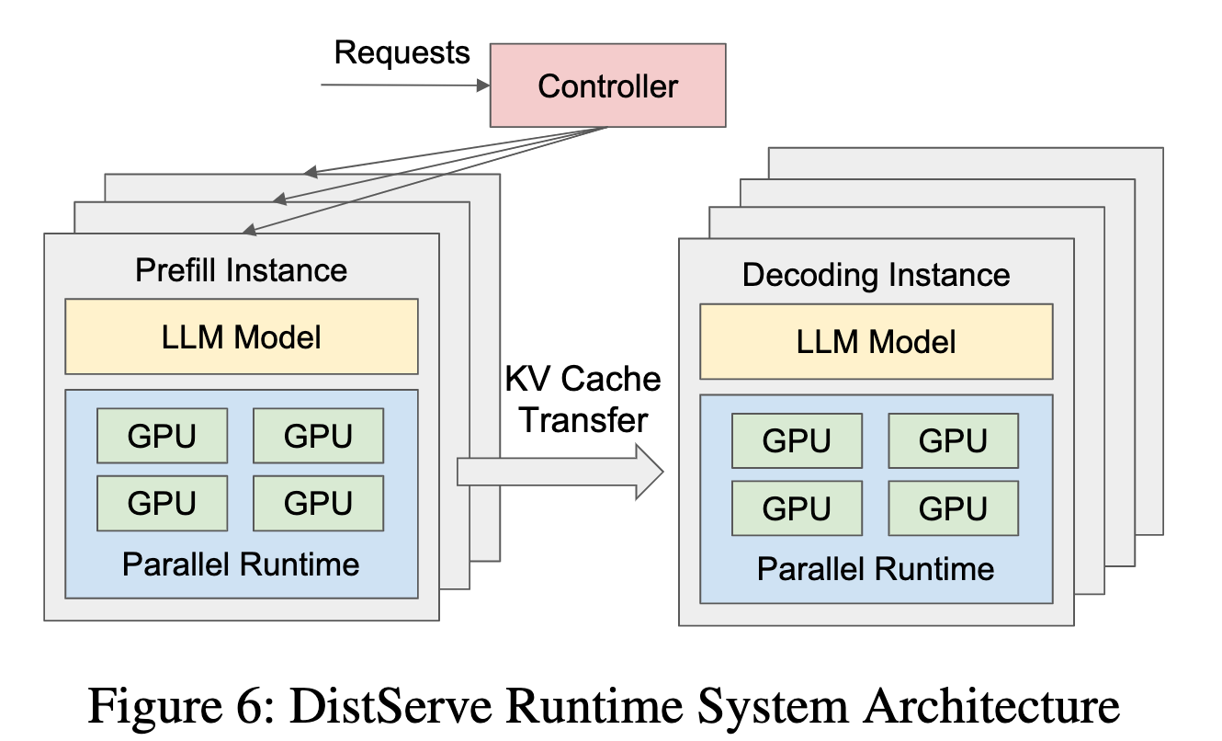
Online Scheduling
Scheduling strategy:
Dispatched to the prefill instance with the shortest queue for prefill processing
Dispatch to the least loaded decoding instance for decoding steps

Slide 29
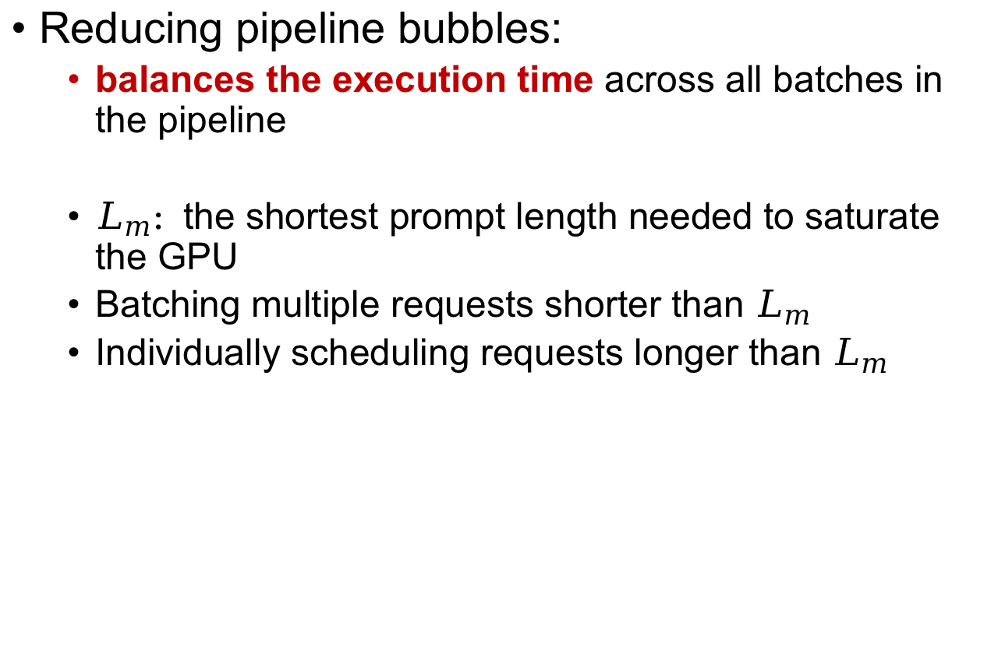
Online Scheduling
Reducing pipeline bubbles:
balances the execution time across all batches in the pipeline
$L_{m}:$the shortest prompt length needed to saturate the GPU
Batching multiple requests shorter than $L_{m}$
Individually scheduling requests longer than $L_{m}$

Slide 30
Online Scheduling
Combat busrtiness:
Burstiness in workloads can cause a deluge of KV caches transferring to decoding instances, risking memory overload.
Solution:
Employ a "pull" method for KV cache transmission rather than a "push" approach
Replanning:
replan the configuration when a significant workload pattern is detected

Slide 31
Outline
Background & Motivation
Tradeoff Analysis
Method
Evaluation

Slide 32
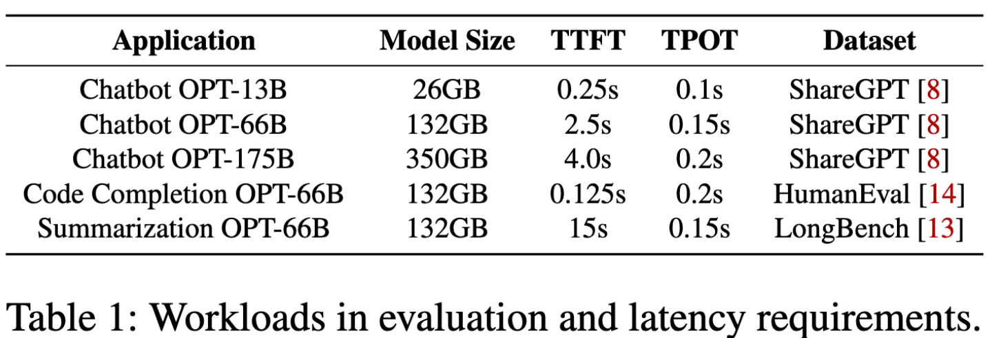
Experiment Setup
Dataset: chatbot, code-completion, summarization
Model: OPT model series
Metrics: SLO attainment(90%), maximum per-GPU goodput, minimal SLO the system can handle

Slide 33
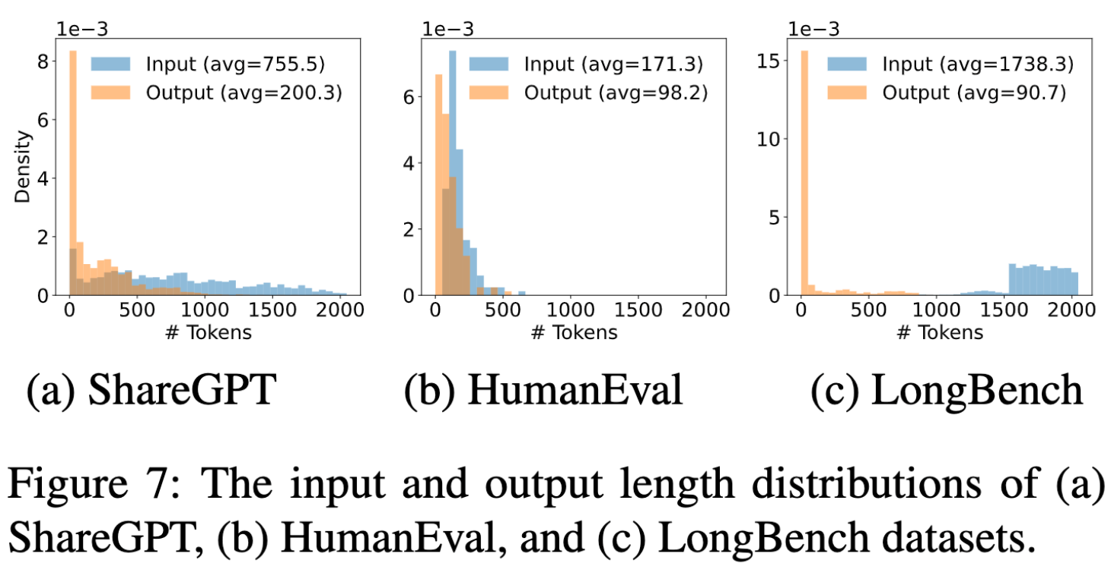
Experiment Setup

Slide 34
Experiment Setup
Baselines:
vLLM
supports continuous batching to increase throughput and paged-attention to reduce memory fragmentation during KV cache allocation
only supports intra-op parallelism
DeepSpeed-MII
supports chunked-prefill by decomposing long prompts into smaller chunks and composing with short prompts to exactly fill a target token budget
Intra-op is set to 1, 4, 8 for three OPT models (OPT-13B, OPT-66B, OPT-175B)

Slide 35
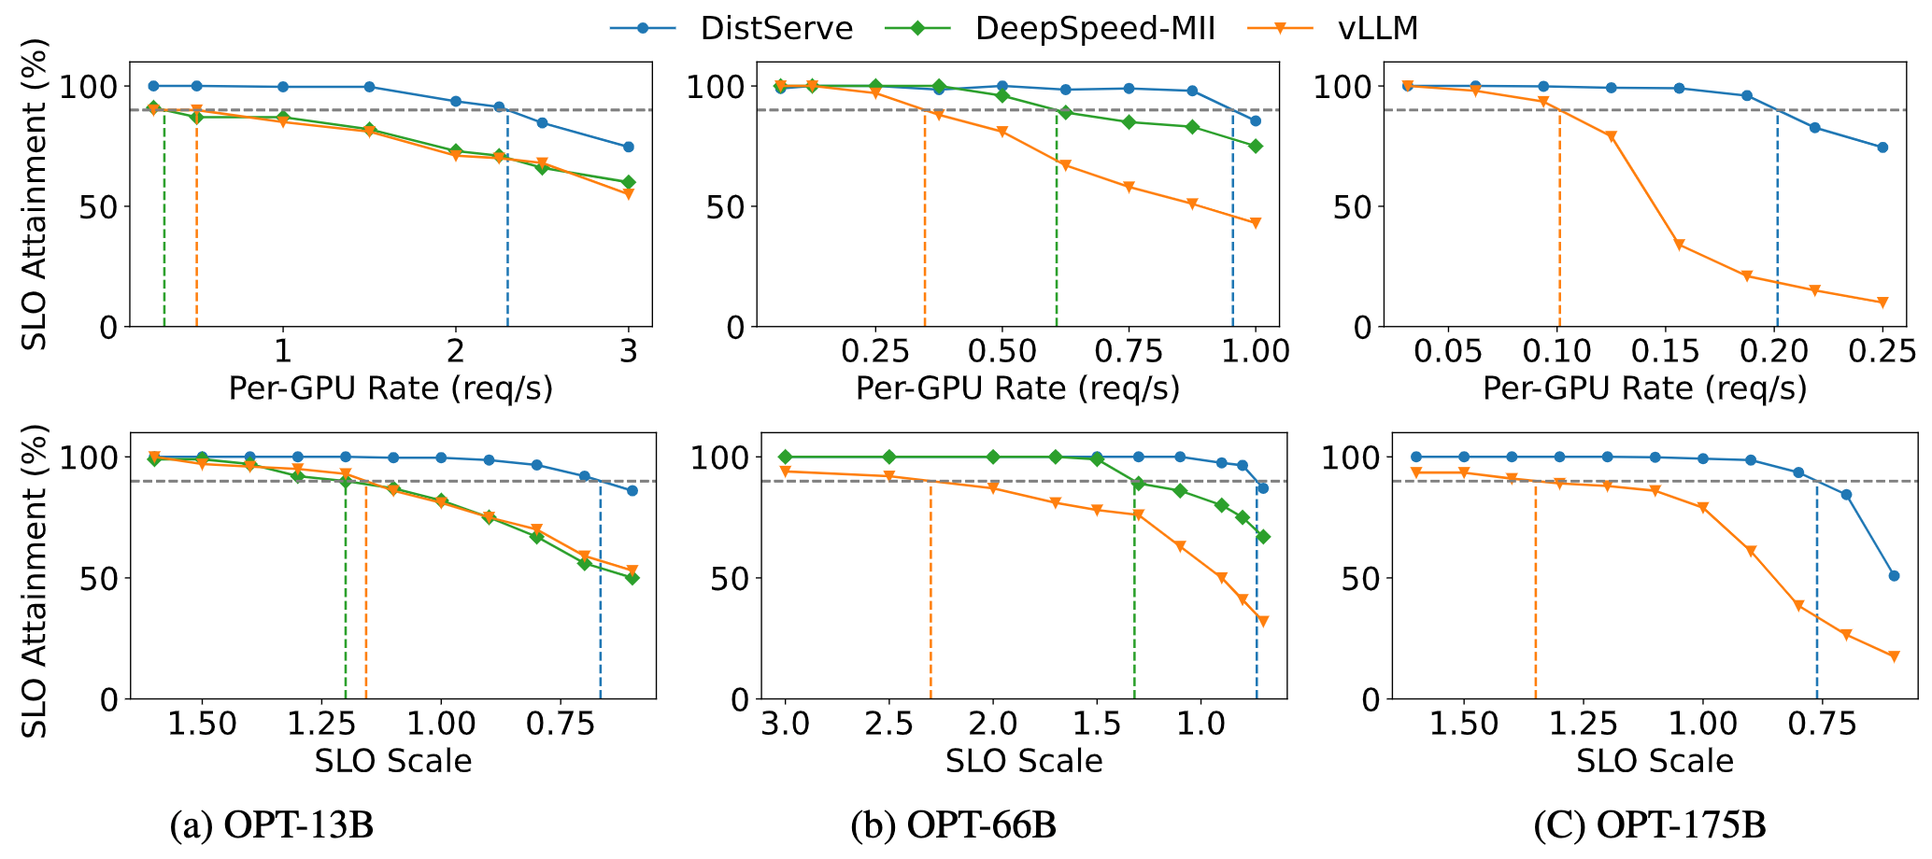
Chatbot application with OPT models on the ShareGPT dataset
Vertical line: the maximum per-GPU rate the system can handle to meet latency requirements for over 90% of the requests
Notes:
In the case of vLLM, collocating prefill and decoding greatly slows down the decoding phase, thereby significantly increasing TPOT. Due to the stringent TPOT requirements of chatbot applications, although vLLM meets the TTFT SLO for most requests, the overall SLO attainment is dragged down by a large number of requests that violate the TPOT SLO.

Slide 36
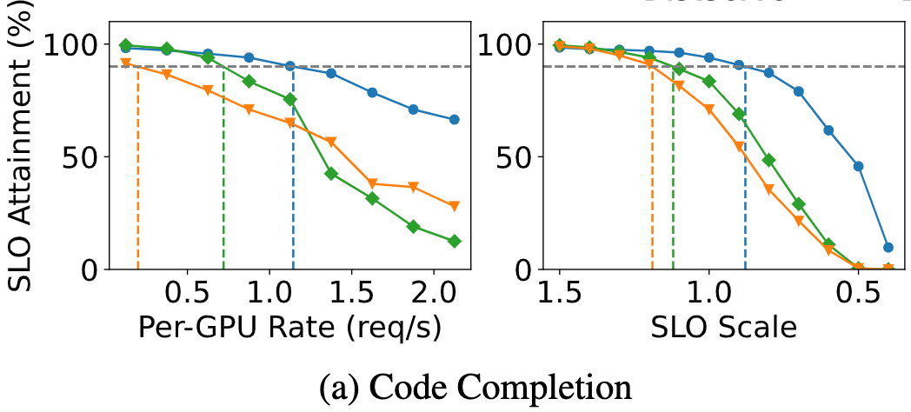
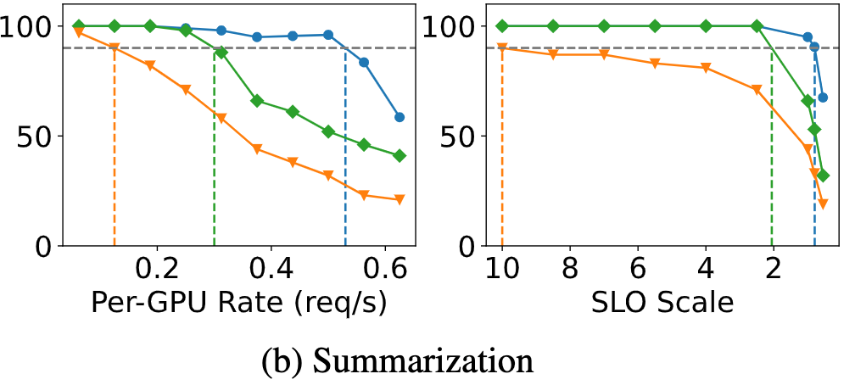
Chatbot application with OPT models on the ShareGPT dataset
Lower TTFT
Loose
requirement
for TTFT

Slide 37
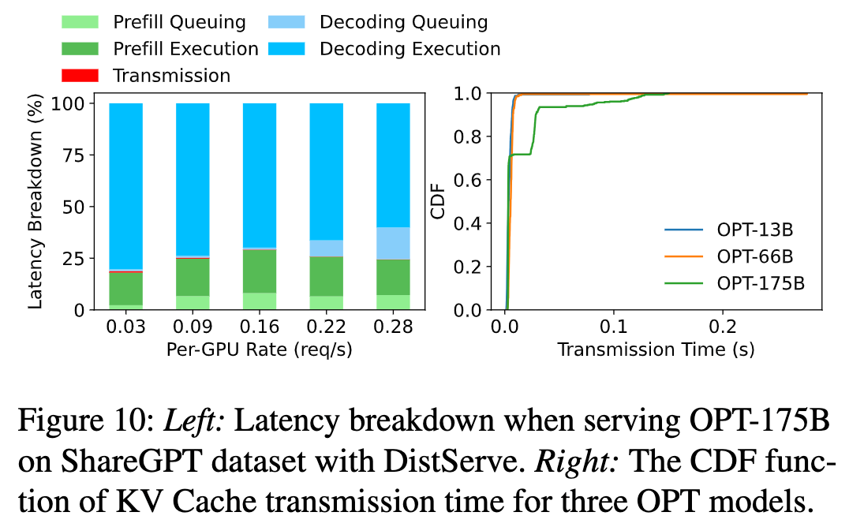
Latency breakdown

Slide 38
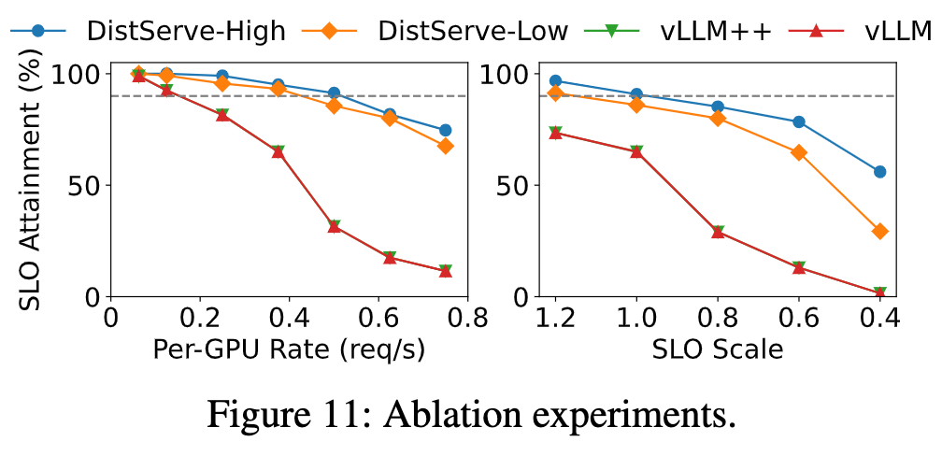
Ablation study

Slide 39
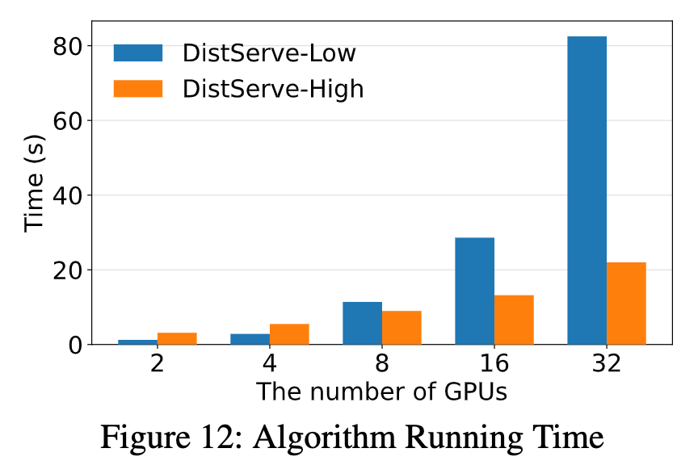
Algorithm running time

