Slide 1
Moving Violations in the District of Columbia (September 2018)
Data Source: http://opendata.dc.gov/
Data wrangling and exploration (Pandas and Geopandas)
Database used: SQLite
Python Flask
Used Chart.js (interactive graphs)

Slide 2
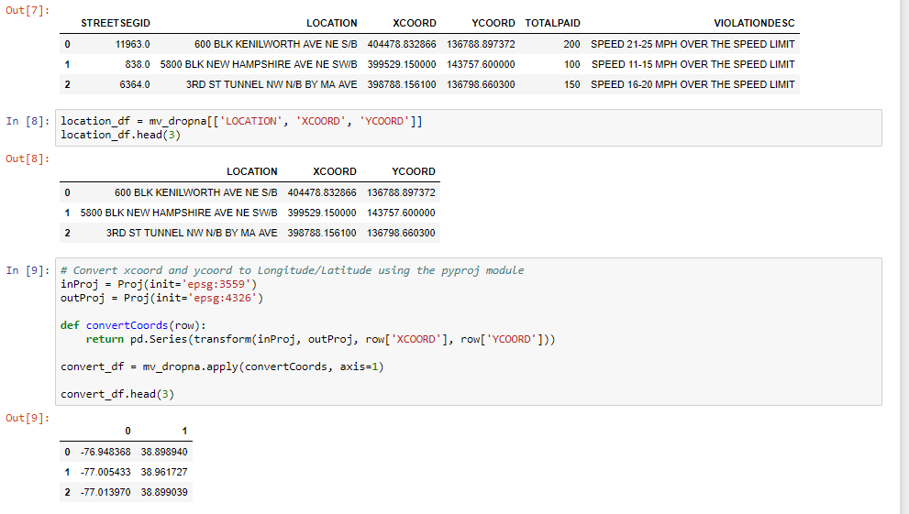
Data wrangling and exploration

Slide 3
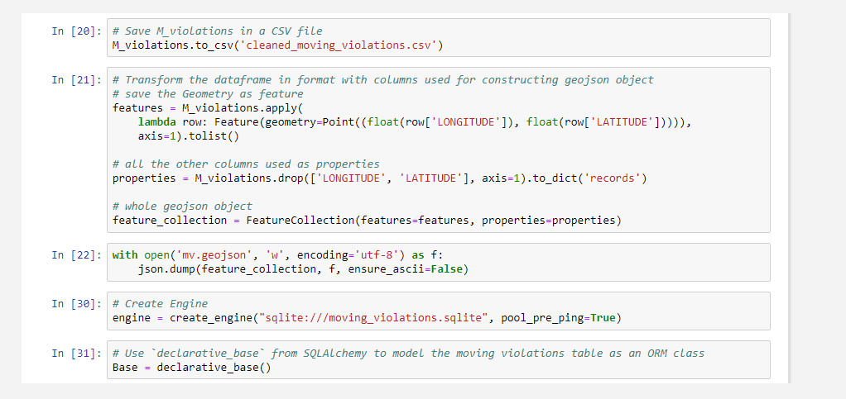
Data wrangling – Transform to construct geojson object

Slide 4
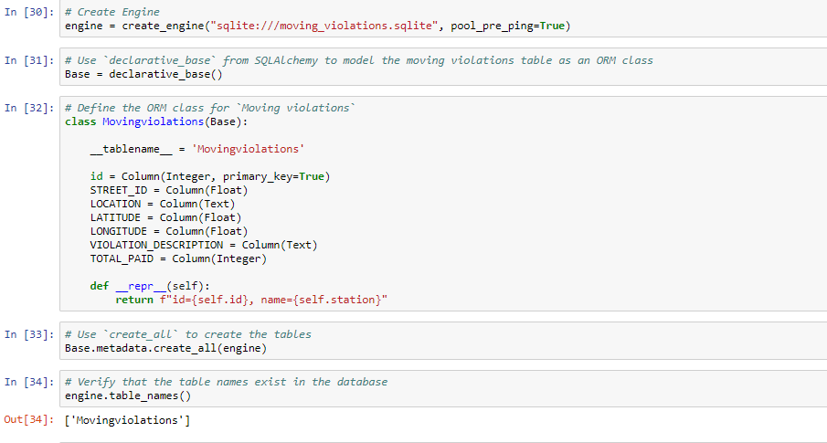
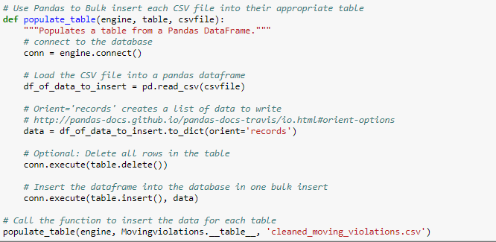
SQLite

Slide 5
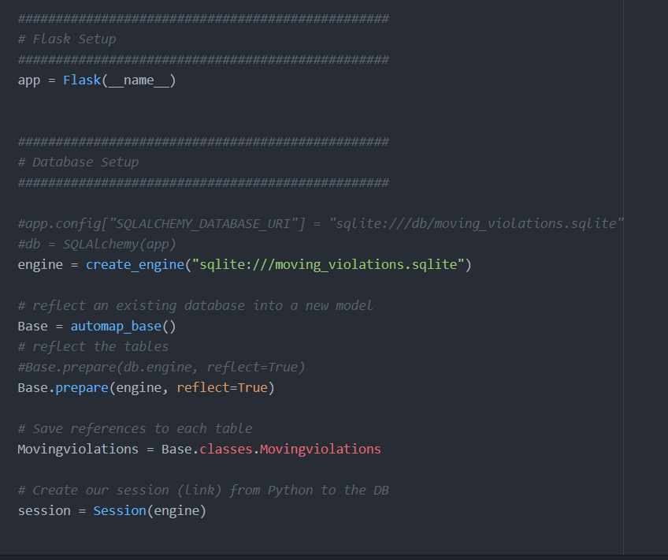
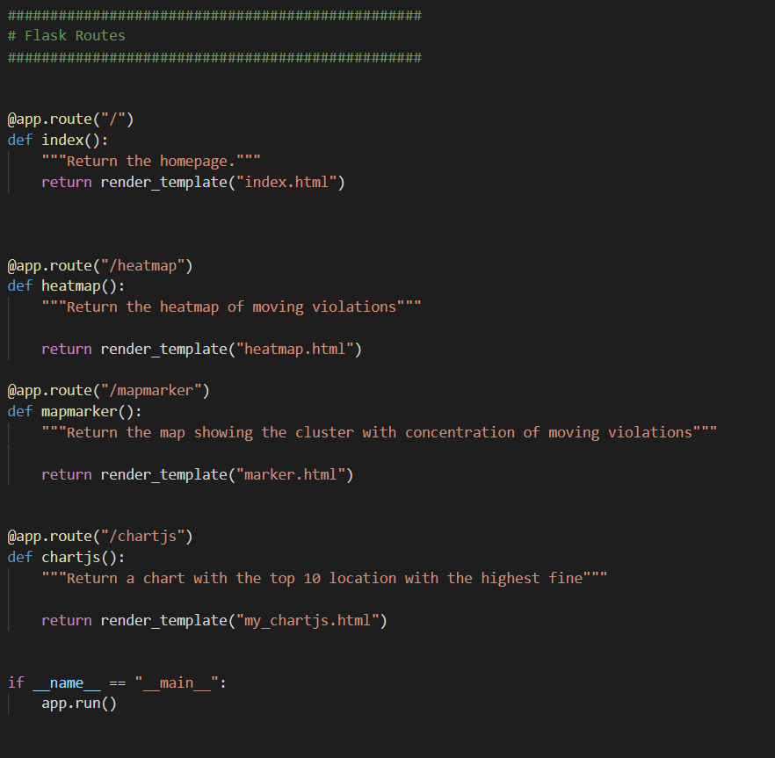
Python Flask

Slide 6
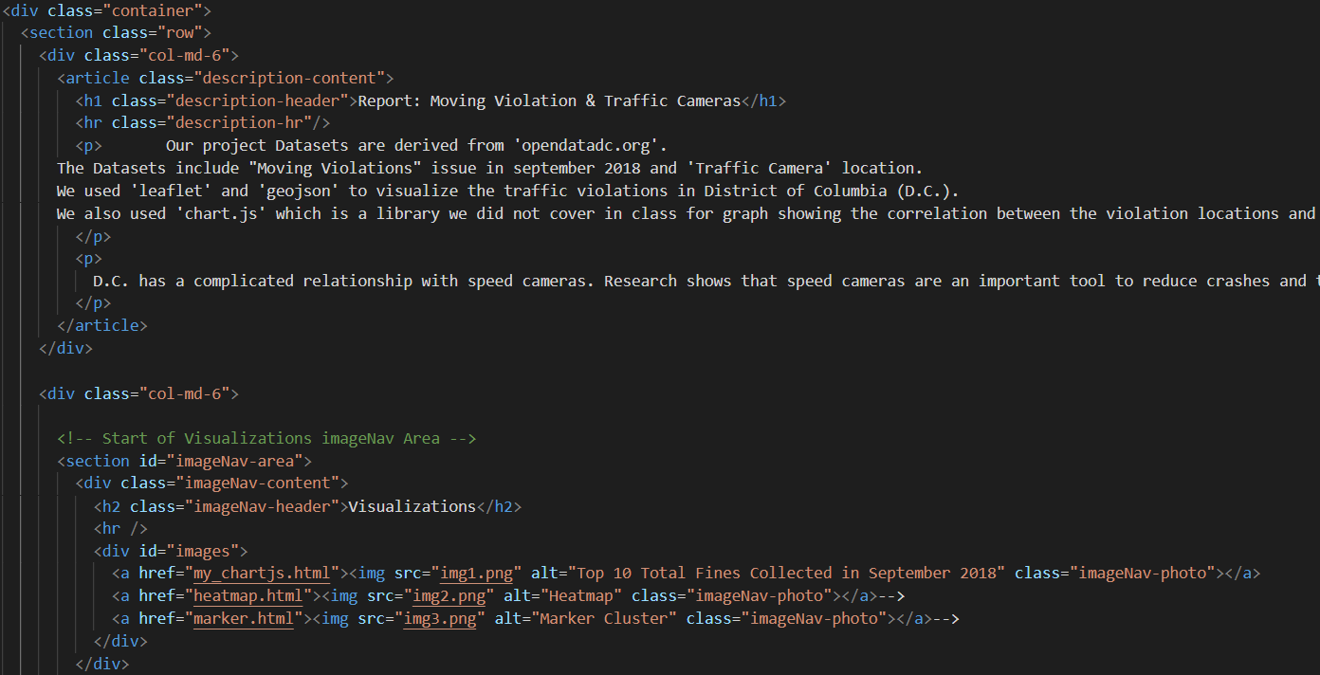
HTML/CSS

Slide 7
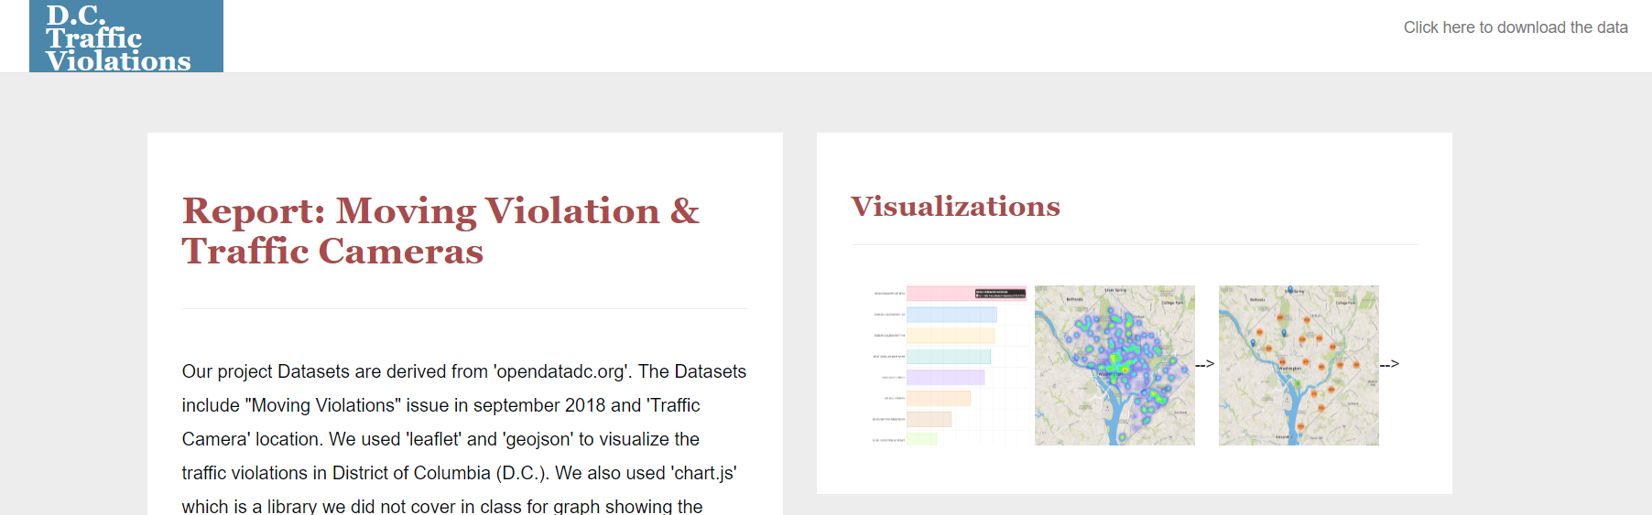
HTML/CSS

Slide 8
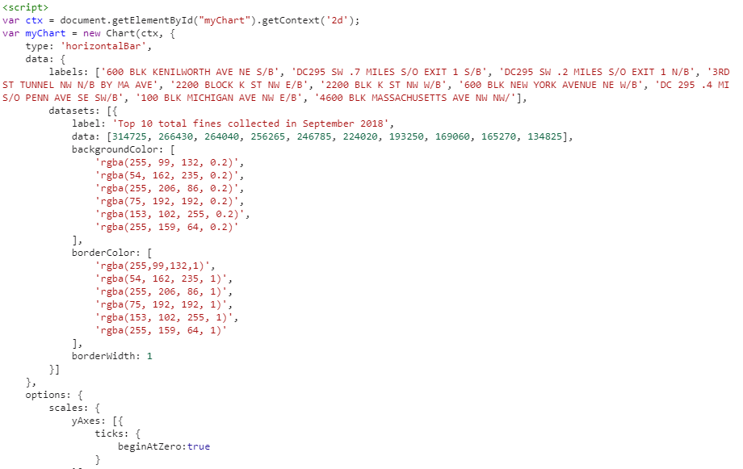
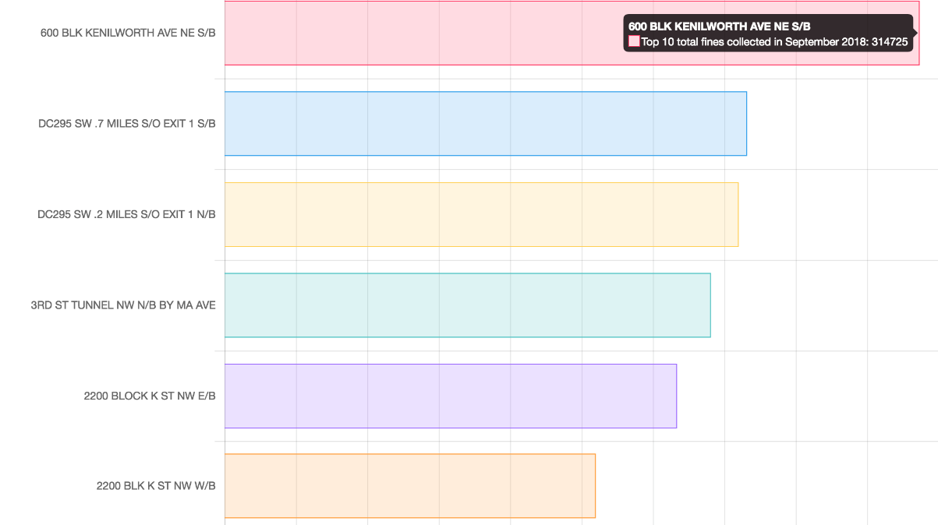
JavaScript library - Chart.js

Slide 9
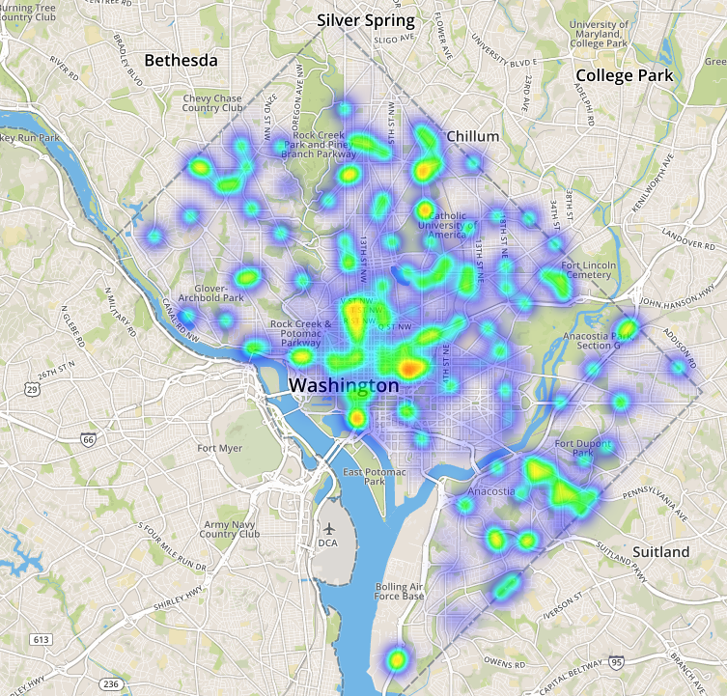
DC Map Moving Violation - Heatmap

Slide 10
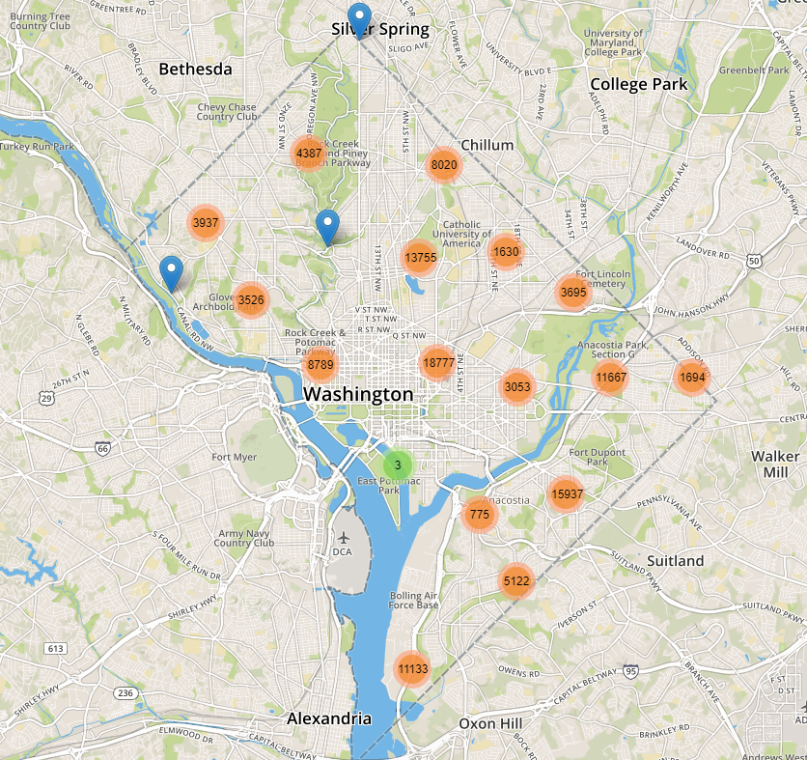
DC Map Moving Violation - MarkerCluster

