Slide 1
Moving Violations in the District of Columbia (September 2018)
Data Source: http://opendata.dc.gov/
Data wrangling and exploration (Pandas and Geopandas)
Database used: SQLite
Python Flask
Used Chart.js (interactive graphs)

Slide 2
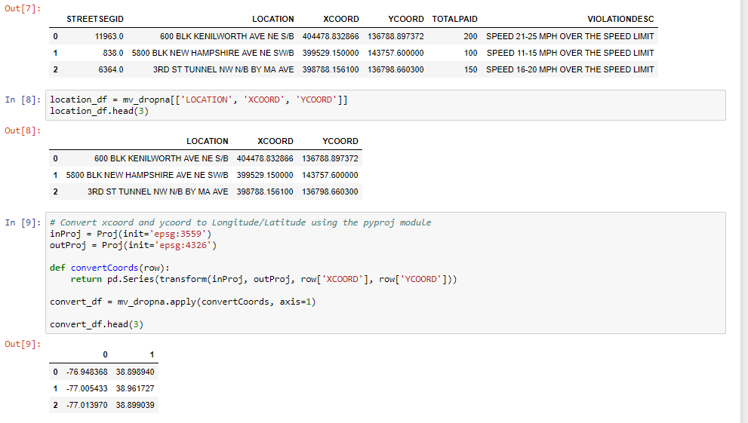
Data wrangling and exploration

Slide 3
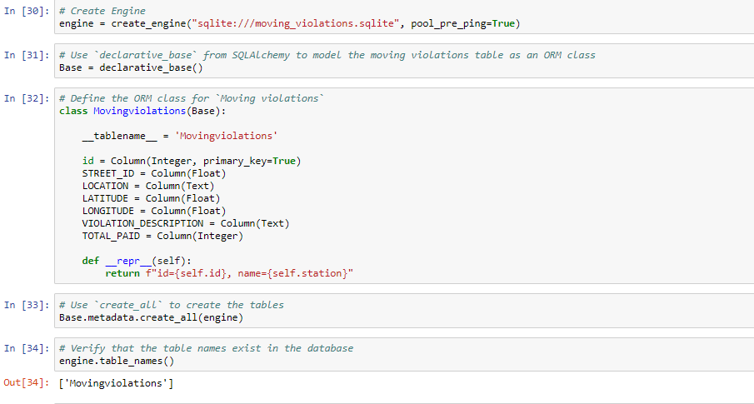
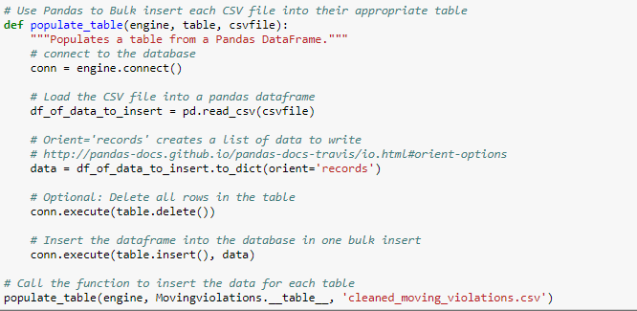
SQLite

Slide 4
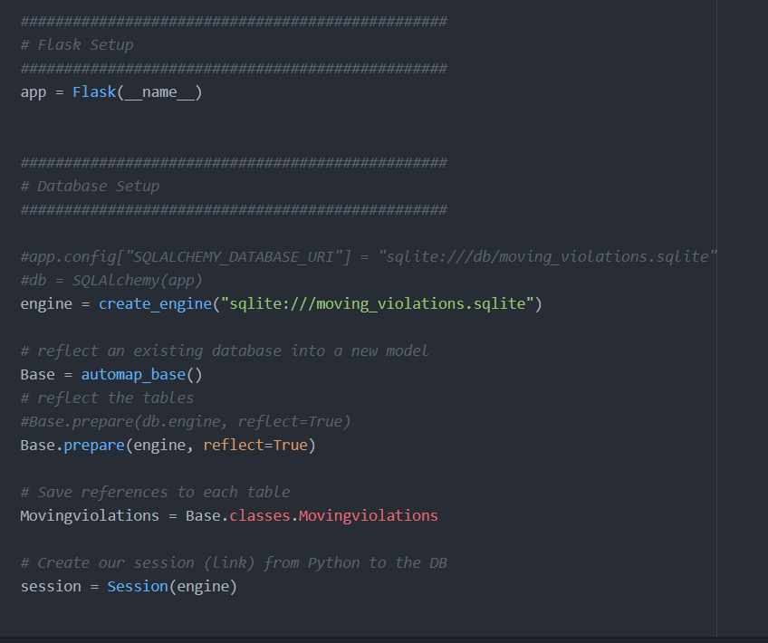
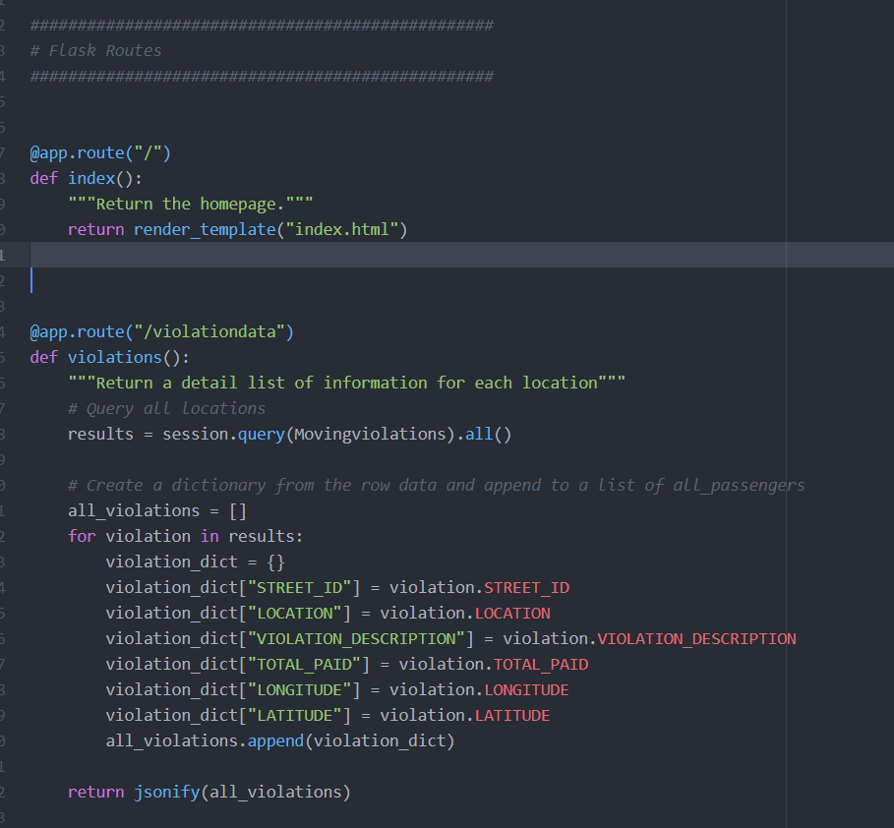
Python Flask

Slide 5
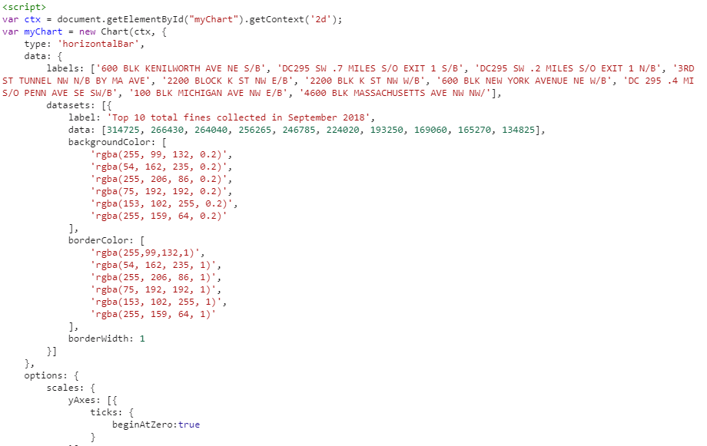
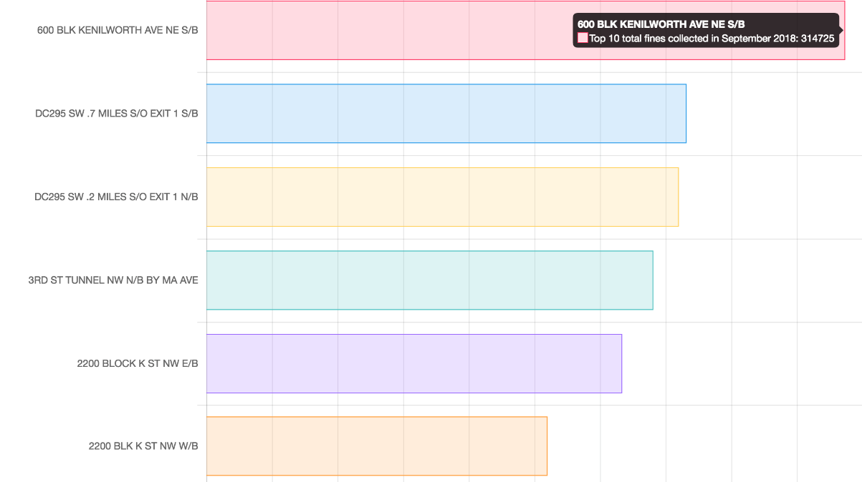
JavaScript library - Chart.js

Slide 6
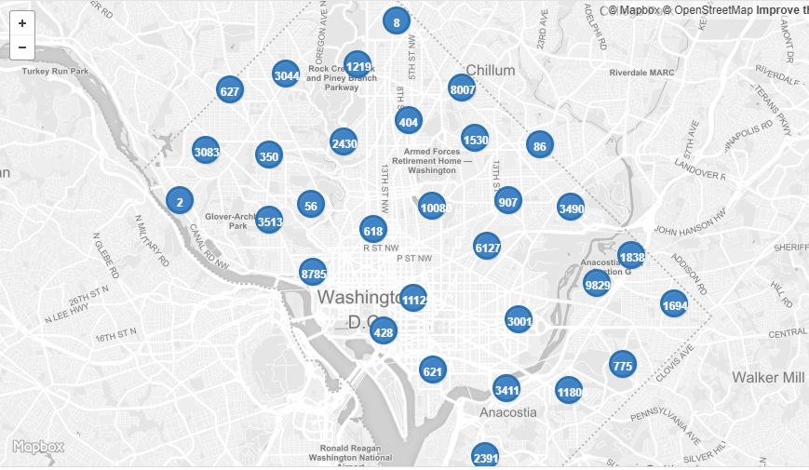
DC Map Moving Violation - Geojson

