Slide 1
Pixie
Get behind-the-scenes insight into how your apps are working

Slide 2
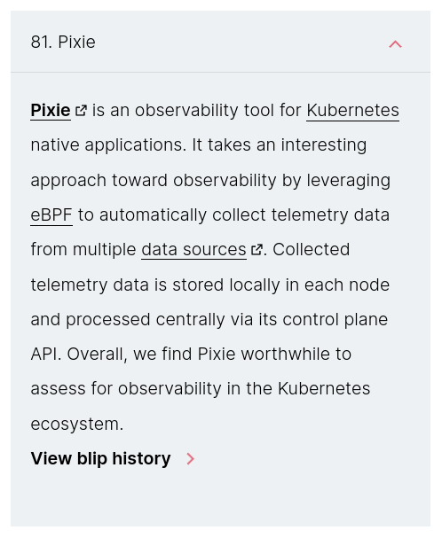
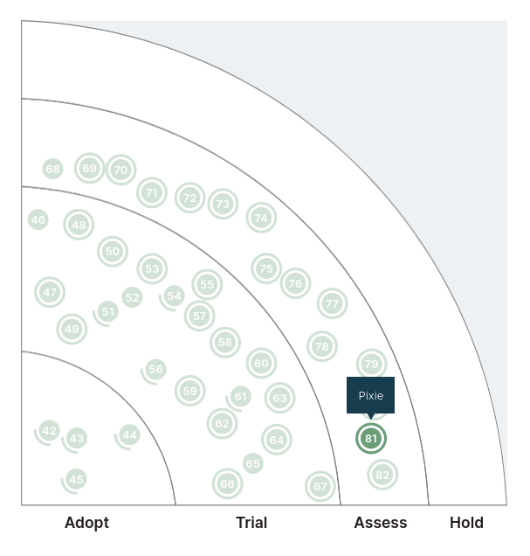

Slide 3
Kubernetes: a platform to run containers across multiple servers, with lots of other bells and whistles
eBPF: a way to run custom code in the kernel space, meaning that code will be able to intercept anything that happens in any running program
multiple data sources: meaning things like network packets, JVM metrics, cpu + memory metrics

Slide 4
So what can we see?

Slide 5
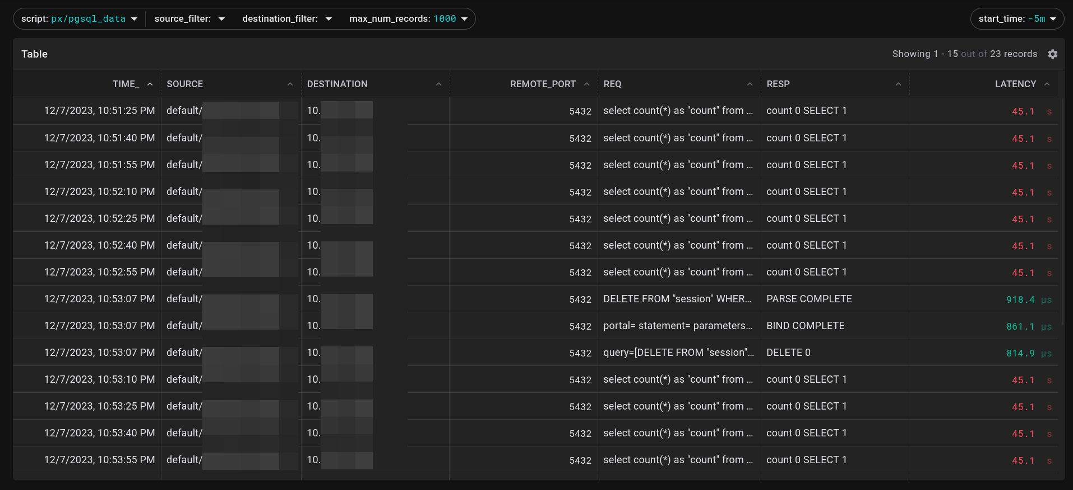
Postgres traffic (the actual queries)

Slide 6
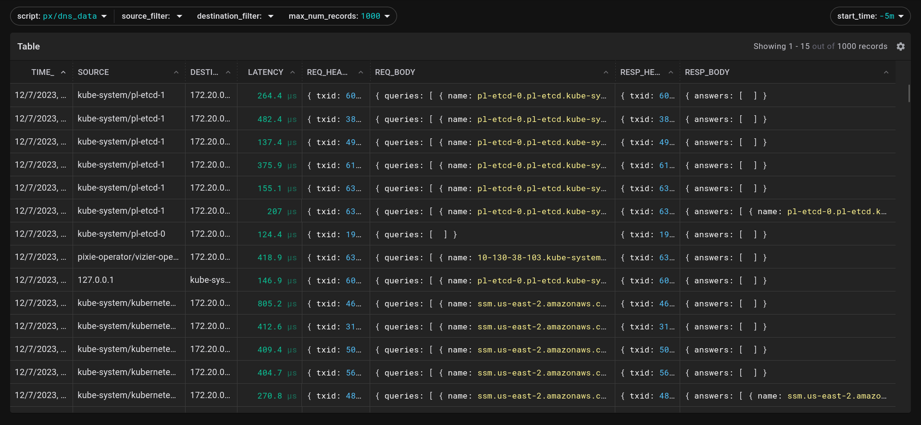
DNS queries

Slide 7
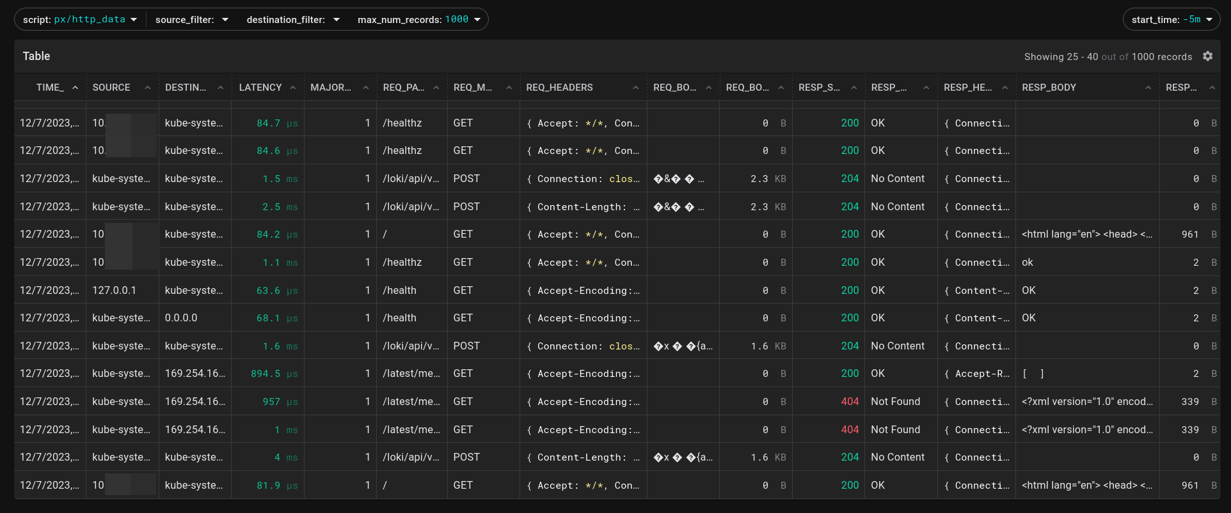
HTTP traffic

Slide 8
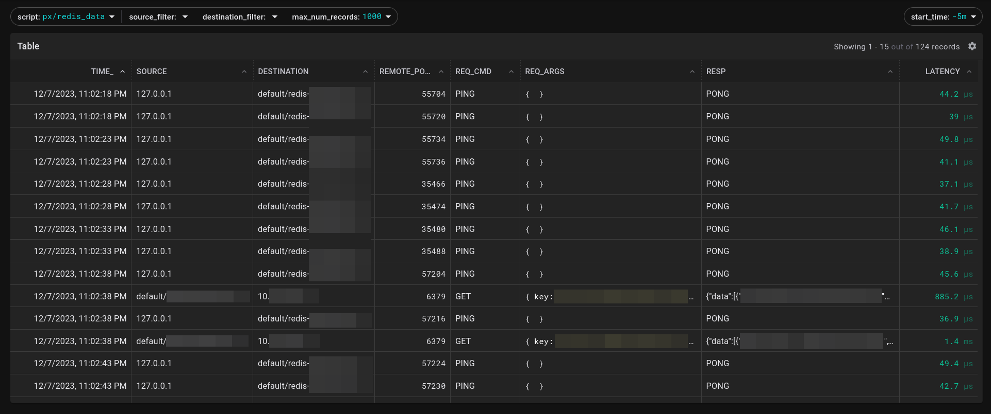
Redis traffic

Slide 9
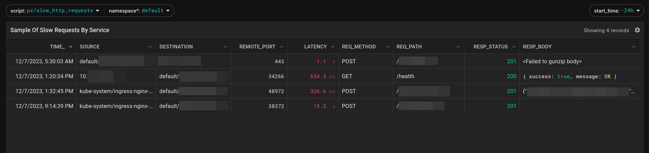
Slow HTTP requests

Slide 10
This will take some of the guesswork out of troubleshooting.

Slide 11
Did the call from my browser make it through all the layers of networking successfully?

Slide 12
Did my app return an error before or after hitting the database?

Slide 13
The logs make it look like everything was successful… did the expected response actually leave the container?

Slide 14
demo!

Slide 15
Pros:
All components are open-source and self-hostable
Cloud version is free, and isn’t aggressive about upselling
Cons:
Has a learning / discovery curve
Helm chart has oddities
No Helm chart for the self-hosted UI
Some backend pods crash with obtuse errors

Slide 16
Tech Radar rating: Assess
My rating: Adopt

