Slide 1
GitOps
Make changes by committing to a git repo

Slide 2
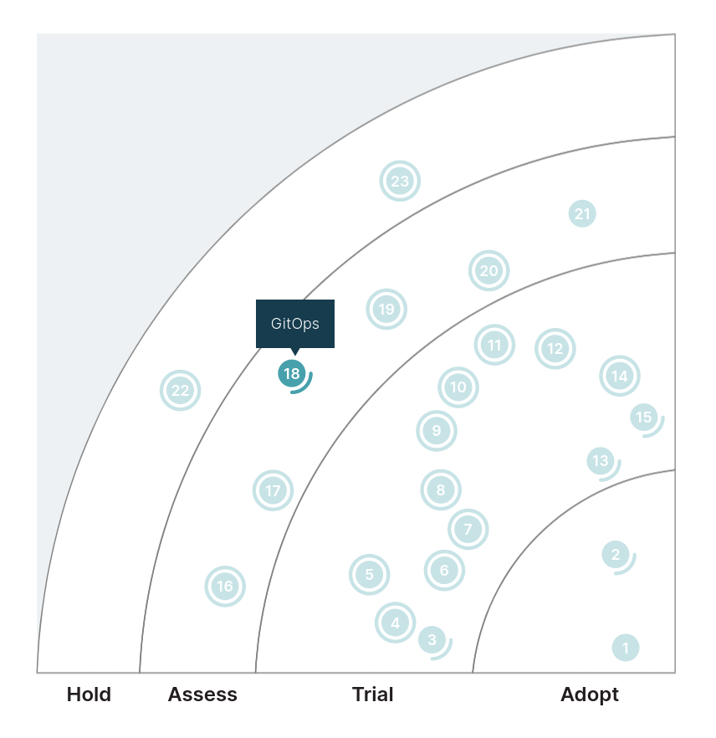

Slide 3
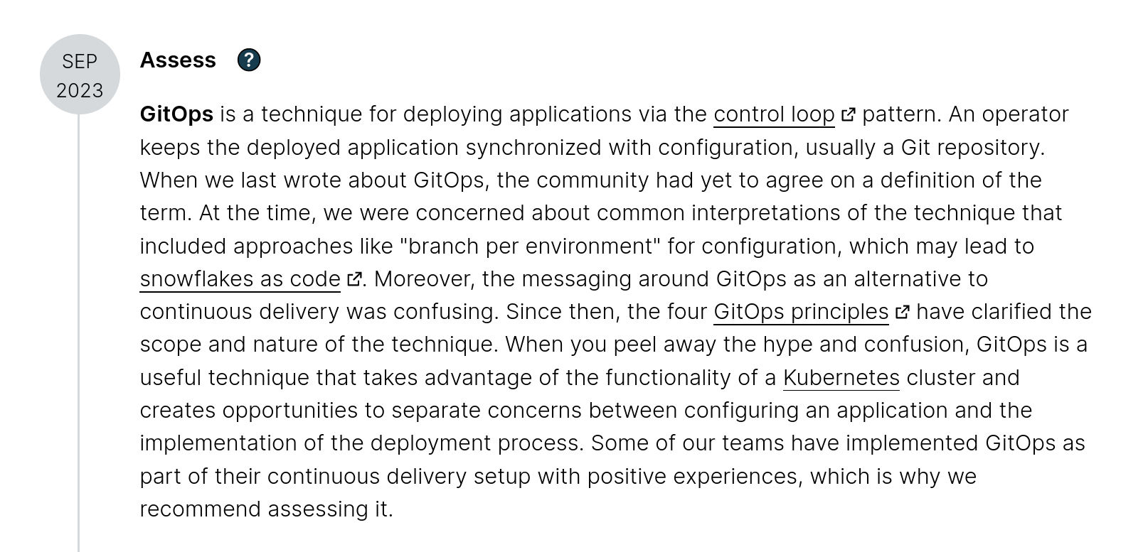

Slide 4
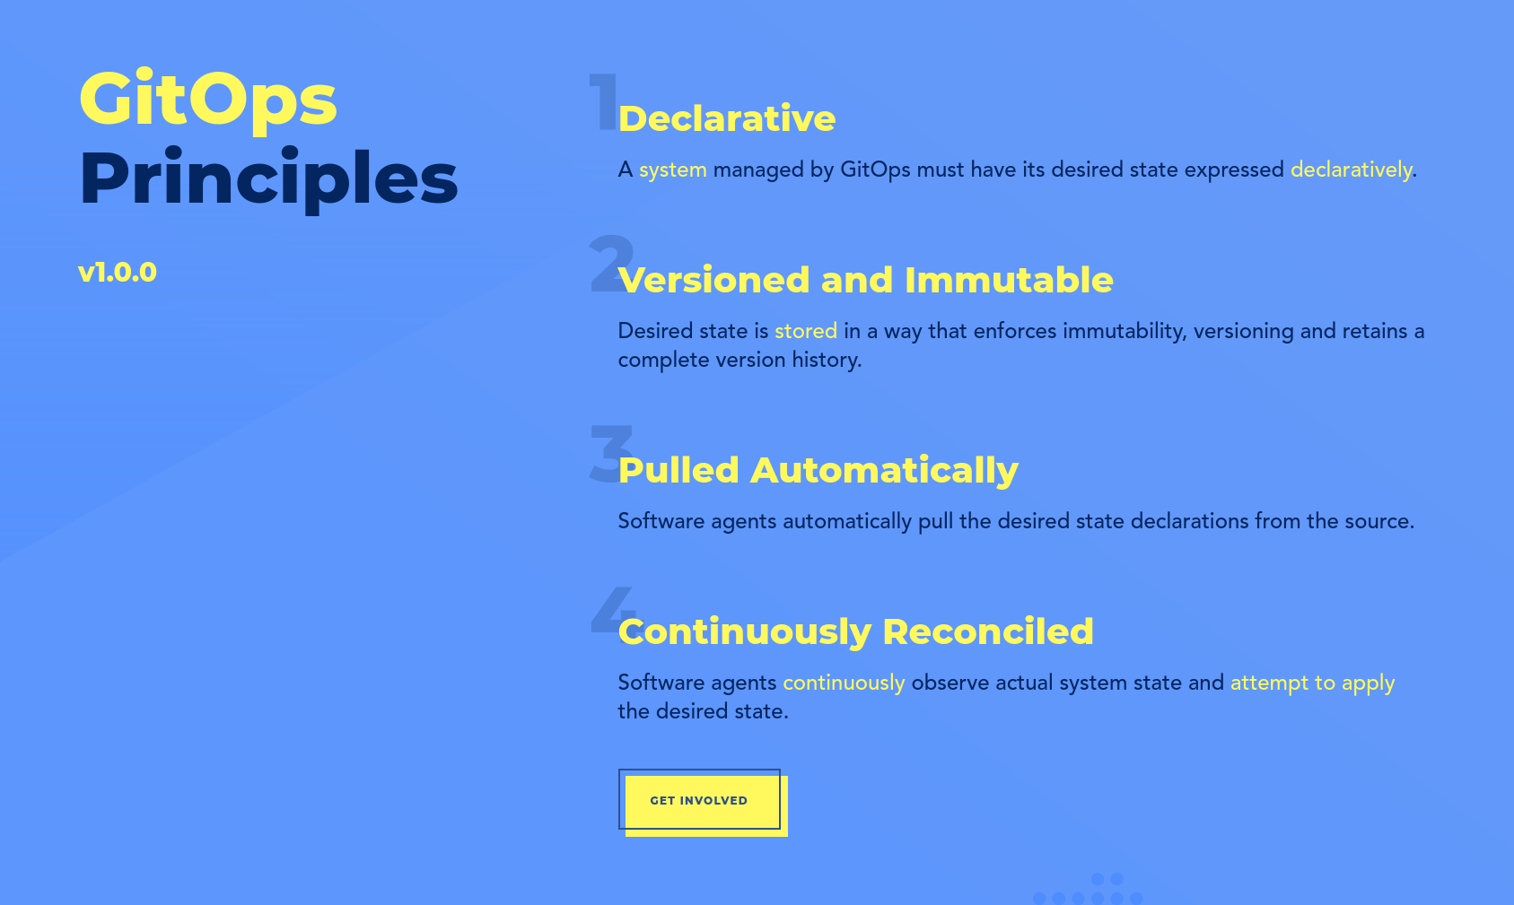
(from: https://opengitops.dev)

Slide 5
a repo we can look at:
https://github.com/egineering-llc/ctf-workshop

Slide 6
Pros:
Automatically fixing drift
Single source of truth
Helps with promoting between environments
Cons:
Can slow down the iteration cycle

Slide 7
Tech Radar rating: Assess
My rating: Adopt

