Slide 1
Neural Substrates of Attention and Awareness
Dan Birman
Gardner Lab
MAD Lunch – 2016-08-23

Slide 2
Neural Substrates of Attention and Awareness

Slide 3
Neural Substrates of Attention and Awareness

Slide 4
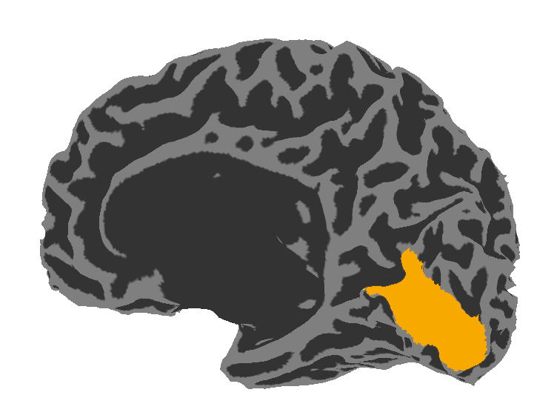
Neural Substrates of Attention and Awareness

Slide 5
Neural Substrates of Attention and Awareness
Correlates with
conscious awareness

Slide 6
Neural Substrates of Attention and Awareness
Correlates with
conscious awareness

Slide 7
Neural Substrates of Attention and Awareness
Verbal report
Correlates with
conscious awareness

Slide 8
Neural Substrates of Attention and Awareness
Verbal report
Drive arbitrary motor plans
Correlates with
conscious awareness

Slide 9
Neural Substrates of Attention and Awareness
Verbal report
Drive arbitrary motor plans
Correlates with
conscious awareness
Store in memory

Slide 10
Neural Substrates of Attention and Awareness
Verbal report
Drive arbitrary motor plans
Correlates with
conscious awareness
Store in memory
Learn new rules

Slide 11
Neural Substrates of Attention and Awareness
Verbal report
Drive arbitrary motor plans
Correlates with
conscious awareness
Etc…
Store in memory
Learn new rules

Slide 12

Neural Substrates of Attention and Awareness
Correlates with
conscious awareness

Slide 13
Neural Substrates of Attention and Awareness

Slide 14
Neural Substrates of Attention and Awareness

Slide 15
Neural Substrates of Attention and Awareness

Slide 16
Attention
Prior Information about perceptual information

Slide 17
Attention
Prior Information about perceptual information
Spatial Priors

Slide 18
Attention
Prior Information about perceptual information
Spatial Priors
Feature Priors

Slide 19
Attention
Prior Information about perceptual information
Top-down: based on earlier information

Slide 20
Attention
Prior Information about perceptual information
Top-down: based on earlier information
Bottom-up: driven by a stimulus

Slide 21
Top-down feature based attention
Cue a specific feature, in advance.

Slide 22
Top-down feature based attention
Cue a specific feature, in advance.
Does not prevent bottom-up salience

Slide 23
Top-down feature based attention
Cue a specific feature, in advance.
Does not prevent bottom-up salience
Record one measure of conscious awareness: ability to discriminate stimulus strength

Slide 24

Top-down feature based attention
Cue a specific feature, in advance.
Does not prevent bottom-up salience
Record one measure of conscious awareness: ability to discriminate stimulus strength
Visual Area V1: Contrast
High Contrast
Low Contrast

Slide 25
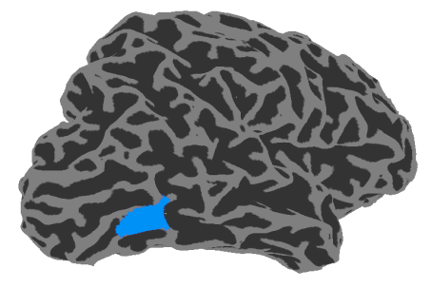
Top-down feature based attention
Cue a specific feature, in advance.
Does not prevent bottom-up salience
Record one measure of conscious awareness: ability to discriminate stimulus strength
0% Coherence
100% Coherence
Visual Area V1: Contrast
Visual Area hMT: Motion
High Contrast
Low Contrast

Slide 26
Manipulating attention
Blocked cue: Attend to contrast/motion
500 ms stimulus
500-1000 ms delay
Response
Left/Right
Report side with stronger motion/contrast

Slide 27
Perception of unattended feature
15% of trials
Blocked cue: Attend to contrast/motion
500 ms stimulus
500-1000 ms delay
C/M
Ignore prepared response
Respond about unattended feature

Slide 28
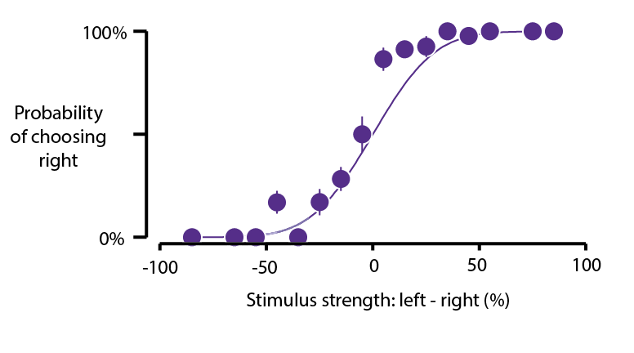

Slide 29
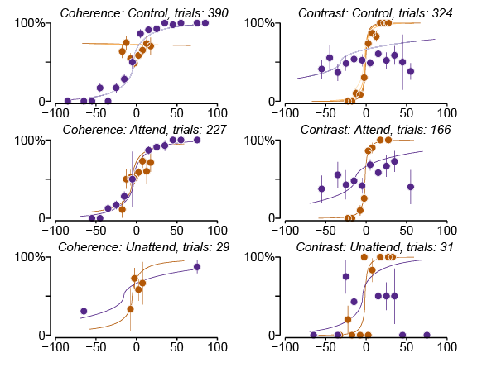
Contrast Effect
Motion Coherence Effect

Slide 30
Contrast Effect
Motion Coherence Effect

Slide 31
Contrast Effect
Motion Coherence Effect
Splitting attention

Slide 32
Contrast Effect
Motion Coherence Effect

Slide 33
Contrast Effect
Motion Coherence Effect
Reduced slope = worse performance

Slide 35
“Leak” of motion

Slide 38
d‘=1

Slide 39
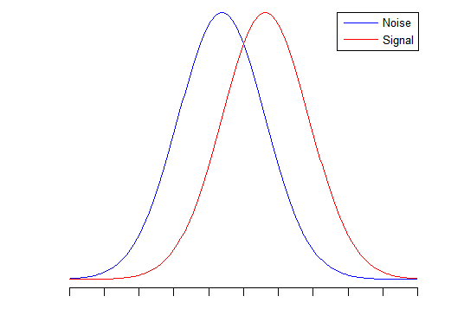
d’=1
d‘=1

Slide 40
d’=1
d‘=1
Threshold or
Just Noticeable Difference

Slide 41
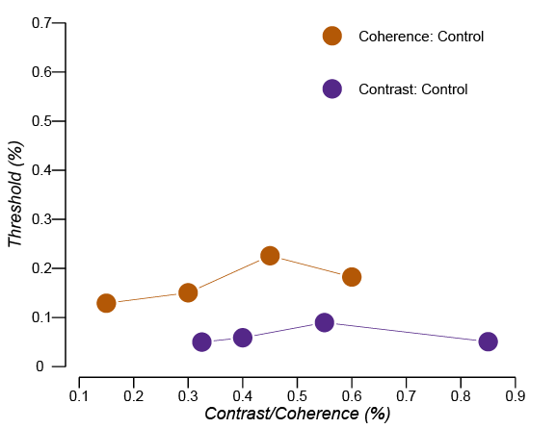

Slide 42
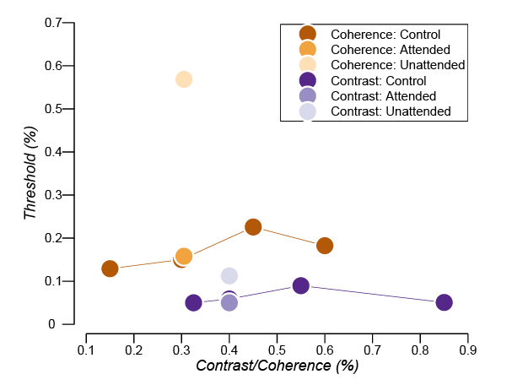

Slide 43
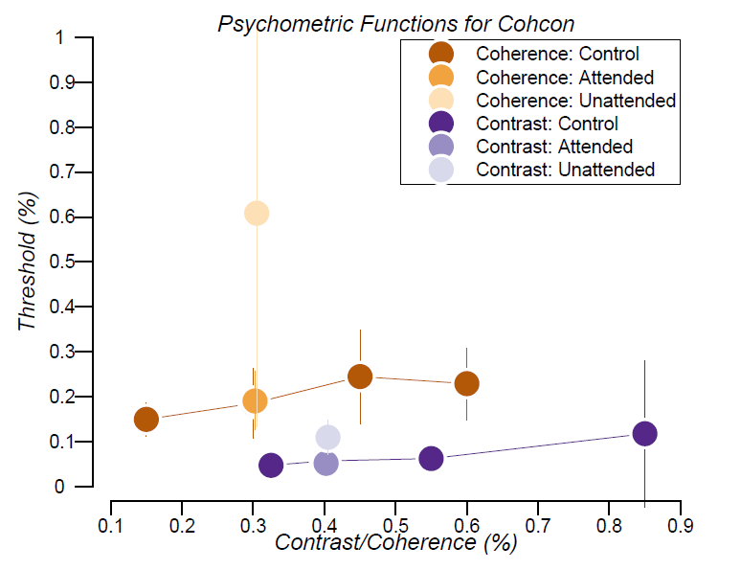

Slide 44
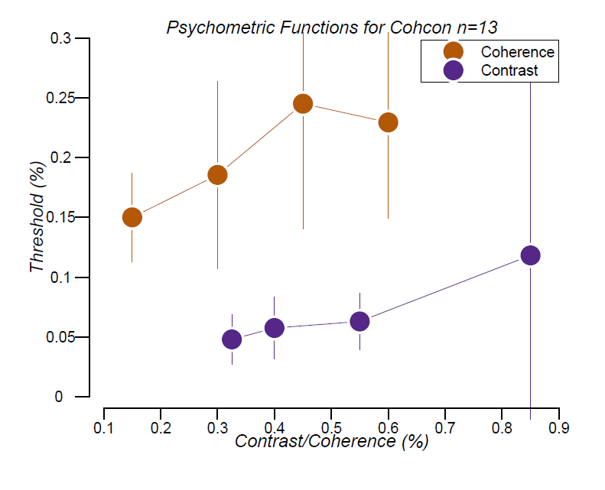

Slide 45
Neural Representations
+

Slide 46
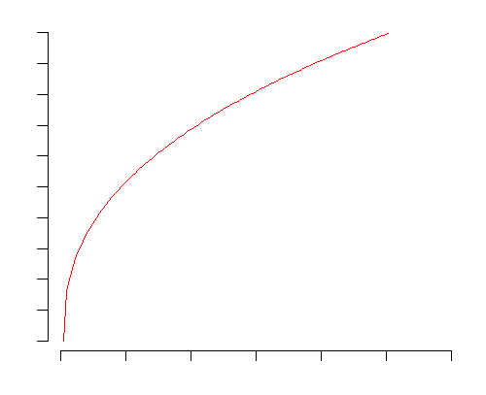
Neural Representations
+
=

Slide 47
Neural Representations
+
=
For a constant change
in neural response
Need increasingly large
stimulus strength differences

Slide 48
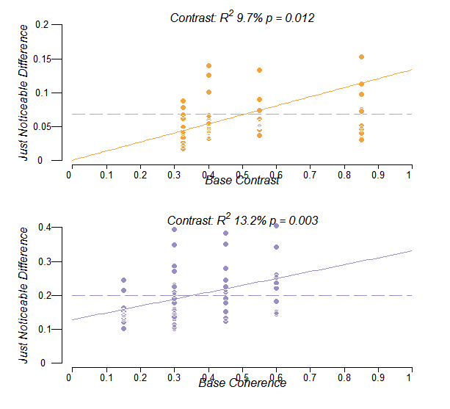
Non-Linear Representations

Slide 49
Outline
Attention: an improvement in performance when prior information about behavioral relevance is available, at the cost of performance for other information.
Awareness: reportability, discriminability, etc
We want to understand the neural mechanism that results in attention and why it sometimes acts in counter-intuitive ways:
For example, attention to contrast hurts discriminability of motion coherence
Dig into behavior
What kinds of neural responses might underlie these behaviors? Well, we can read out from V1 fMRI and MT fMRI signals that are sufficiently large to explain behavior, under the assumption that there is relatively low noise (similar to previous experiments).
Explain model in detail, including fitting both timing and amplitude
Complete fit --- can we explain the behavior using the magnitudes of responses in visual cortex?
Yes (assuming no attention effects)
What does attention do? It acts as an intercept change .
Can we fit the behavior using a model that uses intercept changes instead of beta weights? Yes but only if you allow the slope to change on the unattended motion coherence function:
Does this show up in the data?
A hierarchical model for feature attention is sufficient to explain this behavioral and fMRI data jointly.

Slide 50
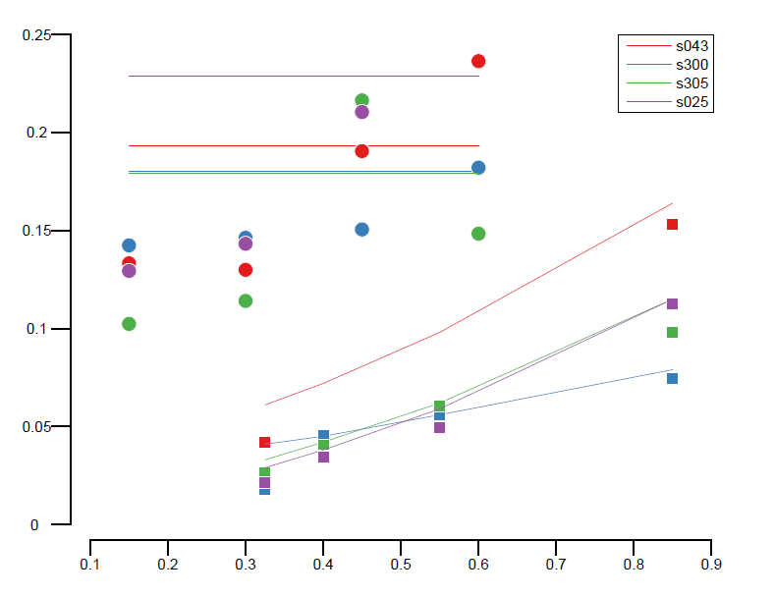
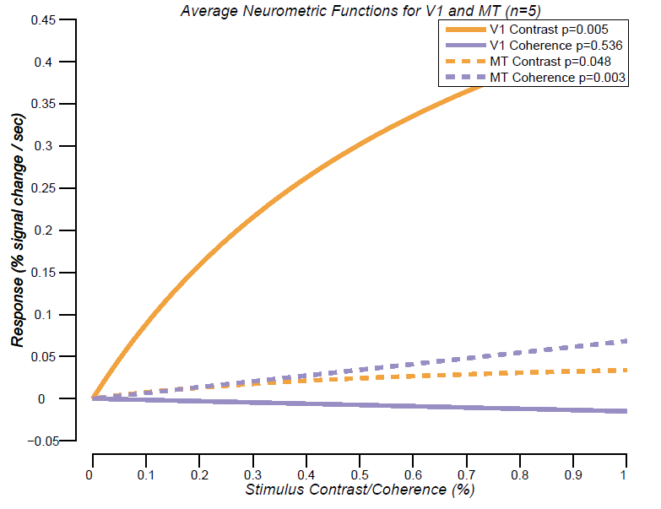
Use real data + curve estimates? From
Average behavioral data

Slide 51
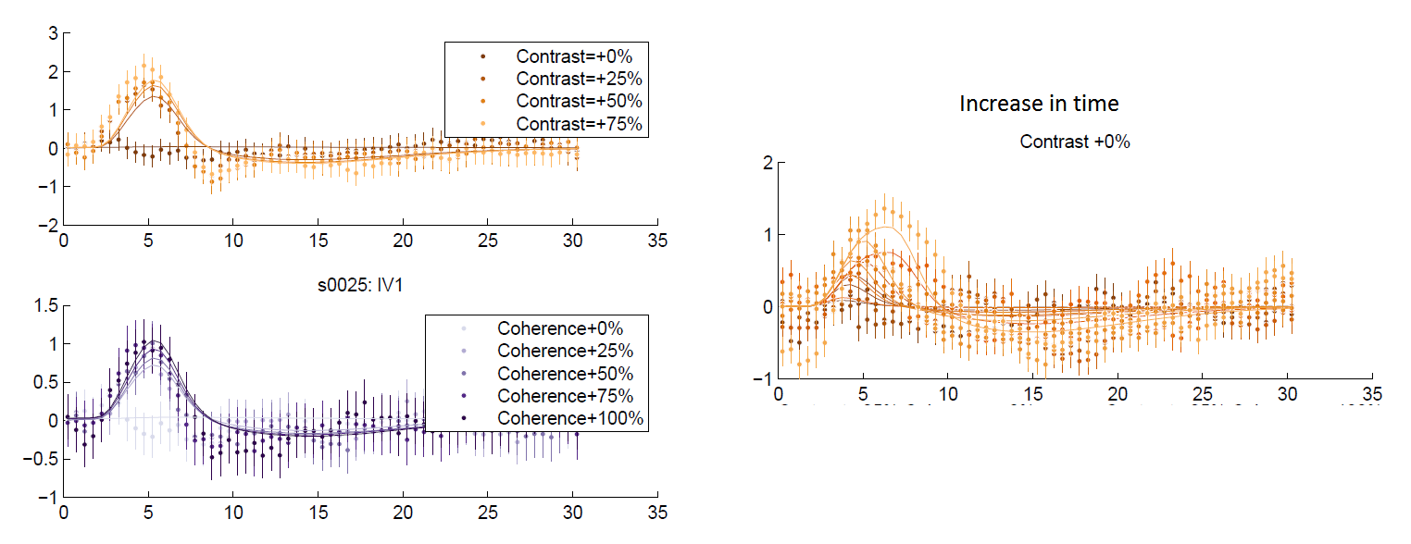

Slide 52
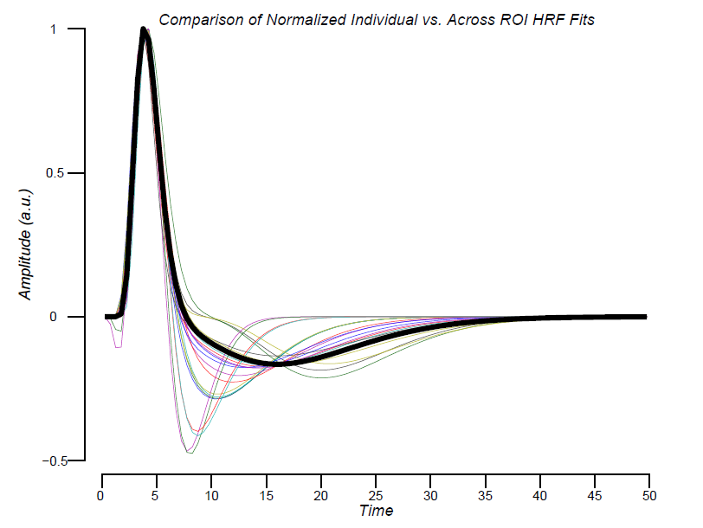

Slide 53
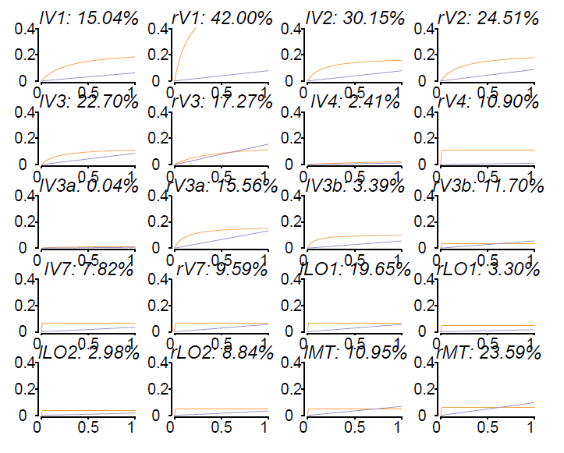

Slide 54
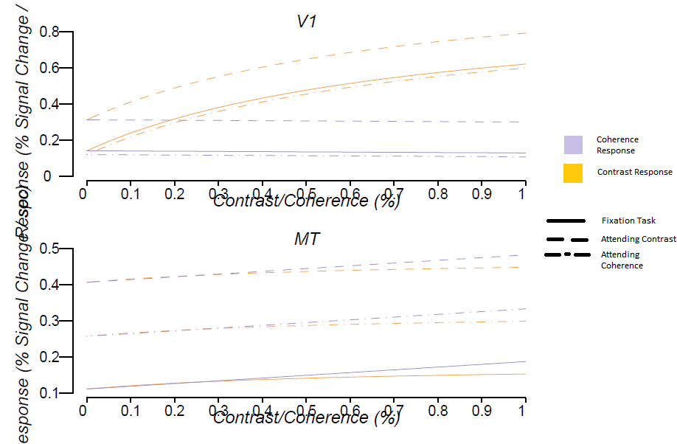

Slide 55
Missing data: behavior w/ intercept model

