Slide 1
Neural Substrates of Attention and Awareness
Dan Birman
Gardner Lab
MAD Lunch – 2016-08-23

Slide 2
Outline
Attention: an improvement in performance when prior information about behavioral relevance is available, at the cost of performance for other information.
Awareness: reportability, discriminability, etc
We want to understand the neural mechanism that results in attention and why it sometimes acts in counter-intuitive ways:
For example, attention to contrast hurts discriminability of motion coherence
Dig into behavior
What kinds of neural responses might underlie these behaviors? Well, we can read out from V1 fMRI and MT fMRI signals that are sufficiently large to explain behavior, under the assumption that there is relatively low noise (similar to previous experiments).
Explain model in detail, including fitting both timing and amplitude
Complete fit --- can we explain the behavior using the magnitudes of responses in visual cortex?
Yes (assuming no attention effects)
What does attention do? It acts as an intercept change .
Can we fit the behavior using a model that uses intercept changes instead of beta weights? Yes but only if you allow the slope to change on the unattended motion coherence function:
Does this show up in the data?
A hierarchical model for feature attention is sufficient to explain this behavioral and fMRI data jointly.

Slide 3
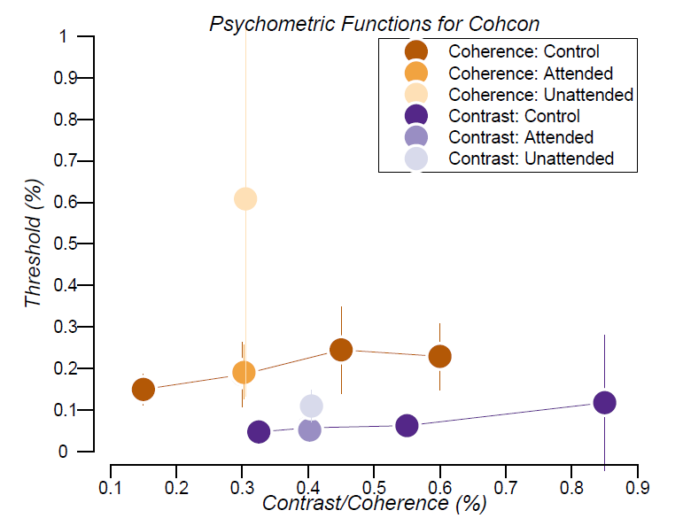

Slide 4
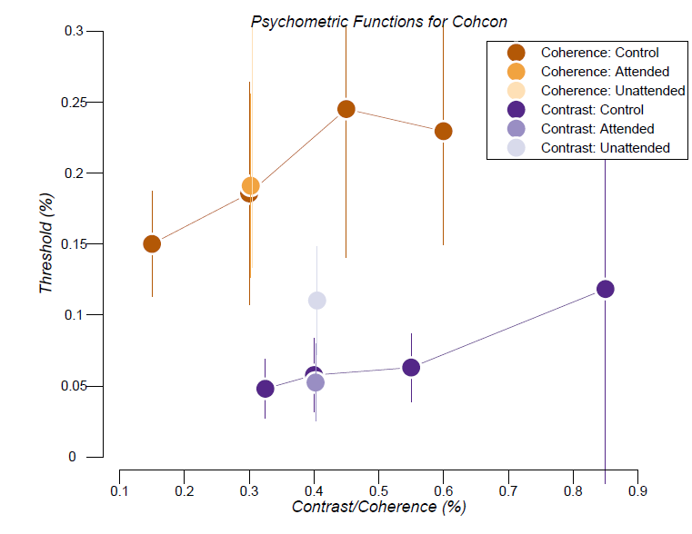

Slide 5
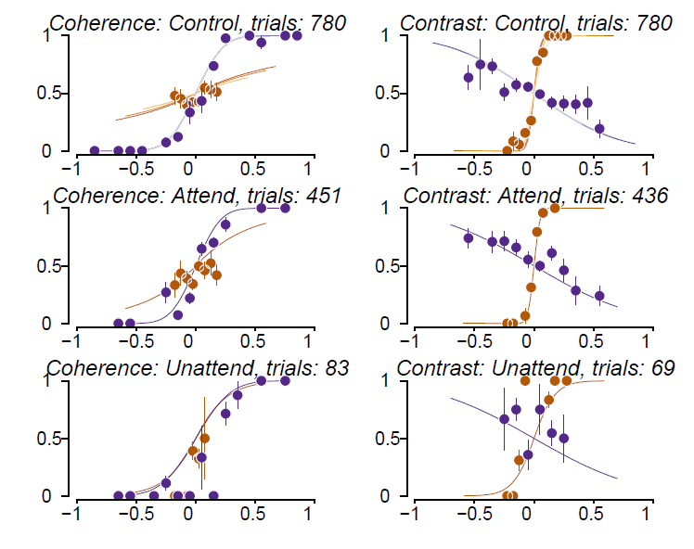

Slide 6
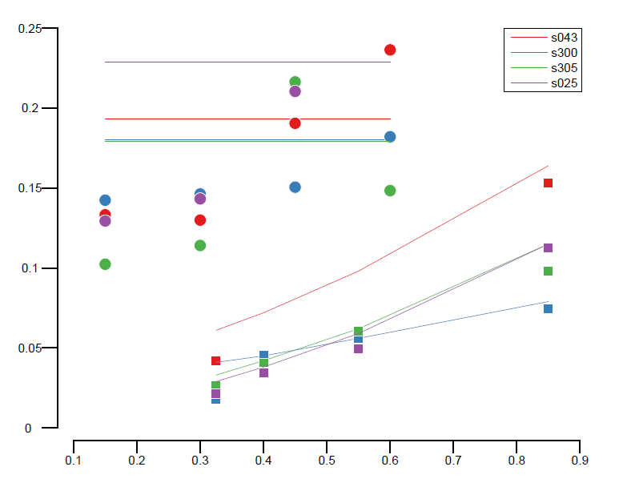

Slide 7
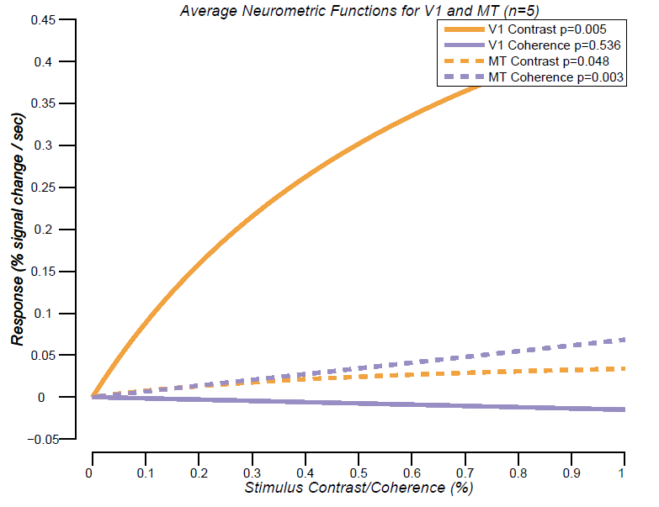

Slide 8
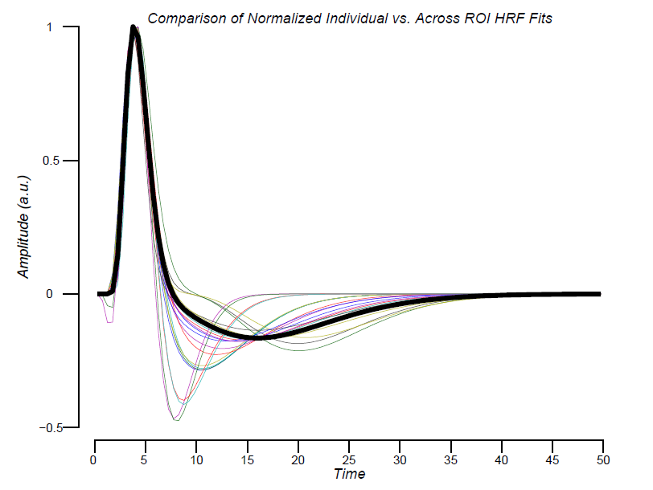

Slide 9
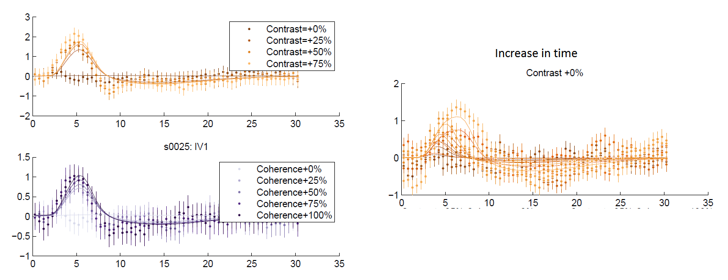

Slide 10
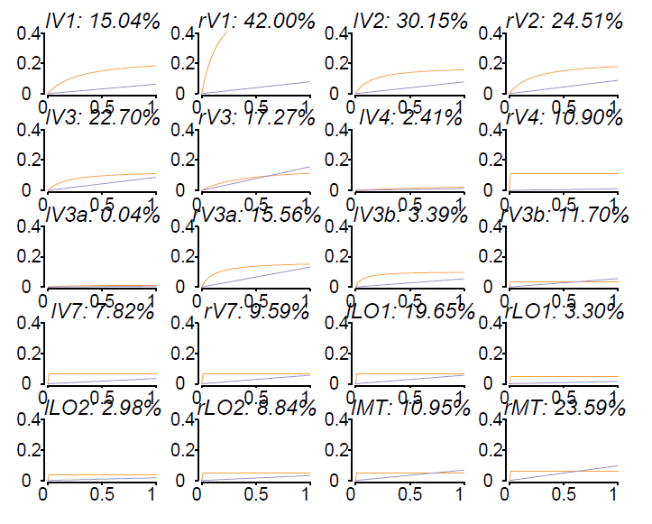

Slide 11
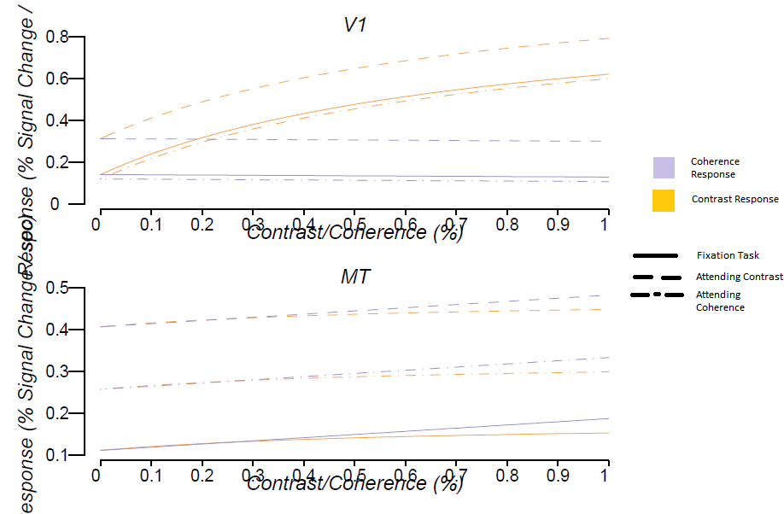

Slide 12
Missing data: behavior w/ intercept model

