Slide 1

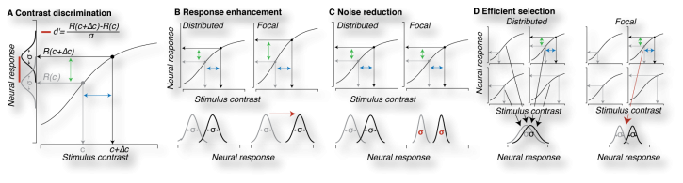
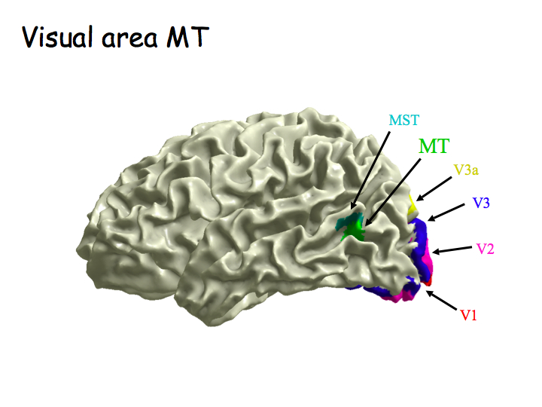
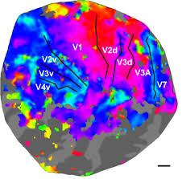
Neural Substrates of Attention and Awareness
Asymmetrical Behavioral Effects of Feature-Based Attention
Are Predictable from Neural Architecture
GRU
.stanford.edu
Behavior
Daniel Birman, Justin Gardner
Department of Psychology, Stanford University
dbirman@stanford.edu
Model of Behavior
Paying Attention to Contrast
Asked to Respond about Contrast
Paying Attention to Motion
Asked to Respond about Contrast
Contrast Performance
Motion Performance
Paying Attention to Motion
Asked to Respond about Motion
Paying Attention to Contrast
Asked to Respond about Motion
Participants were asked to estimate which of two dot displays had higher contrast or motion coherence. Threshold performance is shown (higher values indicate worse performance).
Hierarchical Explanation
Neural Data
V1
We observed an asymmetry in how attention to contrast and motion interact in the visual system. Data recorded from fMRI suggest that attention to contrast inhibits the representation of motion, but not the reverse.
Future Work
We expect that this asymmetry exists for all features represented by the visual system—we plan to investigate this further for contrast, color, orientation, motion, scene gist, and faces.
Convolutional neural networks, which share this feed-forward property, should show a similar asymmetry when they are tuned (by an “attention” mechanism) towards specific priors.
MT
MT
V1

