Slide 1

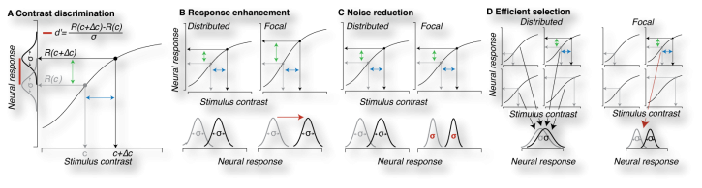
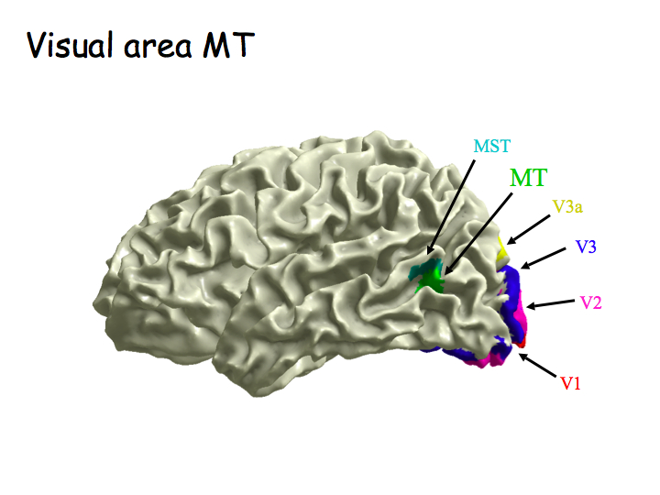
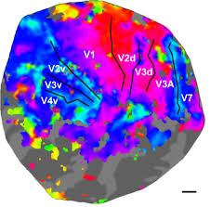
Neural Substrates of Attention and Awareness
Asymmetrical Behavioral Effects of Feature-Based Attention
Can be Predicted from Neural Architecture
GRU
.stanford.edu
Behavior
Daniel Birman, Justin Gardner
Department of Psychology, Stanford University
dbirman@stanford.edu
Model of Behavior
Paying Attention to Contrast
Asked to Respond about Contrast
Paying Attention to Motion
Asked to Respond about Contrast
Contrast Performance
Motion Performance
Paying Attention to Motion
Asked to Respond about Motion
Paying Attention to Contrast
Asked to Respond about Motion
Participants were asked to estimate which of two dot displays had higher contrast or motion coherence. Threshold performance is shown (higher values indicate worse performance).
Hierarchical Explanation
Neural Data
V1
We observed an asymmetry in how attention to contrast and motion interact in the visual system. Data recorded from fMRI sessions suggests that attention to contrast inhibits the representation of motion in area MT, but that the reverse is not true.
In future work we will investigate whether this hierarchical relationship is a general feature of the visual system.
MT
MT
V1

