Slide 1
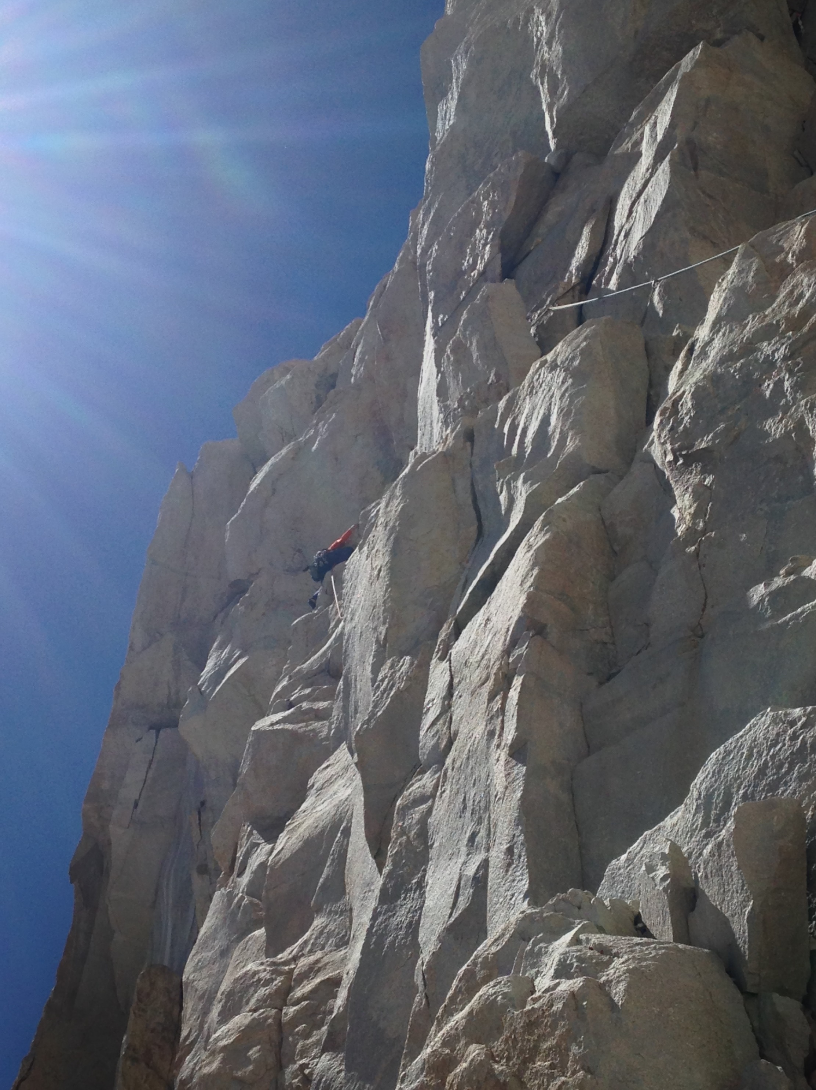
Neural Substrates of Attention and Awareness
Dan Birman
Gardner Lab
MAD Lunch – 2016-08-23

Slide 3

Neural Substrates of Attention and Awareness

Slide 4
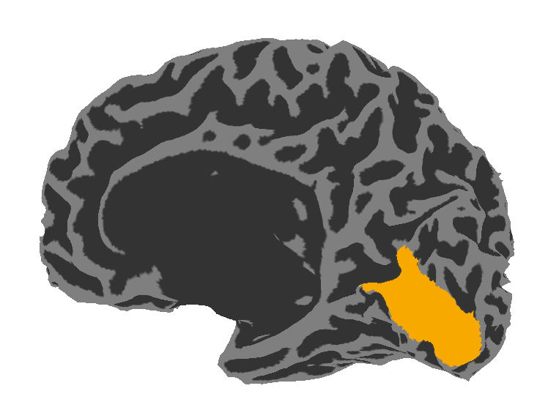
Neural Substrates of Attention and Awareness

Slide 5
Neural Substrates of Attention and Awareness
Correlates with
conscious awareness

Slide 6
Neural Substrates of Attention and Awareness
Correlates with
conscious awareness

Slide 7
Neural Substrates of Attention and Awareness
Verbal report
Correlates with
conscious awareness

Slide 8
Neural Substrates of Attention and Awareness
Verbal report
Drive arbitrary motor plans
Correlates with
conscious awareness

Slide 9
Neural Substrates of Attention and Awareness
Verbal report
Drive arbitrary motor plans
Correlates with
conscious awareness
Store in memory

Slide 10
Neural Substrates of Attention and Awareness
Verbal report
Drive arbitrary motor plans
Correlates with
conscious awareness
Store in memory
Learn new rules

Slide 11
Neural Substrates of Attention and Awareness
Verbal report
Drive arbitrary motor plans
Correlates with
conscious awareness
Etc…
Store in memory
Learn new rules

Slide 12
Neural Substrates of Attention and Awareness
Discriminate stimuli
Verbal report
Drive arbitrary motor plans
Correlates with
conscious awareness
Etc…
Store in memory
Learn new rules

Slide 13
Neural Substrates of Attention and Awareness
Correlates with
ability to discriminate

Slide 14

Neural Substrates of Attention and Awareness
Correlates with
ability to discriminate

Slide 15
Neural Substrates of Attention and Awareness

Slide 16
Neural Substrates of Attention and Awareness

Slide 17
Neural Substrates of Attention and Awareness

Slide 18
Neural Substrates of Attention and Awareness
Priors

Slide 19
Attention
Priors about perceptual information

Slide 20
Attention
Priors about perceptual information
Spatial Priors

Slide 21
Attention
Priors about perceptual information
Spatial Priors
Feature Priors

Slide 22
Attention
Priors about perceptual information
Top-down: based on earlier information

Slide 23
Attention
Priors about perceptual information
Top-down: based on earlier information
Bottom-up: driven by a stimulus

Slide 24
Top-down feature based attention
Cue a specific feature, in advance.

Slide 25
Top-down feature based attention
Cue a specific feature, in advance.
Does not prevent bottom-up salience

Slide 26
Top-down feature based attention
Cue a specific feature, in advance.
Does not prevent bottom-up salience
Record one measure of conscious awareness: ability to discriminate stimulus strength

Slide 27
Top-down feature based attention
Cue a specific feature, in advance.
Does not prevent bottom-up salience
Record one measure of conscious awareness: ability to discriminate stimulus strength
What is the functional role of information becoming “consciously accessible”?

Slide 28

Top-down feature based attention
Cue a specific feature, in advance.
Does not prevent bottom-up salience
Record one measure of conscious awareness: ability to discriminate stimulus strength
Visual Area V1: Contrast
High Contrast
Low Contrast

Slide 29
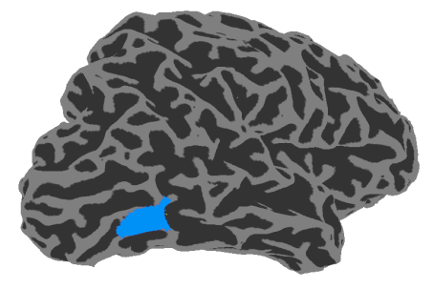
Top-down feature based attention
Cue a specific feature, in advance.
Does not prevent bottom-up salience
Record one measure of conscious awareness: ability to discriminate stimulus strength
Visual Area V1: Contrast
Visual Area hMT: Motion
High Contrast
Low Contrast
0% Coherence
100% Coherence

Slide 30
Manipulating attention
Blocked cue: Attend to contrast/motion
500 ms stimulus
500-1000 ms delay
Response
Left/Right
Report side with stronger motion/contrast

Slide 31
Perception of unattended feature
15% of trials
Blocked cue: Attend to contrast/motion
500 ms stimulus
500-1000 ms delay
C/M
Ignore prepared response
Respond about unattended feature

Slide 32
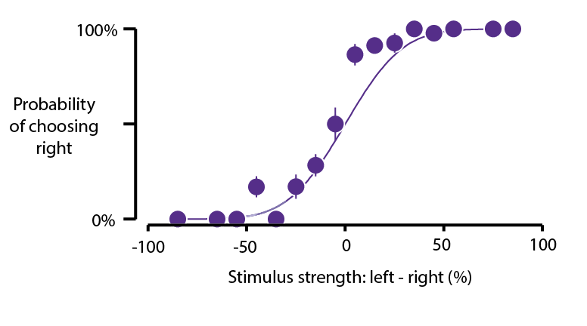

Slide 33
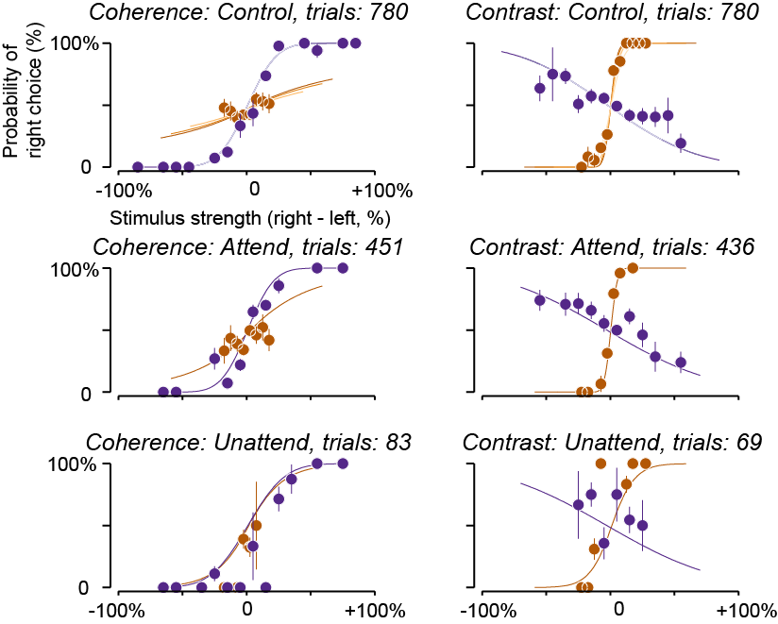
Contrast Effect
Motion Coherence Effect

Slide 34
Contrast Effect
Motion Coherence Effect

Slide 35
Contrast Effect
Motion Coherence Effect
Splitting attention

Slide 36
Contrast Effect
Motion Coherence Effect

Slide 37
Contrast Effect
Motion Coherence Effect
Reduced slope = worse performance

Slide 39
“Leak” of motion

Slide 42
d‘=1

Slide 43
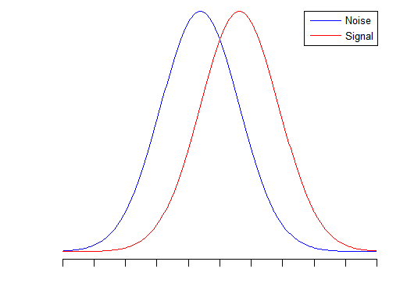
d’=1
Response Amplitude
d‘=1

Slide 44
d’=1
Response Amplitude
d‘=1
Threshold or
Just Noticeable Difference

Slide 45
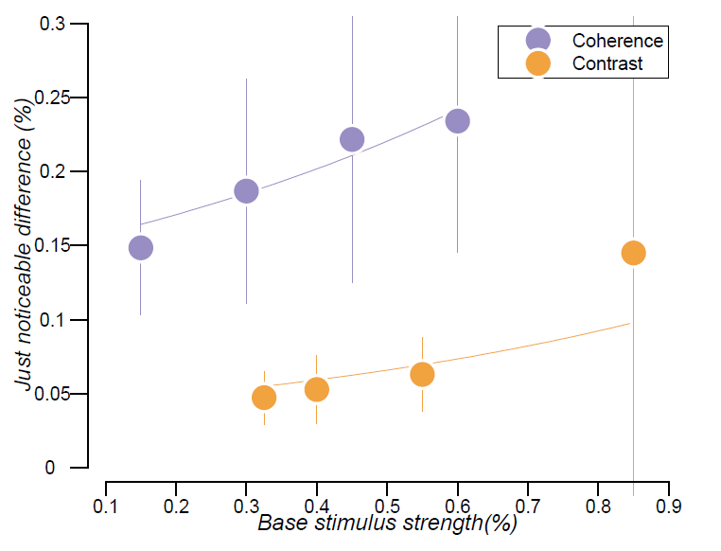

Slide 46
Neural Representations
+

Slide 47
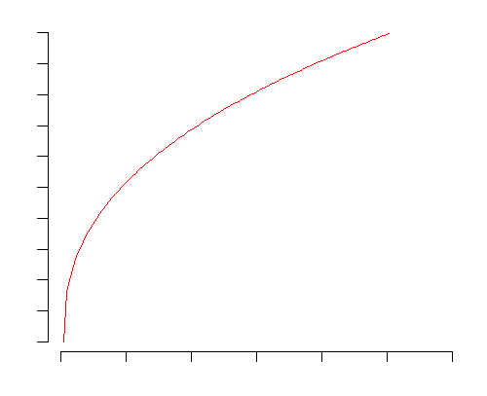
Neural Representations
+
=

Slide 48
Neural Representations
+
=
For a constant change
in neural response
Need increasingly large
stimulus strength differences

Slide 49
Add slide with time series model explanation (GLM)

