Slide 1
Natural Scene Perception Requires Attention (Cohen et al. 2011)
Dan Birman
Gardner Lab
Psych 254 Mid – 2015-02-18

Slide 2


Notes:
Show animation, then go back and repeat: asking to attend to background (21 total black dots move, 22 with the first)
Point here is that you have no AWARENESS of the changes in the first attempt, while you’re attending to the dots. But you need very little additional attention to notice them. No bottom-up attention = inattentional blindness

Slide 4
Notes:
Now it’s obvious

Slide 5

A
Gist Perception: Impossible Under Load?

Slide 6










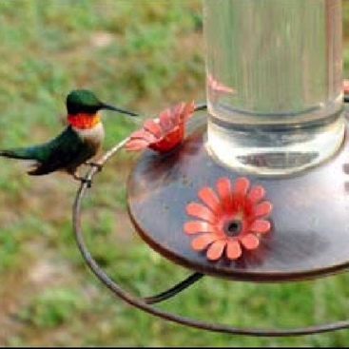
A
Q
N
U
C
K
X
1
3
5
Z
Notes:
Some tasks DO interfere enough to inhibit awareness. No awareness without attention. So is attention the precursor to awareness?

Slide 7
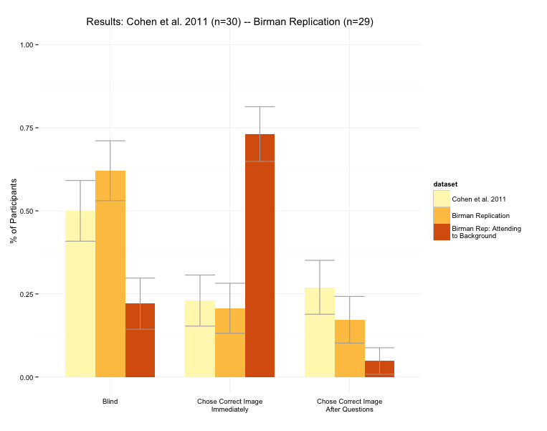






Gist Perception: Impossible Under Load?
B
G
A
B
G
5
1
Cohen et al., 2011
Notes:
Some tasks DO interfere enough to inhibit awareness. No awareness without attention. So is attention the precursor to awareness?

Slide 8
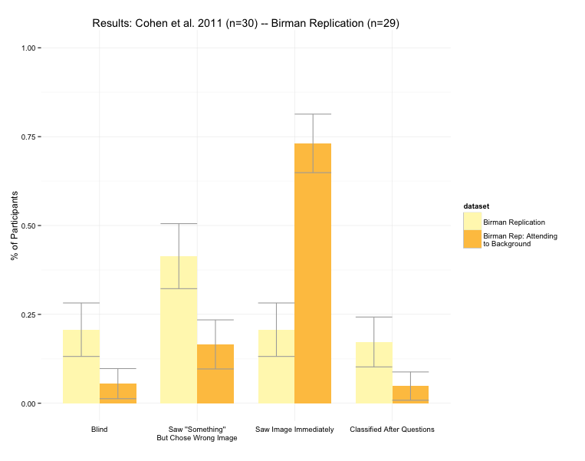
Gist Perception: Impossible Under Load?
B
G
A
B
G
5
1
Cohen et al., 2011
Notes:
Some tasks DO interfere enough to inhibit awareness. No awareness without attention. So is attention the precursor to awareness?

Slide 9
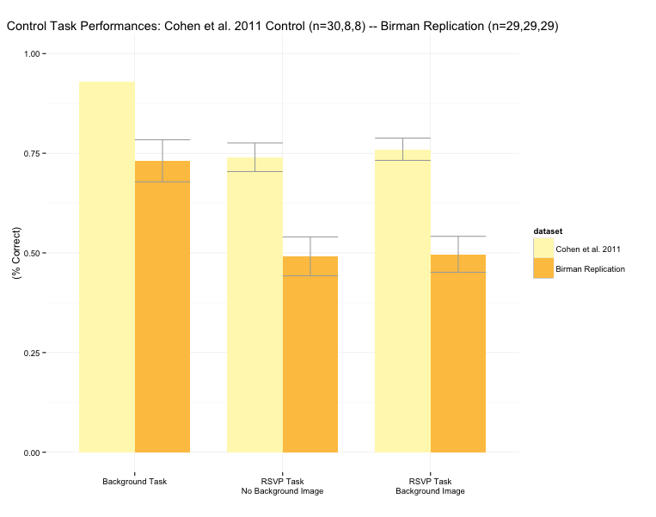
Gist Perception: Impossible Under Load?
B
G
A
B
G
5
1
Cohen et al., 2011
Notes:
Some tasks DO interfere enough to inhibit awareness. No awareness without attention. So is attention the precursor to awareness?

