Slide 1
Natural Scene Perception Requires Attention (Cohen et al. 2011)
Dan Birman
Gardner Lab
Psych 254 Final – 2015-03-11

Slide 2


Notes:
Show animation, then go back and repeat: asking to attend to background (21 total black dots move, 22 with the first)
Point here is that you have no AWARENESS of the changes in the first attempt, while you’re attending to the dots. But you need very little additional attention to notice them. No bottom-up attention = inattentional blindness

Slide 4
Notes:
Now it’s obvious

Slide 5

A
Gist Perception: Impossible Under Load?

Slide 6
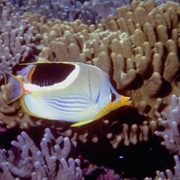
A
Gist Perception: Impossible Under Load?

Slide 7











A
Q
N
U
C
K
X
1
3
5
Z
Notes:
Some tasks DO interfere enough to inhibit awareness. No awareness without attention. So is attention the precursor to awareness?

Slide 8






Gist Perception: Impossible Under Load?
B
G
A
B
G
5
1
Notes:
Some tasks DO interfere enough to inhibit awareness. No awareness without attention. So is attention the precursor to awareness?

Slide 9
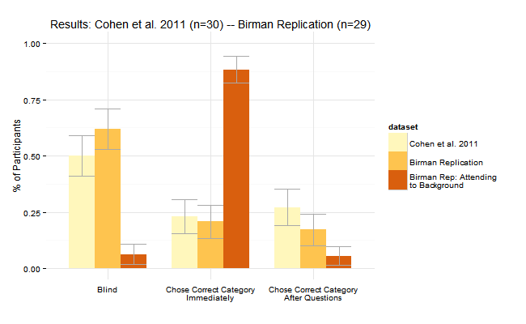
Gist Perception: Impossible Under Load?
B
G
Cohen et al. (n=30) vs. Birman (n=29): Category Gist
A
B
G
5
1
Notes:
Some tasks DO interfere enough to inhibit awareness. No awareness without attention. So is attention the precursor to awareness?

Slide 10
Gist Perception: Impossible Under Load?
B
G
Cohen et al. (n=30) vs. Birman (n=29): Category Gist
A
B
G
5
1
Notes:
Some tasks DO interfere enough to inhibit awareness. No awareness without attention. So is attention the precursor to awareness?

Slide 11
Gist Perception: Impossible Under Load?
B
G
Cohen et al. (n=30) vs. Birman (n=29): Category Gist
A
B
G
5
1
Notes:
Some tasks DO interfere enough to inhibit awareness. No awareness without attention. So is attention the precursor to awareness?

Slide 12
Gist Perception: Impossible Under Load?
B
G
Cohen et al. (n=30) vs. Birman (n=29): Category Gist
A
B
G
5
1
Notes:
Some tasks DO interfere enough to inhibit awareness. No awareness without attention. So is attention the precursor to awareness?

Slide 13
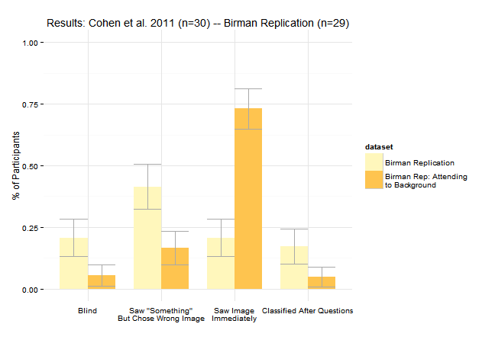
Gist Perception: Impossible Under Load?
B
G
Birman (n=29): Image Identification
A
B
G
5
1
Notes:
Some tasks DO interfere enough to inhibit awareness. No awareness without attention. So is attention the precursor to awareness?

Slide 14
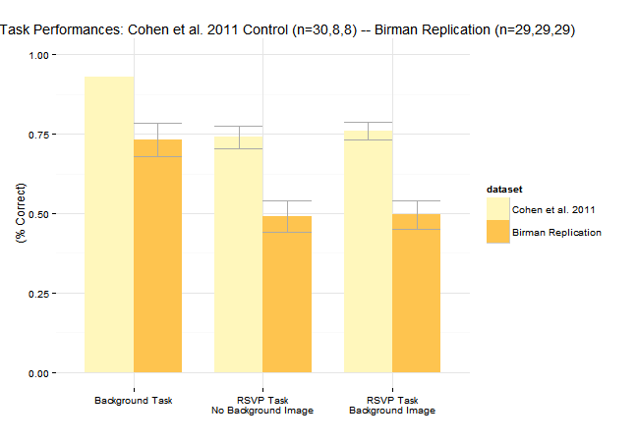
College Students vs. MTurk
Notes:
Some tasks DO interfere enough to inhibit awareness. No awareness without attention. So is attention the precursor to awareness?

