Slide 1
Natural Scene Perception Requires Attention (Cohen et al. 2011)
Dan Birman
Gardner Lab
Psych 254 Mid – 2015-02-18

Slide 2










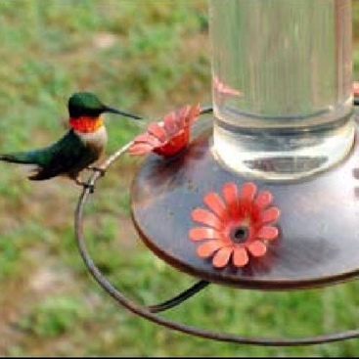
A
Q
N
U
C
K
X
1
3
5
Z
Notes:
Some tasks DO interfere enough to inhibit awareness. No awareness without attention. So is attention the precursor to awareness?

Slide 3
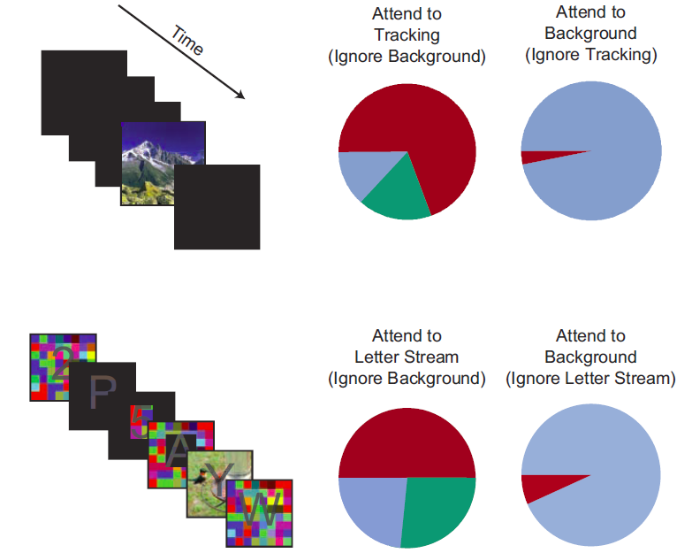





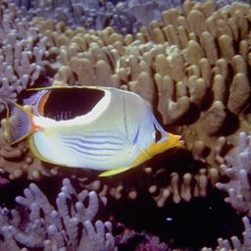
Gist Perception: Impossible Under Load?
B
G
A
A
C
5
Blind
Classified
Saw
1
Cohen et al., 2011
Notes:
Some tasks DO interfere enough to inhibit awareness. No awareness without attention. So is attention the precursor to awareness?

Slide 4
Gist Perception: Impossible Under Load?
(n=4)
Four
RSVP
Five RSVP
Five Background
Performance ~50%
Always correct on 0/1
Never 2/3/4
Performance ~60%
~10% Blind
Critical Trial
~90% Blind

