Slide 1
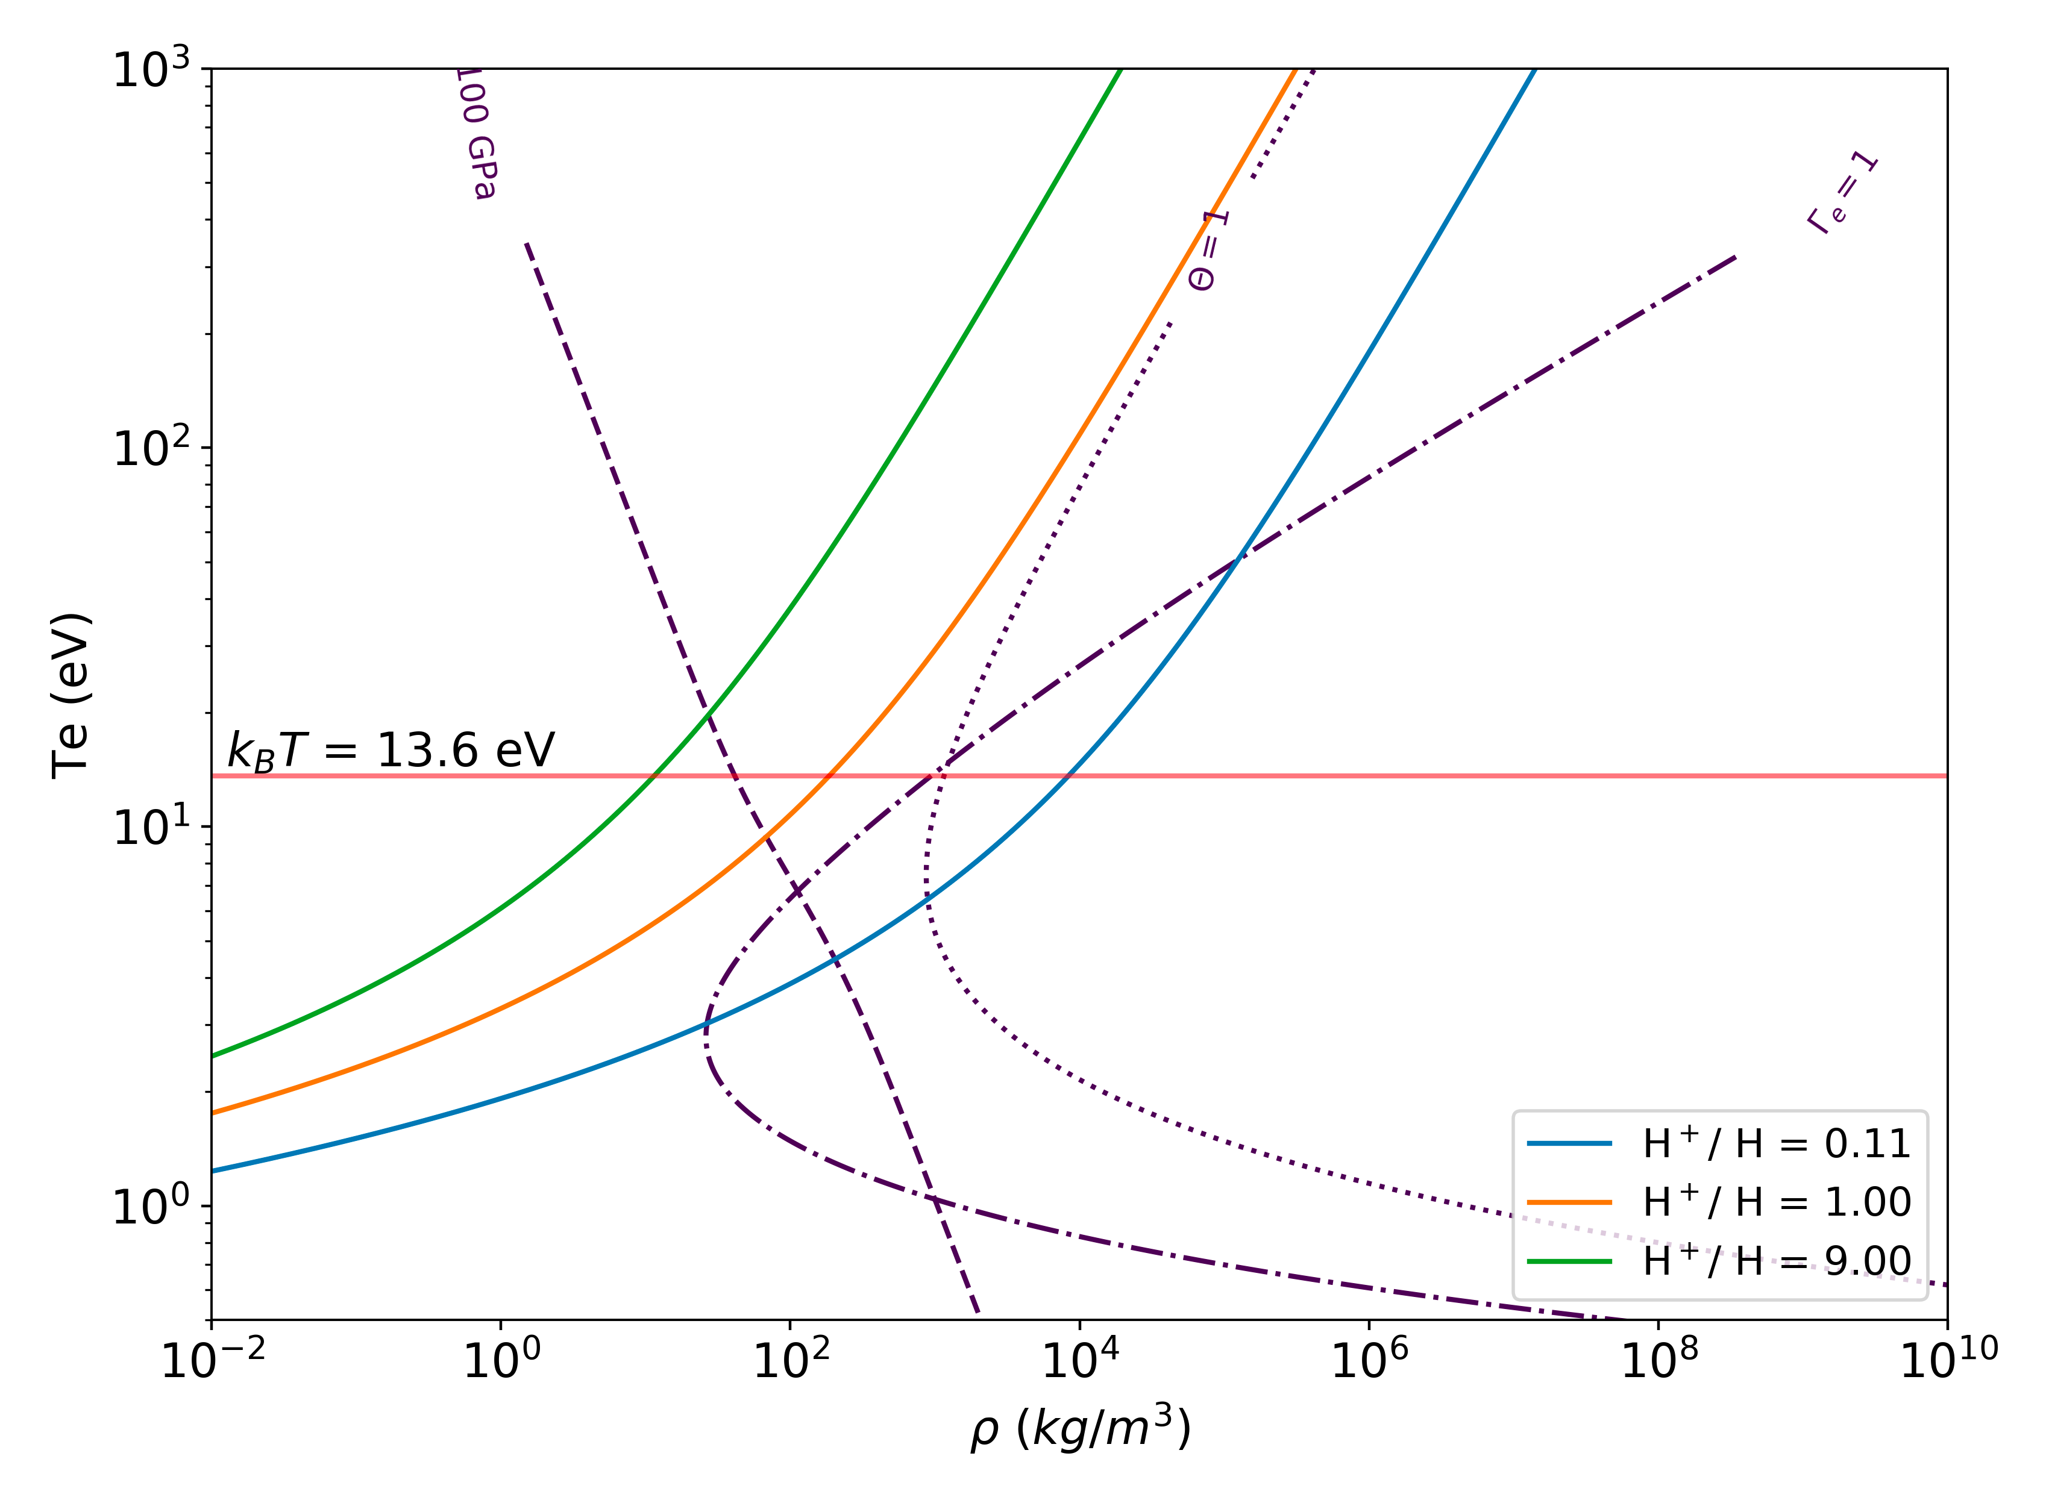
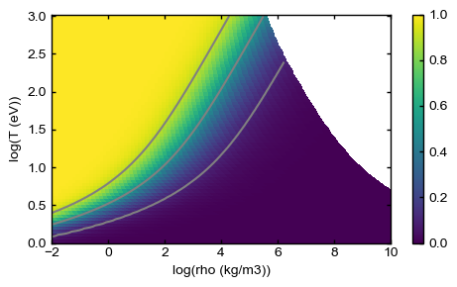
Saha Boltzmann model for H with nmax=1 is SPOT ON with solutions to HED HW 3.4 for H Saha ionization with ground state only
S-B contours in grey
HED soln contours in green, orange, blue
Zbar=0.9
Zbar=0.5
Zbar=0.1

Slide 2
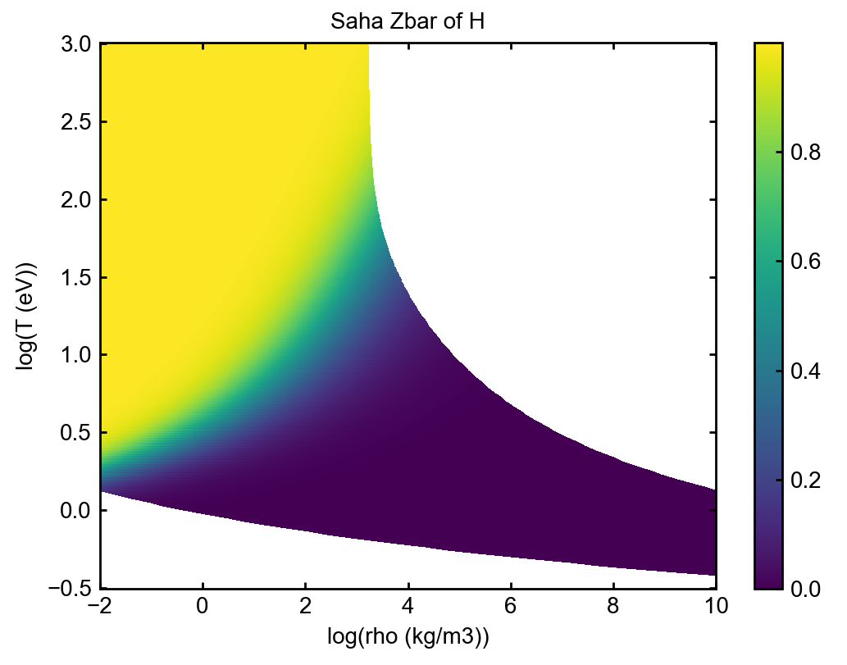
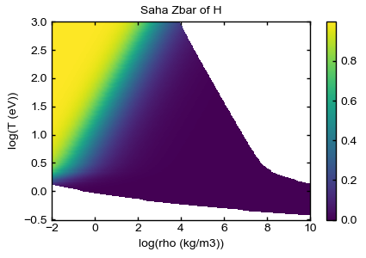
Increasing nmax reduces ionization, as expected
Nmax = 1
Nmax = 10
Zbar ≈ 1
Zbar < 0.5

