Slide 2
1. Project introduction
1-1 What is this project doing?

Slide 3
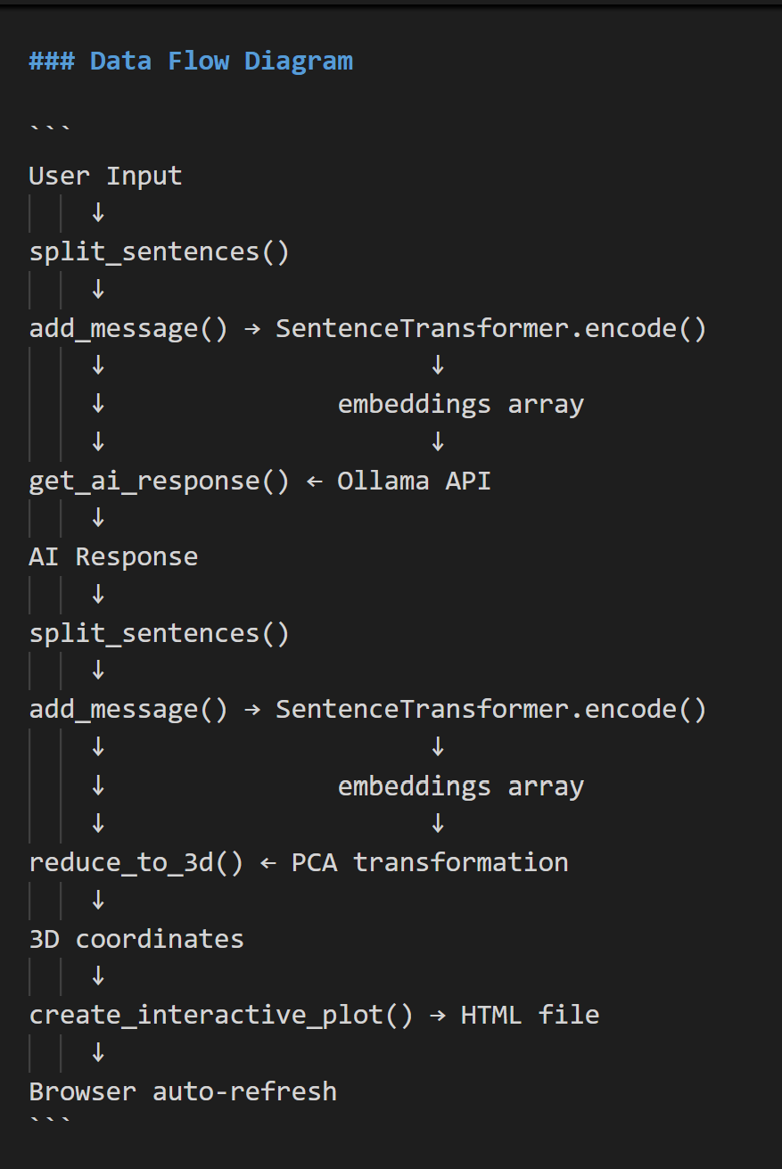
1. Project introduction
1-1 What is this project doing?

Slide 4
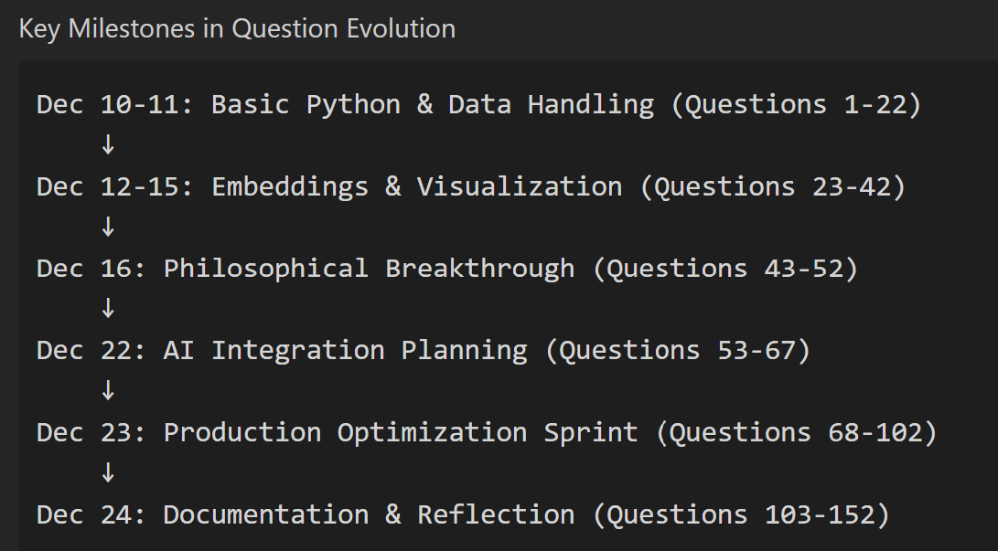
1. Project introduction
1-2 Timeline

Slide 5
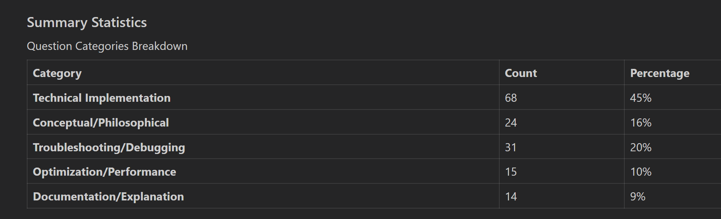
1. Project introduction
1-3 Developing Progress

Slide 6
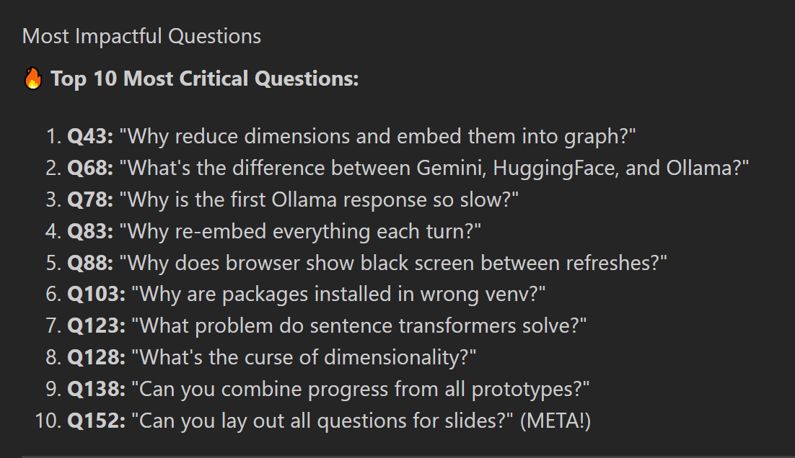
1. Project introduction
1-3 Developing Progress

Slide 7

2. Workflow | Transformer → Dimension Reduction → Visualized
2-1 AI dialogue & Sentence transformers
Real-time AI Conversation
- Ollama provides local, unlimited AI responses
- No API keys or quotas needed
- Runs llama3.2
(llama3.2 model)

Slide 8

2. Workflow | Transformer → Dimension Reduction → Visualized
2-1 AI dialogue & Sentence transformers
Converts text to 384D vectors
Uses 6-layer transformer with self-attention
Captures semantic meaning geometrically
Similar meanings → close vectors
(all-MiniLM-L6-v2 model)

Slide 9
2. Workflow | Transformer → Dimension Reduction → Visualized
2-1 AI dialogue & Sentence transformers
```
User Input
↓
split_sentences()
↓
add_message() → SentenceTransformer.encode()
↓ ↓
↓ embeddings array
↓ ↓
get_ai_response() ← Ollama API
↓
AI Response
↓
split_sentences()
↓
add_message() → SentenceTransformer.encode()
↓ ↓
↓ embeddings array
↓ ↓
reduce_to_3d() ← PCA transformation
↓
3D coordinates
↓
create_interactive_plot() → HTML file
↓
Browser auto-refresh
```

Slide 10
2. Workflow | Transformer → Dimension Reduction → Visualized
2-1-1 Tokenize 2-1-2 Attention 2-1-3 Pooling
from transformers import AutoTokenizer
tokenizer = AutoTokenizer.from_pretrained('sentence-transformers/all-MiniLM-L6-v2')
question = "How to reduce 384D to 3D?"
tokens = tokenizer.tokenize(question)
print("Tokens:", tokens)
# Output: ['how', 'to', 'reduce', '384', '##d', 'to', '3', '##d', '?']
# Convert to IDs
token_ids = tokenizer.encode(question, add_special_tokens=True)
print("Token IDs:", token_ids)
# Output: [101, 2129, 2000, 5547, 4029, 2575, 2094, 2000, 1017, 2094, 1029, 102]
# [CLS] how to reduce 384 D to 3 D ? [SEP]

Slide 11
2. Workflow | Transformer → Dimension Reduction → Visualized
2-1-1 Tokenize 2-1-2 Attention 2-1-3 Pooling
# [CLS] = Classification token (ID: 101)
# Purpose: Represents the entire sentence
# [SEP] = Separator token (ID: 102)
# Purpose: Marks the end of the sentence
# Example with your actual questions data:
question1 = "What are word embeddings?"
question2 = "How does t-SNE work?"
Tokenized with special tokens:
[CLS] what are word embeddings ? [SEP]
[101] 2054 2024 2773 7861 1029 [102]
[CLS] how does t ##sne work ? [SEP]
[101] 2129 2515 1056 6619 2147 1029 [102]

Slide 12
2. Workflow | Transformer → Dimension Reduction → Visualized
2-1-1 Tokenize 2-1-2 Attention 2-1-3 Pooling
“He speaks his mother tongue. ”
“She is my mother. ”

Slide 13
2. Workflow | Transformer → Dimension Reduction → Visualized
2-1-1 Tokenize 2-1-2 Attention 2-1-3 Pooling
“He speaks his mother tongue. ”
“She is my mother. ”

Slide 14
2. Workflow | Transformer → Dimension Reduction → Visualized
2-1-1 Tokenize 2-1-2 Attention 2-1-3 Pooling
Mother
“Original/ Primary”
(their native/first language)
Female parent

Slide 15
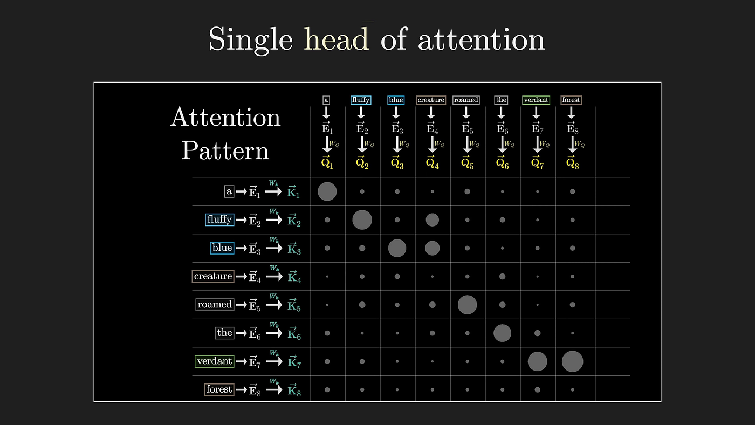
2. Workflow | Transformer → Dimension Reduction → Visualized
2-1-1 Tokenize 2-1-2 Attention 2-1-3 Pooling
From 3blue1brown:
Grant Sanderson

Slide 16
2. Workflow | Transformer → Dimension Reduction → Visualized
2-1-1.Tokenize 2-1-2.Attention 2-1-3.Pooling
# Each token has 384D embedding after all 6 transformer layers:
token_embeddings = [
[0.23, -0.45, 0.67, ...], # [CLS]
[0.12, -0.34, 0.56, ...], # how
[0.15, -0.32, 0.54, ...], # to
[0.67, -0.23, 0.45, ...], # reduce
[0.72, -0.19, 0.43, ...], # 384
[0.68, -0.21, 0.44, ...], # ##d
[0.14, -0.36, 0.51, ...], # to
[0.75, -0.17, 0.41, ...], # 3
[0.71, -0.20, 0.42, ...], # ##d
[0.11, -0.37, 0.58, ...], # ?
[0.22, -0.46, 0.66, ...] # [SEP]
] # Shape: (11 tokens, 384 dimensions)
# Mean pooling: Average all 11 token embeddings
sentence_embedding = mean(token_embeddings, axis=0)
# Result: [0.409, -0.301, 0.520, ...] (384D)

Slide 17
2. Workflow | Transformer → Dimension Reduction → Visualized
2-2 PCA (Principal Component Analysis)
https://devopedia.org/principal-component-analysis

Slide 18
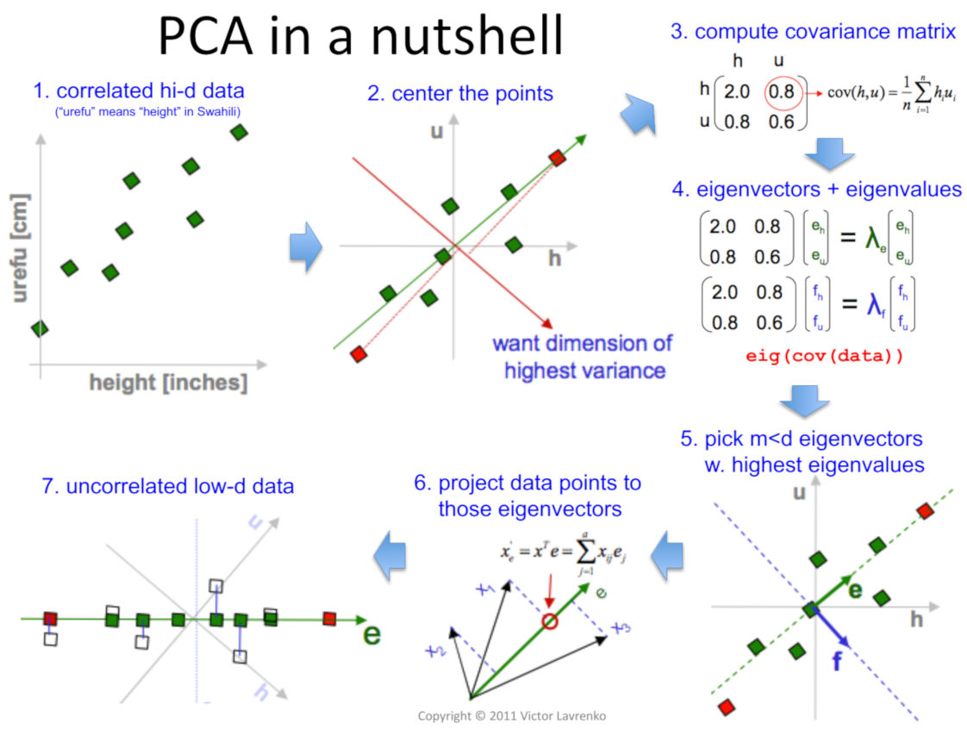
2. Workflow | Transformer → Dimension Reduction → Visualized
2-2 PCA (Principal Component Analysis)
https://devopedia.org/principal-component-analysis

Slide 19
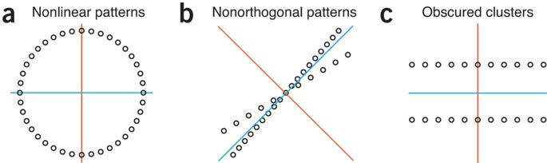
2. Workflow | Transformer → Dimension Reduction → Visualized
2-2 PCA (Principal Component Analysis)
Examples where PCA may not work well. Source: Lever et al. 2017, fig. 4.

Slide 20
2. Workflow | Transformer → Dimension Reduction → Visualized
2-2 PCA (Principal Component Analysis)
### **Visual Example: 384D → 3D**
**Original High-Dimensional Space (384D):**
```
Sentence 1: [0.23, -0.45, 0.67, 0.12, ..., 0.89] (384 numbers)
Sentence 2: [0.25, -0.43, 0.65, 0.14, ..., 0.87] (384 numbers)
Distance: sqrt(Σ(x1-x2)²) = 0.342 (in 384D)
```
**After PCA Reduction (3D):**
```
Sentence 1: [0.5, 0.2, 0.1] (3 numbers)
Sentence 2: [0.6, 0.25, 0.15] (3 numbers)
Distance: sqrt((0.6-0.5)² + (0.25-0.2)² + (0.15-0.1)²) = 0.12 (in 3D)
Note: Distances change but relative structure is preserved!
```

Slide 21
2. Workflow | Transformer → Dimension Reduction → Visualized
2-2 PCA (Principal Component Analysis)
"Why reduce dimensions?"
→ [101, 2339, 5547, 9646, 1029, 102]
→ 6 layers of attention
→ [0.396, -0.291, ..., 0.156] (384D)
→ PCA
→ (0.5, 0.2, 0.1) in 3D plot

Slide 22
2. Workflow | Transformer → Dimension Reduction → Visualized
2-3 Plotly
**D. Live Visualization**
- **Plotly.js** renders interactive 3D scatter plots
- Color-coded: Blue (user) vs Green (AI)
- Auto-refreshing HTML updates every 3 seconds
- Trajectory lines show conversation flow

Slide 23
3. Result
2-1.Tokenize 2-2.Attention 2-3.pooling
Converts text to 384D vectors
Uses 6-layer transformer with self-attention
Captures semantic meaning geometrically
Similar meanings → close vectors

