Slide 1


Slide 2
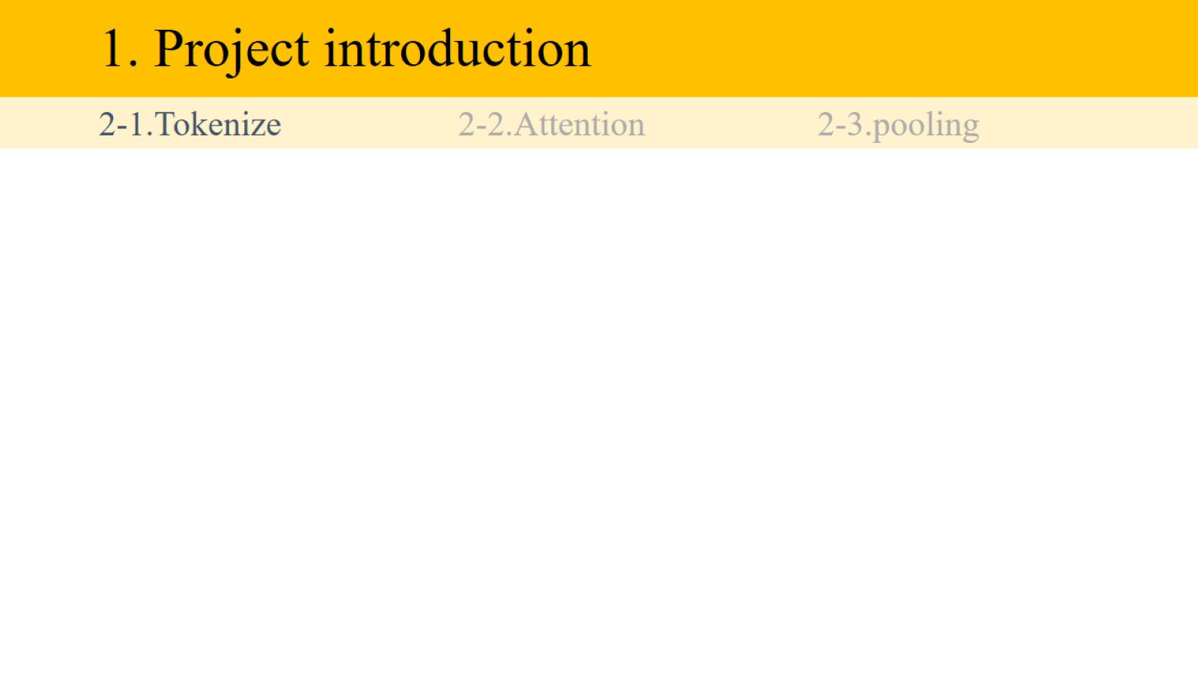
1. Project introduction

Slide 3
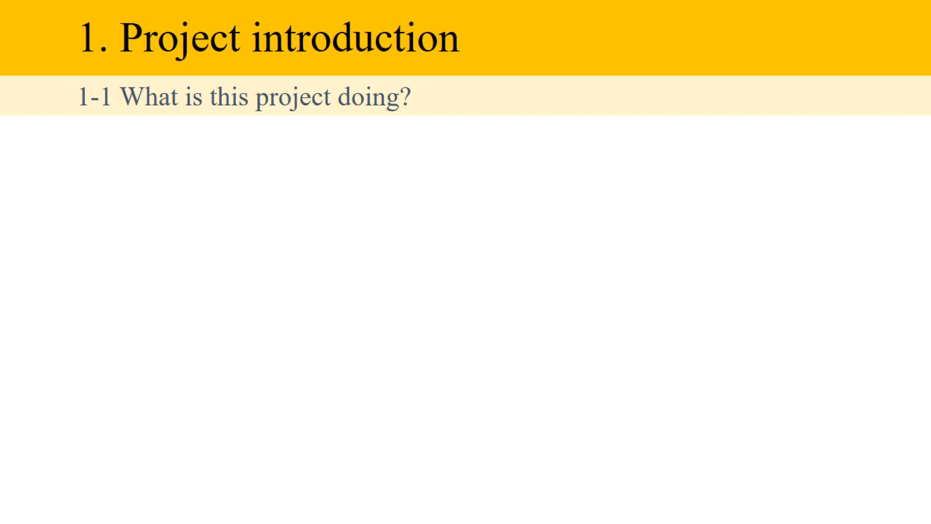
1. Project introduction

Slide 4
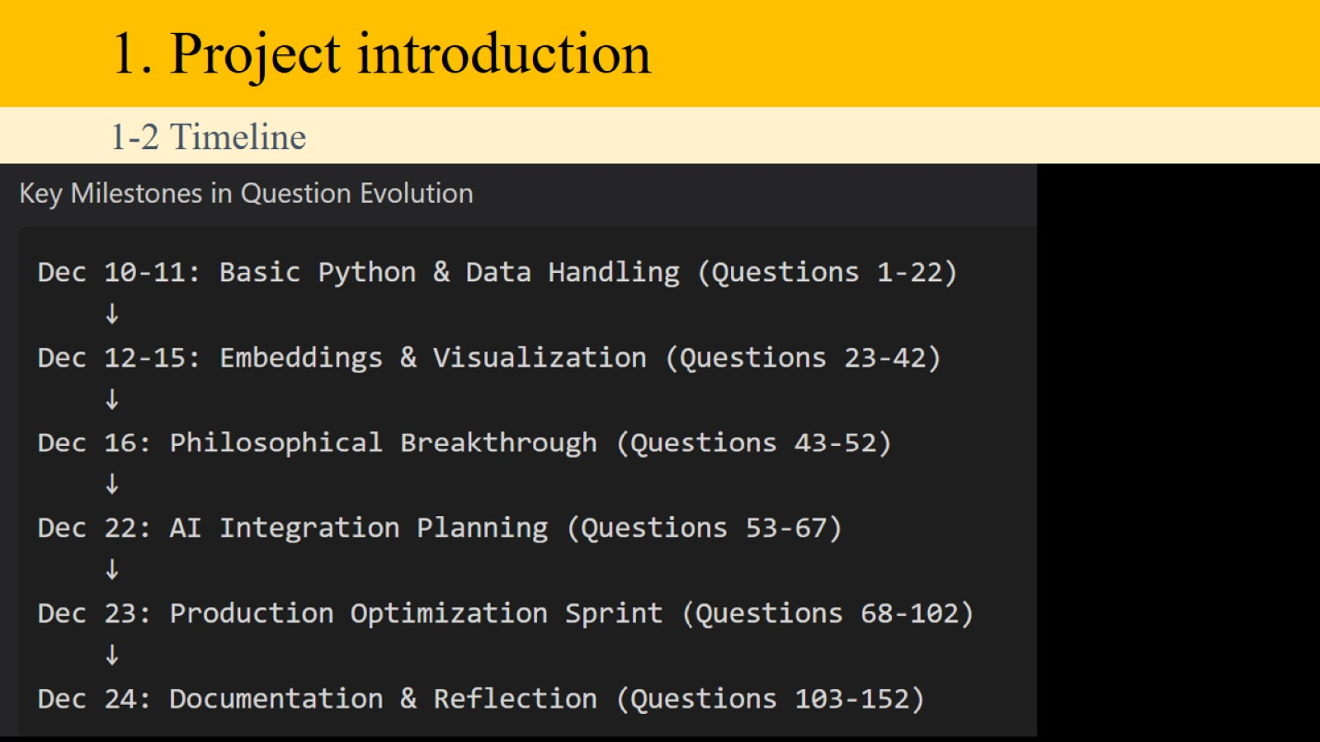
1. Project introduction

Slide 5
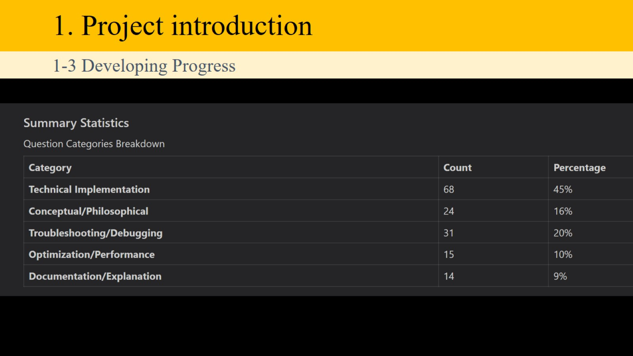
1. Project introduction

Slide 6
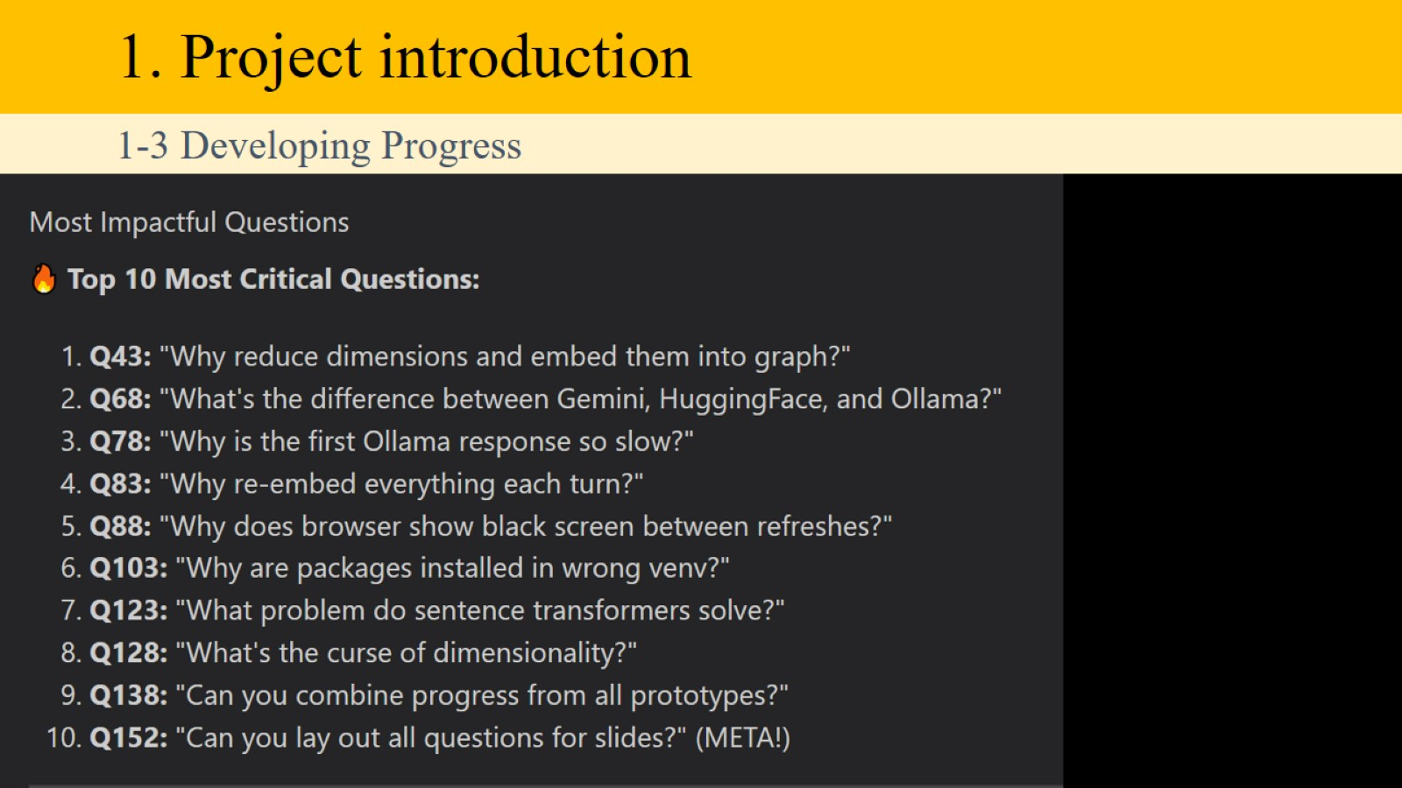
1. Project introduction

Slide 7
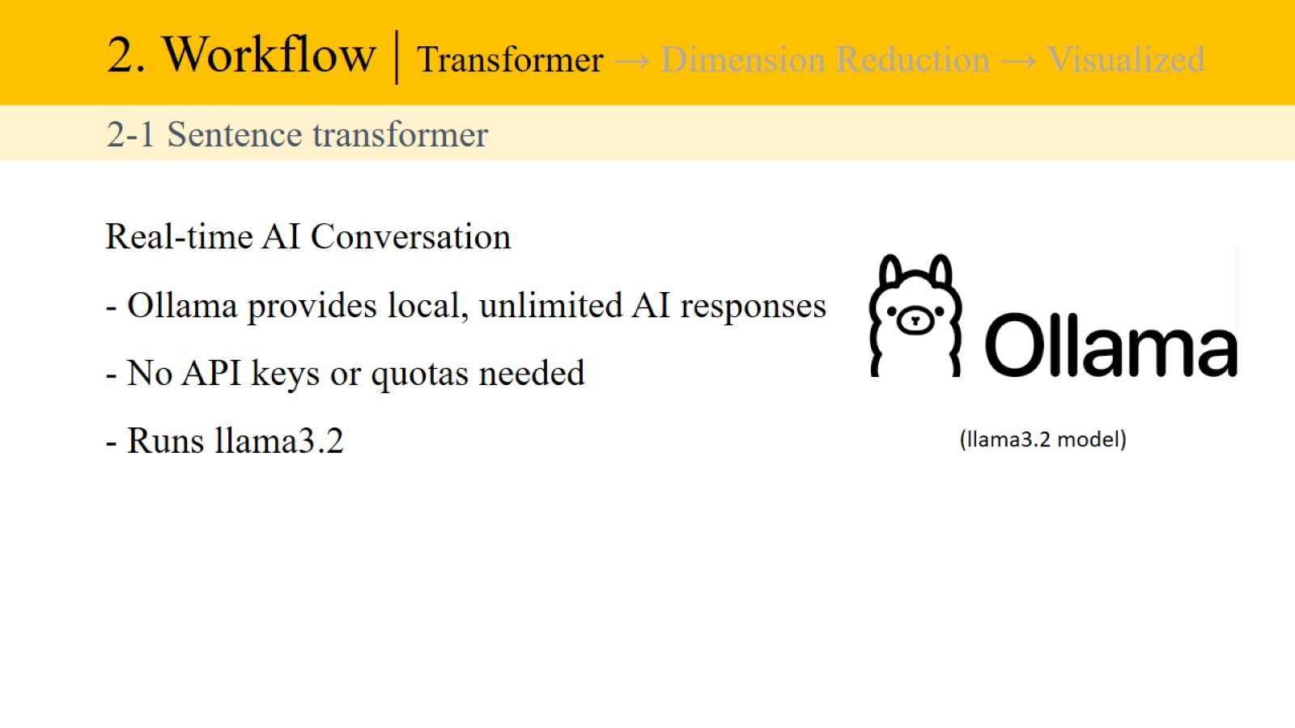
2. Workflow | Transformer → Dimension Reduction → Visualized

Slide 8
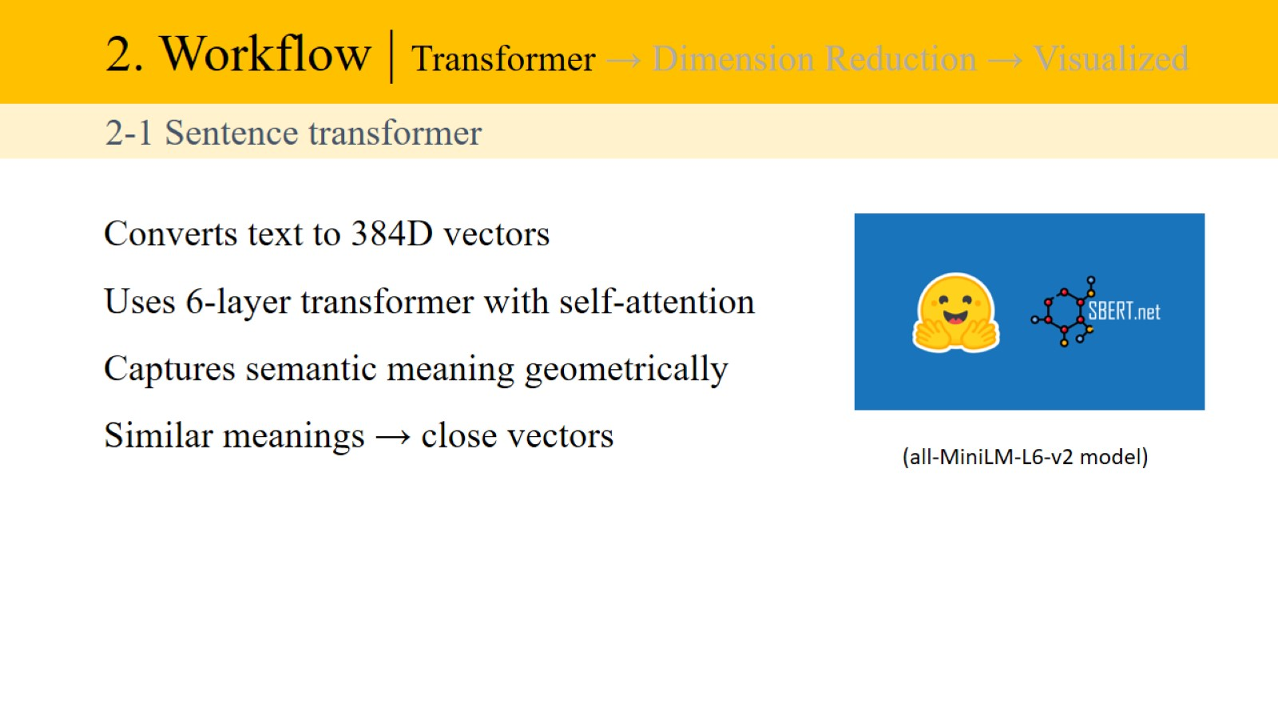
2. Workflow | Transformer → Dimension Reduction → Visualized

Slide 9
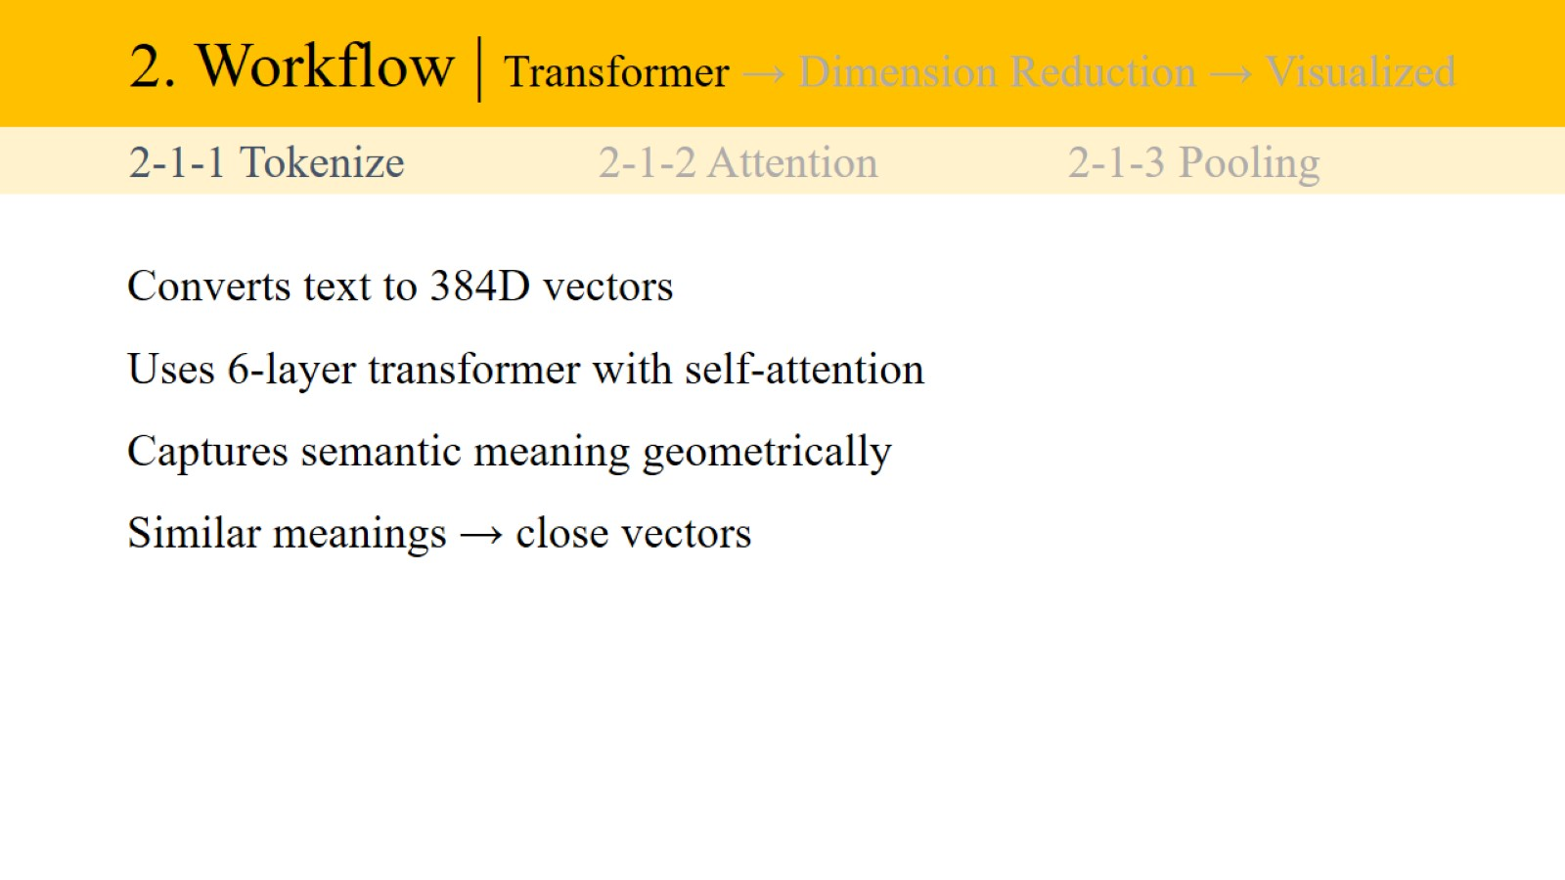
2. Workflow | Transformer → Dimension Reduction → Visualized

Slide 10
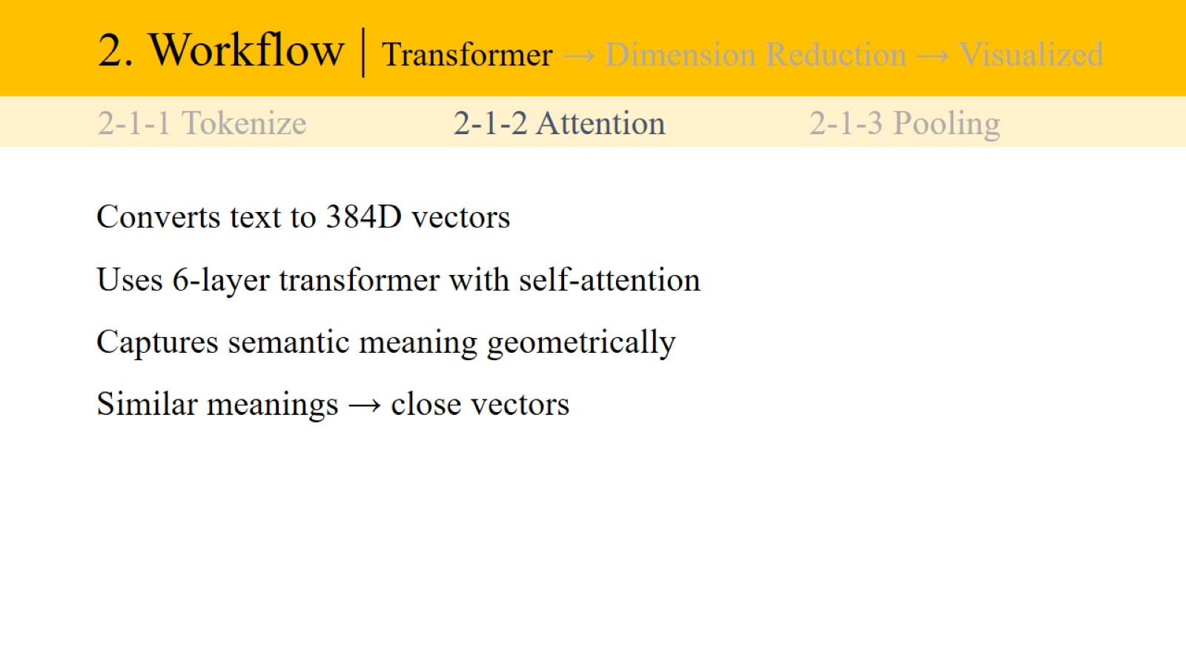
2. Workflow | Transformer → Dimension Reduction → Visualized

Slide 11
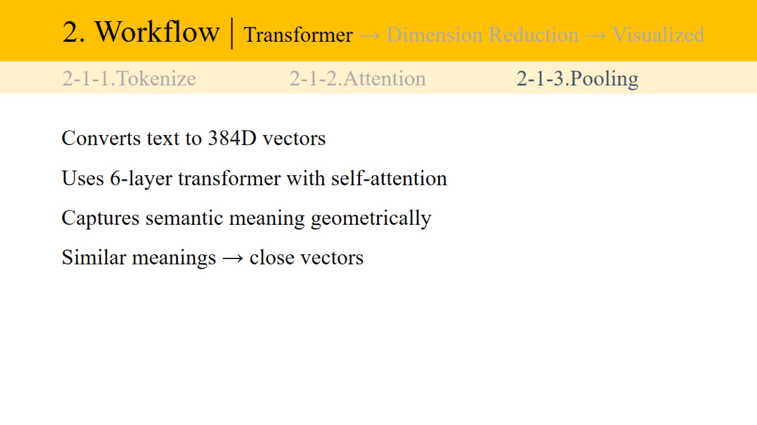
2. Workflow | Transformer → Dimension Reduction → Visualized

Slide 12
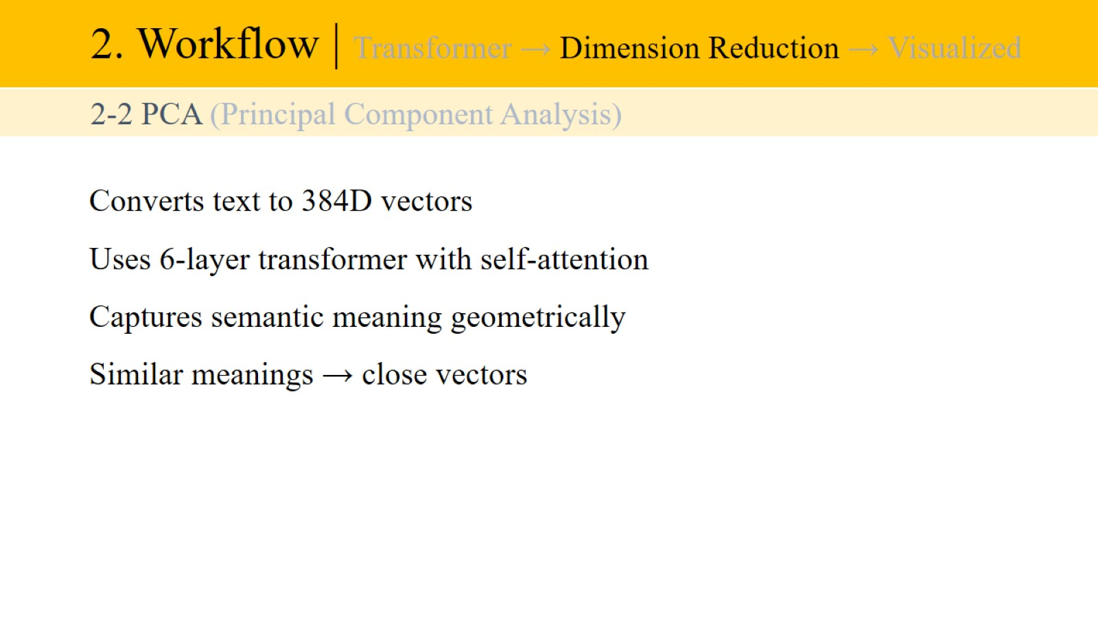
2. Workflow | Transformer → Dimension Reduction → Visualized

Slide 13
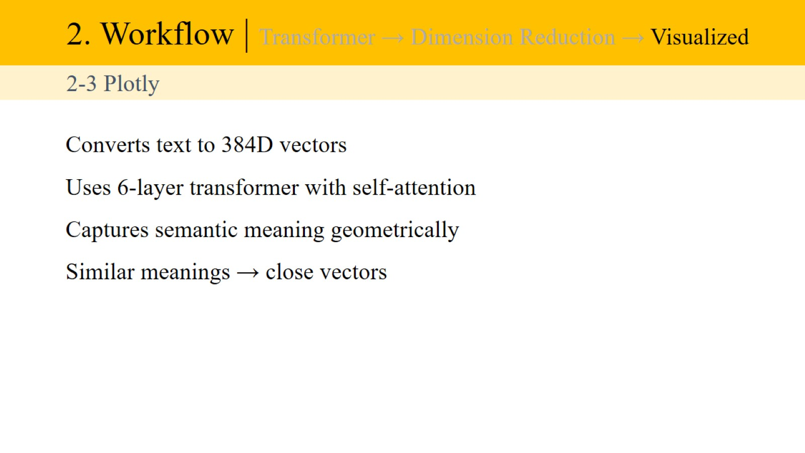
2. Workflow | Transformer → Dimension Reduction → Visualized

Slide 14
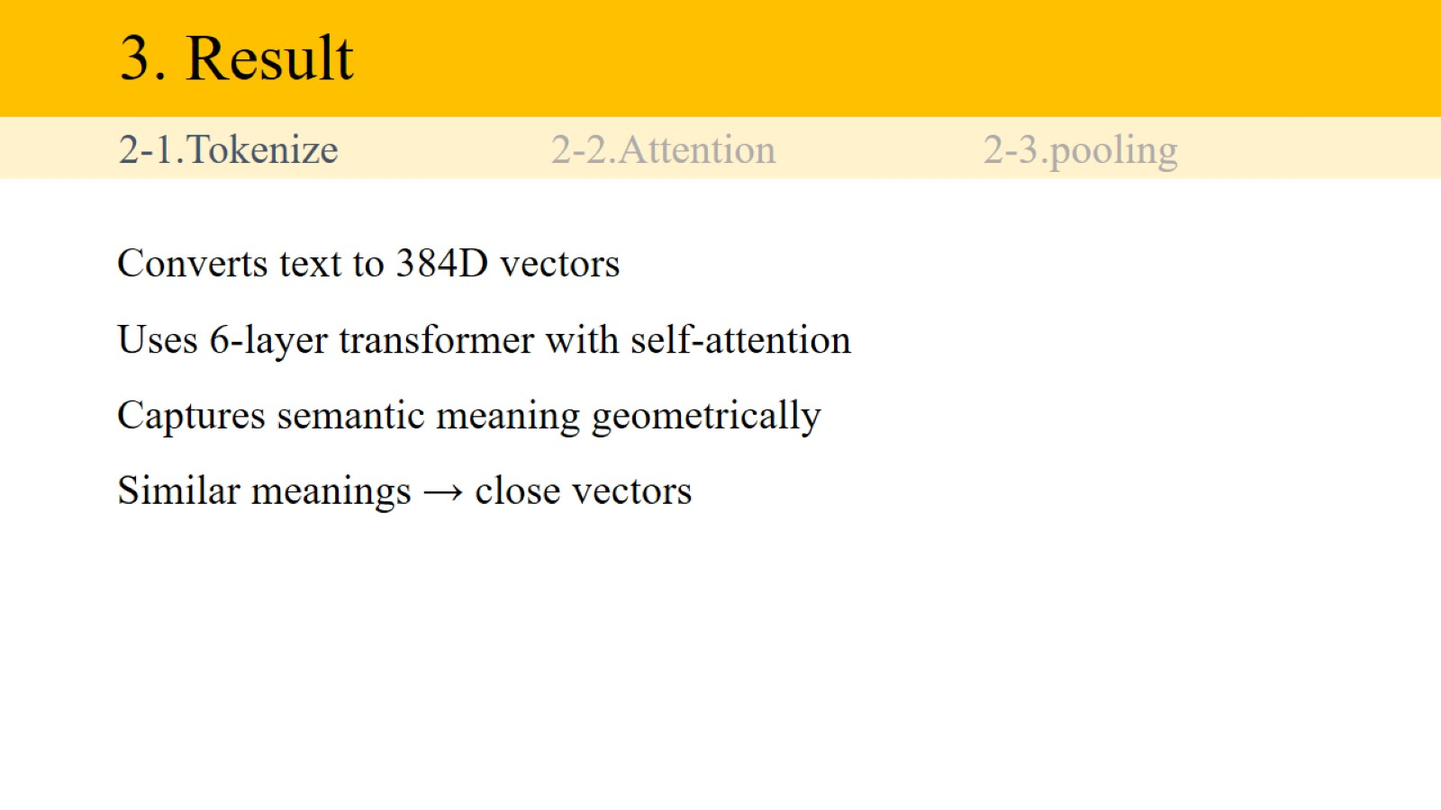
3. Result

