Slide 1

Potential Project 1: Allied Irish Bank (AIB) Scheme Cost Anomaly Detection and Impact
Dale Johnson
Senior Global Pricing Intelligence Analyst – Ingenico ePayments
General Assembly Final Project Proposal
10-12-2017

Slide 2


Background:
For payment-service-providers (PSPs) merchants pay in order to easily offer their customers multiple payment methods (i.e. MasterCard, Visa, Discover). The costs of operating on these payment platforms commonly referred to as “schemes” are assumed by the PSP. These operating costs or “scheme fees” are then passed back to the merchants with an upcharge for using the PSPs API/platform and other value added services.

Slide 3
Problem Statement:
Due to the oligopolistic payment environment schemes are not well regulated and provide limited operating transparency. Such practices can be detrimental to a PSPs operating model (i.e. unannounced significant cost increases against fixed pricing). Often times these changes go unchallenged because they cannot be detected quickly.

Slide 4
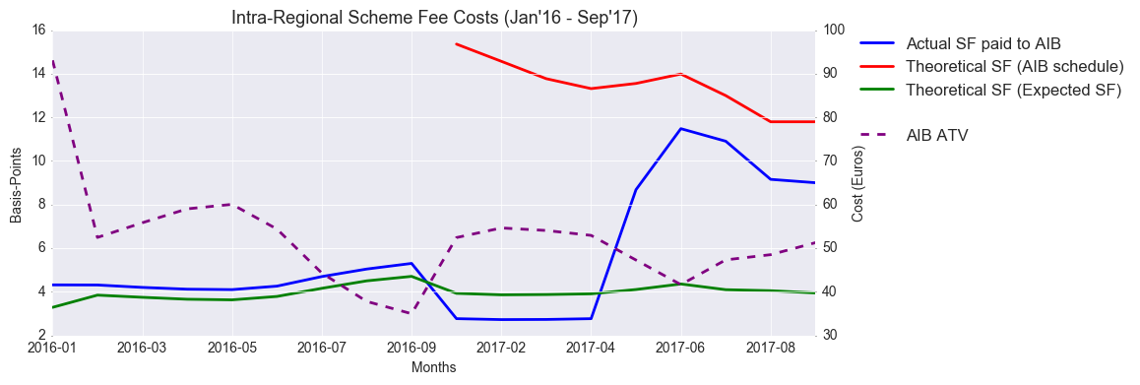
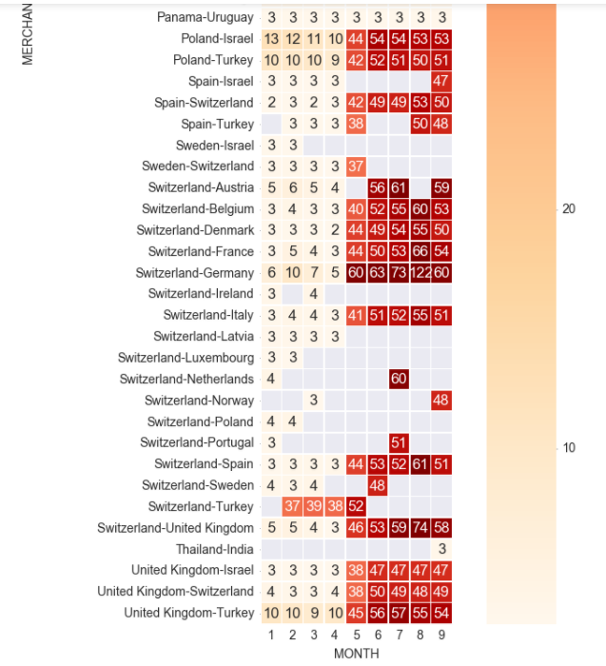
Example:
The example line graph (right) shows different metrics tracked – the focus is on the blue line (what the schemes are saying the org. paid). See the sharp increase starting in 04/2017
The example heat map (right) shows cost changes over time in the form of basis points – see the significant shifts after 04/2017
*Cost are measured in basis-points
* Transactional data sourced from internal db and processed via python pandas scripting

Slide 5
Hypothesis:
“An application can be developed using past transactional cost data to determine if successive cost data is anomalous and what are the contributing factors”
Additionally, a focus should be put on those transactions that at an aggregate level have a major impact on the organization. The distribution information and other characteristics can be broken out and pinpointed for leadership review. Also, it would be ideal if cost impact could be estimated.

Slide 6
Sources:
Aggregated cost files from acquiring banks. Costs are itemized by cost description (Oracle/Neteeza)

Slide 7
Potential Project 2: Deciding Merchant Pricing
Dale Johnson
Senior Global Pricing Intelligence Analyst – Ingenico ePayments
General Assembly Final Project Proposal
10-12-2017

Slide 8
Background:
There are two primary ways of pricing merchants in the Payment-Service-Provider (PSP) space: “Blended” and “Interchange Cost + upcharge.”
This pricing is charged to merchants who want to use PSP services in order to offer their customer the ability to pay on multiple payment platforms or “schemes” (i.e. MasterCard, Visa, PayPal, etc.)
Often times, there is no established methodology as to how pricing is chosen. The consensus is that “blended,” since it’s a fixed charge, presents more risk than “Interchange Cost + upcharge” which can scale with cost increases.

Slide 9
Problem Statement:
The organization is only equipped with “passed down” knowledge of how to suggest pricing to merchants. This does not bid well for the organization because potential revenue could be passed over due to a lack of a scientific approach to pricing decisions. For instance, a more lucrative “blended” pricing structure could potentially be passed over just because a source “feels” it’s best.

Slide 10
Hypothesis:
“Using a combination of industry vertical, credit/debit card types, interchange product use types, region, and chargeback risk, estimated cost as well as cost volatility can be scored and a pricing decision model can be created for onboarding new merchants.”
High volatility =“Interchange Cost + upcharge”
Low volatility = “blended”
Additionally, the organization’s current portfolio can be reassessed using the methodology to see if pricing against current merchants is optimal given its volatility score.
.

Slide 11
Sources:
Aggregated/Transactional cost files from acquiring banks. Costs are itemized by cost description (Oracle/Neteeza)
“Back office data” comes in the form of transactional data with attributes that can be used as conditions to align with cost files (Oracle/Neteeza)
“Front office data” (Oracle/Neteeza)

Slide 12
Potential Project 3: USA Scheme Cost Prediction Model
Dale Johnson
Senior Global Pricing Intelligence Analyst – Ingenico ePayments
General Assembly Final Project Proposal
10-12-2017

Slide 13
Background:
All acquiring bank partners provide cost data to their Payment-Service-Provider (PSP) partners. Some of the data is very detailed and sent daily while some datasets are less detailed and sent less frequently. However in both circumstances there are costs for operating on a payment service platform (i.e. MasterCard Visa) typically called “scheme fees” that are being passed along with no reference to specific transactions. This information is provided in aggregate for specific fees but with no connection to the transactions. Consequently, the organization is usually left having to disperse these fees over the transactional level datasets with little “rhyme or reason.”

Slide 14









Payment Service Provider Basic Operation Flow Chart
Merchant
Merchant Bank
Payment Service Provider (PSP)
Payment Platform or “scheme”
Revenue
Acquiring Bank
Costs and Cost Data
Customer on site using Bank issued card or alt platform (i.e. Paypal)
Issuing Bank

Slide 15
Problem Statement:
The organization is provided scheme cost data in multiple forms. Usually these fees are aggregated by merchant over a specific time period. Furthermore, this information is often provided in a specific cost dataset that cannot be tied back to any one transaction. Ideally we would want to see this information at the transactional level or at least setup in a manner in which future costs can be predicted using a combination of aggregated cost data and transactional “back office” or “front office” transactional data.

Slide 16
Hypothesis:
“Using cost data from aggregated costs files the probability of certain costs being tied to specific transactions can be linked on a number of attributes. These estimated costs can then be compared to the aggregated costs files the organization receives from its acquiring partners. ”

Slide 17
Sources:
Aggregated cost files from acquiring banks. Costs are itemized by cost description (Oracle/Neteeza)
“Back office data” comes in the form of transactional data with attributes that can be used as conditions to align with cost files (Oracle/Neteeza)
“Front office data” (Oracle/Neteeza)

