Slide 1
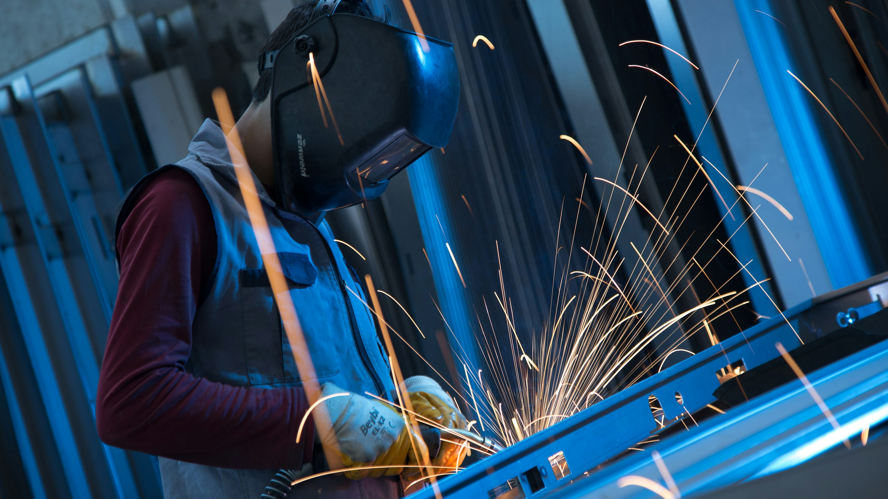

Metalwork Apprenticeships
Information session
• Earn, learn, and build a skilled career
27 February 2026 • Mercy Secondary School Ballymahon
Notes:
[Sources]
- https://unsplash.com/photos/a-welder-uses-sparks-to-join-metal-FQynd63cHeQ (background image, accessed 2026-02-10)
[/Sources]

Slide 2
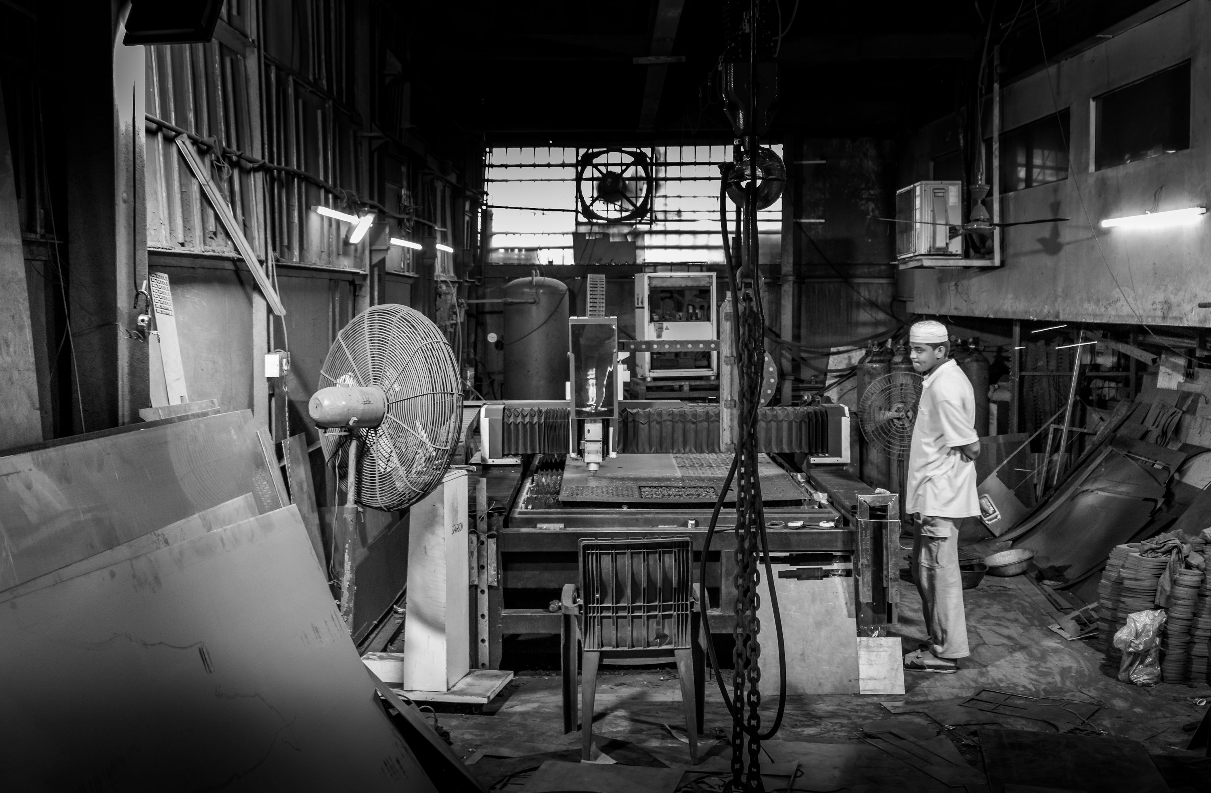
Today’s session
What you’ll learn in the next 15–20 minutes
Agenda
What an apprenticeship is (and how it works)
The metalwork roles you can train for
Skills you’ll build on the job and at college/training
What we look for in applicants
How to apply + what happens next
Bring your questions!
No experience required—just curiosity and effort.
Midland Engineering | Metalwork Apprenticeships
043 335 7312 | Info@midlandstainlessengineering.ie
Notes:
[Sources]
- https://unsplash.com/photos/man-standing-in-a-cluttered-industrial-workshop-krhnefg9yBQ (image, accessed 2026-02-10)
[/Sources]

Slide 3
What is an apprenticeship?
A paid job with structured training and a recognised qualification
Paid job
Training + study
Qualification
You’re employed from day one. You earn a wage while building real workplace skills.
You’ll learn in the workplace and spend protected time on training (e.g., college or a provider).
You work towards industry-recognised standards and finish with a qualification and experience.
In short: you learn a trade by doing the job—with support.
You’ll build competence over time: safety → basics → supervised work → independent work → final assessment.
Midland Engineering | Metalwork Apprenticeships
043 335 7312 | Info@midlandstainlessengineering.ie
Notes:
[Sources]
- https://www.apprenticeships.gov.uk/influencers/what-is-an-apprenticeship (definition: paid job + training)
- https://www.gov.uk/become-apprentice (eligibility and how apprenticeships work, accessed 2026-02-10)
- https://www.dol.gov/general/topic/training/apprenticeship (paid on-the-job training + classroom instruction)
[/Sources]

Slide 4
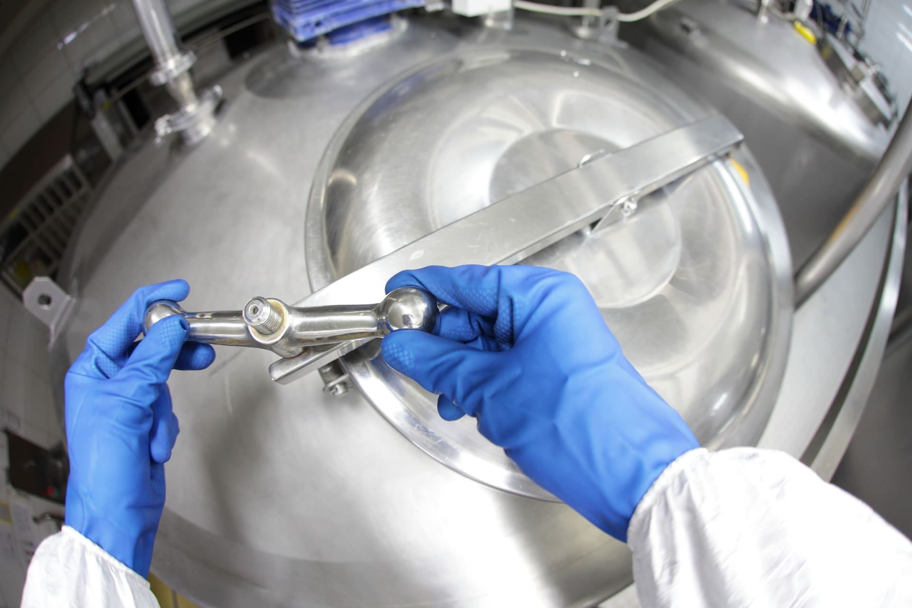
Why metalwork?
Hands-on skills that power modern engineering
4 reasons students choose this path
You make real products you can point to (and be proud of).
You learn practical skills: measuring, cutting, forming, joining, machining.
You develop habits employers value: safety, precision, teamwork, reliability.
You can progress into specialist roles, leadership, or further engineering study.
You’ll train on modern tools and learn safe working from the start.
Midland Engineering | Metalwork Apprenticeships
043 335 7312 | Info@midlandstainlessengineering.ie
Notes:
[Sources]
- https://unsplash.com/photos/a-welder-uses-sparks-to-join-metal-FQynd63cHeQ (image, accessed 2026-02-10)
[/Sources]

Slide 5
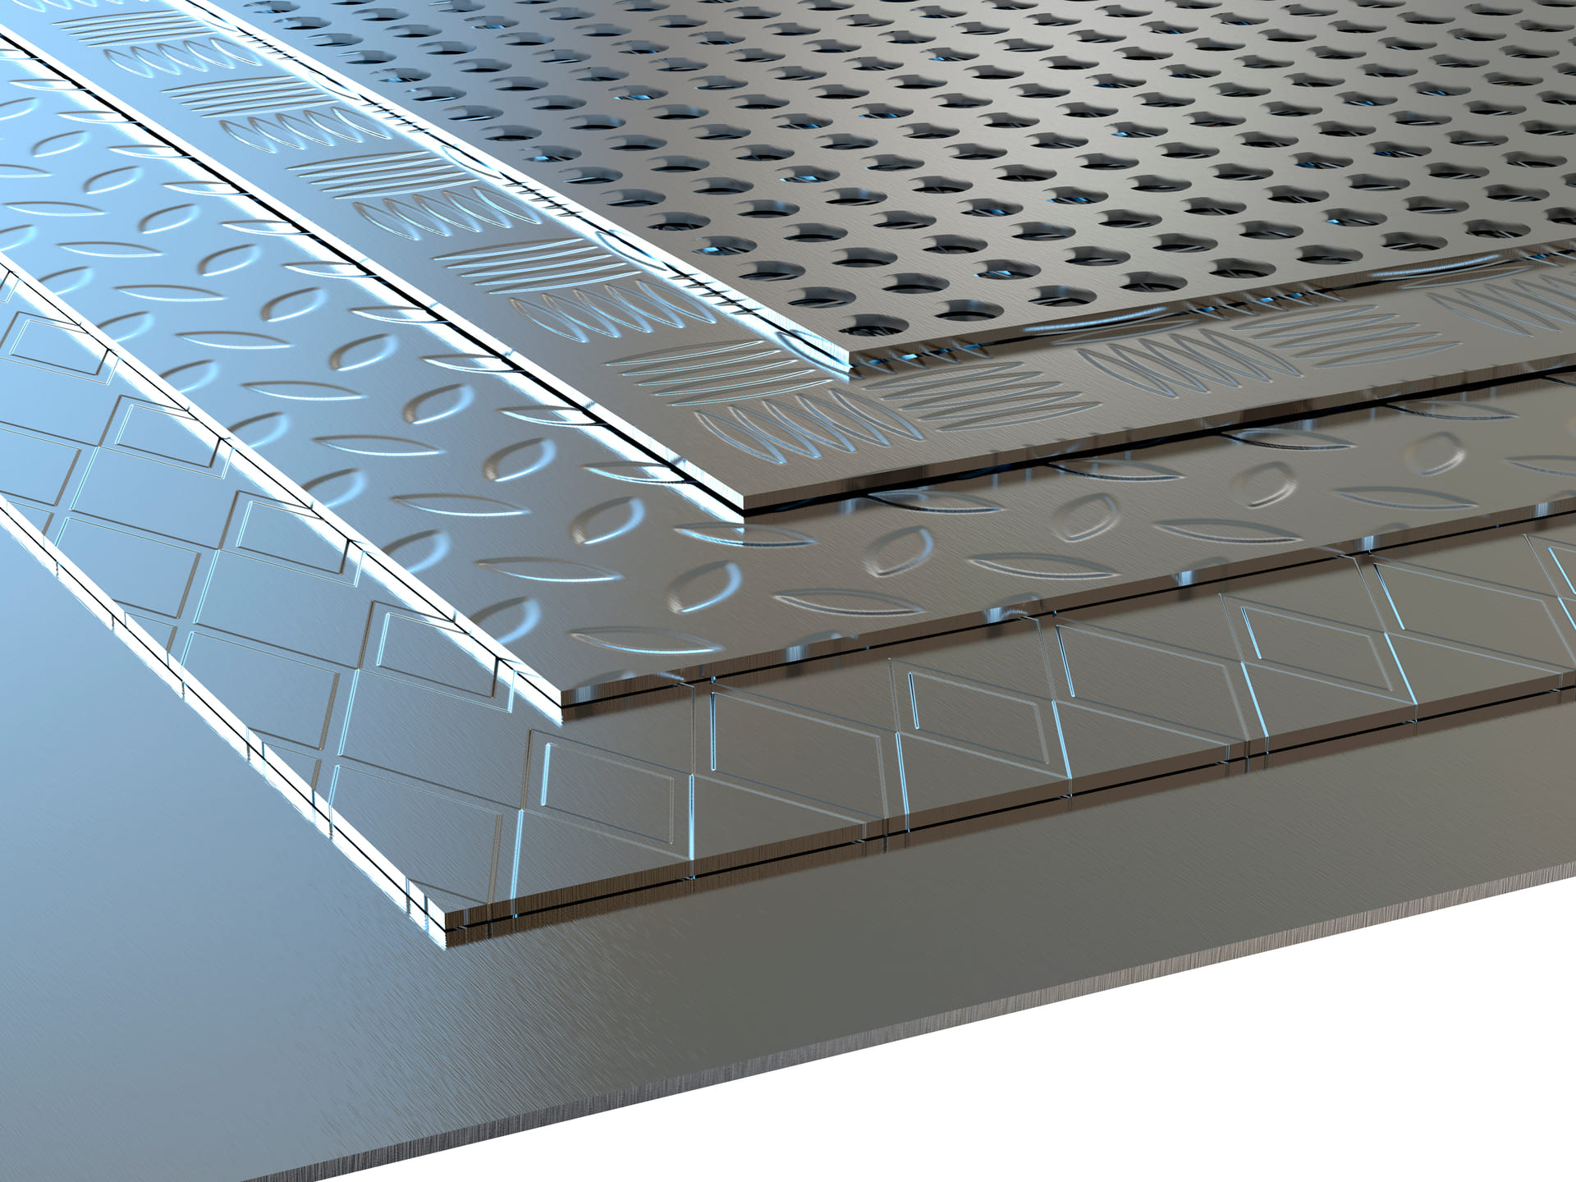
About Midland Engineering
Two divisions — one team — real projects from day one
What we do (examples)
• Steel fabrication & welding
• Stainless steel engineering
• Precision machining & CNC
• Maintenance & repair contracts
• Steel tanks & pressure vessels
• Industrial plant support
Why we invest in apprentices
Because skilled work is learned best with:
• mentoring
• real projects
• high standards
• time to grow
Templemicheal Business Park, Ballinalee Road, Longford
Midland Engineering workshops, Longford
Midland Engineering | Metalwork Apprenticeships
043 335 7312 | Info@midlandstainlessengineering.ie
Notes:
[Sources]
- https://unsplash.com/photos/man-standing-in-a-cluttered-industrial-workshop-krhnefg9yBQ (image, accessed 2026-02-10)
[/Sources]

Slide 6
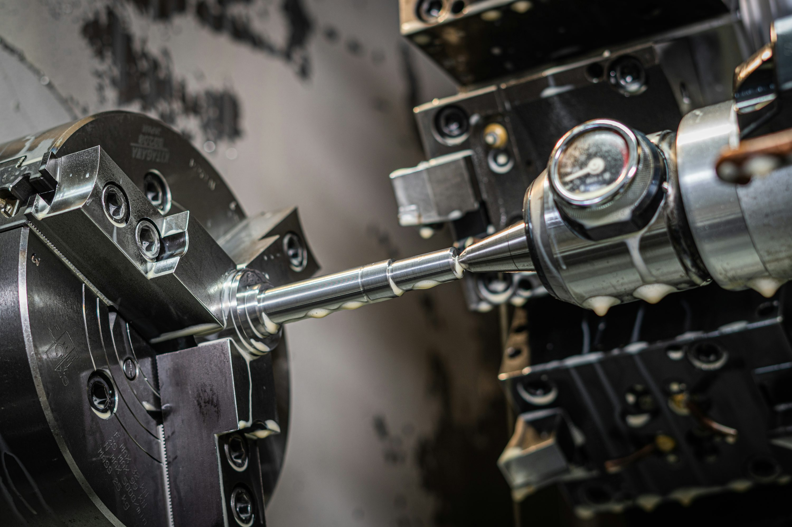
Metalwork apprenticeship pathways
Pick a route—or start broad and specialise as you learn
Examples of routes (your exact titles may vary)
Fabrication & Welding
CNC Machining
Read drawings • cut & form • tack & weld • finish & inspect • build assemblies
Set up tools • run CNC lathes/mills • measure parts • adjust offsets • keep quality records
Maintenance / Fitting
Toolmaking / Bench Fitting
Service equipment • diagnose faults • replace components • align & test • keep machines safe
Hand fitting • precision assembly • jigs & fixtures • measuring • problem-solving
Midland Engineering | Metalwork Apprenticeships
043 335 7312 | Info@midlandstainlessengineering.ie
Notes:
[Sources]
- https://unsplash.com/photos/a-close-up-of-a-machine-DV_rG1mjDxs (banner image, accessed 2026-02-10)
[/Sources]

Slide 7
Skills you’ll build
Technical skills + the habits that make you employable for life
Technical (the trade)
Professional (the habits)
Measuring & marking out (accuracy matters)
Reading drawings and tolerances
Cutting, forming, drilling & finishing
Welding / joining methods (route dependent)
Machine set-up and basic programming (CNC routes)
Quality checks and documentation
Safety-first mindset (PPE, risk checks)
Focus and attention to detail
Communication and teamwork
Learning mindset: ask, practise, improve
Timekeeping and reliability
Pride in doing work to a standard
Tip: Strong Maths + good problem-solving = faster progress (we’ll support you to build both).
Midland Engineering | Metalwork Apprenticeships
043 335 7312 | Info@midlandstainlessengineering.ie

Slide 8

A week in the life
A typical pattern (exact split varies by programme)
Example structure
Mon
Shop-floor learning + supervised tasks
Tue
Shop-floor learning + supervised tasks
Wed
Shop-floor learning + projects
Thu
Shop-floor learning + projects
Fri
College / training provider (theory + assessments)
You’ll also have guided practice time: logs, revision, and skill sign-offs.
Midland Engineering | Metalwork Apprenticeships
043 335 7312 | Info@midlandstainlessengineering.ie
Notes:
[Sources]
- https://unsplash.com/photos/teacher-lecturing-students-in-a-classroom-setting-9aDUzd9R8ts (background image, accessed 2026-02-10)
[/Sources]

Slide 9
What we look for (and how we support you)
Attitude beats experience — we train the skills
You’ll do well if you…
Safety, quality, and teamwork
come first—always.
Turn up on time and ready to learn
Follow safety rules every time
Ask questions when you’re unsure
Take feedback and improve
Enjoy hands-on problem solving
Have a solid base in Maths (we can help you build it)
We’ll teach you the methods—and why they matter.
Support you can expect
• A mentor/coach on shift
• A structured training plan
• PPE and safety induction
• Regular check-ins and progress reviews
Midland Engineering | Metalwork Apprenticeships
043 335 7312 | Info@midlandstainlessengineering.ie
Notes:
[Sources]
- https://unsplash.com/photos/a-close-up-of-a-machine-DV_rG1mjDxs (image, accessed 2026-02-10)
[/Sources]

Slide 10
Where it can take you
A trade is a launchpad — your path can keep growing
1
Apprentice
Learn the basics safely, build core skills, get signed off.
2
Improver / Junior
Take on bigger tasks with less supervision.
3
Skilled craftsperson
Work independently; quality and productivity grow.
4
Specialist
Welding codes, CNC programming, maintenance diagnostics, inspection, etc.
5
Lead / Supervisor
Guide others, plan work, improve processes.
Many apprentices also move into: CAD/CAM, production engineering, estimating, QA, or apprenticeship mentoring.
Midland Engineering | Metalwork Apprenticeships
043 335 7312 | Info@midlandstainlessengineering.ie

Slide 11
How to apply
Simple steps — we’ll guide you through the process
Typical steps
Apply / learn more
1
Register interest
Leave your details so we can share openings.
QR
2
Apply online
Short application + CV (we can help you build one).
3
Chat / interview
Scan to apply
A friendly conversation about what you enjoy and how you learn.
Bring (if you have it):
Your CV (or a short “about me”)
School/college results
A note of why you’re interested
Any projects (DT, metalwork, robotics, etc.)
4
Practical / aptitude
Simple tasks to see your approach (not prior skill).
5
Offer + start
Contract, PPE, induction, and your training plan.
Tip: If you’re not sure which route fits, apply anyway — we can help you choose.
Midland Engineering | Metalwork Apprenticeships
043 335 7312 | Info@midlandstainlessengineering.ie

Slide 12
Questions?
We’d love to hear what you’re curious about.
Next steps
• Talk to your teacher/careers adviser
• Book a workshop tour / taster session
• Apply online (or register interest)
Email: Info@midlandstainlessengineering.ie
Web: midlandstainlessengineering.ie
Note: programme details (routes, entry requirements, pay, start dates) vary — confirm with the recruitment team.
Notes:
[Sources]
- https://unsplash.com/photos/a-welder-uses-sparks-to-join-metal-FQynd63cHeQ (background image, accessed 2026-02-10)
[/Sources]

