Slide 1



Porto Seguro's Safe Driver Prediction
Team 5
Mengting Ding, Dylan Koury, Olivia Siegal

Slide 2
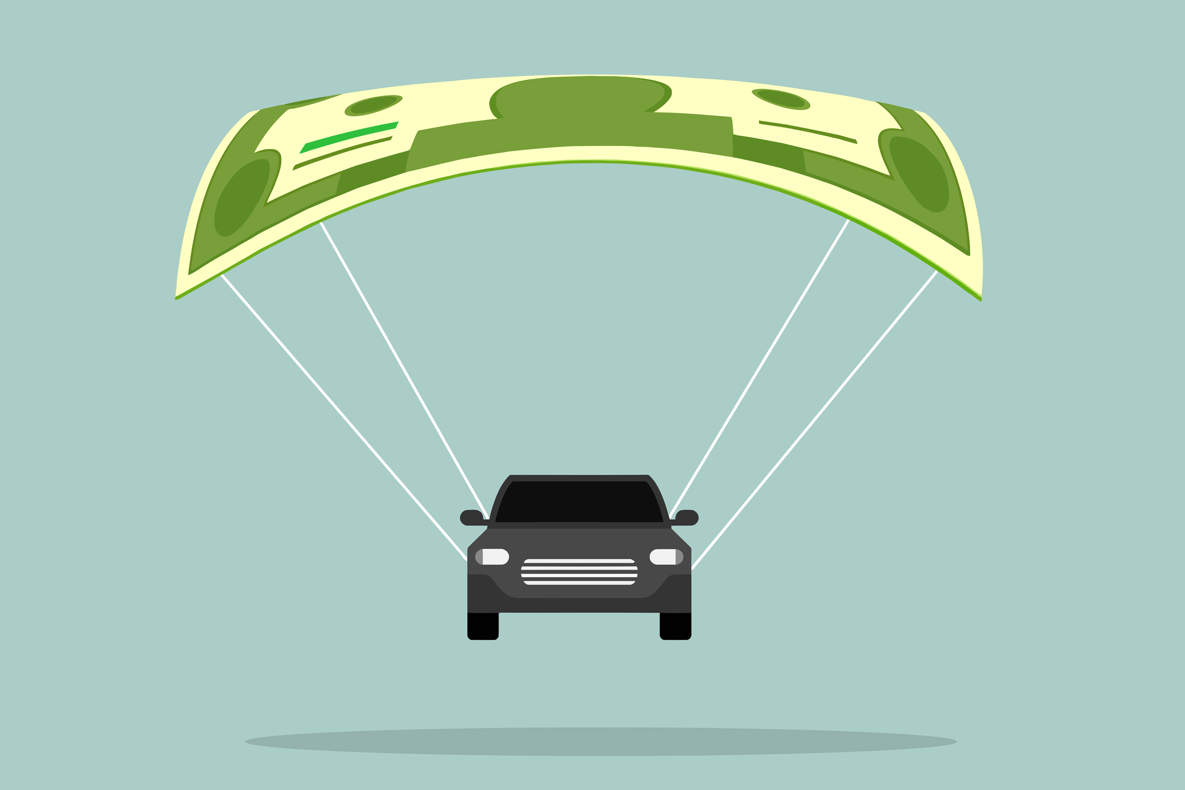
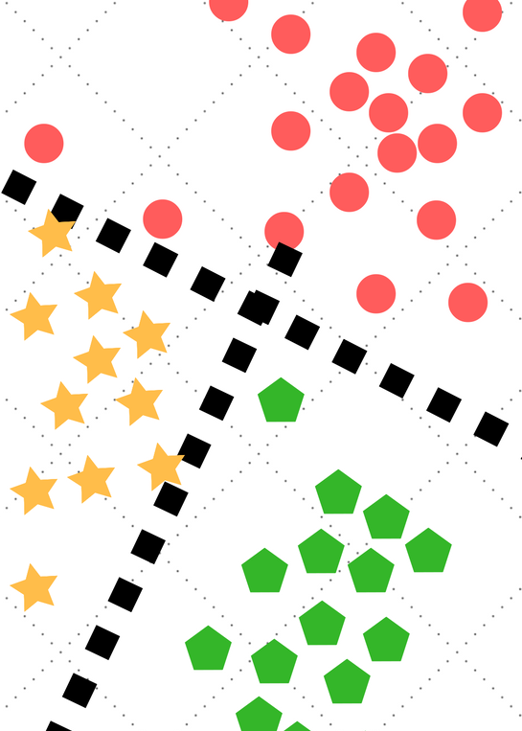
Agenda
Introduction
Kaggle Competition Results
Data Exploration & Prep
Model Considerations & Results
Conclusions & Recommendations

Slide 3

Problem Statement
Inaccuracies in a company's claim predictions can yield high insurance prices for good drivers while reducing cost for bad ones.

Slide 4

Porto Seguro's Safe Driver Prediction
Largest auto & homeowner insurance company in Brazil
Goal: Make car insurance more accessible to more good drivers
What is the probability that a driver will initiate an insurance claim in the next year?
Measure model performance with the Normalized Gini Coefficient

Slide 5
Normalized Gini Coefficient
Gini Coefficient
Origin: a measure of inequality of wealth in society
In machine learning, it is used to assess the performance of binary classifier models
0 < Gini Coefficient < 0.5
The higher the coefficient, the better the model
Normalized Gini Coefficient: adjusts the Gini Coefficient by the theoretical maximum so that the maximum score is 1

Slide 6
Gini Coefficient is not Gini Impurity
Gini impurity:
Recall: tree models
Measure of misclassification
Applied to multiclass classifiers
Gini coefficient
Requires a classifier that includes some measure of rank for each observations according to likelihood (probability) of being in a positive class
Applies only to binary classifiers

Slide 7
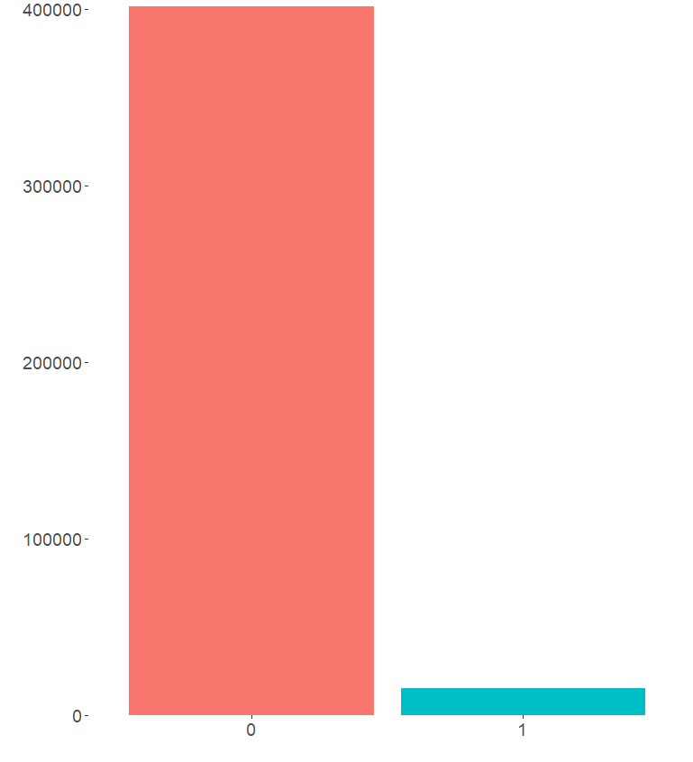
Porto Seguro's Claims Data
401,463
Response variable: target
0: no claim filed
1: claim filed
unbalanced
57 features
Anonymized dataset
Missing values
Originally coded as –1
Converted to NA's
Removed features with more than 70% missing data
Replaced remaining NA's with 0
15,186

Slide 8
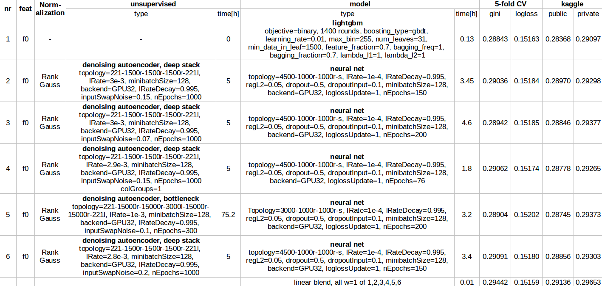
Kaggle Competition: Winner
Method
C++/CUDA programming languages
Average of 6 models
5 Neural Networks
1 LightGBM
Validation method: cross-validation
Normalized Gini Coefficient = 0.29
Not repeatable
Repeated the Lightgbm portion
Normalized Gini Coefficient
Split dataset: 0.18
Full dataset: 0.25
Notes:
The methods of the winner of this competition were not replicable for the purposes of this course
C++/CUDA programming
languages were used to
build their models
6 models were averaged
for the final score – 5 of
them were neural networks,
1 of them was lightgbm

Slide 9
Kaggle Competition: Winner
Method
C++/CUDA programming languages
Average of 6 models
5 Neural Networks
1 LightGBM
Validation method: cross-validation
Normalized Gini Coefficient = 0.296
Not repeatable
Repeated the LightGBM portion
Normalized Gini Coefficient
Split dataset: 0.18
Full dataset: 0.25
Notes:
We attempted to replicate the results of the 1st place's lightgbm model, using the same parameters supplied by the winner.
While this gave us
our best model gini,
the results were still
well below .29
Upon testing again without splitting our data into a testing and validation, we calculated a model gini of about .25 rather than our .189
This leads us to believe competitors neglected to split their data into training and validation, which while providing a higher score, is likely due to overfitting

Slide 10

Kaggle Competition: Runner-up
Method
Python
XGBoost & Neural Network
Features of neural network based on XGBoost model predictions
Features in XGBoost model are based on grouped set of features
Validation method: 5-fold cross-validation
Normalized Gini Coefficient = 0.294
Not repeatable
Not easily interpretable
Notes:
The second-place finalist in this competition also implemented artificial intelligence to arrive at their solution
The features of this network are based on the predictions from an xgboost model
In turn the features (and target) of that model are based on grouped sets of features

Slide 11

General Kaggle Critiques
Missing Considerations
Class Imbalance
Even neural networks perform better with balanced datasets
Validation methods
Training/Testing sets?
Some mentions of cross-validation for neural networks
Complex Methodology
Top competitors used neural networks
Some mentions of poor performance of machine learning methods (e.g., KNN)
Not reproduceable
Difficult to interpret & explain

Slide 12
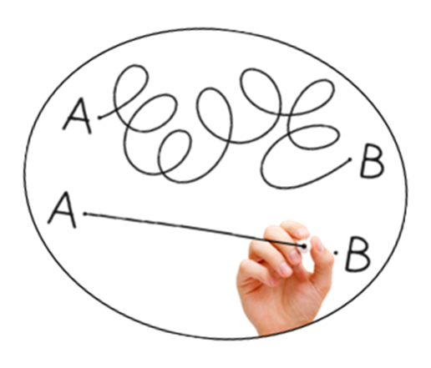
Our Strategy
Parsimony.
The best model is the simplest model.
The best model is easiest to reproduce, explain, and interpret.

Slide 13
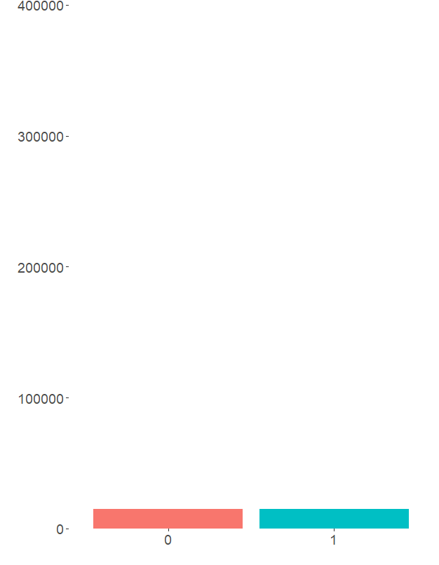
Preprocessing: balanced dataset
Models with imbalanced datasets
Can yield high accuracy, but do not perform well during validation
Logistic model with unbalanced dataset
high accuracy
all predictions were for majority class (no claim)
m
Under-sampled the majority class to balance the dataset
R package: unbalanced
Both classes contain 15,186 observations

Slide 14

Preprocessing: Center, Scale & Split
Center & Scale
Most features' values were smaller than 5
Some features' max values were greater than 20
Centering & scaling the data reduced bias
m
Training & Testing Sets
70-30 split
20-80 split for KNN

Slide 15
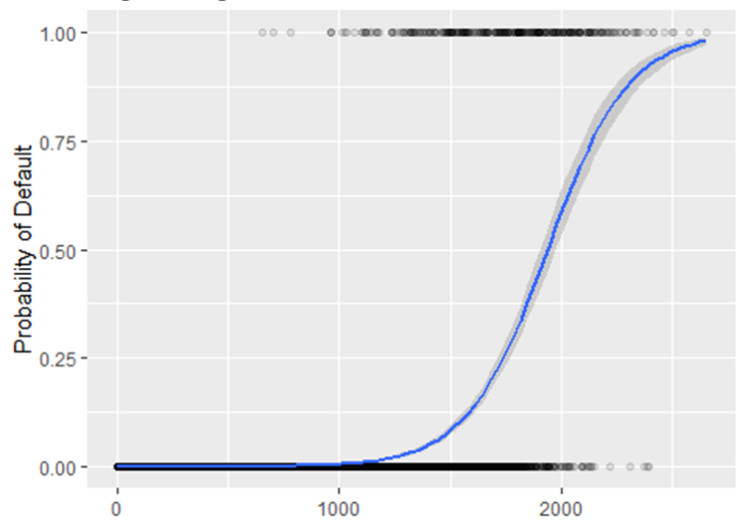
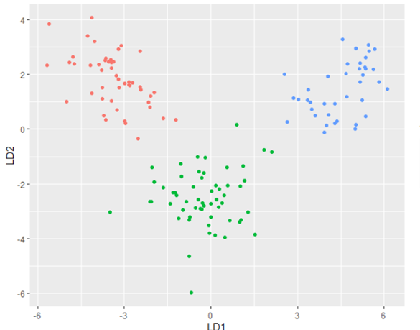
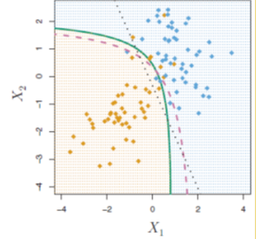
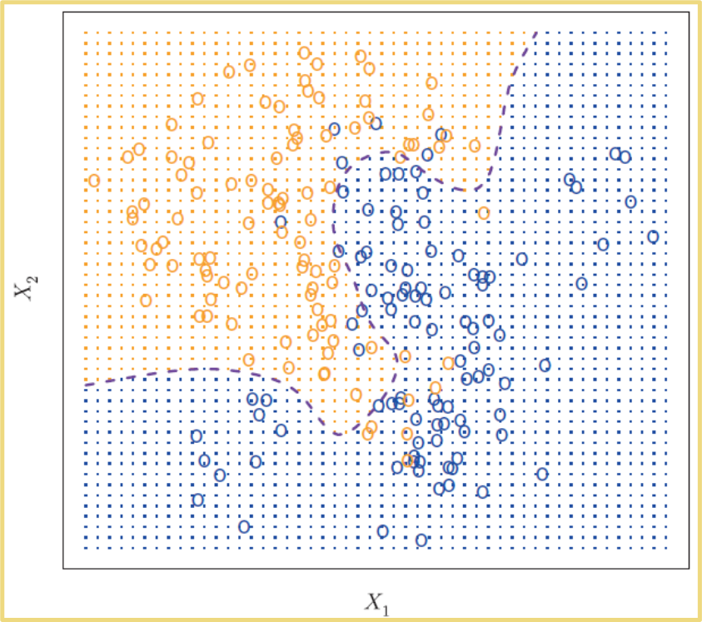
Models Considered: Recall ML1
Logistic
Simplest model
Good for binary classifiers
Linear decision boundaries
LDA
Assumes observations are drawn from normal distributions with common covariance matrix classes
If assumptions hold, can perform better than logistic
Linear decision boundaries
QDA
Can perform well when there are limited training observations
Quadratic decision boundaries
KNN
Most flexible (non-parametric)
Unreliable in high dimensions
Logistic Regression
Linear Discriminant
Quadratic Discriminant
K-Nearest Neighbors

Slide 16
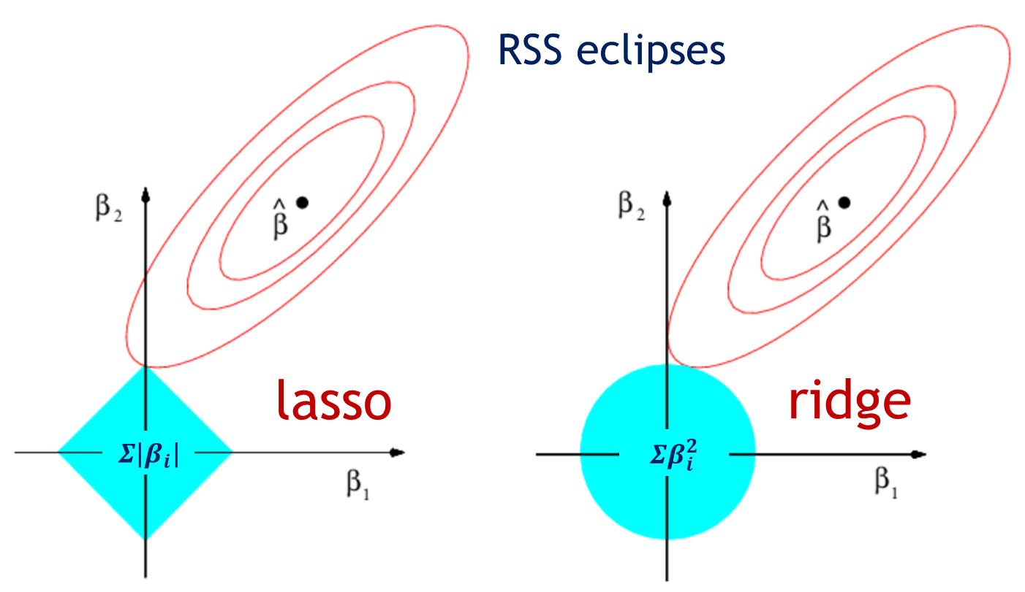
Models Considered: Feature Engineering
Recall, 57 features and 595,212 observations
Ridge
Shrinks beta coefficient towards zero (not at zero)
Small amount of bias introduced into training data
Use when most features in the model are useful
Lasso
Shrinks beta coefficient towards zero (and to zero)
Allows feature reduction
Use when some features in the model are likely useless
Easier to interpret than Ridge

Slide 17

Models Considered: Trees
Bagging
Bootstrap + Aggregate
Use all X features
m
Random Forests
Improvement on bagging
Randomly selects X features to include
m
Boosting
Extends random forests
Trees learn from one another
Gradient boosting: ensemble of weak learners are used to improve the model
Notes:
Boosting
Extends random forests
Trees learn from each other
Gradient boosting: Ensemble of weak learners are used to improve the model

Slide 18
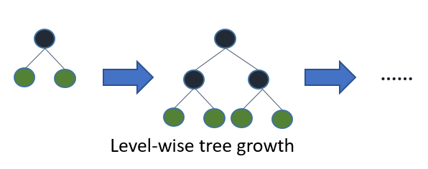
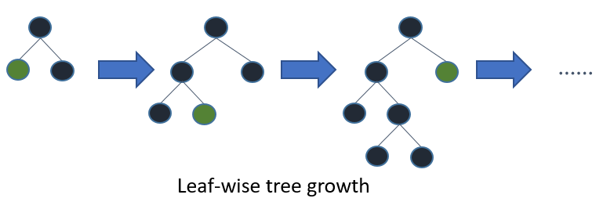
Models Considered: Boosting Algorithms
XGBoost
Algorithm focused on computation speed and model performance
Designed to work with large & complex datasets
Only accepts numerical data – must encode categorical as dummy variables
Builds more robust models than LightGBM
LightGBM
Histogram-based algorithm that performs bucketing of values -> faster training speed & accuracy
Designed to work with large & complex datasets
Works well with categorical data
Can result in overfitting on training data
Notes:
https://neptune.ai/blog/xgboost-vs-lightgbm

Slide 19
Model Results
Model | Accuracy rate | Normalized Gini
LightGBM | 0.5706 | 0.1891
XGBoost | 0.5906 | 0.1836
LDA | 0.6191 | 0.1629
randomForest | 0.5941 | 0.1602
Bagging | 0.5934 | 0.1575
KNN | 0.5892 | 0.1065
Ridge | 0.8892 | 0.0913
Lasso | 0.9189 | 0.0639
QDA | 0.3615 | 0.0162
Logistic | 0.7898 | -0.0424
Boosting (gbm) | 0.4050 | -0.1603
Accuracy Rates
Most were good
However, false negatives were high for several of the models, which indicates presence of overfitting
Normalized Gini Coefficient
Recall: 0 < Normalized Gini < 1.0
Better measure of performance
XGBoost & LightGBM resulted in best Normalized Gini Coefficients
Note: negative coefficients for Logistic & Boosting (gbm)
reversing model: predicts opposite outcome more successfully

Slide 20
Conclusions & Recommendations
Goal: Make car insurance more accessible to good drivers with models that predict if a person will file a claim in the next year.
m
Kaggle models
Performed better
Not reproduceable
Complex, for negligible additional Gini Coefficient value
Recommend testing on new data
Our models
Simpler
Trained then tested on new data
Easier to interpret and explain
m
We recommend Porto Seguro select the model that best suits their needs.
Notes:
If they don’t have to explain it to anyone then it has the higher score go with that, but if they do need to explain then go with that

