Slide 1


Welcome to H.O.T.
www.handsontech.org
Our Purpose:
Forum for interaction
  Many hobbyists build/tinker in isolation
  Make new friends with common tech interests
Learn together
  Lots of fun new tech to explore
  Share expertise, help each other
Build something
  Hands-On learning
  Make something fun & useful

Slide 2



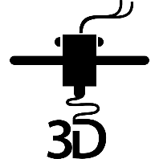

One Hands-On Tech club
Two Groups
3D Printing
Small Computers

Slide 3
New to the club? Welcome!
Wondering what H.O.T. is all about?
This is a hands-on group, so we may be in the middle of a series of meetings on our way to building something interesting
Go to handsontech.org>New Members for a specially designed launching point for new members!
Please take the time to look through a few presentations at handsontech.org>Small Computers or handsontech.org>3D Printing.
  Presentations are always available online after our meetings for reference and as self-paced projects

Slide 4
Club communications are via Email & Web !
To join our email list(s), fill membership form at handsontech.org>New Members
  When asked for your email address, use a gmail email address if possible (we use google forums & they are picky)
  You will be added automatically to our Hands-On Tech (H.O.T.) overall email list
  You will also be added to the Small Computers and/or 3D Printing mailing lists and forums if you expressed interest in the membership form.
Meeting calendar is at handsontech.org

Slide 5
Small Computers and Robots
Small Computers have become powerful enough to be capable of running ROS (The Robot Operating System).
Today, we will explore ROS, but first let’s get some background in robots.

Slide 6
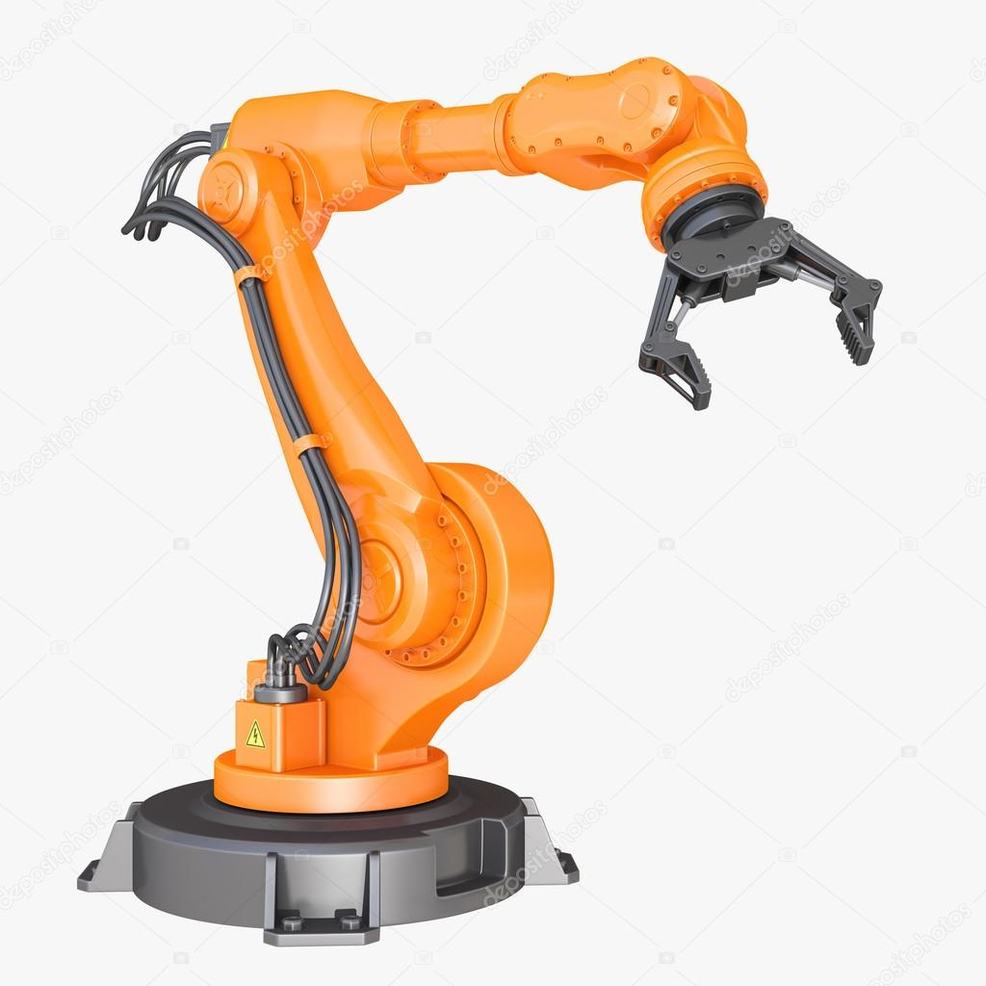
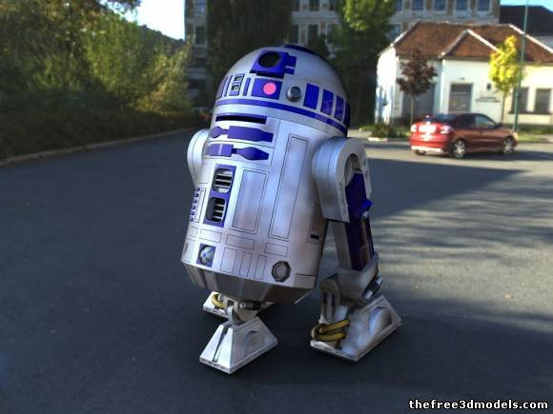
Different types of Robots
Mobile Robots
Industrial Robots
Robots with Articulated Joints

Slide 7
Common Mobility Configurations
Ackerman (like a car)
Differential drive (like a zero-turn mower)
  2 independent DOF: X and Theta-Z
Holonomic
  3 independent DOF: X, Y, Theta-Z
Other (Skid steer, Tank)

Slide 8
Control Capabilities
Tele-Op (Remote control)
Line Following
video
video

Slide 9
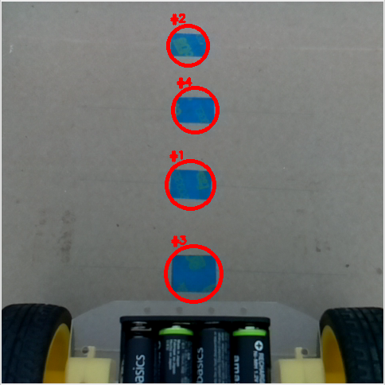
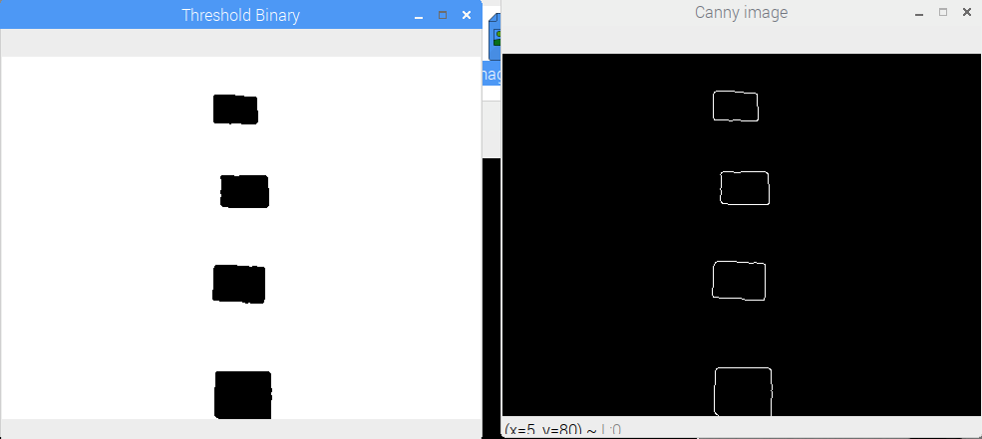
Image processing

Slide 10
Control Capabilities
Tele-Op (Remote control)
Line Following
Obstacle Avoiding
Mowing the Lawn
  ex: Early robotic vacuum cleaner
Autonomous Navigation
  ex: Newer robot vacuum cleaner
video

Slide 11
Autonomous navigation
Getting from point A to Point B
The robot needs to know where it is:
  A Map would be nice
  It needs to discover where it is on the map
    Cameras?
    GPS?
    Lidar?
In order to drive to a goal position
  Path Planning
  Detect and avoid obstacles

Slide 12
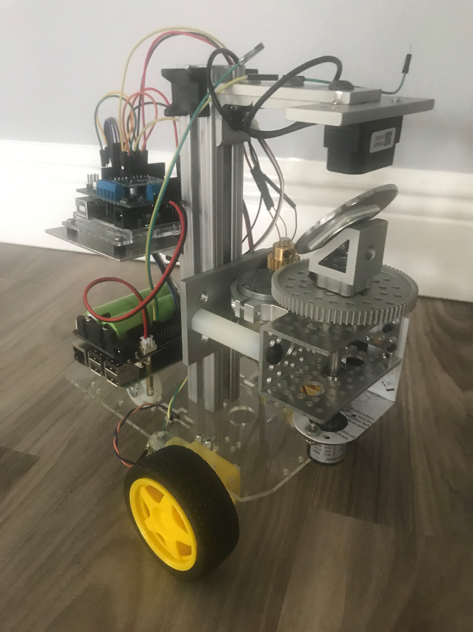
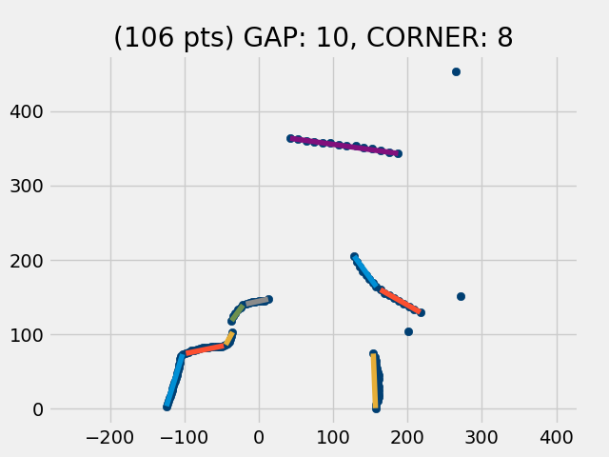
Diff drive Robot with LiDAR & IMU

Slide 13
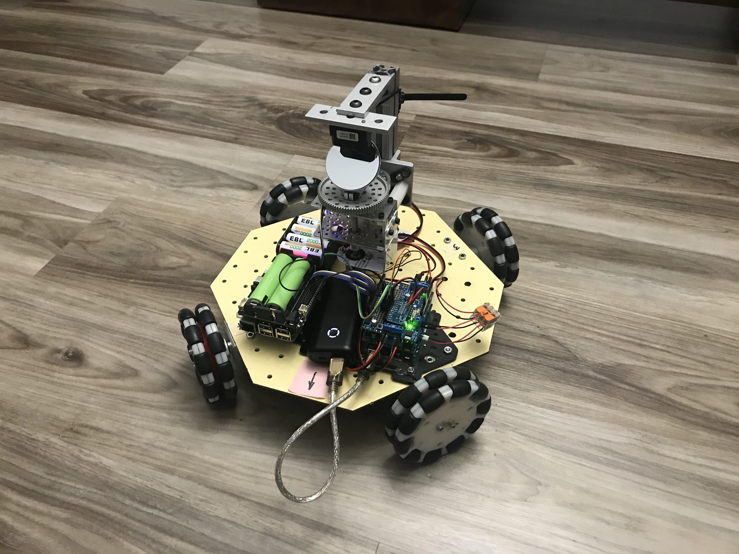
Holonomic robot w/ LiDAR and IMU
Omni-wheel robot

Slide 14
ROS provides many needed functions
Maps its environment
Localization (where am I on map?)
Sensor Fusion (odometer & IMU)
Path planning to goal pose
Obstacle Avoiding

Slide 15
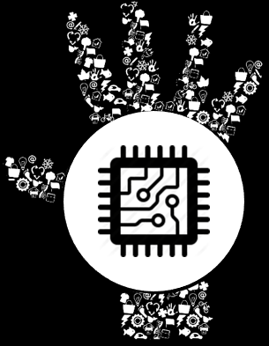

What Is ROS?

Slide 16
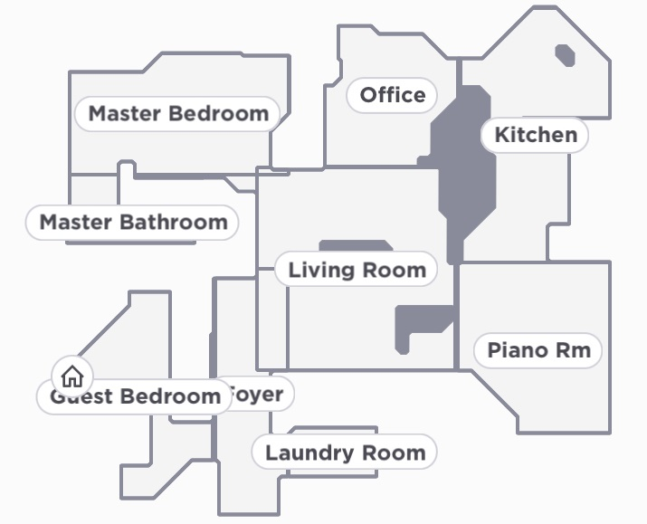
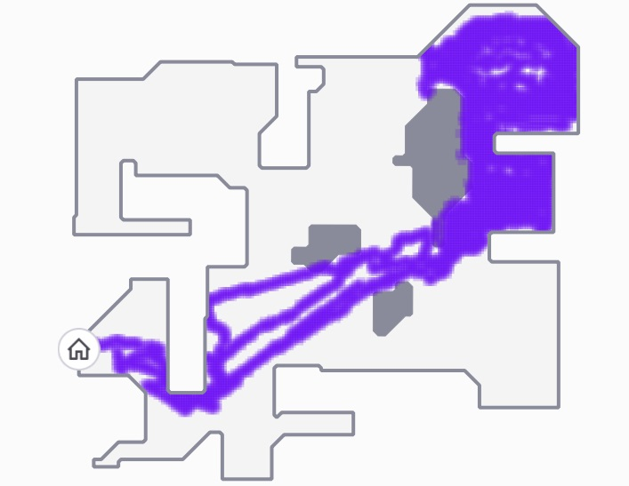
Look what my Ninja can do
Map and navigate its environment

Slide 17
Modern Robot Vacuum Cleaners
Can Map their environment
Can Localize themselves on map
Can plan their Path to goal pose
Can clean your house
Can return home to empty dirt

Slide 18
We will use ROS to build a robot that is able to:
Map its environment
Localize itself on map
Plan Path to goal pose
Clean the house
Return home

Slide 19
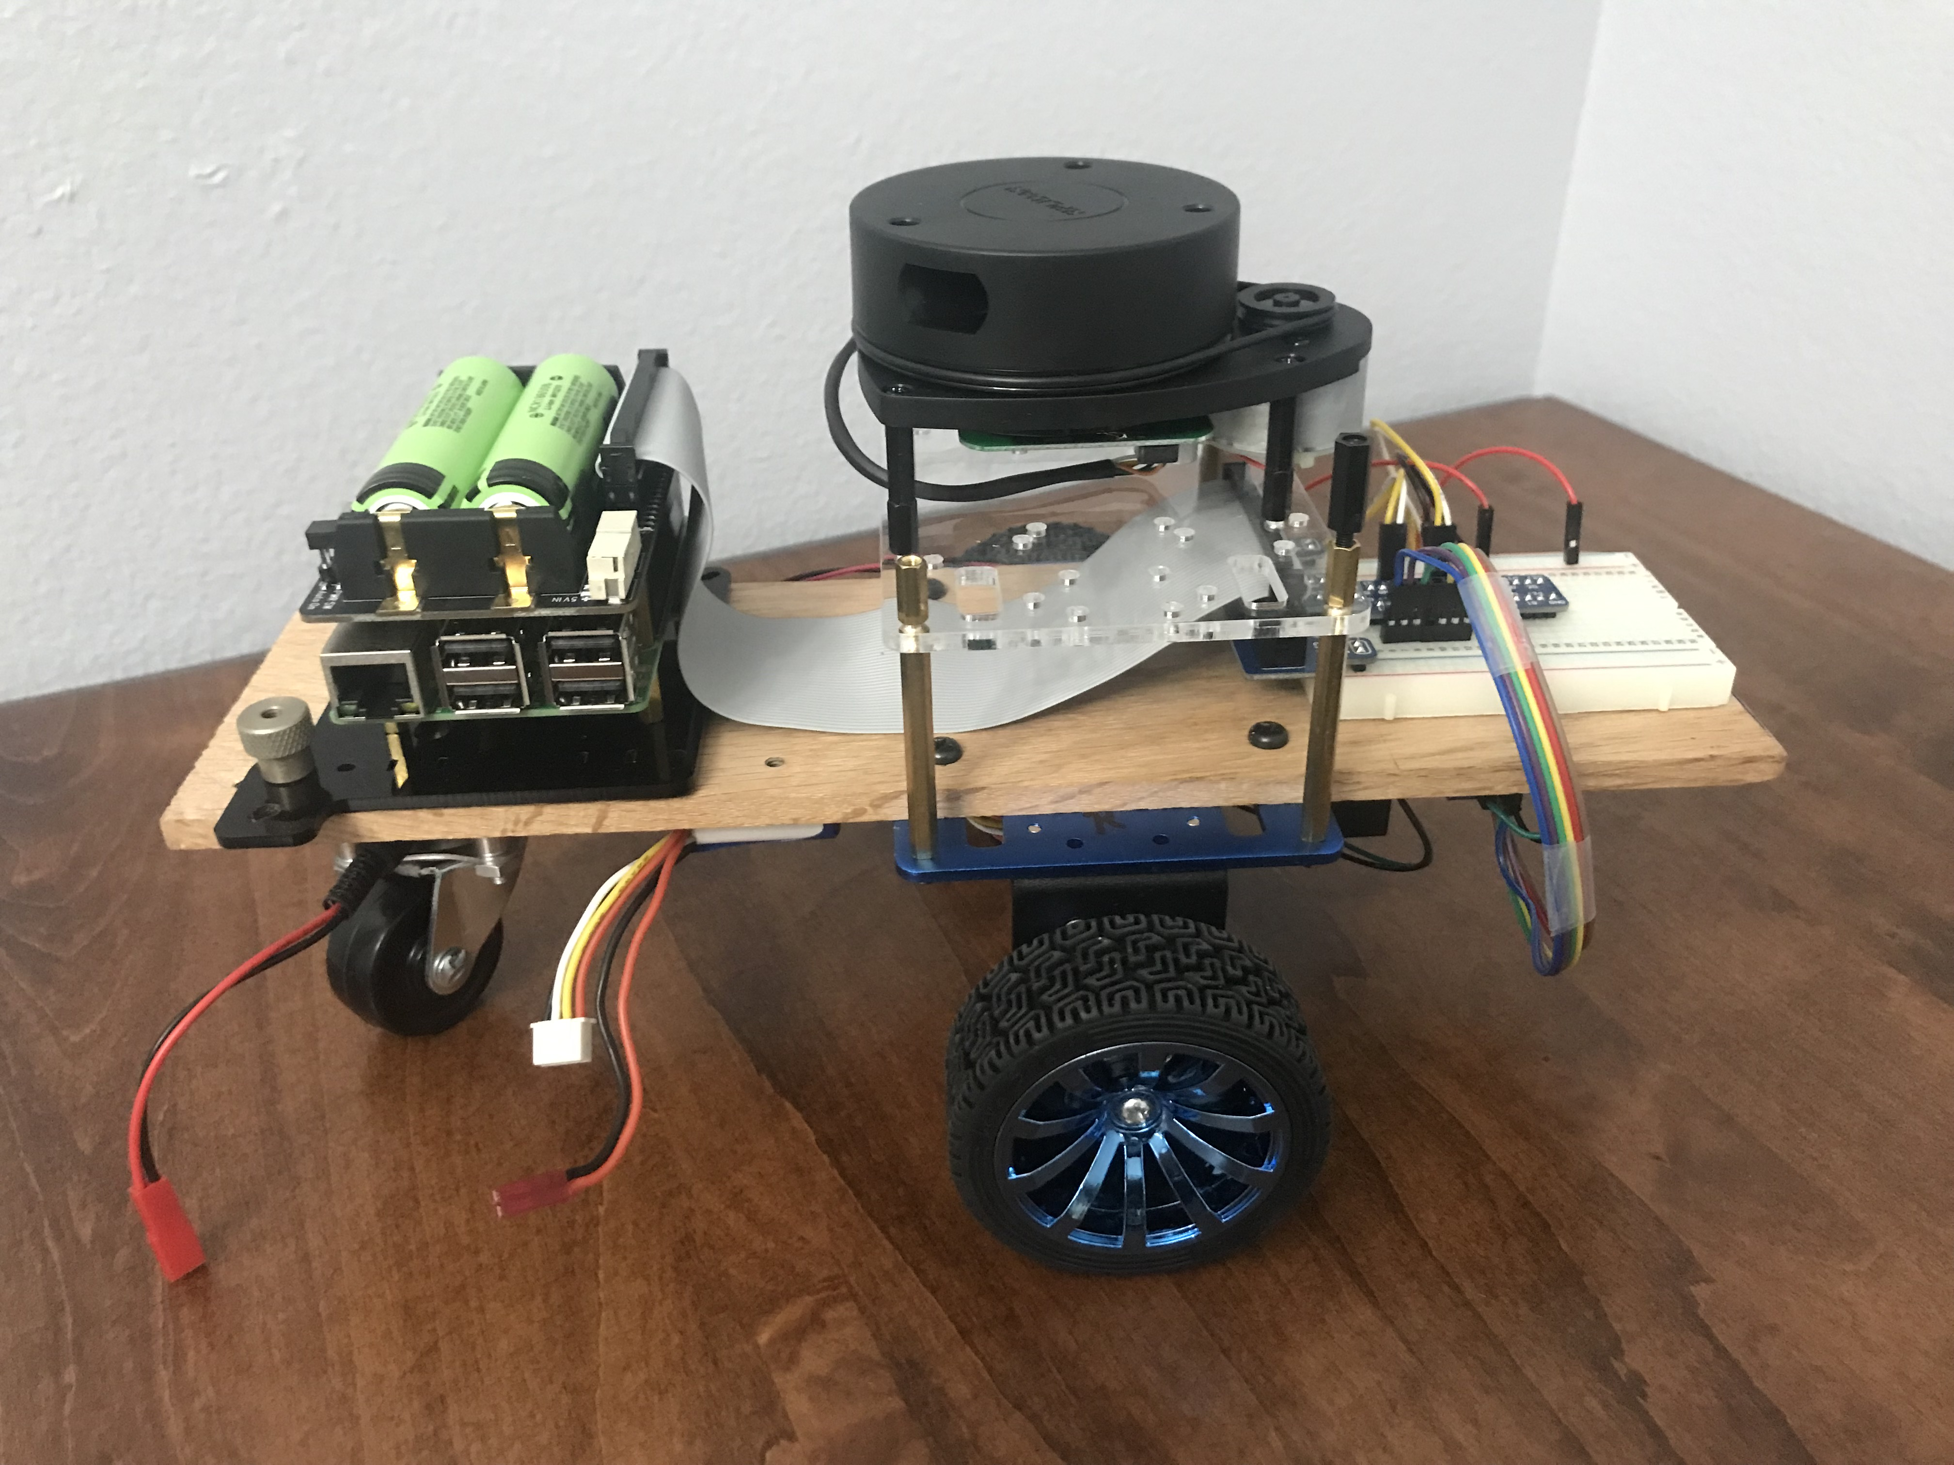
Let’s start simple
Differential drive
RPLidar
Raspberry Pi 3B+
Geekworm UPS

Slide 20
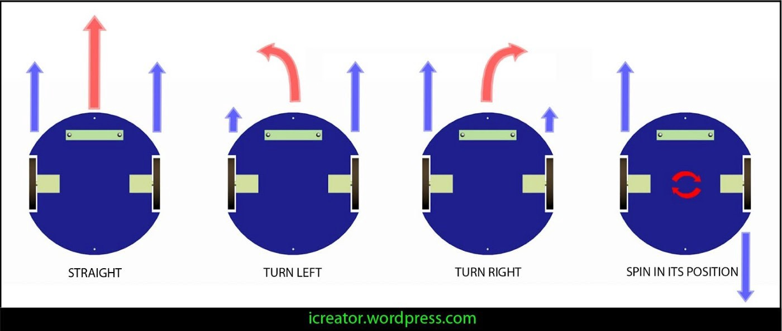
How Differential Drive Works

Slide 21
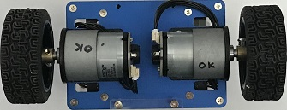
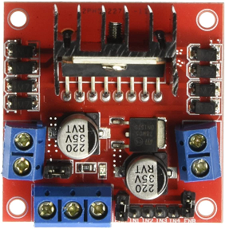
/right_ticks
/left_ticks
/act_vel
Odometry
Publisher
encoder publisher
/odom
/tf
Nodes
Communicate via
Topics
/cmd_vel
Motor Controller

Slide 22
How ROS works
Roscore node is started first
  Coordinates communication between nodes
  Serves as master clock
  Parameter server
  Package manager
New nodes register with roscore
  Specify topics they want to subscribe to
  Specify topics they will publish

Slide 23
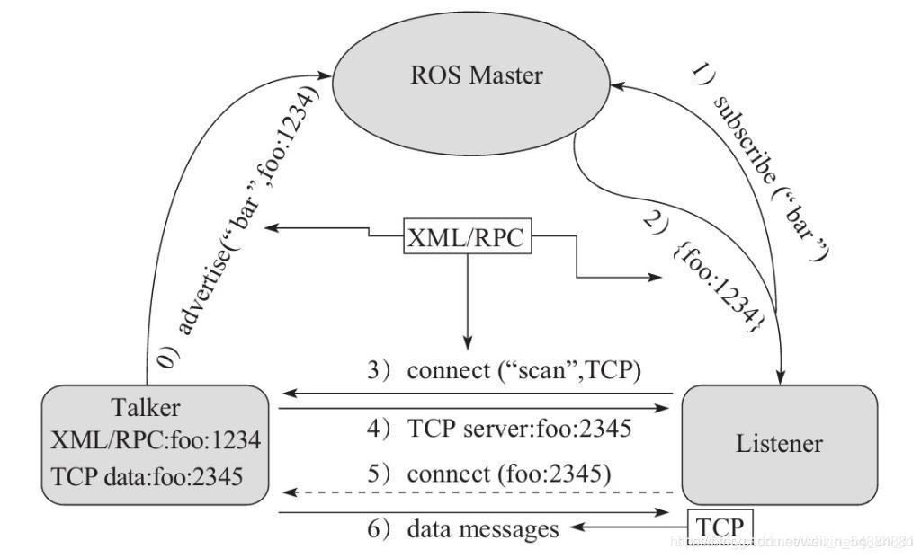
How ROS communication works
ROS communicates via TCP
Roscore is at ROS_MASTER_URI=http://raspi4:11311/

Slide 24
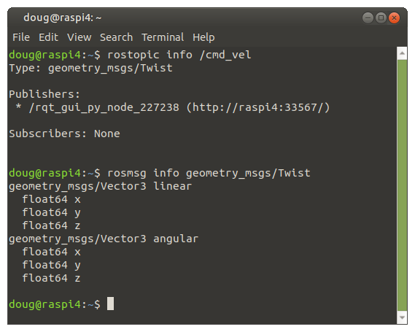
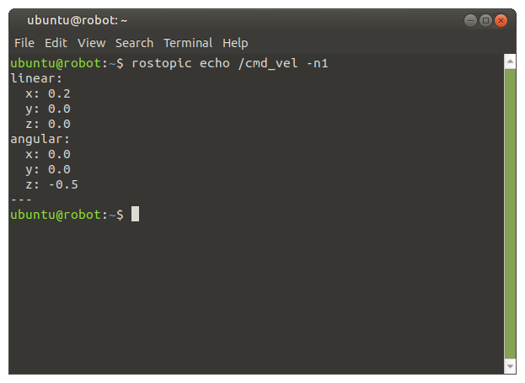
How ROS communication works
A Message is published over a channel called a Topic
Example: the /cmd_vel topic contains a Twist message

Slide 25
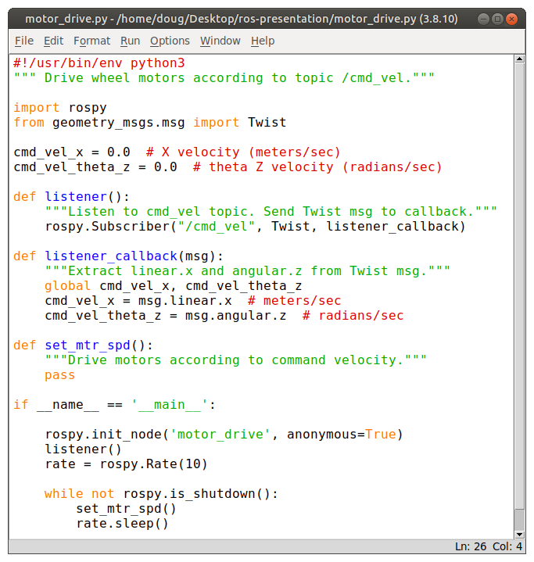
Motor Controller Node to drive motors
Import rospy, Twist
Register w/ roscore
Subscribe to /cmd_vel
  Listener()
  Listener_callback()
Set loop rate to 10 Hz
  Drive motors

Slide 26
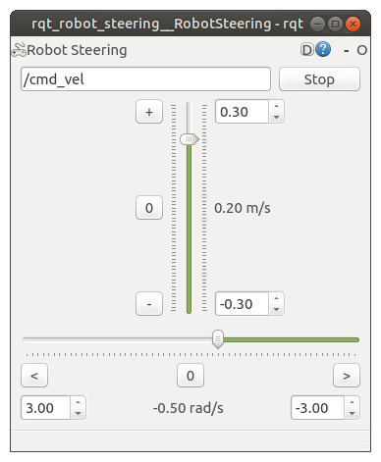
Robot Steering tool used to steer robot
Standard GUI tool
Command-line launched
User setable velocities
  X (Linear)
  Theta Z (Angular)
Publishes /cmd_vel @ 10 Hz

Slide 27
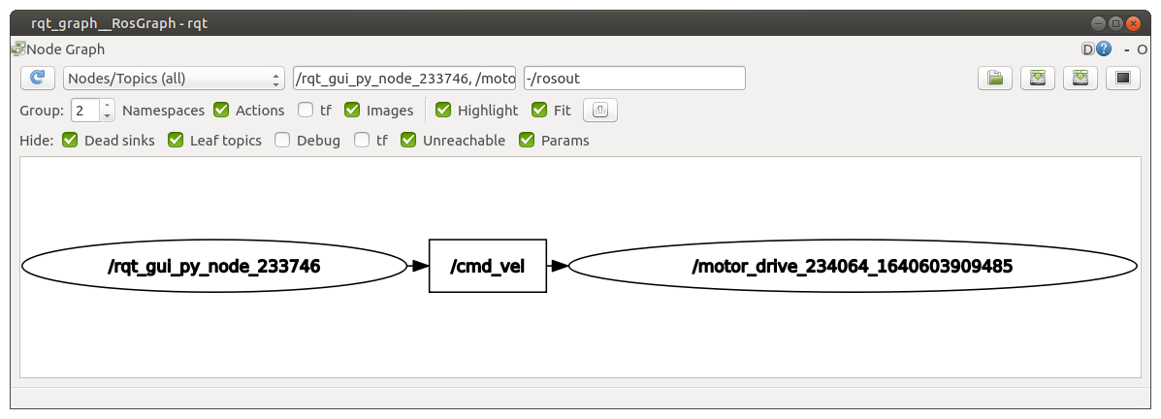
Use rqt_graph to show nodes / topics

Slide 28
/right_ticks
/left_ticks
/act_vel
Odometry
Publisher
Encoder Publisher
/odom
/tf
Nodes
Communicate via
Topics
/cmd_vel
Motor Controller

Slide 29
Counting encoder ticks on RasPi
Use pigpio to give gpio pins super powers
  All gpio pins enabled as interrupts
  Enables PWM output on all pins

Slide 30
motor_encoder Node
Combines motor_controller and encoder_publisher functions into a single node
Registers w/ roscore
Subscribes to /cmd_vel
Sends PWM signals to L298N motor driver
Counts encoder ticks and Publishes to topics:
  /right_ticks
  /left_ticks
  /act_vel

Slide 31
/right_ticks
/left_ticks
/act_vel
Odometry
Publisher
Encoder Publisher
/odom
/tf
Nodes
Communicate via
Topics
/cmd_vel
Motor Controller

Slide 32
What is ROS?
Not an OS, but a middle-ware
Currently runs best on linux (Ubuntu)
Defacto standard in robotics community
Handles communication between processes called “Nodes”
Nodes can be stopped/started on the fly
Nodes can run on different computers
  Distribution of processing load
  Collaboration between robots

Slide 33
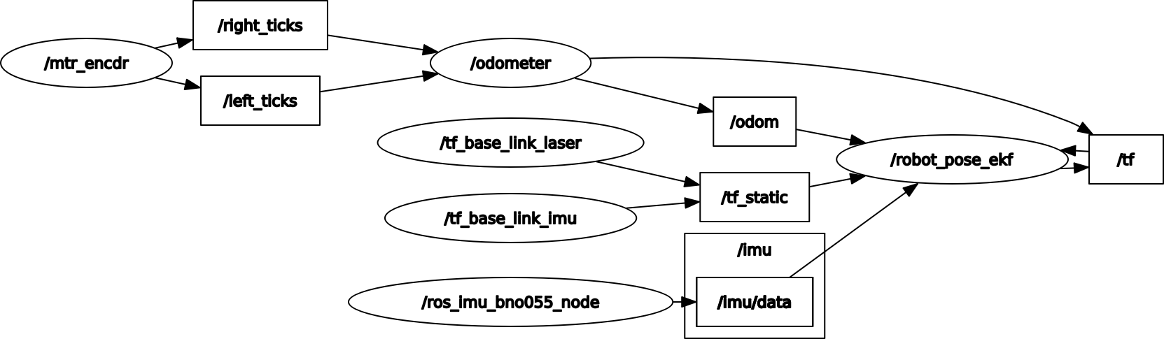
Node-Topic graph for our simple robot

Slide 34
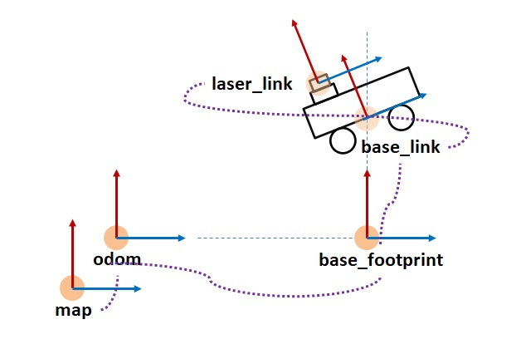
Coordinate Frames

Slide 35
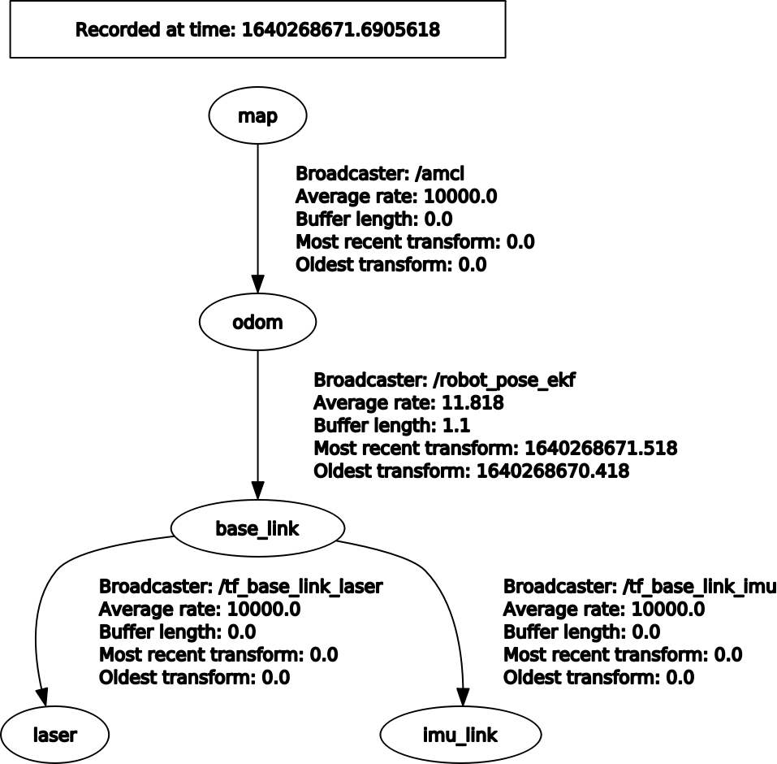
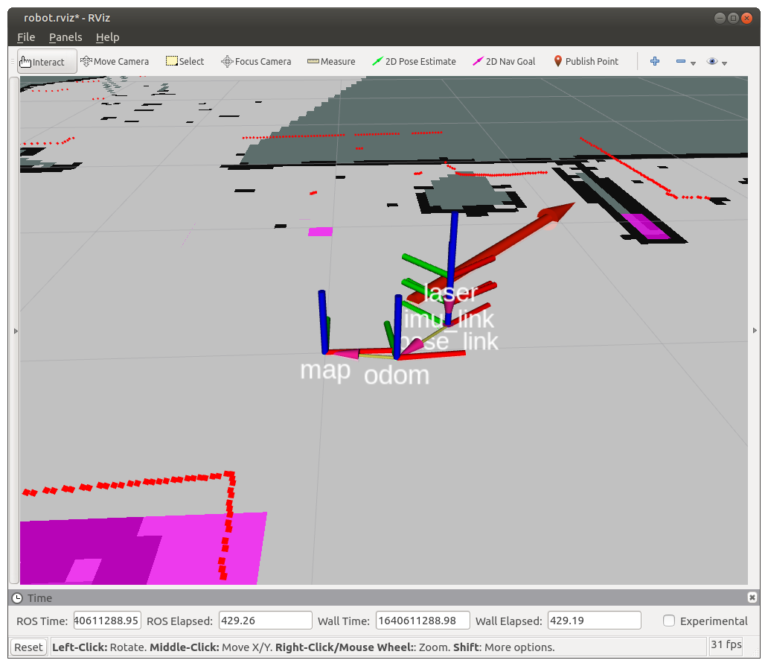
Coordinate Frames of our Robot

Slide 36
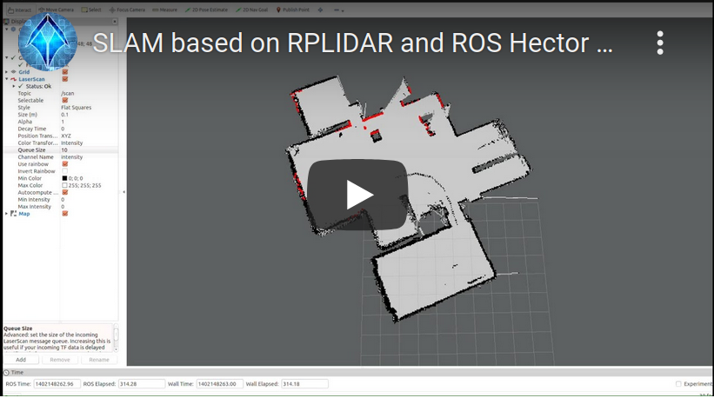
How the robot builds the map
video

Slide 37
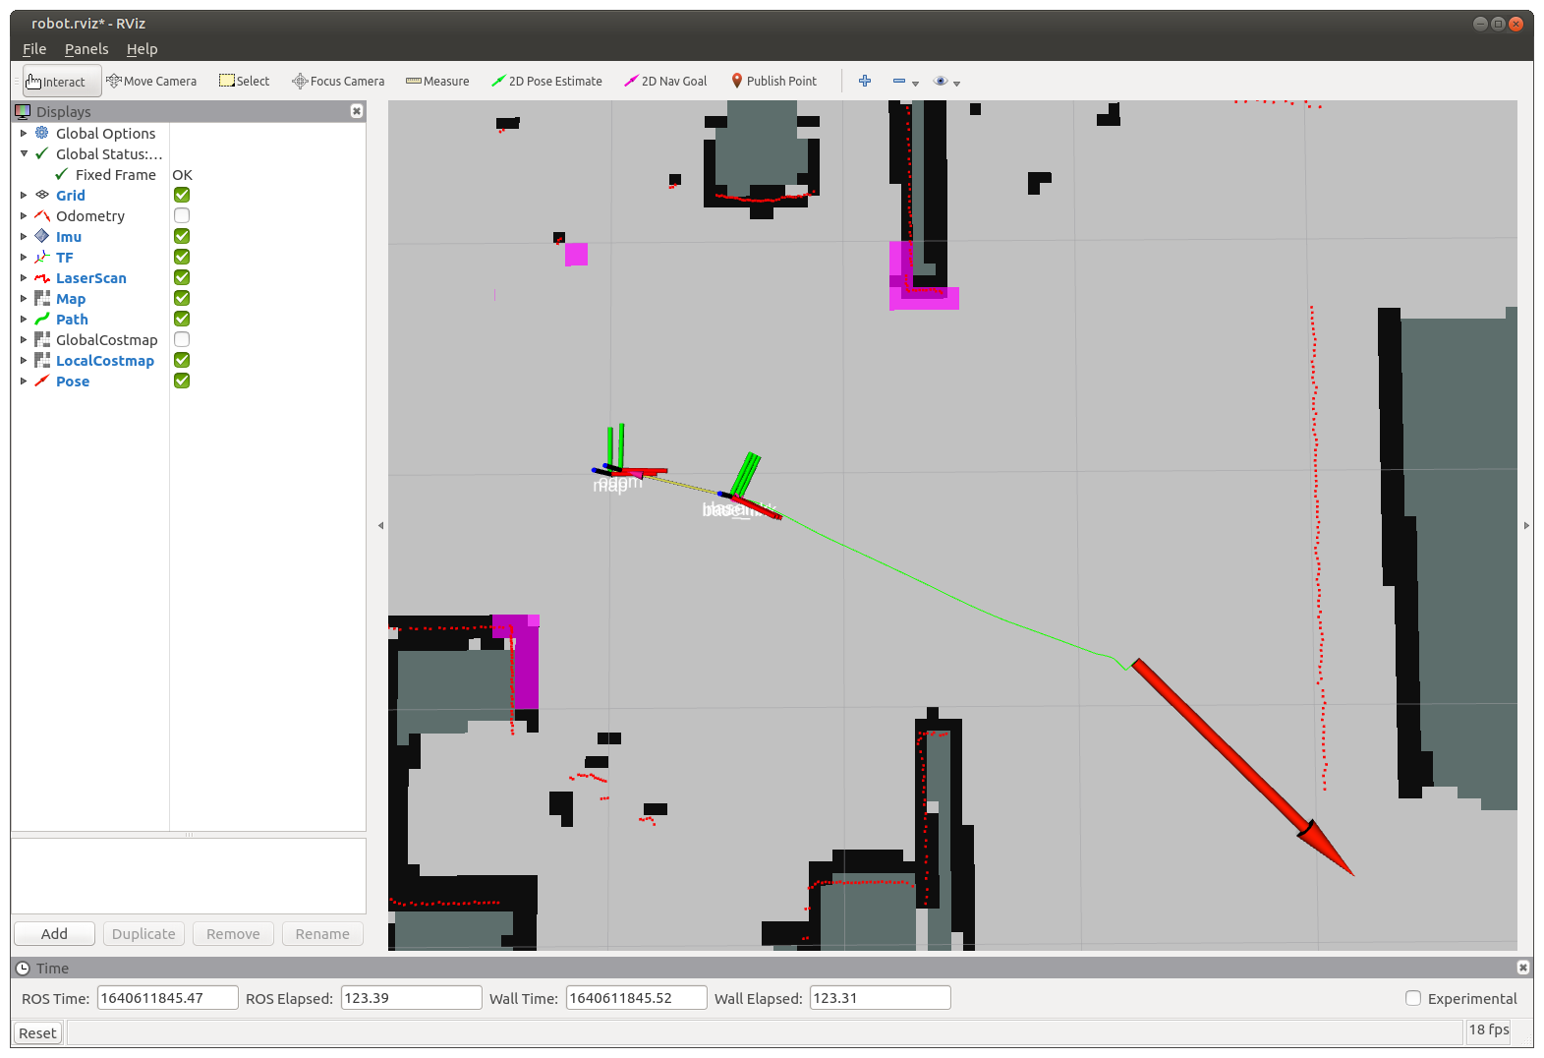
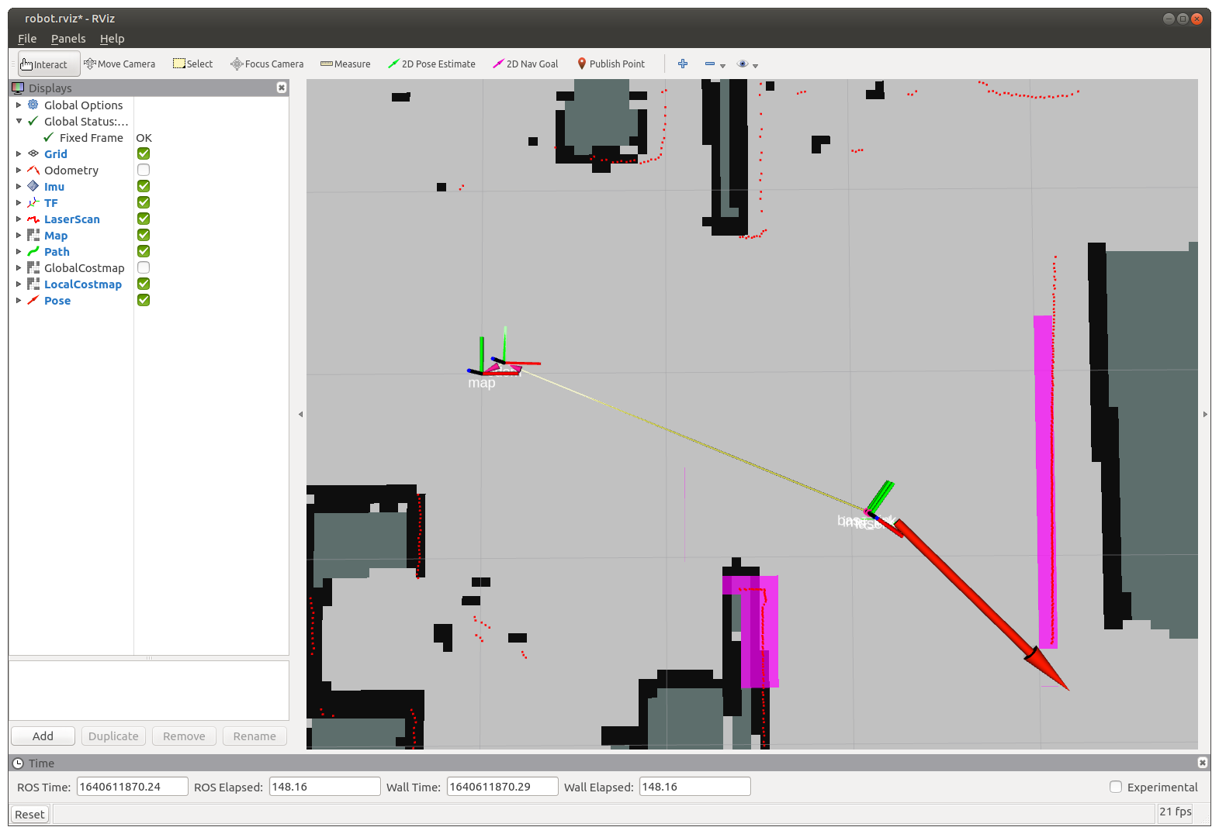
Path Planning

Slide 38
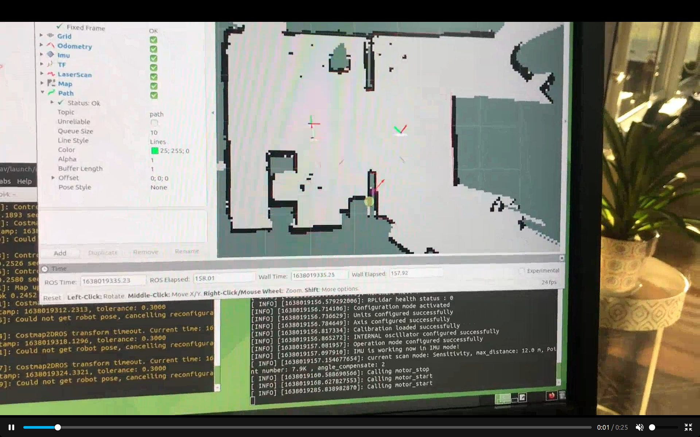
The robot drives to Goal Pose
video

Slide 39
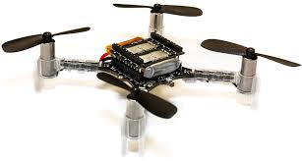
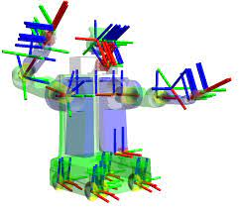
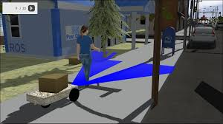
Other things ROS does...
Drones
Articulated Robots
Simulation

Slide 40
How to Learn ROS
Online tutorials at wiki.ros.org/tutorials
Automatic Addison online tutorials
Book: Practical Robotics in C++ by Lloyd Brombach
Robot Ignite Academy
Digital Book: ROS_Robot_Programming_EN.pdf

